Slide 1
Data Analyst Professional Practical Exam Presentation Dr. Anoushiravan zahedi

Slide 2
Pens and Printer
Founded in 1984 and provides high-quality office products
New Products
Sales Methods
Email
Call
Email and Call

Slide 3
Data Validation

Slide 4
Columns
Column Name | Details | Required Modifications
week | Week sale was made, counted as weeks since product launch | NA
customer_id | Character, unique identifier for the customer | Transformed to Category
nb_sold | Numeric, number of new products sold | NA
years_as_customer | years_as_customer Numeric, number of years customer has been buying from us(company founded in 1984) | Out of range values replaced with NaN
nb_site_visits | Numeric, number of times the customer has visited our website in the last 6 months | NA
state | Character, location of the customer i.e. where orders are shipped | Transformed to Category
sales_method | Character, which of the three sales methods were used for that custome | Cleaned & Transformed to Category
revenue | Numeric, revenue from the sales, rounded to 2 decimal places. | Missing data

Slide 5
Sales Method
Sales Method | Count
Email | 7456
Call | 4962
Email + Call | 2549
em + call | 23
email | 10

Slide 6
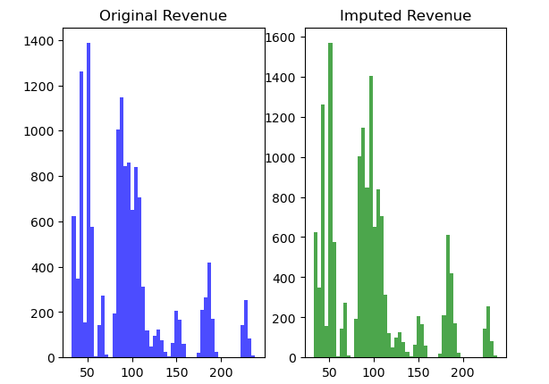
Revenue
Sales Method | Proportion of NA
Call | 0.036477
Email | 0.072864
Email + Call | 0.135692

Slide 7
Exploratory analysis

Slide 8
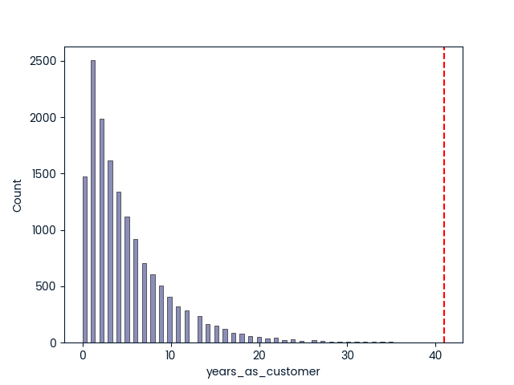
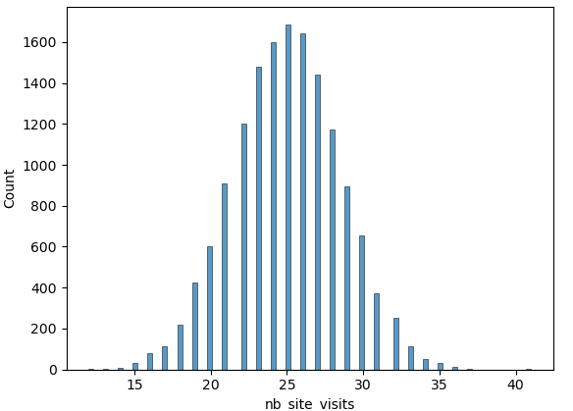
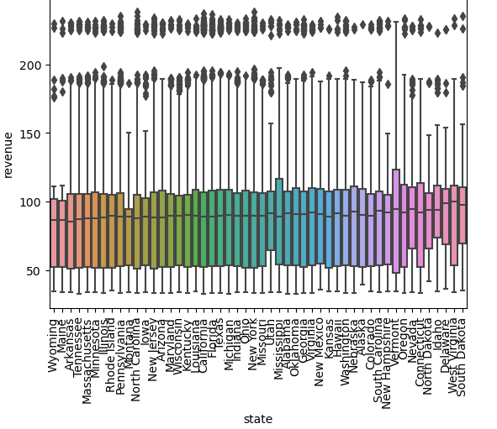
Customers and their characteristics

Slide 9
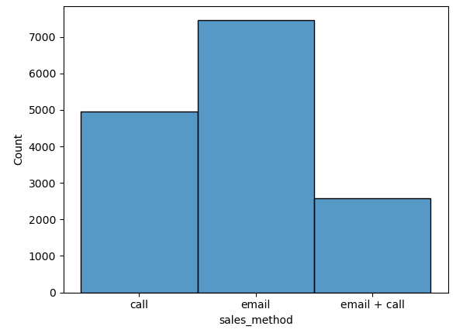
Allocation of customers to sales methods

Slide 10
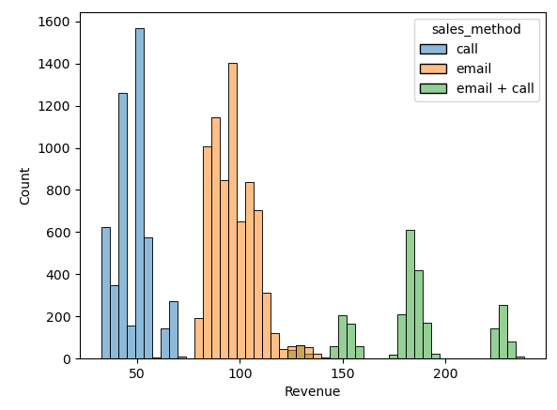
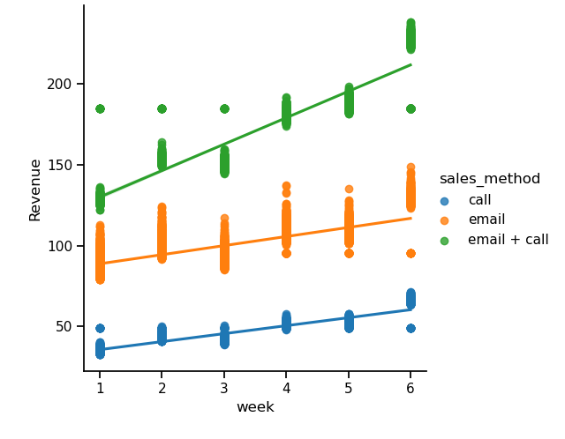
Revenue for different groups
Contrast | A | B | U-val | p-corr | hedges
sales_method | email | email + call | 15854.5 | 0.0 | -5.241444
sales_method | email | call | 37046292.0 | 0.0 | 4.969941
sales_method | email + call | call | 12762264.0 | 0.0 | 7.903535

Slide 11
Definition of a metric for the business

Slide 12
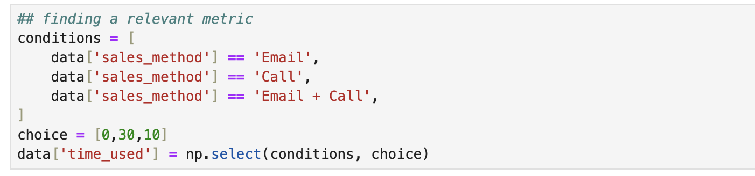
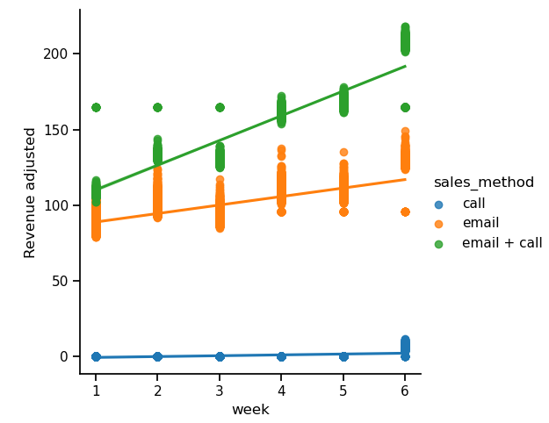
Adjusted revenue
A | B | U-val | p-corr | hedges
email | email + call | 15854.5 | 0.0 | -5.241444
email | call | 37046292.0 | 0.0 | 4.969941
email + call | call | 12762264.0 | 0.0 | 7.903535

Slide 13
Conclusions
Email & call > Email > Call
The differences between the sales methods are significant.
Using adjusted revenue

Slide 14
Thank you
Dr. Anoushiravan Zahedi
anoushiravanzahedi@gmail.com

