Slide 1
FinInsight: Expense Control & Profitability Analytics
Data Analytics Project
Name: Anouska Mandal
B.Tech CSE (E-Commerce Technology)
VIT BHOPAL
Submission Date – 20.07.26

Slide 2
Project Overview
FinInsight is a financial analytics project designed to monitor expenses, compare budgets with actual spending, and evaluate product profitability. The project uses Microsoft Excel for data analysis and dashboards, along with SQL for data storage and querying, helping organizations make informed financial decisions.
Key Features
Data cleaning and preparation
KPI tracking
Budget vs. Expense analysis
Profitability analysis
Interactive dashboard
SQL database and analysis

Slide 3
Project Objectives
The primary objectives of the FinInsight project are:
Analyze organizational budget, expenses, and revenue.
Compare Budget vs Actual Expenses to identify spending variances.
Measure product-wise profitability using revenue and cost data.
Develop an interactive dashboard for quick financial insights.
Perform SQL-based data analysis to support decision-making.

Slide 4
Tools & Technologies Used
Microsoft Excel
Data cleaning and preparation
KPI calculations
Variance and profitability analysis
Dashboard creation using charts
SQL (phpMyAdmin / MySQL)
Database creation
Table management
Data import from CSV
Data analysis using SQL queries
XAMPP
Local server environment for MySQL/phpMyAdmin

Slide 5
Dataset Description
The FinInsight project uses three datasets to analyze financial performance.
Budget Dataset
Department
Month
Budget Amount
Expenses Dataset
Date
Department
Category
Amount
Revenue Dataset
Product
Month
Revenue
Cost

Slide 6
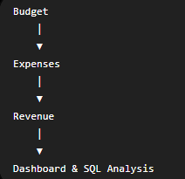
Purpose of Each Dataset
Dataset | Purpose
Budget | Stores the planned budget for each department.
Expenses | Records actual departmental expenses.
Revenue | Tracks product revenue and cost to calculate profit.

Slide 7
Data Preparation & Cleaning
Data Preparation
Imported Budget, Expenses, and Revenue datasets into Microsoft Excel.
Organized the data into structured tables for analysis.
Ensured consistent data formatting across all datasets.
Data Cleaning
Checked for missing or duplicate records.
Standardized numeric, currency, and date formats.
Verified data accuracy before performing analysis.

Slide 8
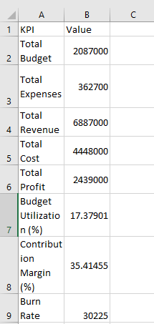
Key Performance Indicators (KPIs)
KPIs Created
Total Budget
Total Expenses
Total Revenue
Total Profit
Purpose
Monitor the organization's financial performance.
Compare planned budget with actual spending.
Support quick and informed business decisions.

Slide 9
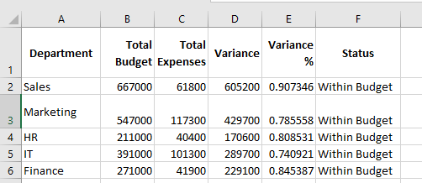
Variance & Alerts
Variance Analysis & Alerts
Variance Analysis
Compared Budget with Actual Expenses.
Calculated Variance and Variance %.
Identified departments with budget deviations.
Alerts
Within Budget – Expenses are within the allocated budget.
Over Budget – Expenses exceed the allocated budget.
Applied Conditional Formatting to highlight alerts.

Slide 10
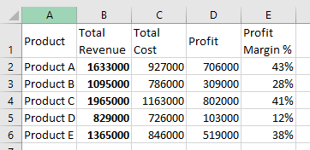
Profitability Analysis
Key Metrics
Revenue
Cost
Profit
Profit Margin
Analysis Performed
Compared Revenue and Cost for each product.
Calculated Profit = Revenue − Cost.
Identified products with the highest profitability.
Evaluated overall financial performance.

Slide 11
Executive Dashboard
Dashboard Highlights
Displays key financial KPIs.
Compares Budget vs Expenses.
Shows Revenue and Profitability trends.
Provides department-wise financial insights.
Supports quick and informed decision-making.

Slide 12
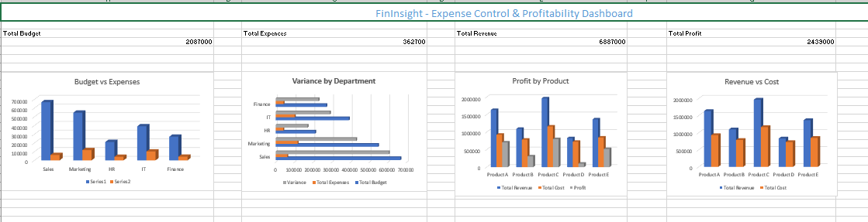

Slide 13
SQL Database & Analysis
Database Implementation
Created the FinInsight database using MySQL/phpMyAdmin.
Imported Budget, Expenses, and Revenue datasets.
Created relational tables for data management.
SQL Analysis
Retrieved financial records using SQL queries.
Performed aggregation using SUM() and GROUP BY.
Analyzed budgets, expenses, revenue, and profit.

Slide 14
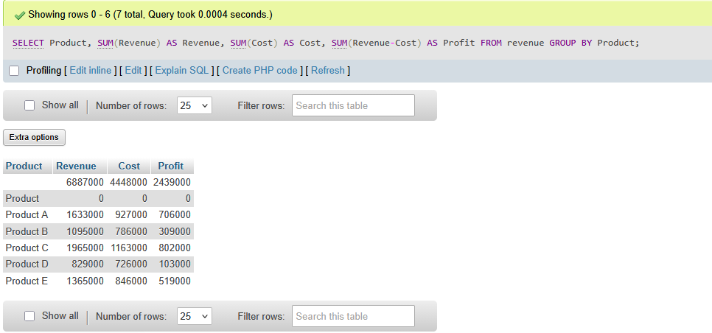

Slide 15
Key Findings
Budget and actual expenses were successfully compared across departments.
Variance analysis helped identify over-budget and within-budget departments.
Profitability analysis highlighted product-wise financial performance.
The executive dashboard provided a clear visualization of KPIs and trends.
SQL queries enabled efficient data retrieval and financial analysis.

Slide 16
Conclusion & Future Scope
Conclusion
Successfully developed the FinInsight financial analytics solution.
Performed budget, expense, and profitability analysis using Microsoft Excel.
Built an interactive Executive Dashboard for effective visualization.
Used SQL to manage and analyze financial data.
The project supports better financial monitoring and decision-making.
Future Scope
Integrate Power BI for interactive business intelligence dashboards.
Connect the solution to a live database for real-time updates.
Implement predictive analytics for budget forecasting.
Add automated financial reports and alerts.

