Slide 1
Embedded System Lab Final Project: Chroma Key
Pham Duc An (范德安) – 0450296
Le Chi Hieu (黎志孝) – 0450214

Slide 2


Chroma Key [1/2]

Slide 3
Chroma Key [2/2]
A visual effects technique for compositing (layering) two images or video streams together based on color hues (chroma range)
Used heavily in many fields to remove a background from the subject of a photo or video – particularly the newscasting, motion picture and videogame industries
Commonly used in video production and post-production
There are two types of backdrop: green and blue

Slide 4
Targets
Implement chroma key on Zed board
Realtime processing with webcam and display to monitor
Take the video from webcam
Process the video and insert the background
Display to HDMI

Slide 5
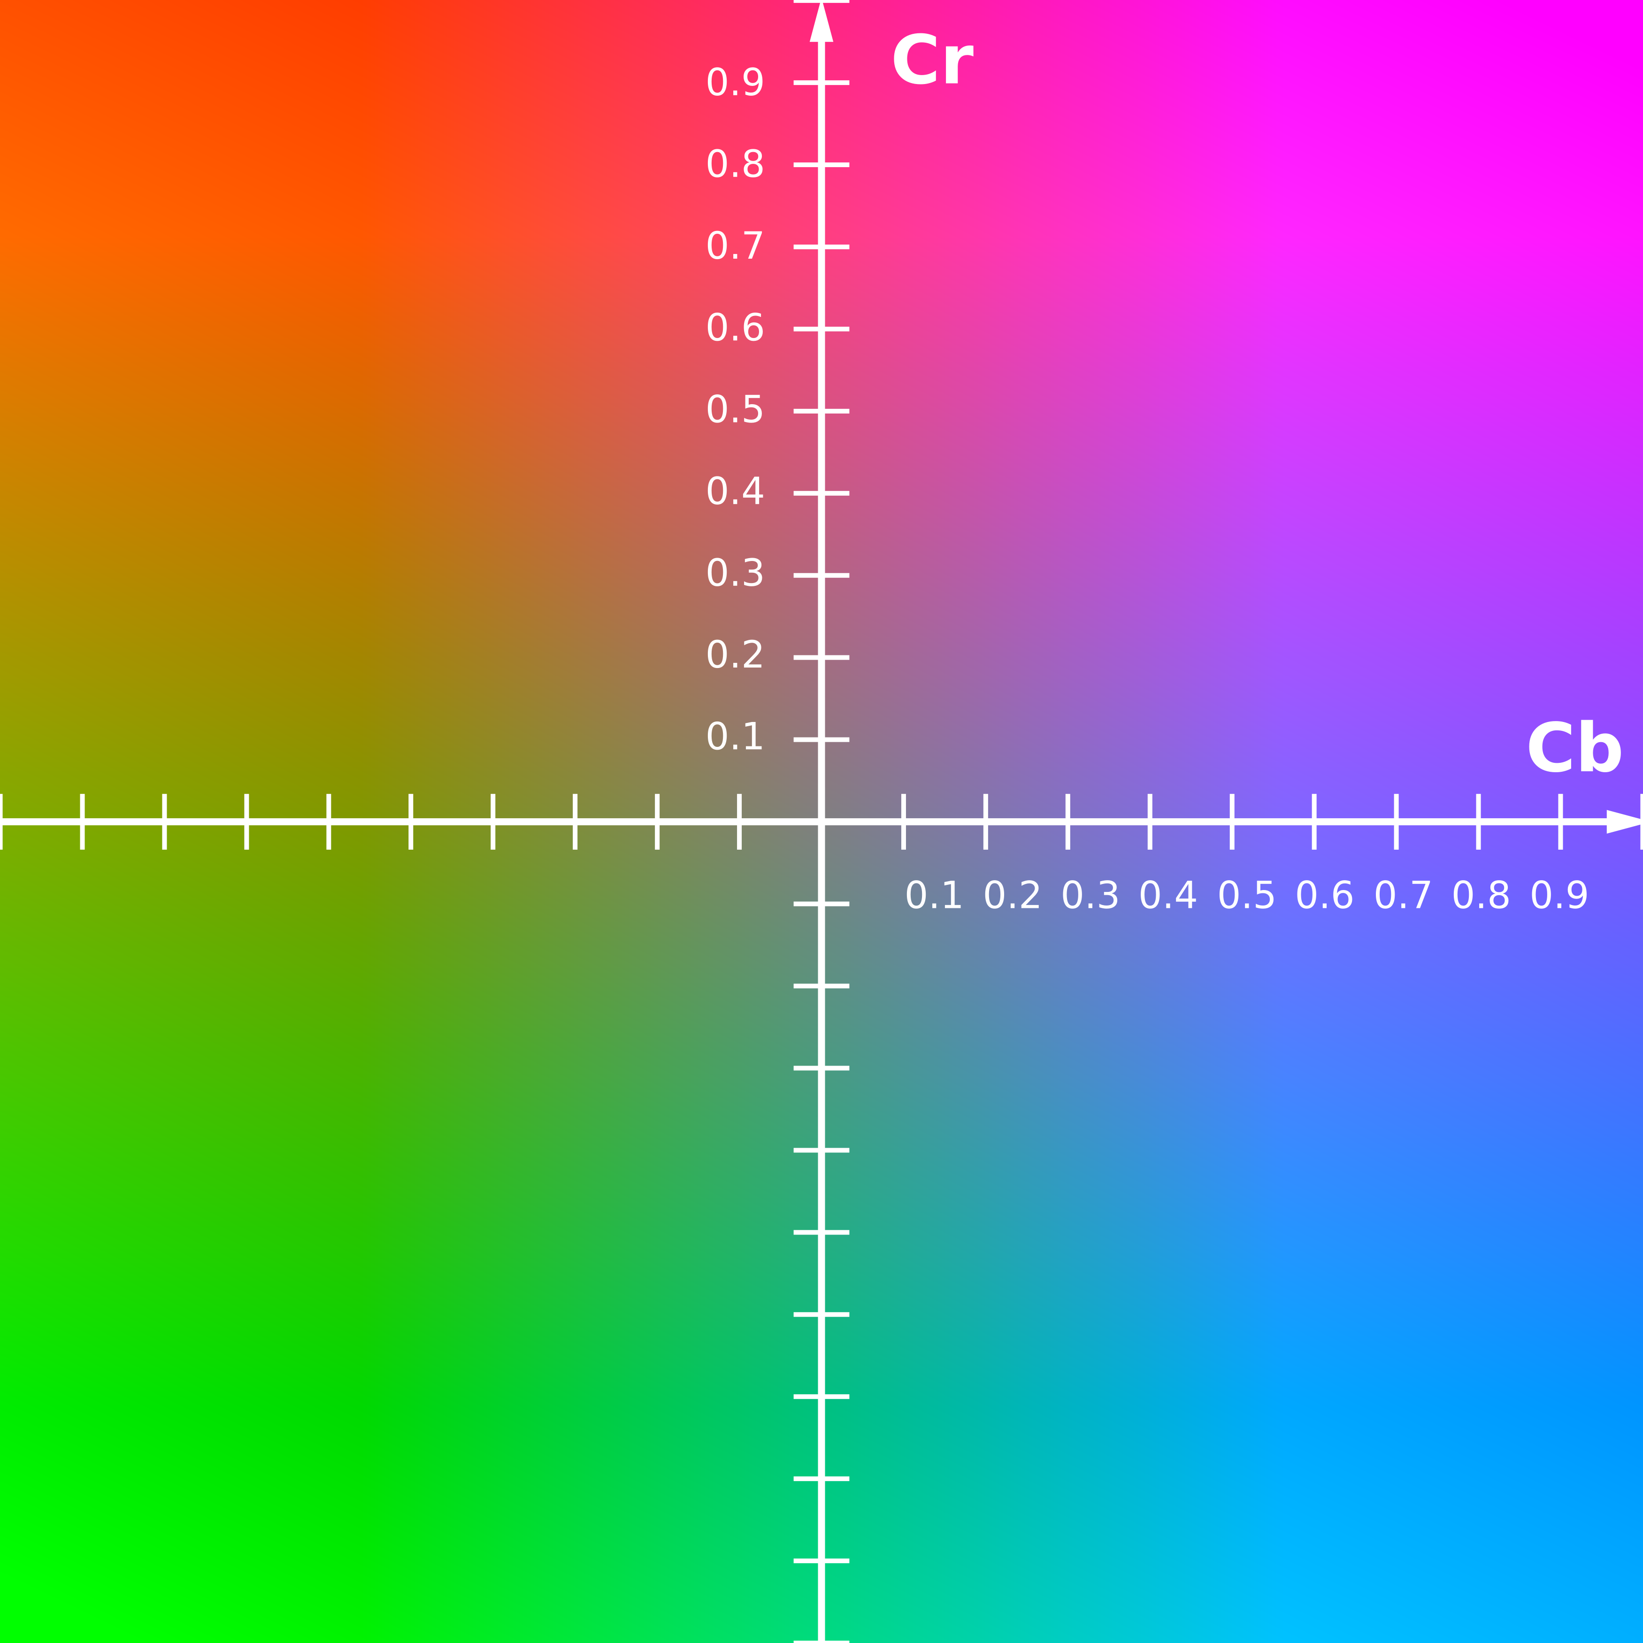
Algorithms
Color space segmentation: use color space and threshold to detect background and foreground
The selected part is based on experiment
background color

Slide 6
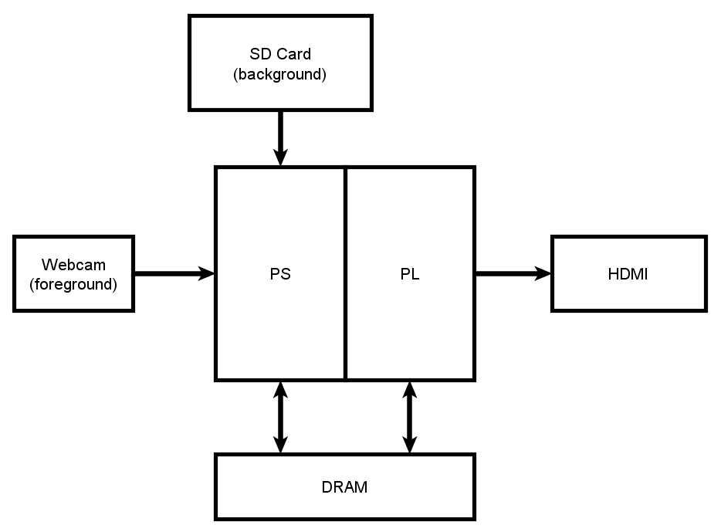
Solutions [1/2]

Slide 7
Solutions [1/2]
Read background image
Open HDMI & Webcam
Read Webcam data
Process Chroma key
Display to monitor

Slide 8
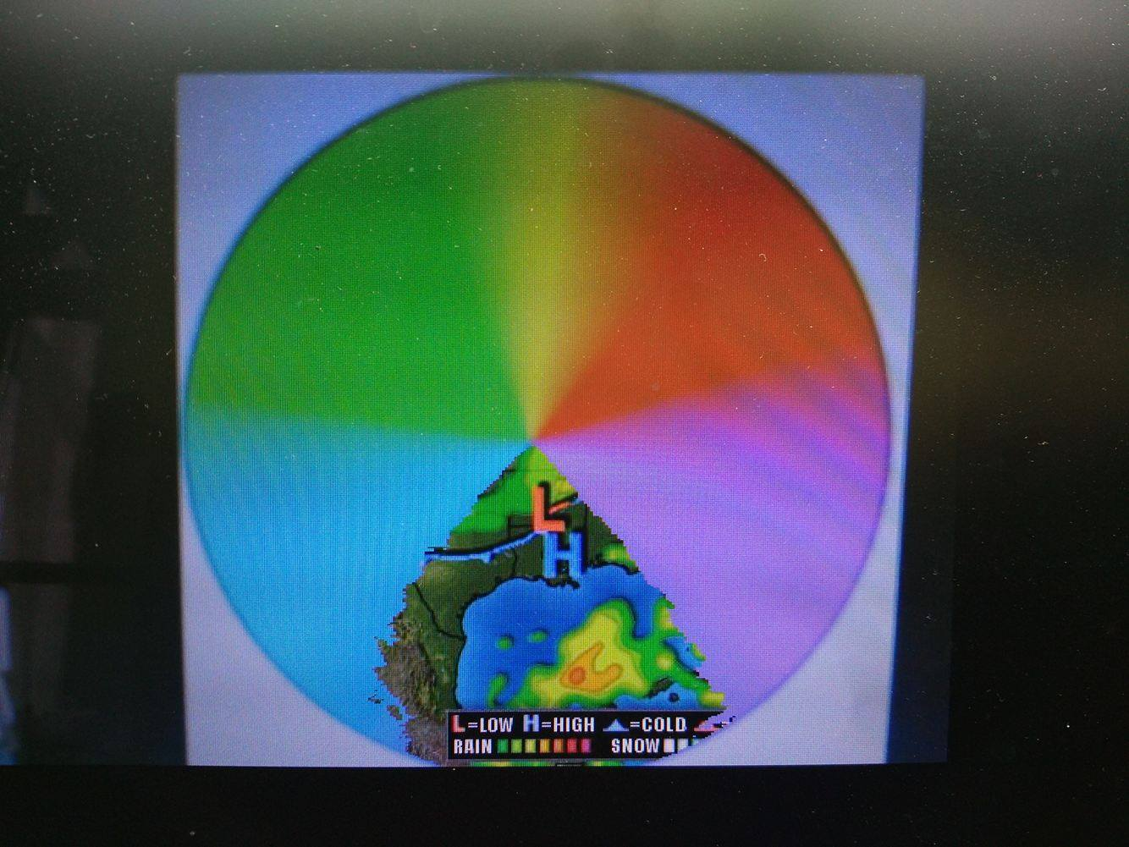
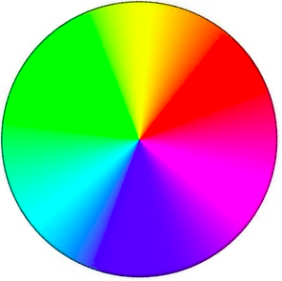
Experimental Result

Slide 9
Conclusions
The algorithm works as expected
There are minor issues due to the simplicity of the algorithm
Blue key is easier to implement than green key
Luminance still have some effects to the Chroma-Key

