Slide 1
IESL 2017 Final Project CNN Accelerator
Pham Duc An

Slide 2
Specifications
Implement a CNN accelerator
SystemC
Transaction modeling
TLM 2.0
Loosely-timed

Slide 3
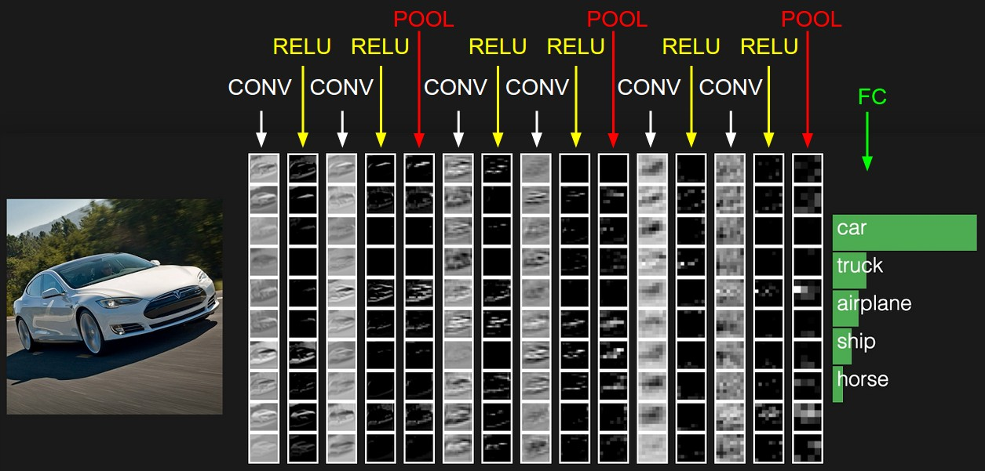
CNN

Slide 4
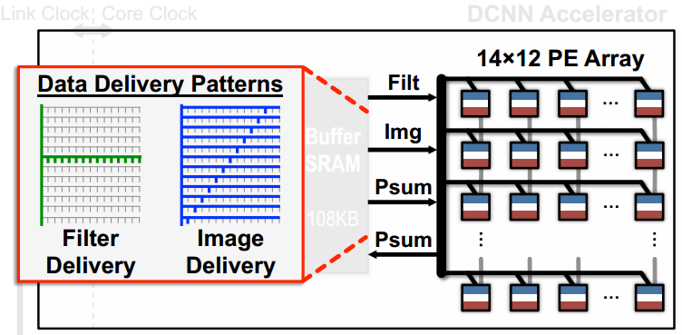
Architecture
Based on Eyeriss [1]

Slide 5
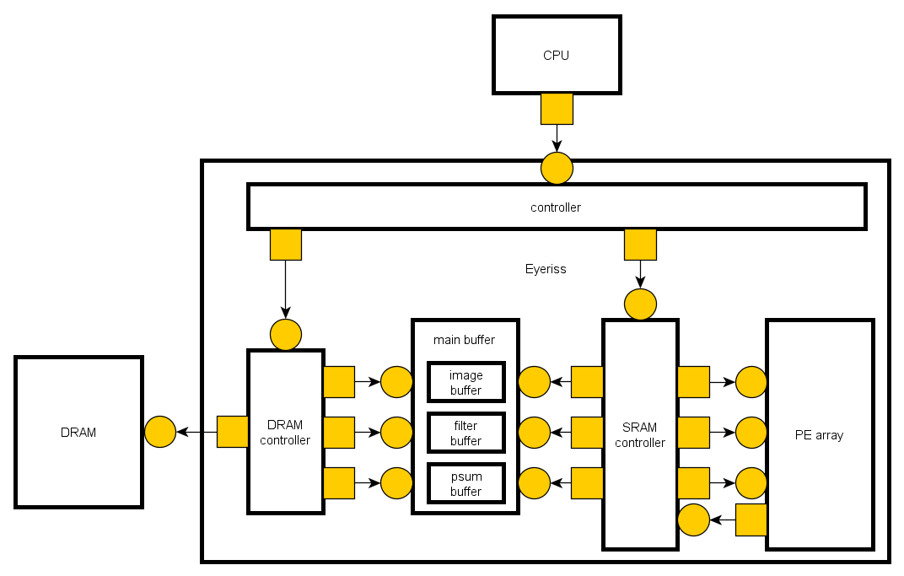
System Model

Slide 6
PE Array

Slide 7
PE Row

Slide 8
Data Scheme
Input stationary at buffer level: keep the whole input in the main buffer
Output stationary at PE level: keep the output result and accumulate it at PE

Slide 9
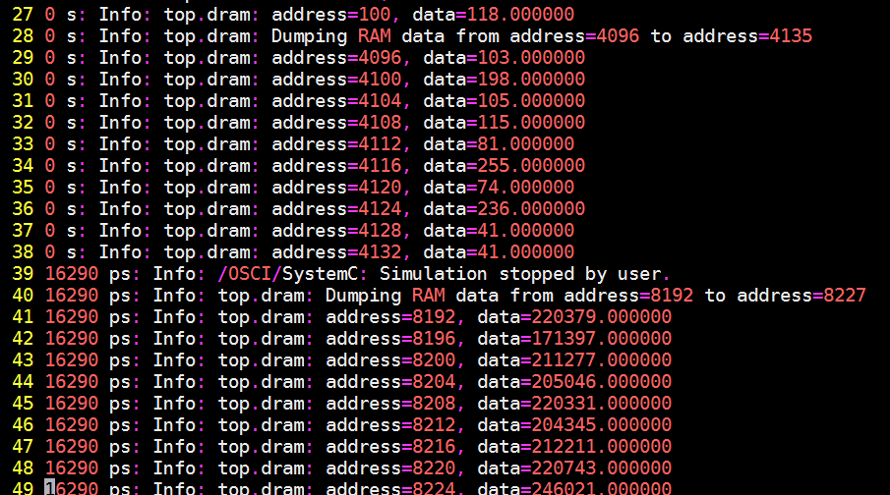
Testing Result [1/2]
With 5x5 Eyeriss with only 3x3 PEs are activated

Slide 10
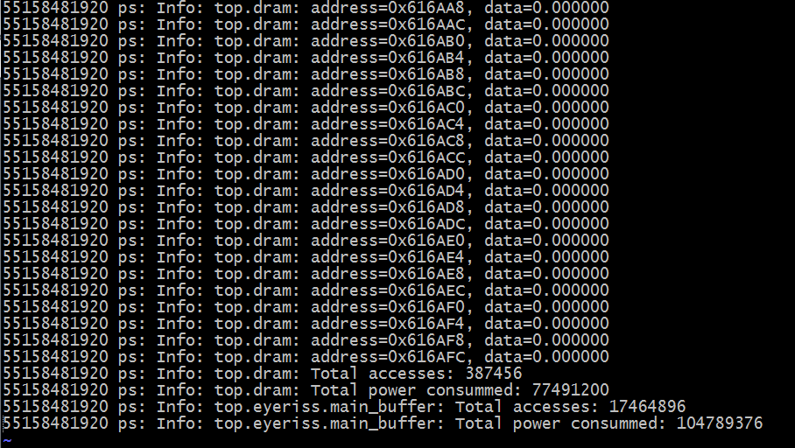
Testing Result [1/2]
AlexNet layer 3

Slide 11
Evaluation & Conclusion
The paper itself [1] has some missing information
The testing result on AlexNet is only with single layer
Locality is high, the power consumed by on-chip buffer is much higher than off-chip memory

Slide 12
References
[1] Chen, Yu-Hsin, Joel Emer, and Vivienne Sze. "Eyeriss: A spatial architecture for energy-efficient dataflow for convolutional neural networks." Computer Architecture (ISCA), 2016 ACM/IEEE 43rd Annual International Symposium on. IEEE, 2016.

