Slide 1

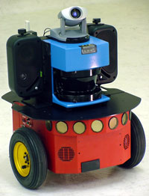
Software Infrastructure Workshop
Asaf Feniger
29/11/2017
1

Slide 2

Software Infrastructure Goals
Create infrastructure to evaluate ANPL research on single/multi robot SLAM & BSP in realistic simulation and real-world experiments.
Allow researchers to implement only what they need (use parts other created and fit their needs).
Currently implemented for multi robot centralized case with ground robots using laser scans and odometry measurements.
2

Slide 3
Workshop Topics
End to end full demo – MRBSP with 2 UGV in gazebo simulation.
Installation – How to install ANPL software
ROS notations
High level code structure – passive and active
Launch files and software configuration
how to run the code
Code outputs
Matalb analysis tools
Matlab interface with the code
Code handling policy
Hands on exercises
3

Slide 4
MRBSP Demo
2 UGVs (Unmanned Ground Vehicle) in a simulated environment (Gazebo simulator).
UGVs are equipped with 2D range sensor (LIDAR) and odometry sensor. The code also supports 3D range sensors for the creation of the map.
Each robot listens to its own sensor and passes on only keyframes. Each robot has a state machine and a controller.
All other calculations (DA, belief, map, planning) are centralized.
Candidate actions are manually generated and the planner chooses the best set of actions according to a cost function.
4

Slide 5
Workshop Topics
End to end full demo – MRBSP with 2 UGV in gazebo simulation. ☑
Installation – How to install ANPL software
ROS notations
High level code structure – passive and active
Launch files and software configuration
how to run the code
Code outputs
Matalb analysis tools
Matlab interface with the code
Code handling policy
Hands on exercises
5

Slide 6
Installation
This installation assumes Ubuntu 16.04 with ros-kinetic installed. It also assumes the ANPL environment is installed.
Create new catkin workspace (named mrbsp_ws)
$ mkdir –p ~/ANPL/code/mrbsp_ws/src
$ cd ~/ANPL/code/mrbsp_ws
Initialize catkin workspace and build it
$ catkin init
$ catkin build
Source the workspace (and save it in .bashrc file)
$ echo “source $HOME/ANPL/code/mrbsp_ws/devel/setup.bash” >> ~/.bashrc
Clone mrbsp_ros package to src folder
$ git clone https://bitbucket.org/ANPL/mrbsp_ros src/mrbsp_ros
Clone anpl software workshop repository
$ git clone https://bitbucket.org/ANPL/anpl_software_workshop src/anpl_software_workshop
Build workspace
$ catkin build
6

Slide 7
Code Updating
If the code is already installed on the computer, make sure you have the latest version.
$ cd ~/ANPL/code/mrbsp/src/mrbsp_ros
$ git pull
Re-compile the code
$ cd ../..
$ catkin build
7

Slide 8
Workshop Topics
End to end full demo – MRBSP with 2 UGV in gazebo simulation. ☑
Installation – How to install ANPL software ☑
ROS notations
High level code structure – passive and active
Launch files and software configuration
how to run the code
Code outputs
Matalb analysis tools
Matlab interface with the code
Code handling policy
Hands on exercises
8

Slide 9
ROS Notations
The ANPL software is using ROS. Some key concepts:
ROSNODE – A node is a process that performs computation. Nodes are combined together into a graph and communicate with one another using streaming topics, RPC services, and the parameter server. (link)
ROS master – Provide naming and registration service to the rest of the nodes in the ROS system. (link)
ROS parameter server – A shared, multi-variate dictionary that is accessible via network APIs. (link)
ROSCORE – A collection of ROS nodes and programs that are pre-required of a ROS based system. ROSCORE enables communication between ROS nodes, and it start up ROS master and ROS parameter server. (link)
9

Slide 10
ROS Notations
ROS package – Software in ROS is organized in packages. A package might contain ROS nodes, a ROS independent library, a dataset, configurations files, a third party piece of software or anything else that logically constitutes a useful module. (link)
ROS (catkin) workspace – A folder where you modify, build, and install catkin (ROS) packages. (link)
ROSLAUNCH – A tool for easily launching multiple ROS nodes locally and remotely via SSH, as well as setting parameters on the parameters server. (link)
RVIZ – A tool to visualize ROS topics and other information. RVIZ also allow user interface with ROS.
10

Slide 11
Workshop Topics
End to end full demo – MRBSP with 2 UGV in gazebo simulation. ☑
Installation – How to install ANPL software ☑
ROS notations ☑
High level code structure – passive and active
Launch files and software configuration
how to run the code
Code outputs
Matalb analysis tools
Matlab interface with the code
Code handling policy
Hands on exercises
11

Slide 12
High level code structure
The code can be divided to 4 operating modes:
In addition, the code can be implemented as centralized / decentralized system.
Passive
Active
SR
Single robot passive slam
Single robot active slam
MR
Multi robot passive slam
Multi robot active slam
12

Slide 13
Passive SLAM Data Flow
Optimized pose
Keyframe initialization
Updated poses
Odometry
DA
Belief
Factors
Measurements
Sensors
Measurements &
poses
Map
13

Slide 14
Passive SLAM
Packages:
Odometry node – Keyframe selections, calculate relative motion between keyframes. Calculate the robot current pose.
DA node – Create factors and initialize state for the belief.
Belief node – Belief optimization.
Map node – Simulate scans from visited places, samples and trajectory validations.
Passive SLAM runs in a loop until the user decides to stop it.
14

Slide 15
Active SLAM Data Flow
Passive
Odometry
DA
Belief
Current belief + Goals
Planner
Current belief
Chosen Actions
Start & goal
positions
Candidate actions
Sensors
Map
Candidate samples
Action Generator
Validate samples
Robot current pose
Collision Avoidance
Collision warnings
State Machine
Control commands
Controller
Current pose + Current action
Complete action
15

Slide 16
Active SLAM
Packages :
Passive nodes
State machine node – Decide which active node will be call.
Action generator node – Generating candidate actions for the planner node.
Planner node – Evaluate candidate actions and return to state machine node the chosen actions.
Controller node – Translate the actions to the robot actuators.
Collision avoidance node – Check for immediate collisions using current scans.
The active SLAM is managed by the state machine.
16

Slide 17
Utility Packages
Packages:
Mrbsp ros msgs – Provide custom ROS messages and service to exchange data between nodes.
Mrbsp ros utils – Provide headers with utility functions.
Config node – Generate global setting for the experiment (e.g. creating a results folder).
Mrbsp scenarios – Contains configuration files to run different scenarios. Results are stored in this packages.
Rosbag node – Provide a mechanism to run the code by reading sensors data directly from bagfiles.
17

Slide 18
Code Structure - Summery
ANPL’s software code has 14 ROS packages.
(*) - not implemented yet.
Each package contains executables with the same purpose.
Each package contains a base class, and all executable in the package inherit from it. The base class contains member and function that are common to the package executables.
When running the code only one executable from each package should be executed.
Not all packages need to be involved.
Implementation is possible with C++, python and Matlab.
Utility packages | Passive SLAM | Active SLAM
Mrbsp ros msgs | Odometry node | State machine node
Mrbsp ros utils | Da node | Action generator node
Config node | Belief node | Planner node
Mrbsp scenarios | Map node | Controller node
Rosbag node * |  | Collision detection node *
18

Slide 19
Workshop Topics
End to end full demo – MRBSP with 2 UGV in gazebo simulation. ☑
Installation – How to install ANPL software ☑
ROS notations ☑
High level code structure – passive and active ☑
Launch files and software configuration
how to run the code
Code outputs
Matalb analysis tools
Matlab interface with the code
Code handling policy
Hands on exercises
19

Slide 20
Launch Files and Software Configuration
ROS provide tools to easily run executables and load parameters into the code without re-compiling.
For more info, visit ros wiki pages:
ros launch files: http://wiki.ros.org/roslaunch
ros parameters server: http://wiki.ros.org/Parameter%20Server
ros parametes tutorial: http://wiki.ros.org/roscpp_tutorials/Tutorials/Parameters
Launch files and configuration are created for each scenario.
20

Slide 21


Scenario Definition
Scenarios are defined in mrbsp_scenarios package.
Each scenario is a set of executables executed from launch files. One from each package.
Each scenario contains launch files and configurations files relevant to its implementation.
Each time a scenario is launched the results are stored in a results folder under the researcher name and the time the code was launched.
Launch files
Mrbsp_scenarios
Scenario name
Config files
YAML files
Results
21

Slide 22
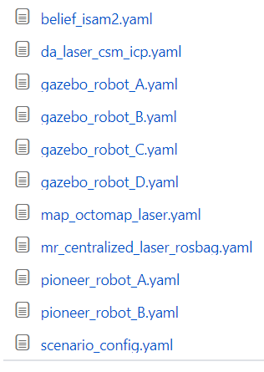
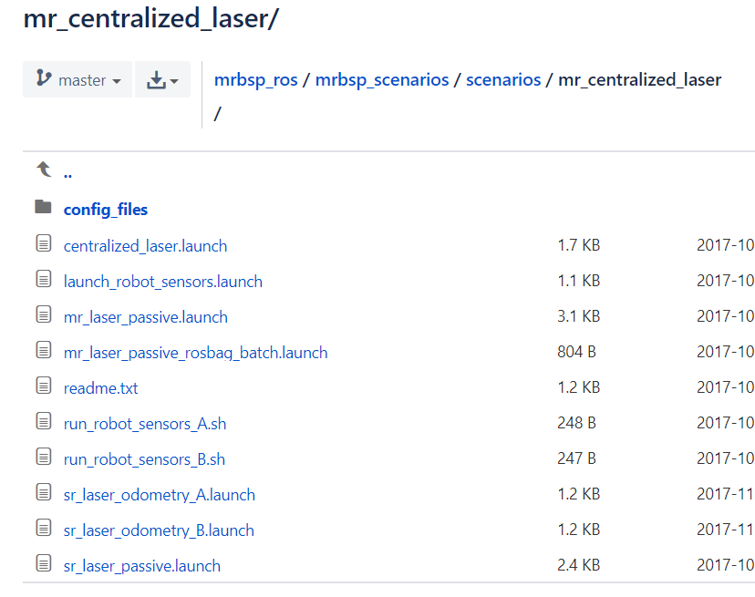
Scenario Definition
mr_laser_centralized scenario folder example:
Results folder
Results
YAML configuration files
Scripts and Launch file to run the scenario
22

Slide 23
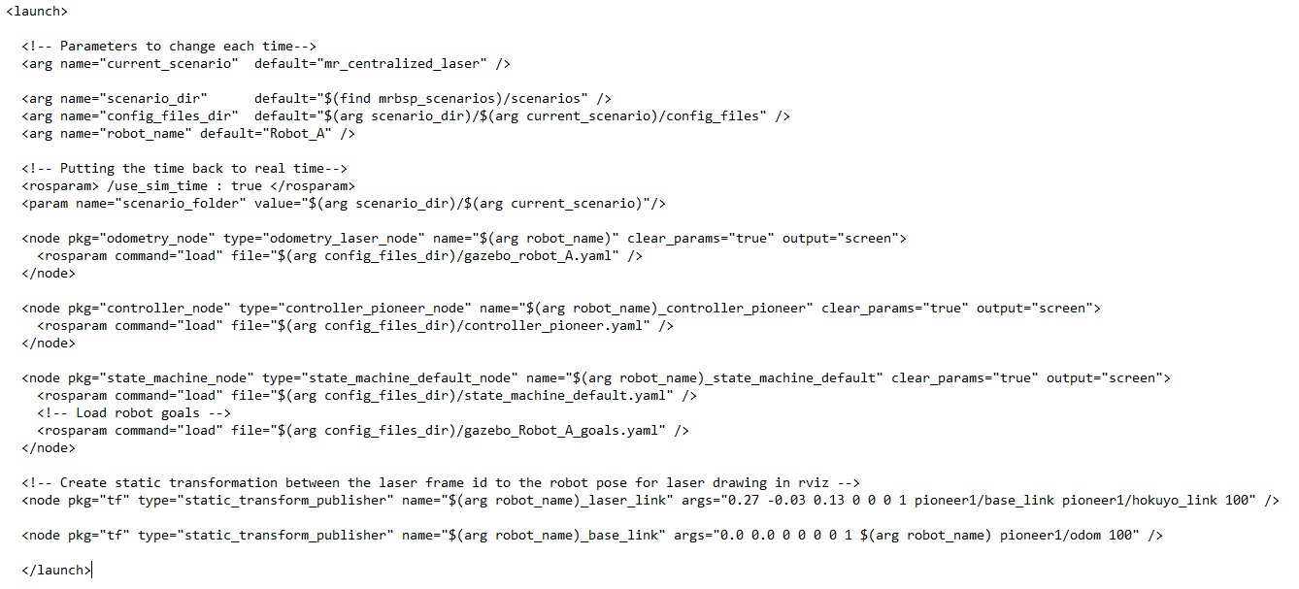
Launch Files
create arguments in the current launch file
create ros parameters without namespace
load ros parameters from yaml file. Prams get node name as namespace
run executables
23

Slide 24
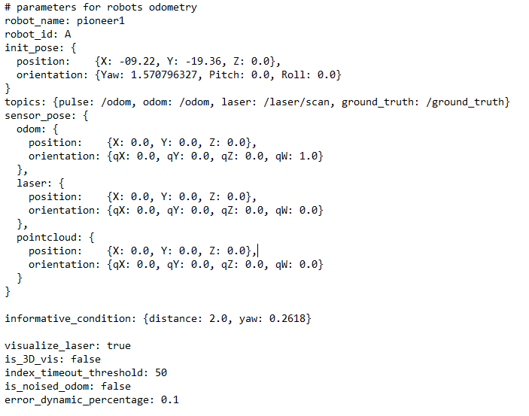
YAML Configuration Files
/robot_name
/sensor_pose/odom/orientation/qW
/informative_conditions/yaw
24

Slide 25
Reading ROS parameters in C++ File
ROS global node handler - ros::NodeHandle nh
Parameter name does not have a namespace.
ROS private node handler – ros::NodeHandler pnh(~)
Parameter name will start with the node name
25

Slide 26
Reading ROS parameters in C++ File
Load param from launch file (not within a node):
<param name="scenario_folder" value="$(arg scenario_dir)/$(arg current_scenario)"/>
Read parameter in C++ code:
std::string scenario_folder;
pnh.getParam("/scenario_folder", scenario_folder);
Load param from yaml file (within a node):
robot_name: pioneer1
Read parameter in C++ code:
std::string robot_name;
pnh.getParam(“robot_name", robot_name);
26

Slide 27
Reading ROS parameters in C++ File
Load param from yaml file (within a node):
sensor_pose: {
odom: {
position: {X: 0.2, Y: 0.1, Z: 0.2},
orientation: {qX: 0.0, qY: 0.0, qZ: 0.0, qW: 1.0}
}
}
Read parameter in C++ code (not from the node that load the parameter):
double X_sensor, Y_sensor, Z_sensor, qX, qY, qZ, qW;
std::string robot_ns = std::string("/robot_" + current_robot_id);
nh.param(std::string(robot_ns + "/sensor_pose/laser/position/X"), X_sensor, double(0.0));
nh.param(std::string(robot_ns + "/sensor_pose/laser/position/Y"), Y_sensor, double(0.0));
nh.param(std::string(robot_ns + "/sensor_pose/laser/position/Z"), Z_sensor, double(0.0));
nh.param(std::string(robot_ns + "/sensor_pose/laser/orientation/qX"), qX, double(0.0));
nh.param(std::string(robot_ns + "/sensor_pose/laser/orientation/qY"), qY, double(0.0));
nh.param(std::string(robot_ns + "/sensor_pose/laser/orientation/qZ"), qZ, double(0.0));
nh.param(std::string(robot_ns + "/sensor_pose/laser/orientation/qW"), qW, double(0.0));
27

Slide 28
Workshop Topics
End to end full demo – MRBSP with 2 UGV in gazebo simulation. ☑
Installation – How to install ANPL software ☑
ROS notations ☑
High level code structure – passive and active ☑
Launch files and software configuration ☑
how to run the code
Code outputs
Matalb analysis tools
Matlab interface with the code
Code handling policy
Hands on exercises
28

Slide 29
Current Implementation
Currently one scenario is implemented – MR passive/active with UGV’s
This scenario is using odometry sensor for odometry calculations, 2D planar ICP for data association, ISAM2 for belief generation, octomap occupancy grid for mapping, and rviz user interface to generate candidate actions.
This implementation is a centralized passive/active SLAM.
29

Slide 30
How to Run the Code
In Ubuntu, open terminal window and run the following commands in separated terminals. use (ctrl + shift + T) to open a new terminal:
Launch roscore: $ roscore
Load simulated environment: $ roslaunch anpl_software_workshop pioneer3at_world.launch
Run centralized nodes: $ roslaunch mrbsp_scenarios centralized_laser.launch
Run robot A nodes: $ roslaunch mrbsp_scenarios robot_setup_gazebo_A.launch
Run robot B nodes: $ roslaunch mrbsp_scenarios robot_setup_gazebo_B.launch
30

Slide 31
Launch ROSCORE
Terminal command: $ roscore
This command will:
Allow the ROS nodes to communicate with each other.
Start up ROS parameter server.
31

Slide 32
Load Simulated Environment
Terminal command: $ roslaunch anpl_software_workshop pioneer3at_world.launch
This command will:
Load Gazebo simulator with a chosen environment (world).
Spawn (add) robots into the simulator and simulate their sensors.
32

Slide 33
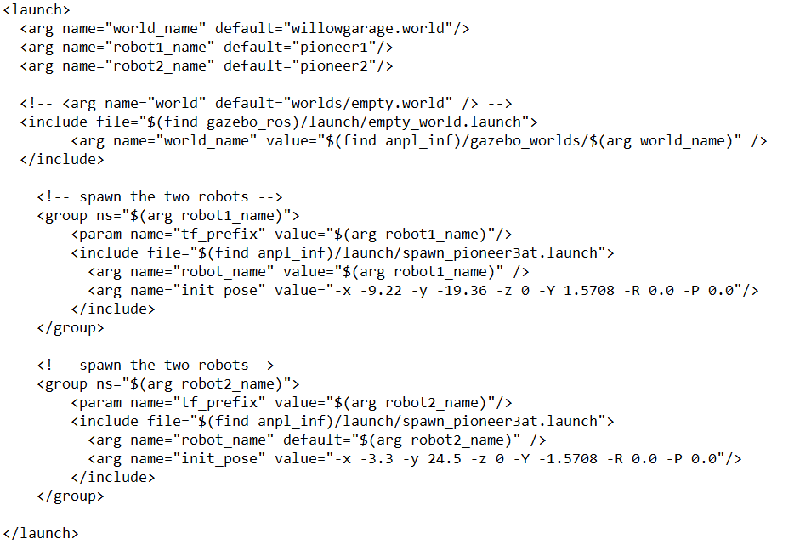
Load Simulated Environment
Launch file arguments
Load gazebo world
Spawn robot 1
Spawn robot 2
Robot 2 arguments
Robot name & robot initial pose
33

Slide 34
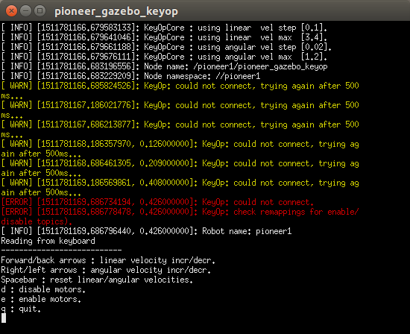
Keyboard Controller
In order to use the Keyboard controller:
Enable motors (press e)
Increase/decrease velocity with the keyboard arrows (the controller is moving the robot at constant velocity)
34

Slide 35
Run Centralized Nodes
Terminal command: $ roslaunch mrbsp_scenarios centralized_laser.launch
This command will:
Open all nodes in the centralized machine (config, da, belief, map, planner, actions generator).
Create folder for the log files and code outputs.
Open RVIZ interface to view live results and use the user interface planner.
35

Slide 36
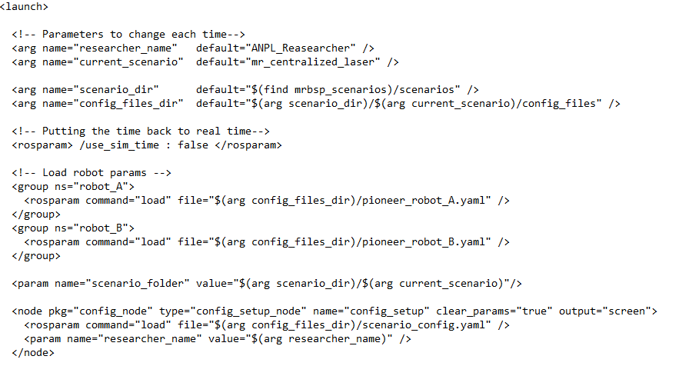
Run Centralized Nodes – Utility Nodes
Launch file arguments
Global ROS parameters
Run config node
36

Slide 37
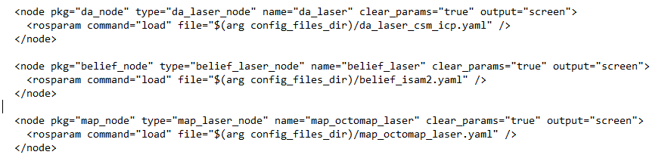
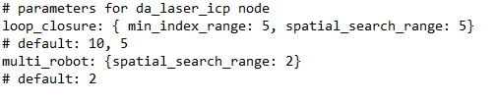
Run Centralized Nodes – DA Node
Launch file command:
Implementation:
This implementation uses planar ICP method to determine data association between pose states. This algorithm uses laser scan measurements from the robot sensors. The algorithm generates prior and between factors for the belief.
Parameters file:
37

Slide 38

Run Centralized Nodes – Belief Node
Launch file command:
Implementation:
This implementation uses ISAM 2 to calculate the belief. This node calculates the current belief (inference).
Parameters file:
38

Slide 39

Run Centralized Nodes – Map Node
Launch file command:
Implementation:
This implementation uses Octomap to generate map form the laser scans.
Parameters file:
39

Slide 40
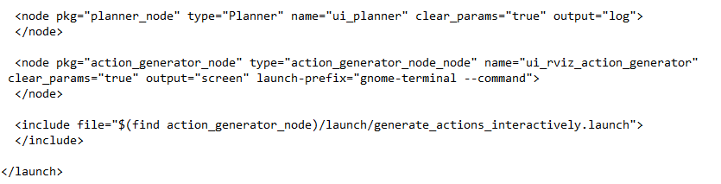
Run Centralized Nodes – Planner Node
Launch file command:
Implementation:
This implementation waits for all robots to request to plan. It receives candidate actions from the actions generator, simulates measurements (ML assumption, fixed noise model), evaluates objective function either in C++ or Matlab and returns to the state machines the best actions for each robot.
Parameters:
40

Slide 41
Run Centralized Nodes – Action Generator Node
Launch file command:
Implementation:
Current implementation allows the user to manually generate candidate path using RVIZ interface.
In the near future, this implementation will be extended (sampling based action generation, motion primitives)
41

Slide 42
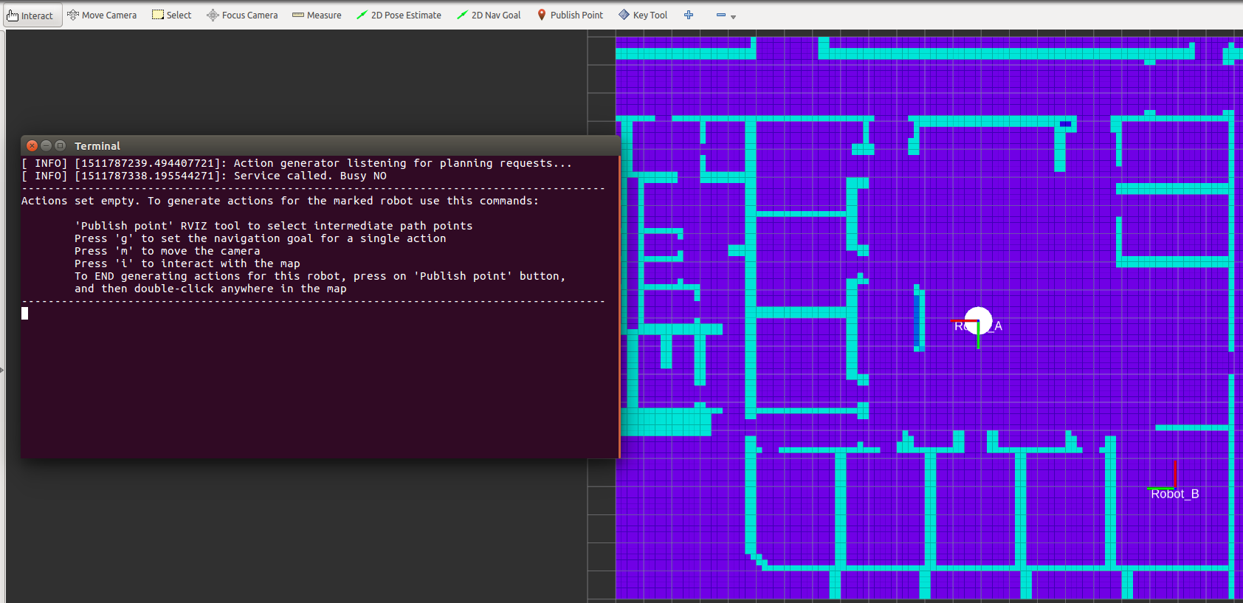
Run Centralized Nodes – RVIZ User Interface
*
*
*
*
Setting navigation goal will end the current candidate action setup
42

Slide 43
Run Robot “A” Nodes
Terminal command: $ roslaunch mrbsp_scenarios robot_setup_gazebo_A.launch
This command will:
Open all nodes on robot A (odometry, state machine, controller).
Use the robot A sensor to provide inputs to the code.
Move robot A according to the chosen trajectory.
43

Slide 44
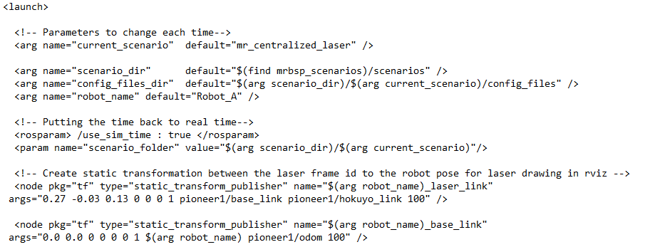
Run Robot “A” Nodes – Utility Nodes
Launch file arguments
Global ROS parameters
Set transfer function between the robot model in gazebo and the code
44

Slide 45
Run Robot “A” Nodes – Odometry Node
Launch file command:
Implementation:
This implementation uses odometry sensor to calculate relative motion and decides when the robot reaches a new keyframe. It passes relative motion information with laser scans to the da node.
45

Slide 46
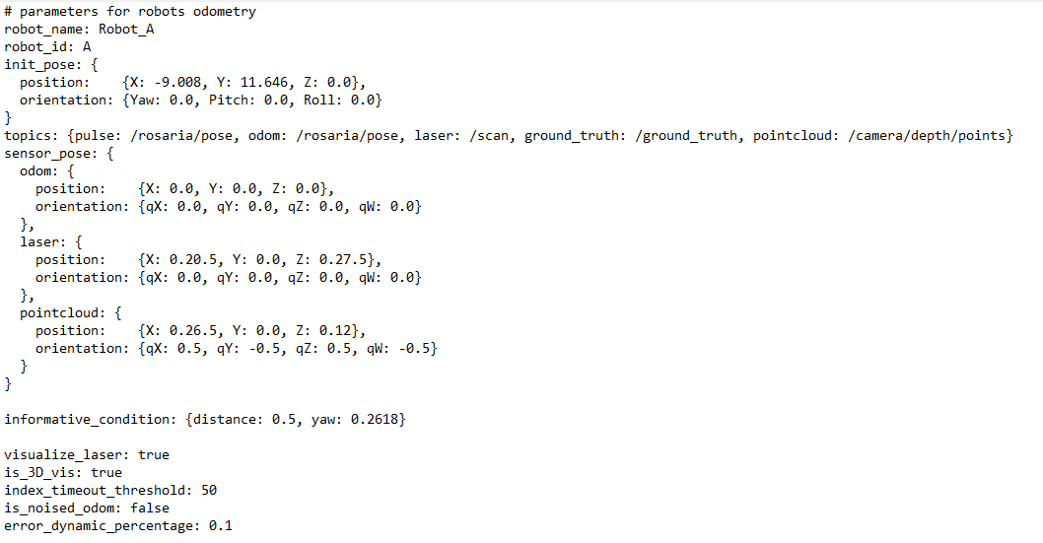
Run Robot “A” Nodes – Odometry Node
Parameters file:
46

Slide 47
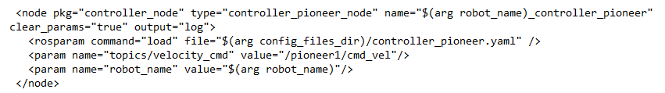
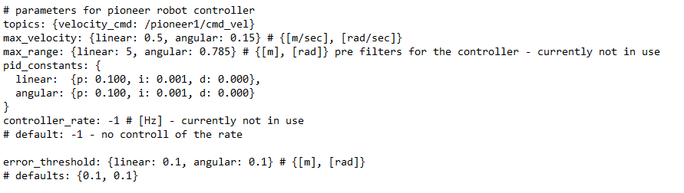
Run Robot “A” Nodes – Controller Node
Launch file command:
Implementation:
This implementation use PI controller to move the robot to a desired position.
Parameters file:
47

Slide 48
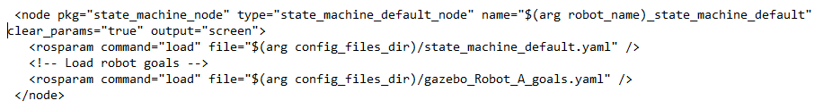

Run Robot “A” Nodes – State Machine Node
Launch file command:
Implementation:
This implementation manages the active part of the code. According to a set of condition it decides when the robot plans, moves or finishes its run.
Parameters file:
48

Slide 49
Run Robot “B” Nodes
Terminal command: $ roslaunch mrbsp_scenarios robot_setup_gazebo_B.launch
This command will:
Open all nodes on robot B (odometry, state machine, controller).
Use the robot B sensor to provide inputs to the code.
Move robot B according to the chosen trajectory.
49

Slide 50
Workshop Topics
End to end full demo – MRBSP with 2 UGV in gazebo simulation. ☑
Installation – How to install ANPL software ☑
ROS notations ☑
High level code structure – passive and active ☑
Launch files and software configuration ☑
how to run the code ☑
Code outputs
Matalb analysis tools
Matlab interface with the code
Code handling policy
Hands on exercises
50

Slide 51

Code Output
Octomap object
Log files
Mrbsp scenarios
Scenario name
Results
Researcher name + date
Serialized files
Matlab results files
51

Slide 52
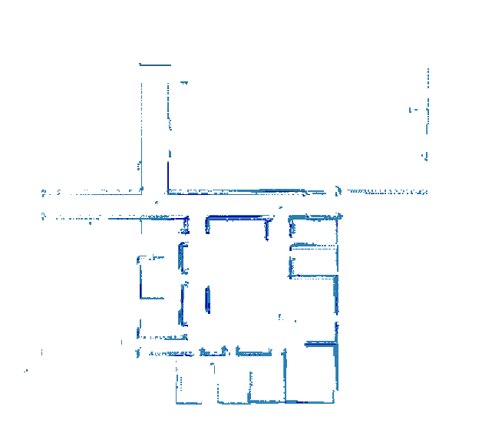
Code Output – Octomap Object
Use octovis to view final map.
$ octovis octomap.ot
52

Slide 53
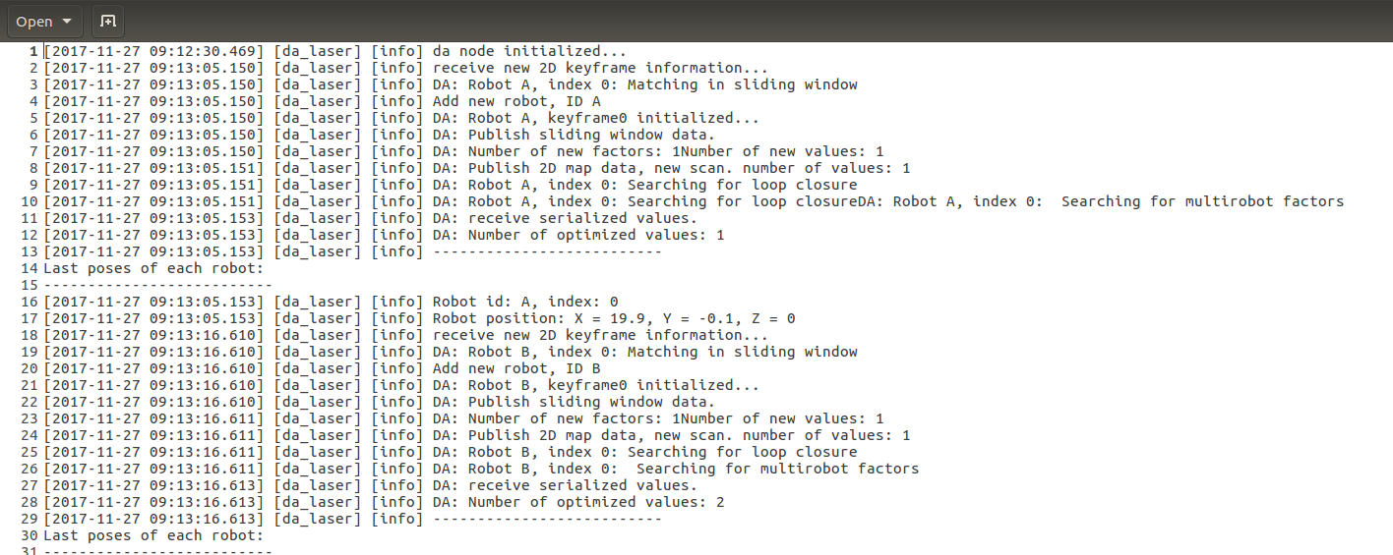
Code Outputs – Log files
Each node generate a loge file.
The logs files store information messages that the user defines. It has verbosity levels for filtering.
53

Slide 54
Workshop Topics
End to end full demo – MRBSP with 2 UGV in gazebo simulation. ☑
Installation – How to install ANPL software ☑
ROS notations ☑
High level code structure – passive and active ☑
Launch files and software configuration ☑
how to run the code ☑
Code outputs ☑
Matalb analysis tools
Matlab interface with the code
Code handling policy
Hands on exercises
54

Slide 55
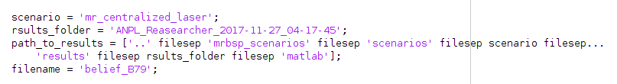
Matlab Analysis Tools
During its run the produce txt file that can be read in matlab scripts.
The matlab scripts are located at: …/mrbsp_ros/Matlab
The main analysis scripts is: “loadResults.m”
To view the results from a specific run change the scenario name and the results folder to your values.
Chose the file with the latest index in the matlab folder at the results folder (without the “_values” or “_factors” at the end of the file name).
55

Slide 56
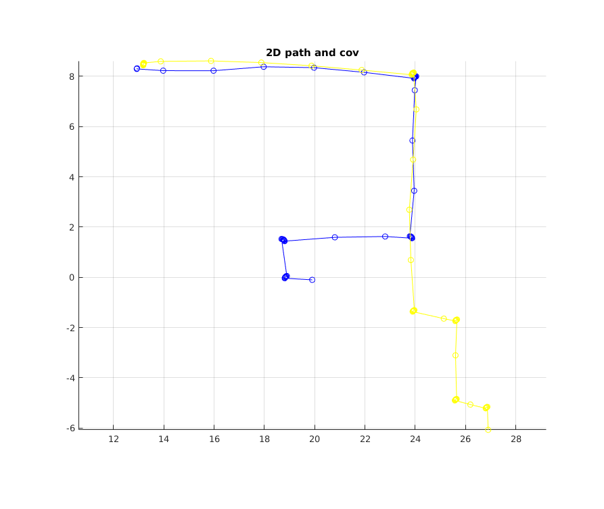
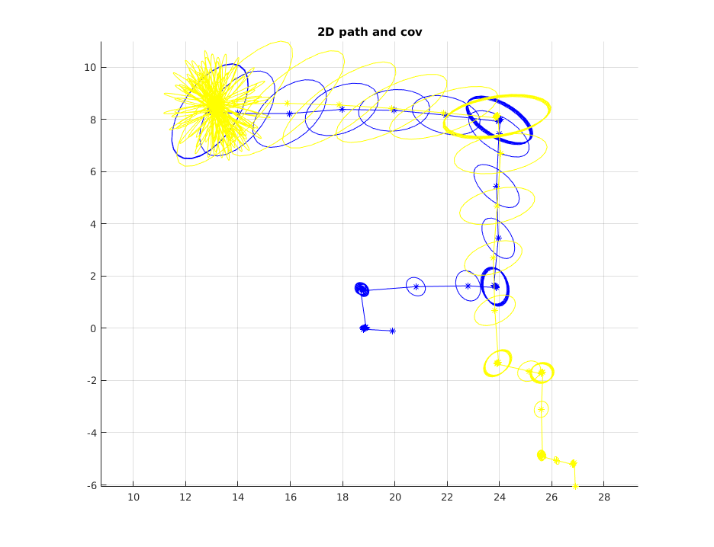
Matlab Analysis Tools
To plots are available:
Factor Graph
Pose with covariance
56

Slide 57
Workshop Topics
End to end full demo – MRBSP with 2 UGV in gazebo simulation. ☑
Installation – How to install ANPL software ☑
ROS notations ☑
High level code structure – passive and active ☑
Launch files and software configuration ☑
how to run the code ☑
Code outputs ☑
Matalb analysis tools ☑
Matlab interface with the code
Code handling policy
Hands on exercises
57

Slide 58

Matlab Interface With the Code
C++ side | Matlab side
std::stringstream to_send; to_send << std::to_string(graph.size()) << m_delimiter; for (int i = 0; i < graph.size(); i++) { gtsam::ISAM2 isam2(parameters); isam2.update(graph.at(i), initialEstimate.at(i)); to_send << gtsam::serialize(isam2.getFactorsUnsafe()) << m_delimiter << gtsam::serialize(isam2.calculateBestEstimate()) << m_delimiter; } std_msgs::String msg; msg.data = to_send.str(); m_matlab_pub.publish(msg); ros::Rate rate(5.); //Hz // busy wait while (!m_is_received) { ros::spinOnce(); rate.sleep(); } if(m_is_correct) { ROS_INFO("Matlab answered %d", m_matlab_answer); return m_matlab_answer; } else return 0; | ... while true disp ('planner waiting'); str = receive(matlab_sub); string_array = strsplit(str.Data, delimiter); size = str2num(string_array{1}); disp (['planner received: ' string_array{1} ' candidate beliefs']); isam2_graph =gtsam.NonlinearFactorGraph.string_deserialize(string_array{2}) isam2_values = gtsam.Values.string_deserialize(string_array{3}) % run your matlab code here... % and send back the result index_to_send = 0; msg = rosmessage(matlab_pub); msg.Data = index_to_send; matlab_pub.send(msg); disp (['Chosen Path: ' num2str(index_to_send)]); end
58

Slide 59
Workshop Topics
End to end full demo – MRBSP with 2 UGV in gazebo simulation. ☑
Installation – How to install ANPL software ☑
ROS notations ☑
High level code structure – passive and active ☑
Launch files and software configuration ☑
how to run the code ☑
Code outputs ☑
Matalb analysis tools ☑
Matlab interface with the code ☑
Code handling policy
Hands on exercises
59

Slide 60
Code Handling Policy
The code is maintained as a git repository in bitbucket and is available to all ANPL members.
The main stable version is at master branch.
When starting a new implementation for a specific researcher, create a new branch from the master branch and start its name with the researcher name.
When the code is ready send a pull request to merge the new branch with devel branch.
If the integration with devel branch succeeds, the code will be tested more carefully and after it will pass all tests, devel branch will be merged with the master branch.
60

Slide 61
Workshop Topics
End to end full demo – MRBSP with 2 UGV in gazebo simulation. ☑
Installation – How to install ANPL software ☑
ROS notations ☑
High level code structure – passive and active ☑
Launch files and software configuration ☑
how to run the code ☑
Code outputs ☑
Matalb analysis tools ☑
Matlab interface with the code ☑
Code handling policy ☑
Hands on exercises
61

Slide 62
Hands On Exercises
Exercise #1: Load robot in gazebo, move it manually with the keyboard controller and view its sensors in RVIZ.
Exercise #2: Create a passive slam scenario for one robot. Move the robot with the keyboard controller and examine the results in matlab.
Exercise #3: Create an active scenario with two robots. Use the interactive action generator and choose manually the best trajectory in matlab.
Exercise #4: Create full active scenario. Use the interactive action generator and choose the best path according to cost function in C++.
62

Slide 63
Exercise #1 – Gazebo Simulation
Open a new terminal.
Go to mrbsp_scenarios package and create a new scenario (name it “workshop”):
$ roscd mrbsp_scenarios/scenarios
$ mkdir workshop
Copy exercise1_gazebo.launch file from the workshop repository to the new scenario folder:
$ roscd anpl_software_workshop/launch/exercise1
$ cp exercise1_gazebo.launch ~/ANPL/code/mrbsp_ws/src/mrbsp_ros/mrbsp_scenarios/scenarios/workshop
Edit the launch file and change the robot initial pose to (x=20.0, y=0.0, z=0.0, Yaw=1.57, Roll=0.0, Pitch=0.0):
$ roscd mrbsp_scenarios/scenarios/workshop
$ gedit exercise1_gazebo.launch
Edit init_pose arguments to the requested values
Use the launch file to open gazebo simulator:
$ roslaunch mrbsp_scenarios exercise1_gazebo.launch
63

Slide 64
Exercise #1 – Gazebo Simulation
Open a new terminal
Open RVIZ to visualize the robot laser scans:
$ roslaunch anpl_software_workshop exercise1_rviz.launch
Use the keyboard controller (opened in a new terminal) to move the robot around and examine the laser scans in RVIZ:
Press ‘e’ to enable the motors
Move to robot with the keyboard arrows
The red line of the robot origin is directing to the robot forward direction
Close gazebo, rviz and the opened terminals (use ctrl C for the terminals)
64

Slide 65
Exercise #2 – Passive SLAM
Open a new terminal.
Copy exercise2 files to the workshop scenario:
$ roscd anpl_software_workshop/launch/exercise2
$ cp exercise2_centralized.launch exercise2_robot_A.launch ~/ANPL/code/mrbsp_ws/src/mrbsp_ros/mrbsp_scenarios/scenarios/workshop
Copy config file folder to the workshop scenario folder:
$ roscd anpl_software_workshop
$ cp -R config_files ~/ANPL/code/mrbsp_ws/src/mrbsp_ros/mrbsp_scenarios/scenarios/workshop
Change researcher name and scenario name in exercise2_centralized.launch:
$ roscd mrbsp_scenarios/scenarios/workshop
$ gedit exercise2_centralized.launch
Change researcher_name argument to your name & current_scenario argument to “workshop”
65

Slide 66
Exercise #2 – Passive SLAM
Change scenario name in exercise2_robot_A.launch:
$ roscd mrbsp_scenarios/scenarios/workshop
$ gedit exercise2_robot_A.launch
Change current_scenario argument to “workshop”
Edit init_pose parameters for robot A according to the initial pose you set in exercise1_gazebo.launch file:
$ roscd mrbsp_scenarios/scenarios/workshop/config_files
$ gedit gazebo_robot_A.yaml
Edit init_pose values
Launch gazebo simulator with the file you created in exercise 1:
$ roslaunch mrbsp_scenarios exercise1_gazebo.launch
Launch robot A and centralized machine nodes:
In new terminal: $ roslaunch mrbsp_scenarios exercise2_centralized.launch
In new terminal: $ roslaunch mrbsp_scenarios exercise2_robot_A.launch
66

Slide 67
Exercise #2 – Passive SLAM
Open RVIZ to visualize the estimated trajectory of the robot and the map:
$ roslaunch anpl_software_workshop exercise2_rviz.launch
Move the robot with the robot controller. Get outside of the big room and enter it form a different entrance in order to detect a loop closure.
Close gazebo, RVIZ, and the opened terminal.
Go to results folder and examine the code outputs.
Go to the current run folder (researcher name + date + time) and type $ octovis octomap.ot
Go to log and matlab folder and examine the results.
Open matlab and go to ~ANPL/code/mrbsp_ws/srs/mrbsp_ros_matalb.
Open loadResutls.m scripts.
Change scenario to “workshop”, results folder to the current run and filename to the file with the highest index (without the “_values” at the end).
Run the script.
67

Slide 68
Exercise #3 – Active SLAM with Matlab Planner
Open a new terminal.
Add one more robot to gazebo by editing exercise1_gazebo.launch from exercise 1:
$ roscd mrbsp_scenarios/scenarios/workshop
$ gedit exercise1_gazebo.launch
Copy line 3 and paste it at line 4. Change arg name to robot2_name and the defaults value to pioneer2.
Copy lines 11-17 (starts with <group and ends with </groupe>) and paste them at line 18 (above the </launch> tag).
On the lines you just copy, change arg robot1_name to robot2_name.
For robot 2, set init_pose argument to (x=26.9, y=-6.07, z=0.0, Yaw=1.57, Roll=0.0, Pitch=0.0)
Launch exercise1_gazebo.launch and check that 2 robot are now existed.
Update gazebo_robot_B.yaml file with the initial pose of robot B.
Copy exercise3 files from the workshop repository:
$ roscd anpl_software_workshop/launch/exercise3
$ cp exercise3_centralized.launch exercise3_robot_A.launch exercise3_robot_B.launch ~/ANPL/code/mrbsp_ws/src/mrbsp_ros/mrbsp_scenarios/scenarios/workshop
At all files, change researcher_name argument to your name & current_scenario argument to “workshop”.
68

Slide 69
Exercise #3 – Active SLAM with Matlab Planner
Open a new terminal and launch exercise3_centralized.launch:
& roslaunch mrbsp_scenarios exercise3_centralized.launch
Open a new terminal and launch exercise3_robot_A.launch:
$ roslaunch mrbsp_scenarios exercise3_robot_A.launch
Open a new terminal and launch exercise3_robot_B.launch:
$ roslaunch mrbsp_scenarios exercise3_robot_B.launch
Open planner node in Matlab.
In a new terminal: $ Matlab
Go to ANPL/code/mrbsp_ws/src/mrbsp_ros/planner_node/matlab
Open planner_a.m script and place a breakpoint at line 29 (“index_to_send ….”)
Run the script.
On RVIZ, use the interactive action generator and create a candidate actions for each robot.
On matlab, examine the belief you receive from the cpp code.
69

Slide 70
Exercise #4 – Active SLAM with C++ Planner
Change the planner to be fully C++ implemented
$ roscd mrbsp_scenarios/scenarios/workshop
$ gedit exercise3_centralized.launch
At line 41 change param name “planner_type” to cpp
Launch the scenarios:
In a new terminal $ roslaunch mrbsp_scenarios exercise1_gazebo.launch
In a new terminal $ roslaunch mrbsp_scenarios exercise3_centralized.launch
In a new terminal $ roslaunch mrbsp_scenarios exercise3_robot_A.launch
In a new terminal $ roslaunch mrbsp_scenarios exercise3_robot_B.launch
Use the interactive action generator and create a candidate actions for each robot
In RVIZ, before double clicking on the screen to finish the actions generation, on the left panel, uncheck “Loaded Map” and “PoseWithCovariance” boxes and check all the unchecked boxes.
Double click on the screen an watch the robots accomplish the chosen actions.
70

Slide 71
Exercise #4 – Active SLAM with C++ Planner
Explore the results of the code in the results folder.
Use the Matlab analysis tools to explore the results in Matlab.
71

Slide 72
The End!!!
72

