Slide 1
Project theme: Deploy/install/update web-application 'CUP' on AWS
2022 г.

Slide 2
Basic project scheme
2
Internet
Control PC
AWS
Nginx-LoadBalancer
aws-4
Nginx-Proxy
aws-2
Nginx-Proxy
aws-3
Pyapp + MySQL
aws-1

Slide 3
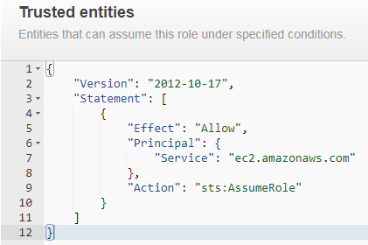
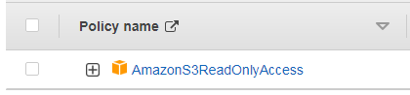
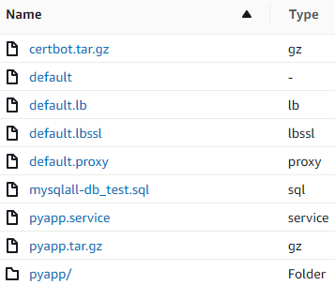
Preparing the Environment 'AWS Role'
3
Create IAM/Role s3-read-only so that created EC2 can copy data from there: configuration files, project base files, certificates.
IAM/Role can be created either manually or with Ansible.
'AWS S3'
Create S3 s3://anpod07-share for store the data needed to create EC2. S3 can be created either manually or with AWScli:
$ aws s3 mb s3://anpod07-share --region=eu-central-1
$ aws s3 sync ./ s3://anpod07-share

Slide 4
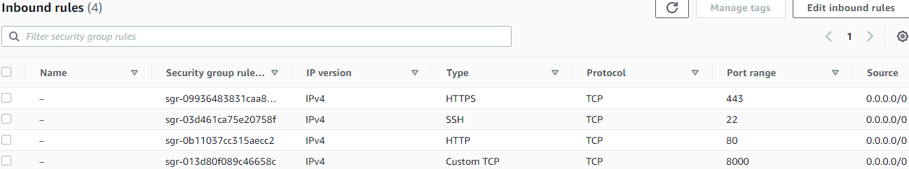
Preparing the Environment 'AWS Security Group'
4
Create EC2/Security Group SG_linux_SSH_HTTP to restrict access to created EC2.
EC2/Security Group can be created either manually or with Ansible.
It is more correct to create different Security Groups for each EC2.
'Docker'
Create Dockerfiles for base DB MySQL and Python-application.
After building docker-images tag them and send to DockerHub.
Docker-images provide a more comfortable application deployment:
Fast deployment for already made images;
do not require installation of additional software except for docker.io;
economically consume server resources;
do not depend on the version and type of Operation System;
allow you to use VOLUMES to easily and quickly change the project code.

Slide 5
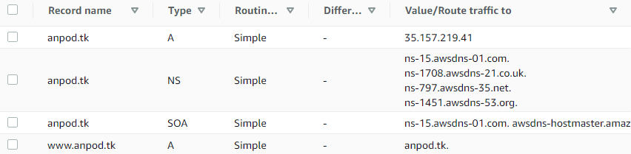
Preparing the Environment domain name anpod.tk
5
To reduce the length of the domain name and the possibility of using https, the domain name anpod.tk is used.
It will be used as a single entry point to access my web-application.
'Route53'
After automatically generating EC2 «aws-4» you need to:
create Hosted zone anpod.tk;
Create two A-record-s for anpod.tk and www.anpod.tk;
in A-record anpod.tk register Public IP from the server «aws-4»;
A-record www.anpod.tk use as an alias to anpod.tk.
It is more correct to use Elastic IP for EC2 «aws-4», however it is not shown here for cost reasons.

Slide 6
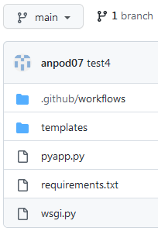
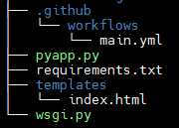
Git
6
create a new repository for the epam_proj project;
create a local repository on Control PC;
set up access between repositories using SSH keys;
copy the Python files of the web application in a local repository;
commit & push to GitHub;
create GitHub Action script «main.yml».
commit & push to GitHub.
The script will be executed on the action 'on push' to the main branch.
It will send our modified code to the VOLUME of the remote EC2 «aws-pyapp» container and restart this container;

Slide 7

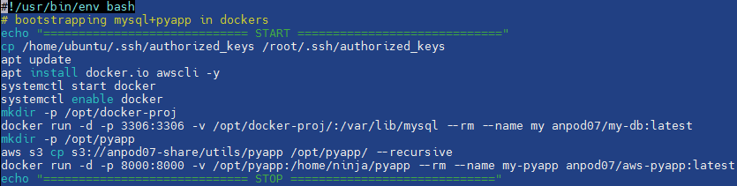
Ansible installation
7
Install the required packages for Ansible on Control PS:
$ ansible-galaxy collection install community.aws
Checking for the presence of modules needed for Ansible:
$ pip list | grep "boto\|aws"
Update modules as needed:
$ pip3 install –upgrade <module>
Bootstrapping-scripts
Create bootstrapping-scripts on Bash for each EC2.
As an example, here is a script for «aws-1»:

Slide 8
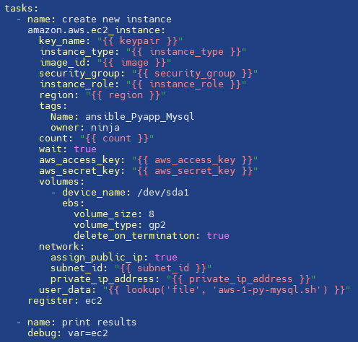
Ansible playbooks
8
Let’s write Ansible-playbooks that will create Instatces for each EC2.
An example is a template with variables:
Playbooks «aws-2» and «aws-3» can remove the Public IP assignment:
'assign_public_ip: false'
however, for the purpose of debugging and demonstrating the project, access is left.

Slide 9
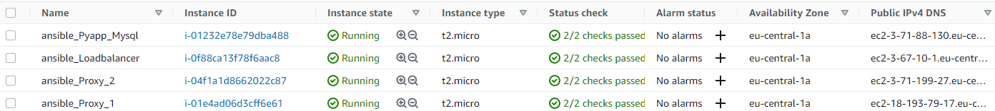
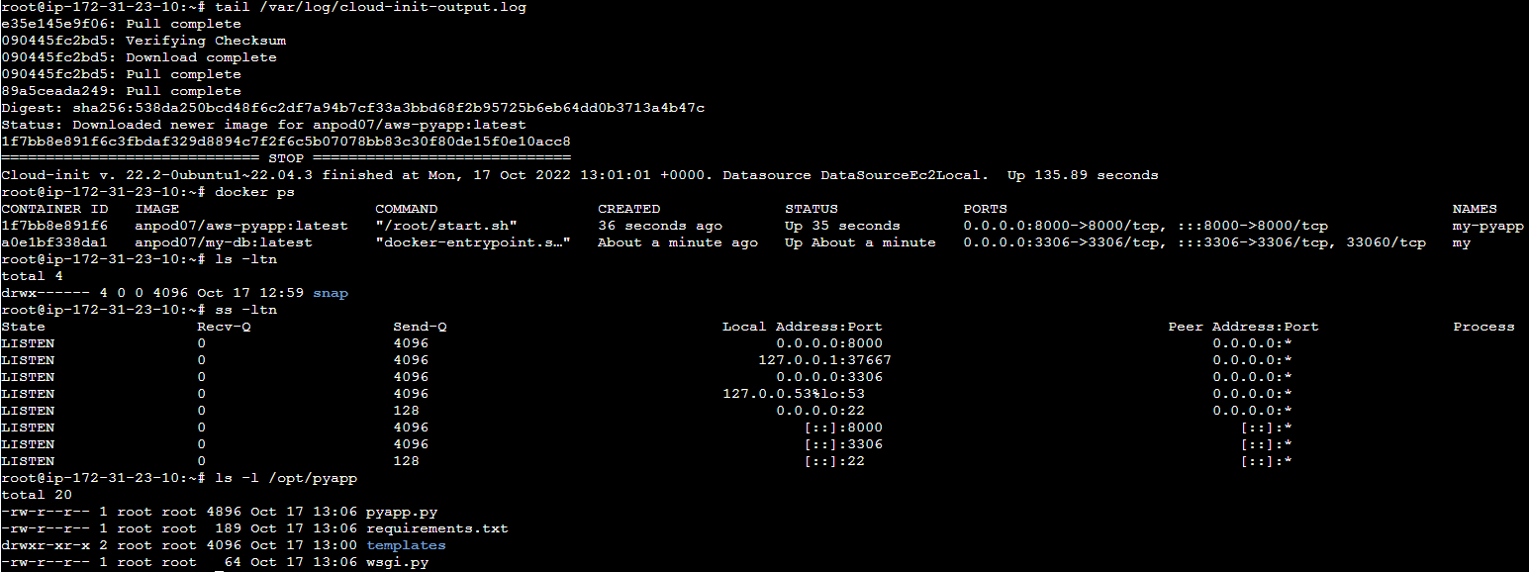
Launch & Testing running Ansible-playbooks, checking EC2
9
Running playbooks whit commands:
$ ansible-playbook aws-1.yaml --vault-password-file pass.txt
Wait a some time while EC2 builds and installs the necessary packages using bootstrapping-scripts.
Check if everything is installed and working, for example on «aws-1»:
The file «/var/log/cloud-init-output.log» contains information about the progress of the bootstrapping-script.

Slide 10
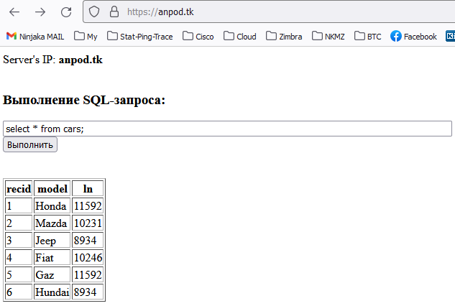
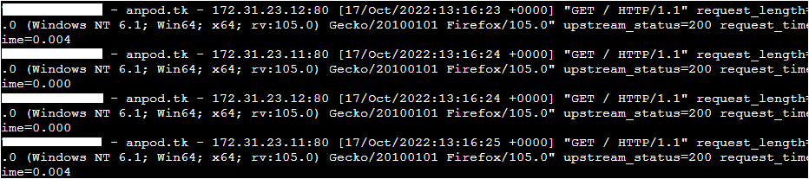
Launch & Testing check for https-certificates and domain name
10
We see https:// in the address bar, which means the Let’s Encrypt certificates have been successfully installed, and Nginx on «aws-4» uses them.
Also, the site is accessed by the anpod.tk domain name, which means Route53 is configured correctly.
Let’s check LoadBalancer log files on «aws-4»:
In the Nginx logs we see requests to the addresses 172.31.23.11 and 172.31.23.12.
This is pair of Nginx-proxy web-servers: «aws-2» and «aws-3».
checking the operation of Nginx-LoadBalancer
Client IP
Client IP
Client IP
Client IP

Slide 11
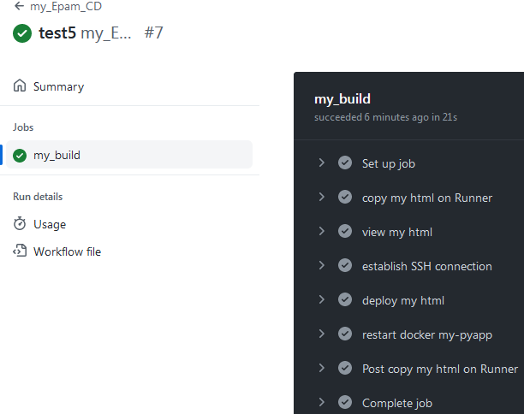
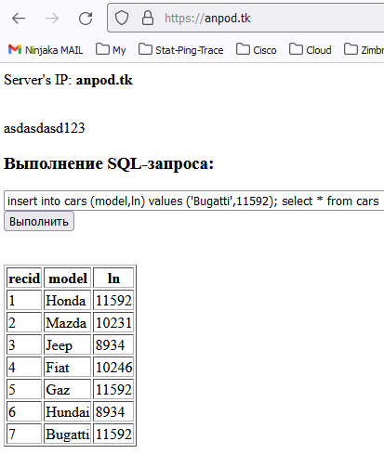
GitHub Action testing
11
Final test: code auto-update via GitHub Action.
go to https://anpod.tk, execute the request, see the result on the web-page;
make minor changes to the code and make push on GitHub;
watch GitHub Action-script execute;
go to https://anpod.tk again, see the result on the web-page.

Slide 12





Full project scheme ('AWS Security Group', 'AWS Role', 'AWS S3', 'Docker', 'Route53', 'GitHub')
12
Control PC
Ansible
Awscli
Git
GitHub
Internet
DockerHub
443/tcp
AWS
Route53
Hosted zone: anpod.tk
Nginx-LoadBalancer
aws-4
Private IP: 172.31.23.13
80/tcp
80/tcp
Nginx-Proxy
aws-2
Private IP: 172.31.23.11
Nginx-Proxy
aws-3
Private IP: 172.31.23.12
8000/tcp
8000/tcp
Pyapp + MySQL
aws-1
Private IP: 172.31.23.10
S3
IAM Role: s3-read-only
Nginx configs
Pyapp files
Certbot certs
Node’s netlink S3 data DockerHub data GitHub Action Route53

