Slide 1
Project theme:
CI/CD a py-web-application on AWS
Created by Andrey Podgornyy
February, 2023 year

Slide 2
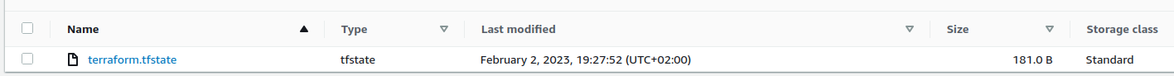
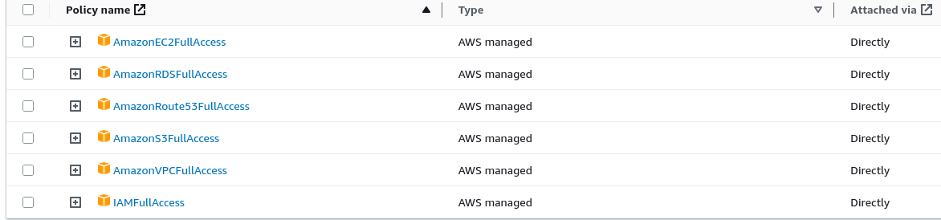
Preparing the Environment on AWS
'AWS S3-bucket'
Preparing the GitHub repos
2
Create S3-bucket anpod07-statefile to store and use terraform-state-file using AWScli:
$ aws s3 mb s3://anpod07-tf-statefile --region=eu-central-1
'AWS User'
Create IAM/User tf so that Jenkins can install the infrastructure on AWS and get access to terraform-state-file on S3.
Let’s create two GitHub-repos:
- anpod07/proj-4 [web-application, Dockerfile, jenkins-pipeline]
- anpod07/proj-4-tf [terraform-scripts, ansible-playbooks, jenkins-pipeline]
Associate them with local repositories on a personal PC using SSH keys.

Slide 3
Preparing the Jenkins Environment
'Jenkins-master in docker'
3
Let’s run Jenkins-master from the official docker-image:
$ mkdir -p /home/andr/jenkins-data [Jenkins’s home directory]
$ docker run --name jenkins -d \
-v /home/andr/jenkins-data:/var/jenkins_home \
-p 8080:8080 -p 50000:50000 \
--restart=on-failure -e "TZ=Europe/Kiev" jenkins/jenkins:lts-jdk11
'Jenkins-node in docker'
Let’s run Jenkins-node on the other host from the official docker-image too.
Basically, it is possible to create many Jenkins-nodes in docker-image on one host,
each with its own functionality. Jenkins-master will only distribute tasks.
The host instance for Jenkins-node will be Ubuntu Server 22.04.
Let’s install docker.io on it:
$ apt install docker.io -y
Share dockerd over the local network by adding a line to the file docker.service:
ExecStart=/usr/bin/dockerd ... -H tcp://192.168.1.125:4343
Restart the dockerd service and ping from Jenkins-master:
$ curl http://192.168.1.125:4343/images/json
We carry out these actions from a secure local network!

Slide 4
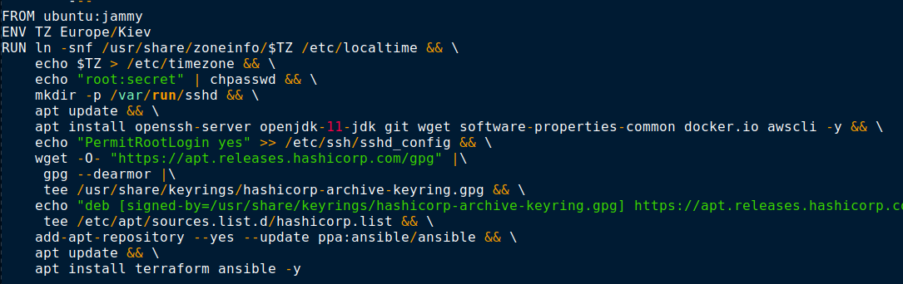
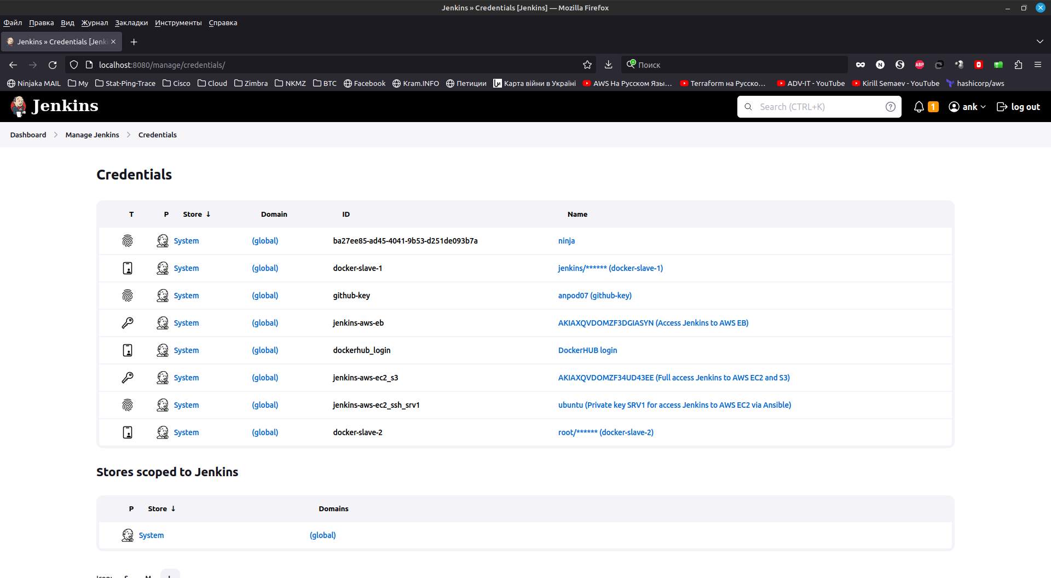
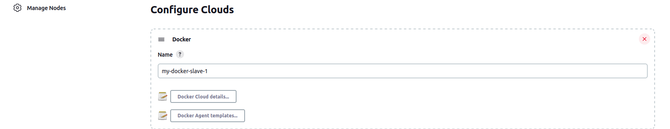
Preparing the Jenkins Environment
'Jenkins-node in docker'
4
Create Dockerfile for Jenkins-node, including those packages to install:
- docker.io
- awscli
- ansible
- terraform
- git
Build the docker-image:
$ docker build -t docker-slave-1 .
On Jenkins-master:
- install Docker plugin;
- create Credentials for access
to docker-slave-1;
- create a new node from Cloud;

Slide 5
Preparing the Jenkins Environment
'Jenkins-node in docker'
5
On Jenkins-master:
- install plugins:
'Git plugin'
'GitHub plugin'
'Pipeline'
'CloudBees AWS Credentials Plugin'
'Timestamper'
'Workspace Cleanup Plugin'
- create Credentials for access to GitHub;
- create Credentials for access to DockerHUB;
- create Credentials for access to AWS EC2;
- create Credentials for access to AWS for create IaaC

Slide 6
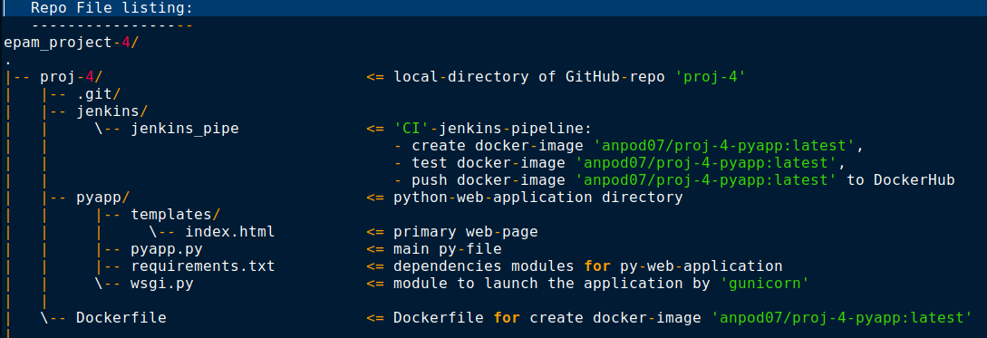
Git proj-4
6
Listing of files on local directory og GitHub repo proj-4

Slide 7
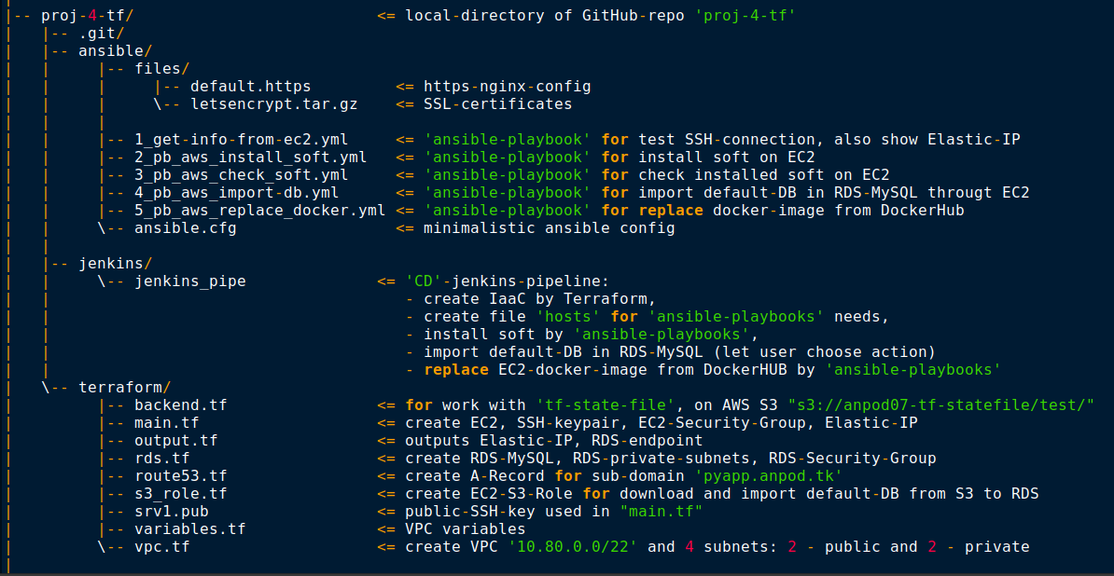
Git proj-4-tf
7
Listing of files on local directory og GitHub repo proj-4-tf

Slide 8
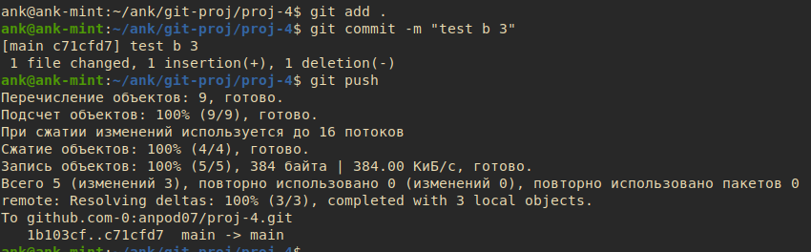
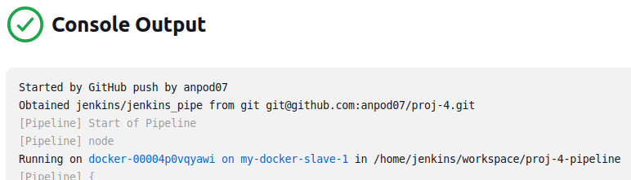
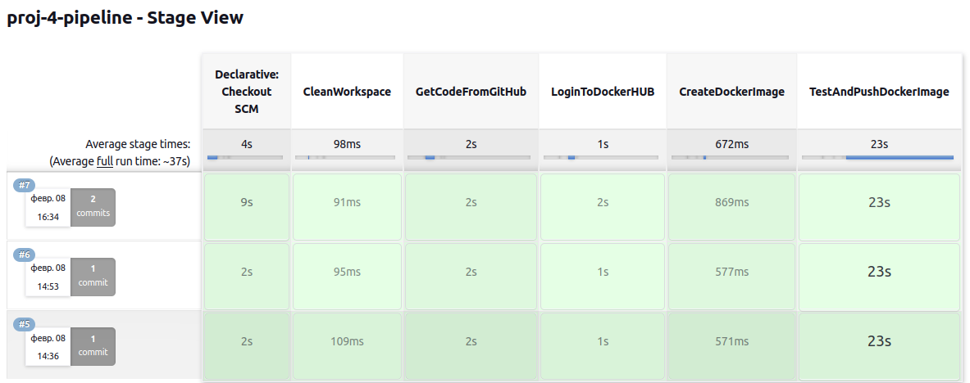
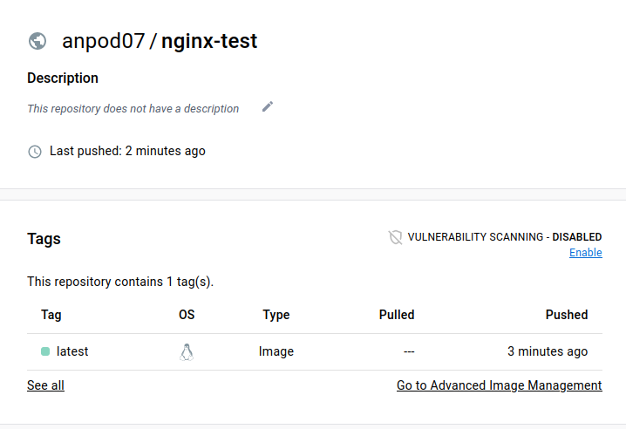
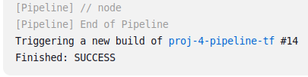
Final test: CI part
8
CD part

Slide 9
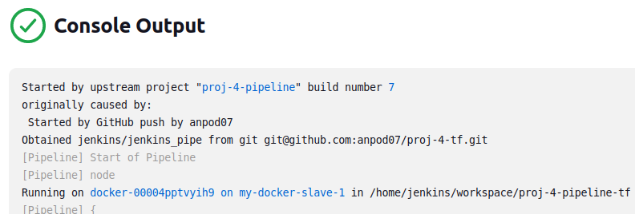
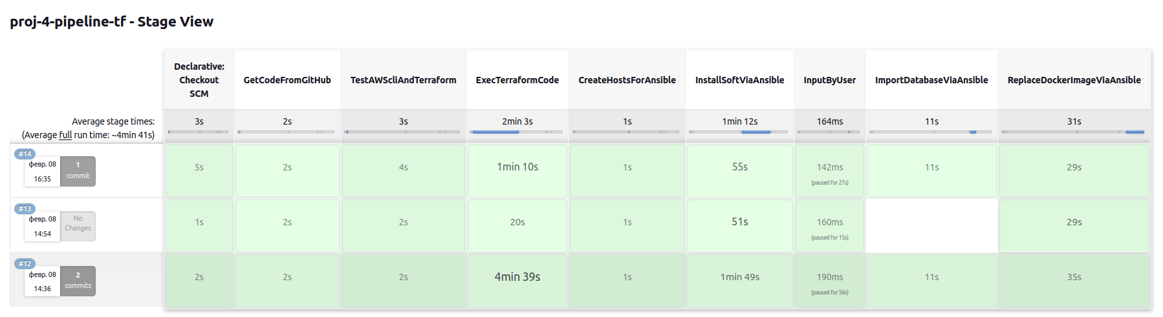
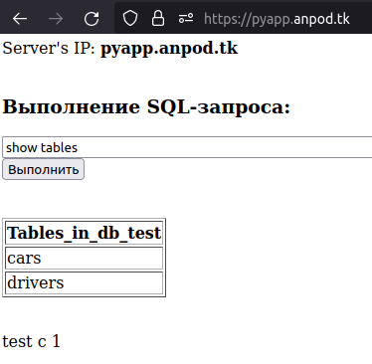
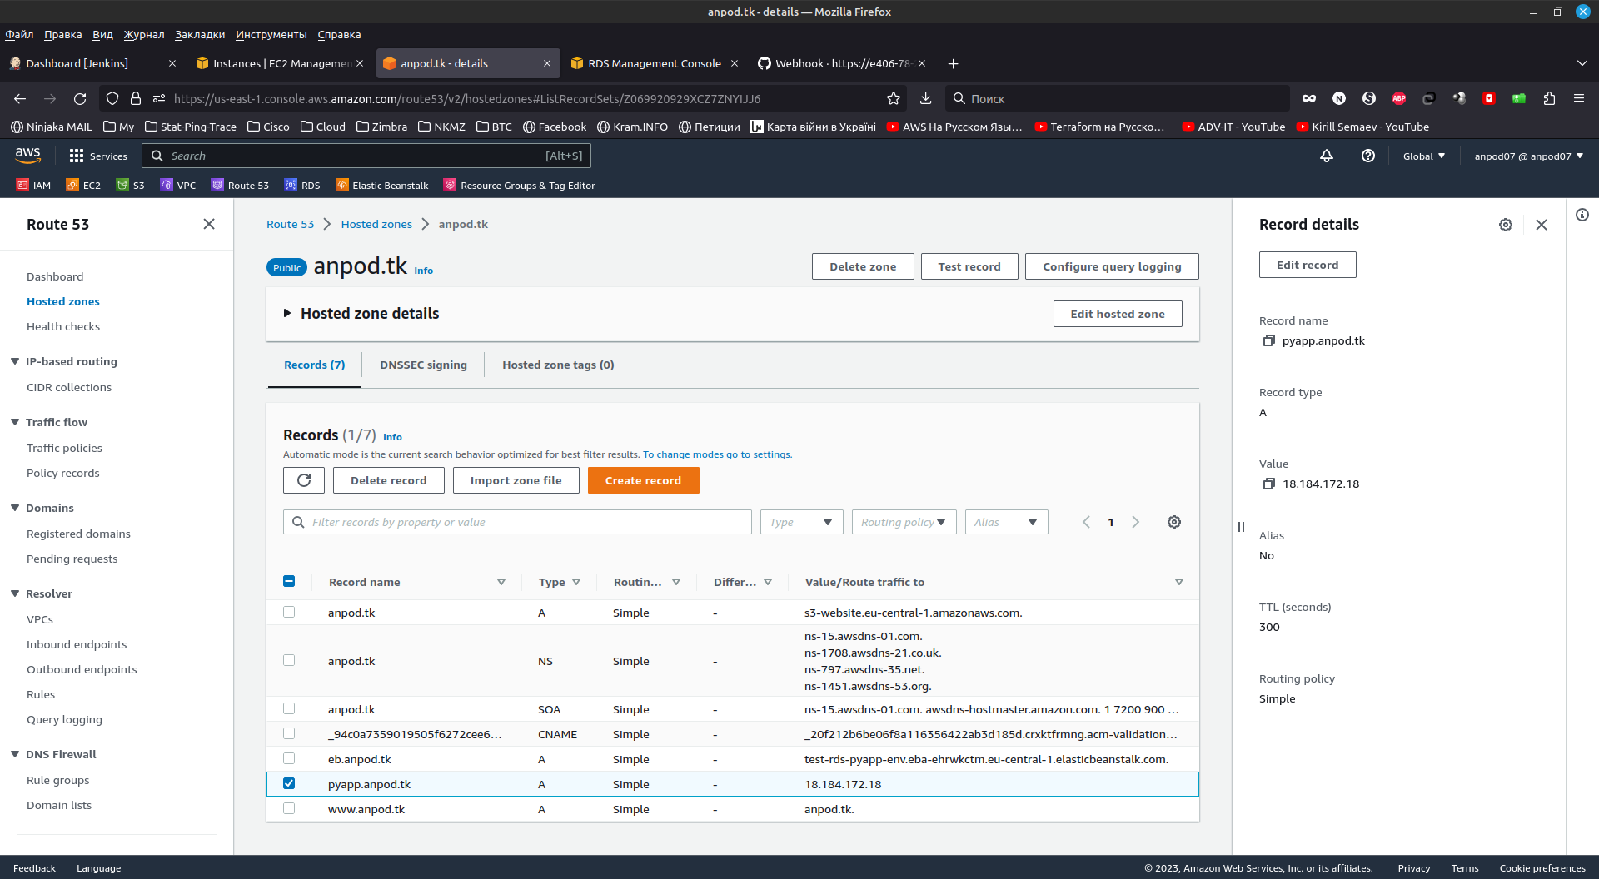
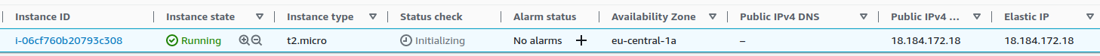
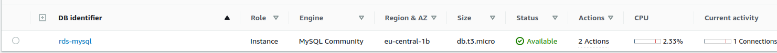
Final test: CD part
9
CI part

Slide 10



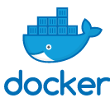
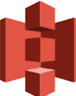
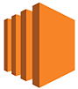
Full project scheme
10
Git
==========
py-web-app
Jenkins
Master / Node
============
3. exec
proj-3-pipeline:
build docker-image,
test docker-image
(py-web-app)
----------------------------
exec
proj-3-tf-pipeline:
4. create EC2,
create S3-role,
create RDS,
create VPC,
create A-record
----------------------------
5. install software,
replace/deploy
docker-image
git push
1
2
GitHub
anpod07/proj-3
===========
py-web-app
-------------------------
Dockerfile
GitHub-webhook over Ngrok
DockerHub
============
anpod07/nginx-test
3.2
Store Image
3.1
Use Dockerfile
5.3
Pull Image
4.2
S3
S3://anpod07-tf
==========
terraform.tfstate
Use tfstate
GitHub
anpod07/proj-3-tf
===========
tf-scripts
-------------------------
ansible-pb
4.3
4.1
Create IaaC
AWS
===========
VPC
---------------------------
EC2
run docker-image
---------------------------
RDS
---------------------------
Route53
Exec tf-scripts
5.1
5.2
Exec ansible-pb
Install/Manage
software

