Slide 1

The Effect of Budget, Length, Year of Production, Number of Votes, and Genre on Movie Rating: A Generalized Linear Regression Model Analysis
Xilai Chen, Anqi He, Kavya K H, Dongxu Li, Zhiwei Yan
School of Mathematics and Statistics
University of Glasgow

Slide 2
Introduction
Internet Movie Database (IMDb) score is a numerical rating system to rate the popularity and quality of movies
It is often used as a reference point to gauge the overall performance of a movie
The main objective of this study is to determine the properties that influence the IMDb score of a film.

Slide 3
Data description
Dataset contains information about 3001 movies
It includes the following variables:
Production year
Duration
Budget
Number of positive votes
Genre
Ranking (IMDb scores)

Slide 4
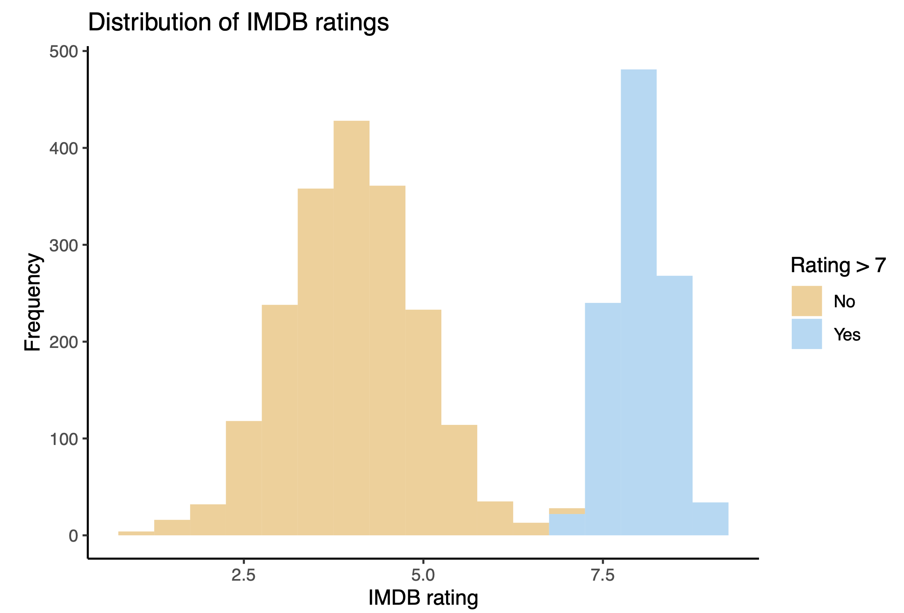
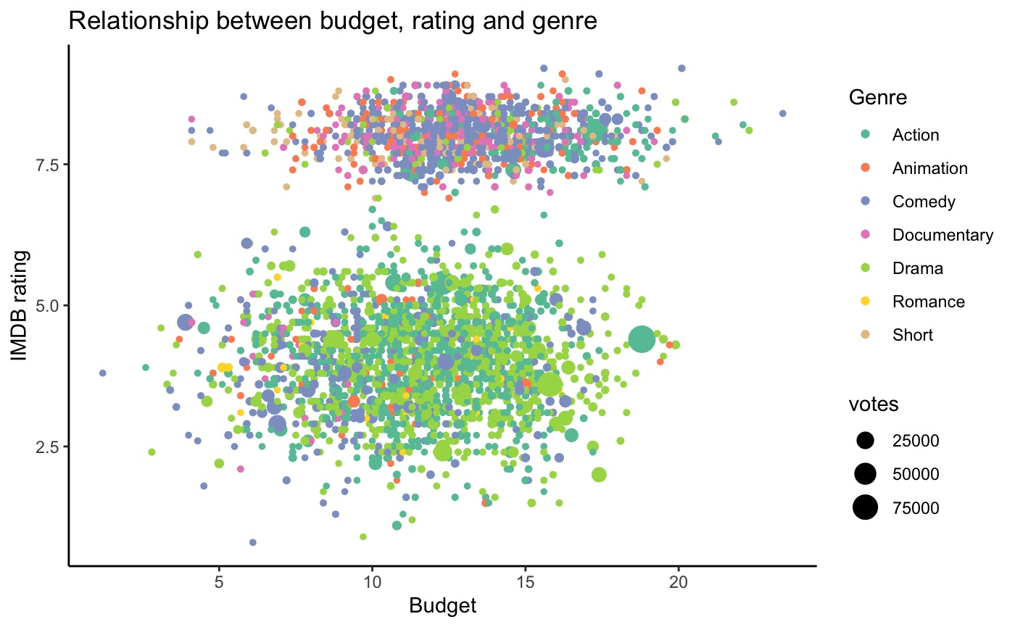
Data exploration
IMDb ratings follow bimodal distribution
Data contain two subgroups based on:
Less popular films have significantly higher ratings.
Blockbuster films receive higher levels of attention.
IMDb scores ≤ 7, and
scores > 7.

Slide 5
Data pre-processing
Missing value processing
The variable length contains 127 missing values
Use median to fill in the missing values
Feature transformation
Binarize rating using the threshold value 7
Use one hot encoding technique for genre

Slide 6
Correlation
 | Year | Length | Budget | Votes | Rating
Year | 1.00000000 | 0.17580075 | 0.03139738 | 0.09221425 | -0.03525934
Length | 0.17580075 | 1.00000000 | 0.04287388 | 0.16244069 | -0.44512681
Budget | 0.03139738 | 0.04287388 | 1.00000000 | 0.03137437 | 0.22510750
Votes | 0.09221425 | 0.16244069 | 0.03137437 | 1.00000000 | -0.04854771
Rating | -0.03525934 | -0.44512681 | 0.22510750 | -0.04854771 | 1.00000000
Covariance matrix suggests that there is little correlation among the variables and no presence of collinearity.

Slide 7
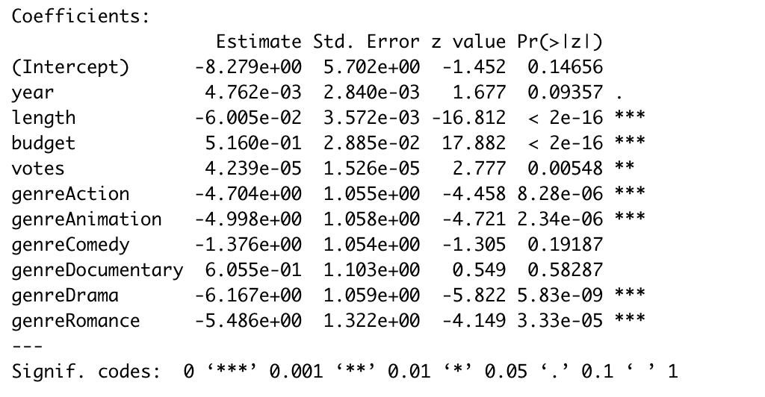
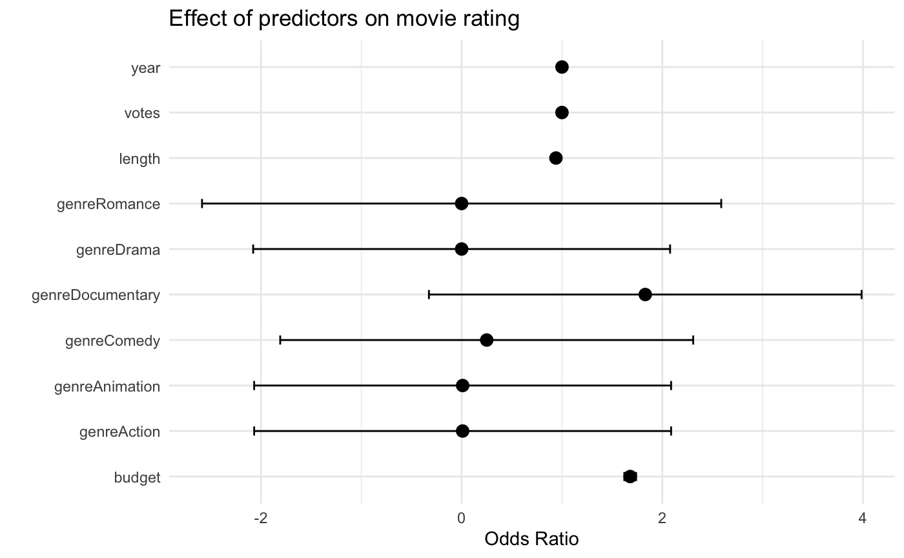
Methodology
GLM based on logistic regression
Choose the variables
Fit2
According to Odds Ration
Select variables based on Odds Ratio
Fit3

Slide 8
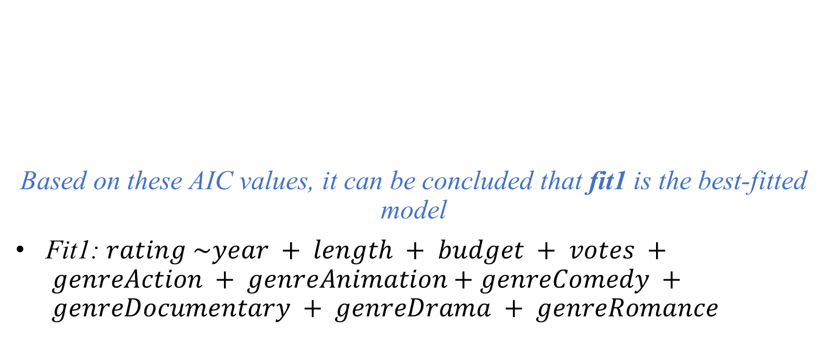
Model Choose
 | AIC
Fit1 | 1572.895
Fit2 | 1615.509
Fit3 | 2736.135
Based on these AIC values, it can be concluded that fit1 is the best-fitted model
Fit1: $rating \sim year + length + budget + votes + genreAction + genreAnimation+genreComedy + genreDocumentary + genreDrama + genreRomance$

Slide 9
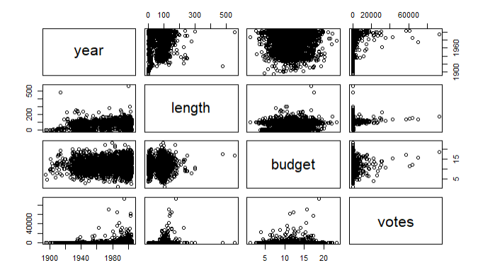
Interaction of variables
The scatter plots between length and year, votes and year, length and votes, budget and length, budget and votes all present a triangular shape, that is, there may be interactions.
The pattern of that plot between year and budget is rectangular. Therefore, we think there is no interaction between these two variables.

Slide 10
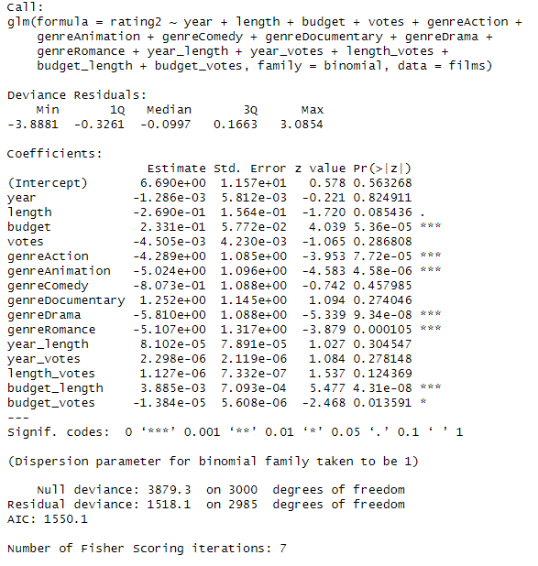
Model with Interaction
Budget and genre have a significant effect on determining whether the rating of a movie is greater than 7.
There are four genres get the p-value less than 0.05, including action, animation, drama and romance.
Budget-length and budget-votes interactions also influence the ratings.

Slide 11
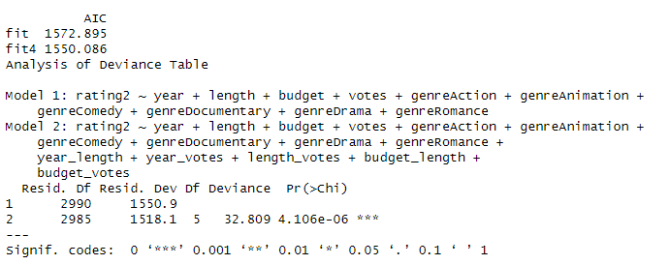
Model Comparison
We compare AIC values between two models. AIC of fit4 is lower than fit. And ANOVA shows that there is significant difference between model 1 and model 2.

Slide 12
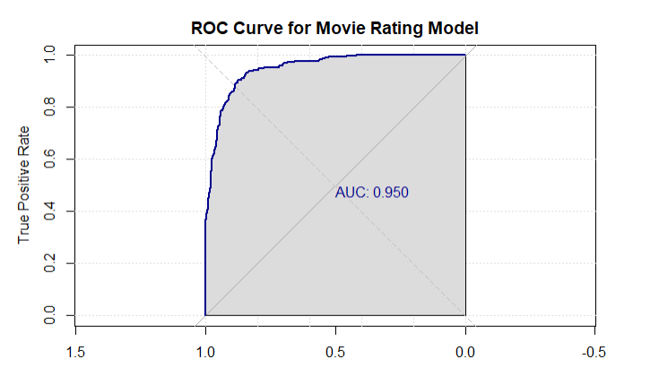
Model summary
The area under the ROC curve is 0.9502, which means that the model works well for predicting the classification of observations in the test dataset.

Slide 13
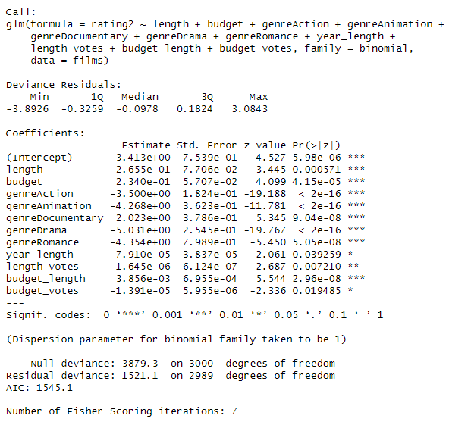
Stepwise regression
We use stepwise regression method to do model optimization.
After optimization, the new model has lower AIC value, and all the variables are significant.

Slide 14
Conclusion
Length, budget and genre have a significant effect on classing whether IMDB rating of a certain movie is over 7.
Length is negatively correlated with rating.
Budget is positively correlated with rating.
Most genre factors have negative correlation with rating, except Documentary.
Interactions also influence the ratings, but all estimators of interactions are small.

Slide 15
Thank you!

