Slide 1
Dynjit: A General-purpose Just-In-Time Compiler for Python Programming Language
システム情報工学研究科 情報理工学位プログラム
プログラム論理研究室 Zhao Wanghongxuan
指導教員：亀山幸義

Slide 2
Index
Background
Existing Attempts
Dynjit
Current Progress
Future Outlook

Slide 3
Index
Background
Existing Attempts
Dynjit
Current Progress
Future Outlook

Slide 4
Background
Python is important.
Python is heavily used in industrial and educational world.

Slide 5
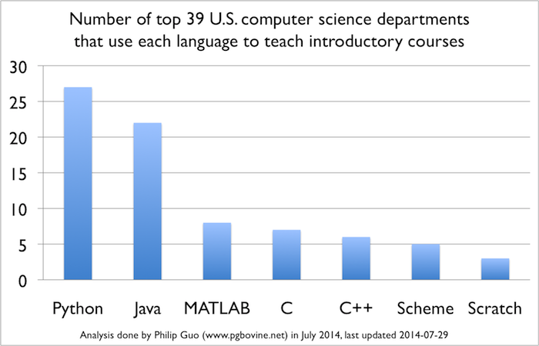
Python in Educational World
CACM Blog(2014): Python Is Now the Most Popular Introductory Teaching Language at Top ­U.S. ­Universities
There is an increasing popularity of using Python for teaching!
The Python official website also gives a record about the spread of Python among the schools around the world
(https://wiki.python.org/moin/SchoolsUsingPython)

Slide 6






Python in Industrial World
PopularitY of Programming Language Index(2020)
Rank | Change | Language | Share | Trend
1 |  | Python | 31.02 % | +2.2 %
2 |  | Java | 16.38 % | -2.8 %
3 |  | JavaScript | 8.41 % | +0.4 %
TIOBE Index
Oct 2020 | Oct 2019 | Change | Programming Language | Ratings | Change
1 | 2 |  | C | 16.95% | +0.77%
2 | 1 |  | Java | 12.56% | -4.32%
3 | 3 |  | Python | 11.28% | +2.19%

Slide 7
Background
Python is so important!
However…

Slide 8
However, Python is Slow
Workarounds
Companies, Individual Developers
High Level Applications
Slow Programs
Extensions by
C/C++/Others
Use Python For
Cause
Cause
There comes out the “two-language” problem
https://epubs.siam.org/doi/abs/10.1137/141000671

Slide 9



"two-language" Considered Harmful
Learn
Maintain
.c(pp) .h(pp)
.so
.py
Mastering Python C APIs
Mastering C/C++
Write C exts
Extensions are only domain-specific
Using C exts
Coding
Overheads
similar case:
notations of
MATLAB vectorization
Magic Code
FFI Overhead
Incomplete Functionalities
Redundant Copies
…
…

Slide 10
Faster Python
Python is dynamic
Python
Objects

Slide 11
Faster Python
Python is dynamic
Python
Objects
“I’m sorry”
“Speed me up?”
Behaviors are decided at runtime
“Could you optimize me?”
Static Optimizer/Compiler
Program behaviors decided by
I/O(eval, reflections)
Complex Runtime Computations
“Properties/Shapes/Types” known at runtime

Slide 12
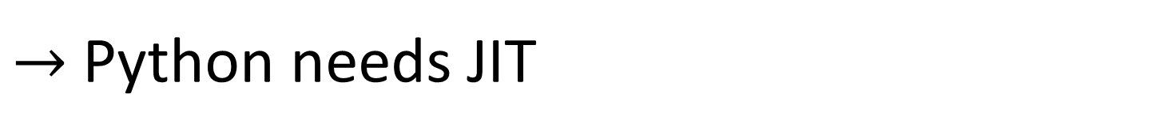
Faster Python
Python is dynamic
Runtime Compilation
There’s a limit to static compilation!
Static Optimizer/Compiler
I REJECT MY "STATIC"!
Referred as Just-In-Time(JIT) compilation
$→$Python needs JIT

Slide 13



The Whole World is Calling for Python JIT
Status
Pyjion
Pyston
JAX
PyPy(most successful so far)
Numba
HOPE
JitPy
…

Slide 14
Index
Background
Existing Attempts
Dynjit
Current Progress
Future Outlook

Slide 15
Existing Attempts
Pyjion
Pyston
JAX
PyPy
Numba
HOPE
JitPy
…

Slide 16
Existing Attempts
Pyjion
Pyston
JAX
PyPy
Numba
HOPE
JitPy
…
3 commits in last 2 years.
Suspended, or even died..

Slide 17
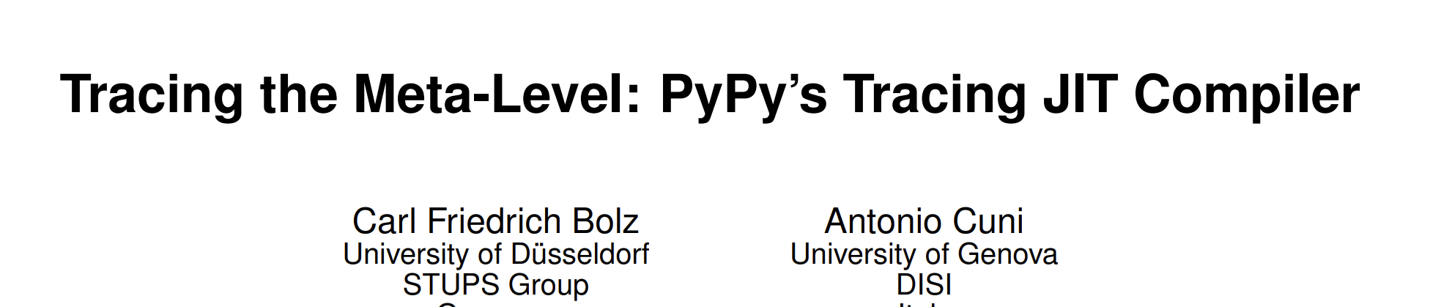
Existing Attempts
Pyjion
Pyston
JAX
PyPy
Numba
HOPE
JitPy
…
Incompatible to CPython memory layouts
https://dl.acm.org/doi/pdf/10.1145/1565824.1565827

Slide 18
Existing Attempts
Pyjion
Pyston
JAX
PyPy
Numba
HOPE
JitPy
…
Only works for numeric computing.
https://dl.acm.org/doi/pdf/10.1145/2833157.2833162

Slide 19
Existing Attempts
Pyjion
Pyston
JAX
PyPy
Numba
HOPE
JitPy
…
All have their own issues!

Slide 20
Lessons Learnt from Existing Attempts
Approaches that don't require patching CPython(C codebase) are probably preferable
A general-purpose JIT is expected
A CPython-compatible JIT is expected
Pyjion & Pyston
Numba & HOPE
PyPy
In nearly 30 years, many Python JIT projects failed for each started with a heavy implementation.
4. A lightweight but extensible JIT implementation is better.

Slide 21

Lessons Learnt from Existing Attempts
We hereby present Dynjit

Slide 22
Index
Background
Existing Attempts
Dynjit
Current Progress
Future Outlook

Slide 23
Dynjit
Why is Python so slow?
Dynjit Approach
By Case: What can Dynjit do?

Slide 24
Why is Python so slow?
Arguments
Passing
Generic Code
Dynamic Attribute Accessing
Dynamic Global Scoping
Interpretative Overhead
Function
use the same
Using
Generic Code
Numerous
Runtime Checks
Overheads e.g.
Heavy
Method Dispatch
…

Slide 25


Why is Python so slow?
Why is Python so slow?
Dynjit
We’re to introduce this in the slides
Generic Code
Dynamic Attribute Accessing
Dynamic Global Scoping
Interpretative Overhead
Partial Evaluation and Type Specialization
"Shape" Inference, Specialization
"__fix__"
Low level code(C/C++) generation

Slide 26
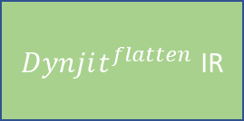
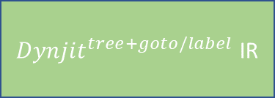
Dynjit’s Approach
Non-Nested Python Function Object
Runtime Call
Runtime Arguments
“Shapes” of Arguments
Cython
any backend interfacing with Python C APIs
C function
JIT Compiler
compile
Cached “Method”
Code generation
Get Python Bytecode,
Translate to
The function pointer address can be referenced in other functions
$Dynjit^{flatten}$ IR
Core CPY IR
User Assumptions 2. “Type” Specialization
Reloop: Remove goto/label
${Dynjit}^{tree+goto/label}$ IR
Partial Evaluation(Most Important)
3. Boolean Value Split 4. Union Type Split 5. Intrinsics

Slide 27
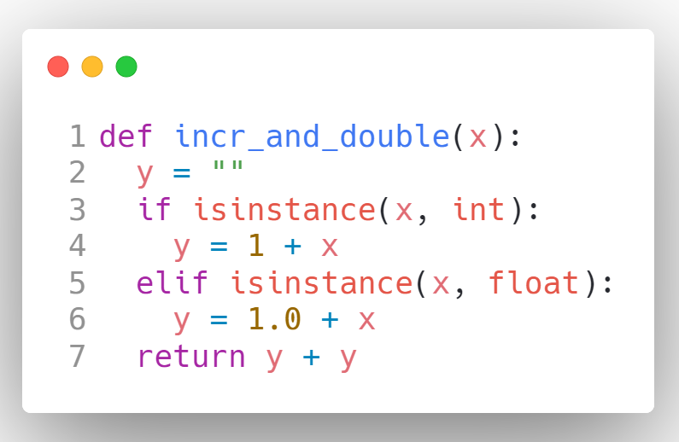
By Case: What can Dynjit do?
Performance Overheads by
Runtime type check
Dynamic dispatch for + operator
…
However, what if the argument x is known at runtime?

Slide 28
By Case: What can Dynjit do?
Performance Overheads by
Runtime type check
Dynamic dispatch for + operator
…
However, what if the argument x is known at runtime?

Slide 29
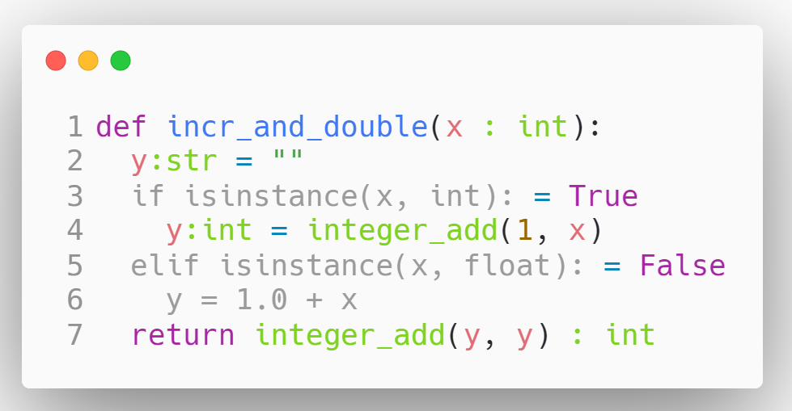
By Case: What can Dynjit do?
Partial Evaluation:
Type inference
Constant propagation
Source Code
Runtime Generated and Specialized
Type Specialization:
Static Dispatch
Reducing Runtime Check

Slide 30
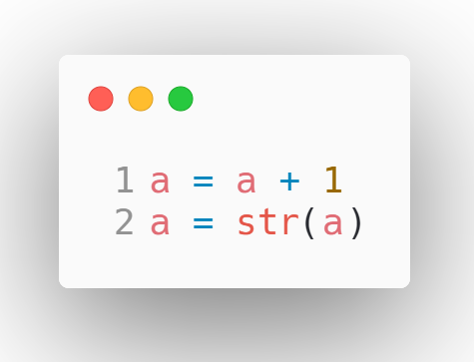
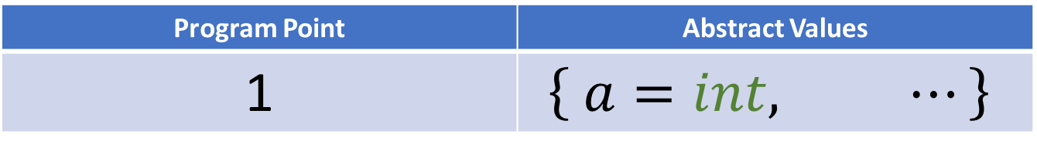
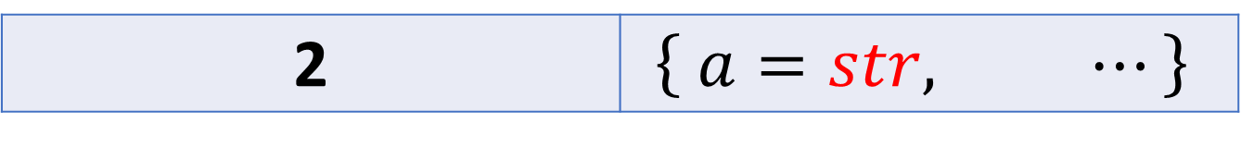
By Case: What can Dynjit do?
Partial Evaluation: Infer Types
Program Point | Abstract Values
1 | $$\left\{ a=int, ⋯\right\}$$
2 | $$\left\{ a=str, ⋯\right\}$$

Slide 31
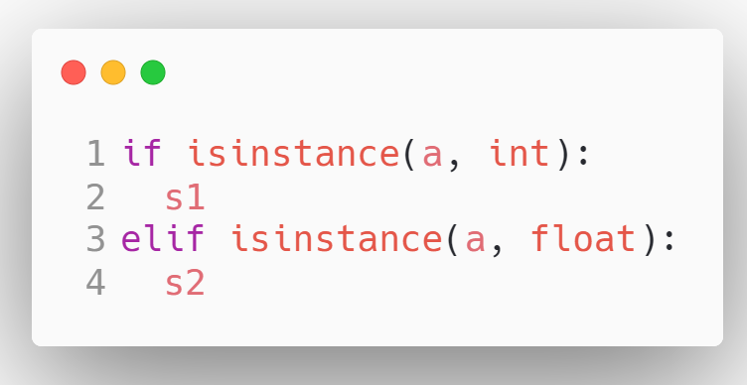
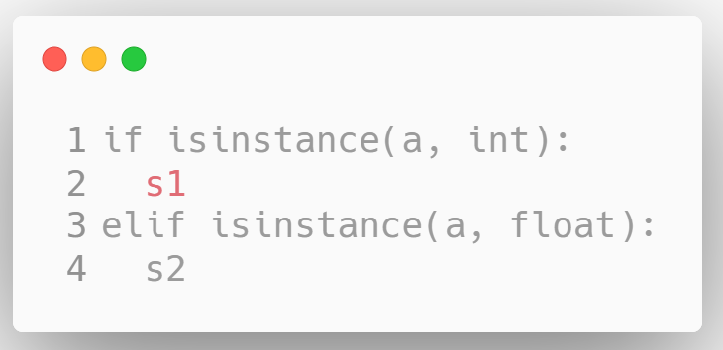

By Case: What can Dynjit do?
Partial Evaluation: Dead Code Elimination
Program Point | Abstract Values
1 | $$\left\{ a=int, ⋯\right\}$$

Slide 32
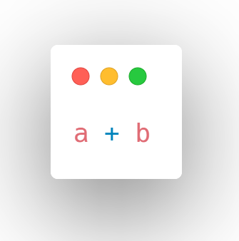
By Case: What can Dynjit do?
Type Specialization
Type a | Type b | Implementation +
str | str | string_concat(_, _)
int | float | f_add(i2f(_), _)
float | float | f_add(_, _)

Slide 33
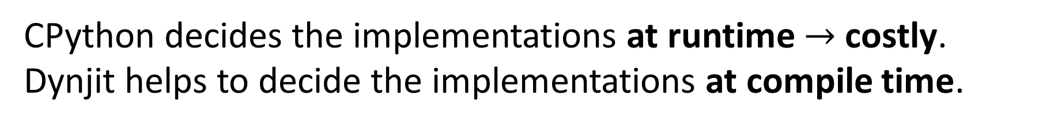
By Case: What can Dynjit do?
Type Specialization
Type a | Type b | Implementation +
str | str | string_concat(_, _)
int | float | f_add(i2f(_), _)
float | float | f_add(_, _)
CPython decides the implementations at runtime $→$ costly.
Dynjit helps to decide the implementations at compile time.

Slide 34
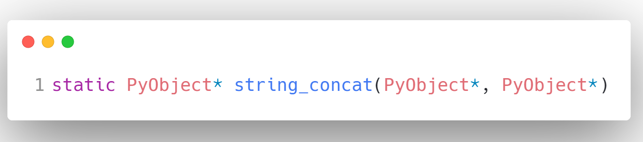
By Case: What can Dynjit do?
34
Type Specialization
Type a | Type b | Implementation +
str | str | string_concat(_, _)
Must be Python Strings
Avoid Runtime Checks

Slide 35

Dynjit
35
JIT compiler is extensible
Python Programs
Optimize
Rollback(no performance loss)
JIT Code
Ordinary Python Code
Dynjit
(more features)
Dynjit
(the early stage)
Existing codebase
Extensible
Lightweight

Slide 36
Index
Background
Existing Attempts
Dynjit
Current Progress
Future Outlook

Slide 37
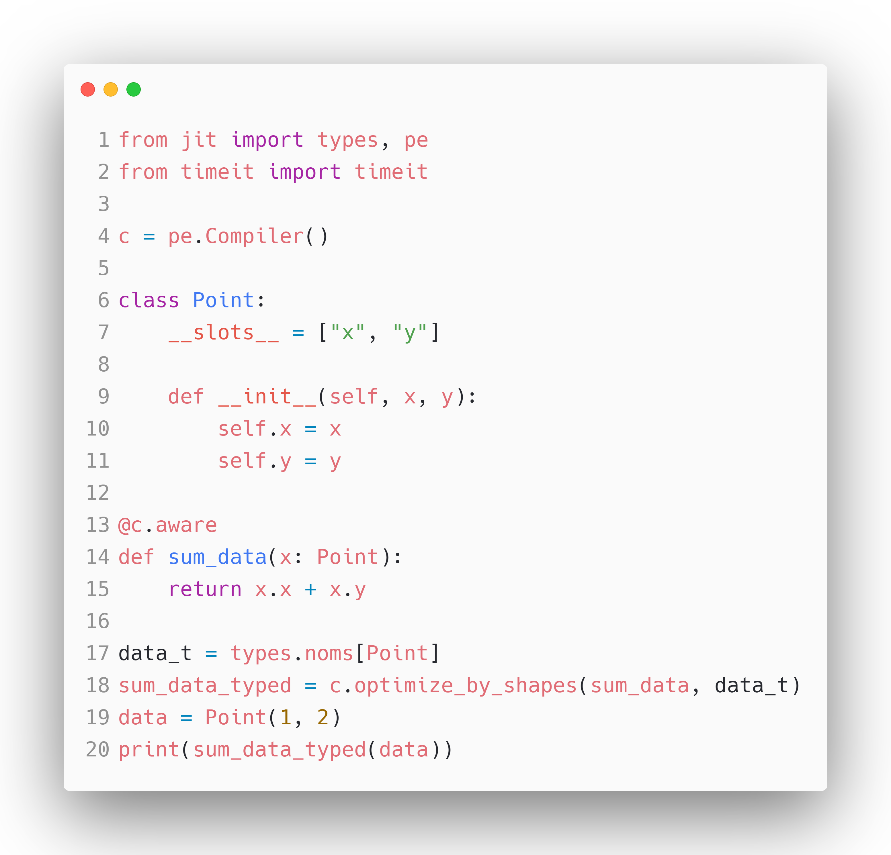
Current Progress
We have already achieved many goals.
Here are some benchmarks, codes of which are provided in the GitHub repository.
Project: https://github.com/thautwarm/dynjit

Slide 38
Current Progress
We have already achieved many goals.
Here are some benchmarks, codes of which are provided in the GitHub repository.
Benchmark Filename | Benchmark Tags | Speed up | Notes
attribute.py | Reading attributes | >= 1.5x | Only for Python classes with "__slots__"; Dynjit eliminates hash lookup
nested_functions.py | Closures | >=1.5x | Special APIs for closure constructions are required; The closure cells should be typed and immutable.
typecheck.py | Generic calls, loops | >= 2.5x | A function called inside the loop contains runtime type checks
float_add_and_loop.py | Loops, numeric | >=3.5x
Project: https://github.com/thautwarm/dynjit

Slide 39
Index
Background
Existing Attempts
Dynjit
Current Progress
Future Outlook

Slide 40
Future Outlook
Support for more Python features
Dynjit can now mix with full-featured CPython programs but unable to optimize all of them.
Addressing restrictions
such as slow recursive
functions and explosion
of generated code.
General
Paper works
Dynjit widely adopts ideas from many existing attempts and some other programming languages.
Stabilization
Evolution
Specific
Object unboxing
Dynjit is a general-purpose JIT compiler, Python object memory layouts are kept, and unboxing is missing. However if unboxing can be supported, Dynjit may match Numba in numeric computing scopes.

