Slide 1
Dynjit
A Just-In-Time Compiler for Python

Slide 2

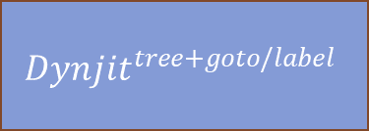
Approach
Non-Nested Python Function Object
Runtime Call
Runtime Arguments
“Shapes” of Arguments
Cython
any backend interfacing with Python C APIs
C function
JIT Compiler
compile
Cached “Method”
Code generation
Get Python Bytecode,
Translate to
The function pointer address can be referenced in other functions
$$Dynjit^{flatten}$$
Core CPY
User Assumptions 2. Type Specialization
Reloop: Remove goto/label
$${Dynjit}^{tree+goto/label}$$
Partial Evaluation
3. Boolean Value Split 4. Union Type Split 5. Intrinsics

Slide 3
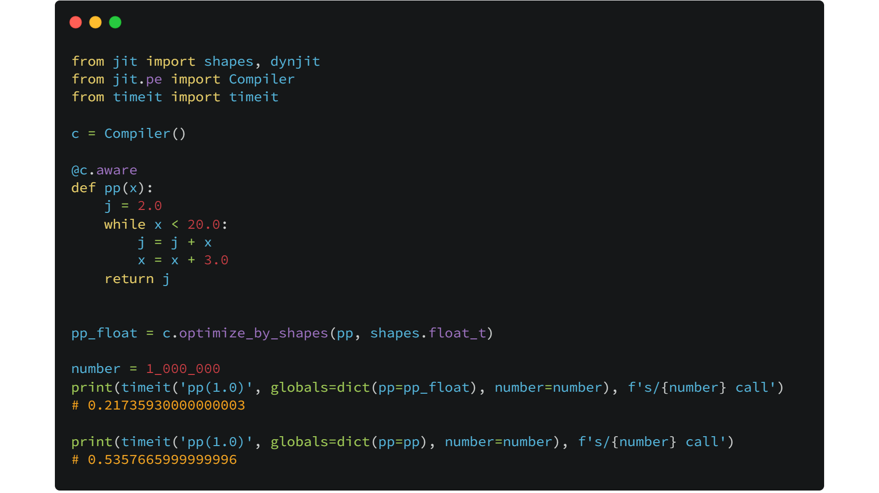
2.5x speed up without unboxing pyobjects
Original Python semantics are kept, big integers and exceptions

Slide 4
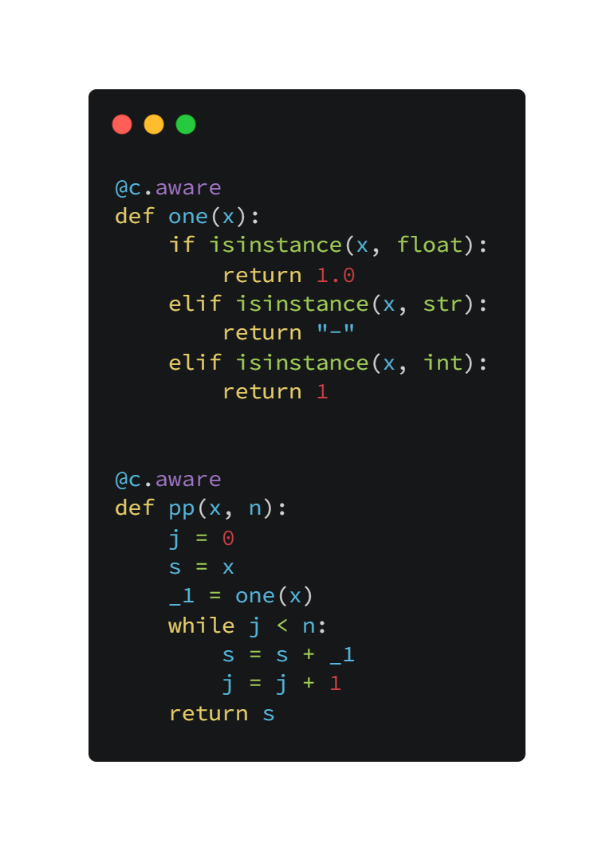
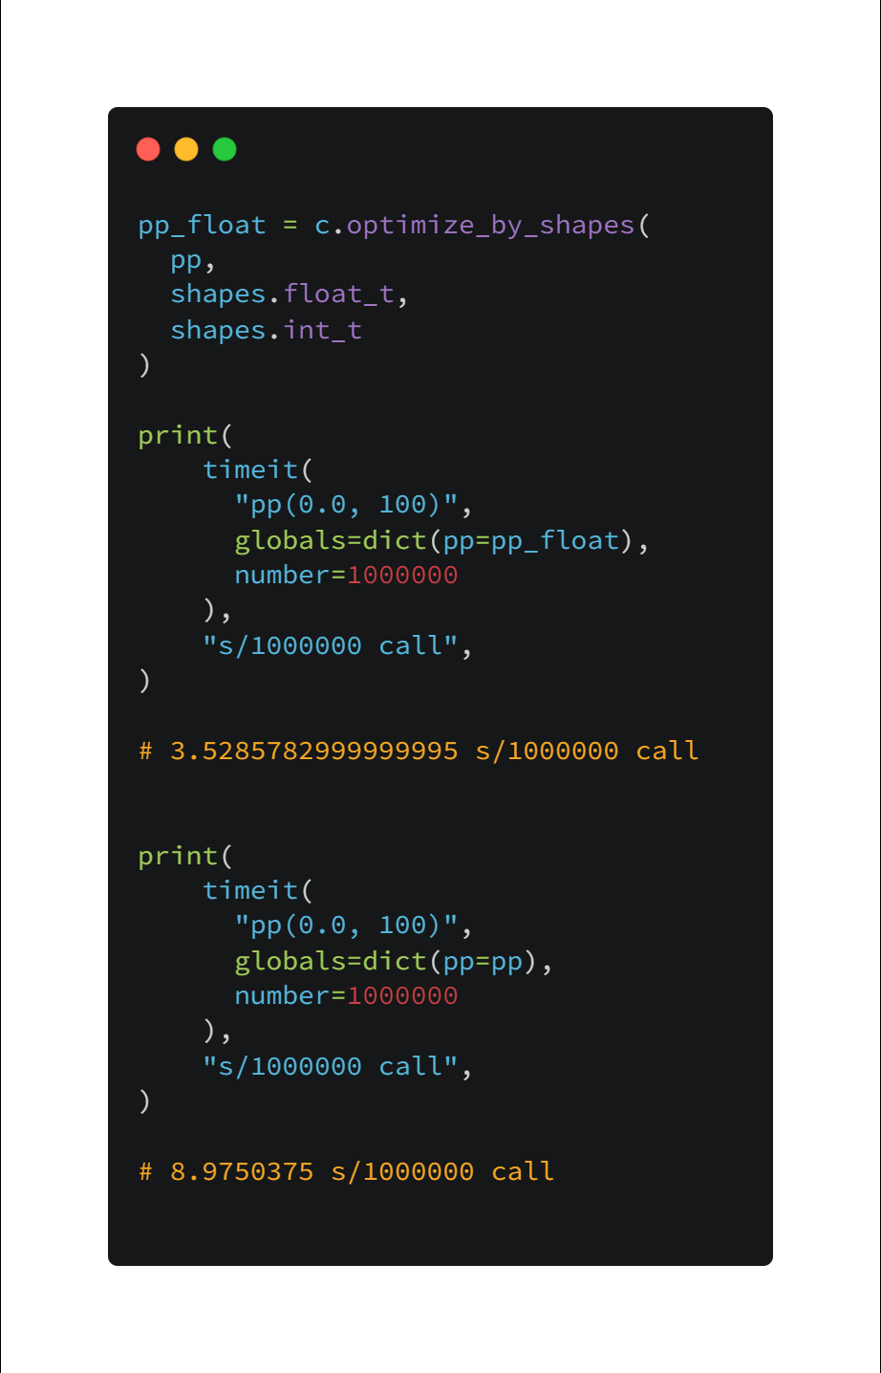

Slide 5
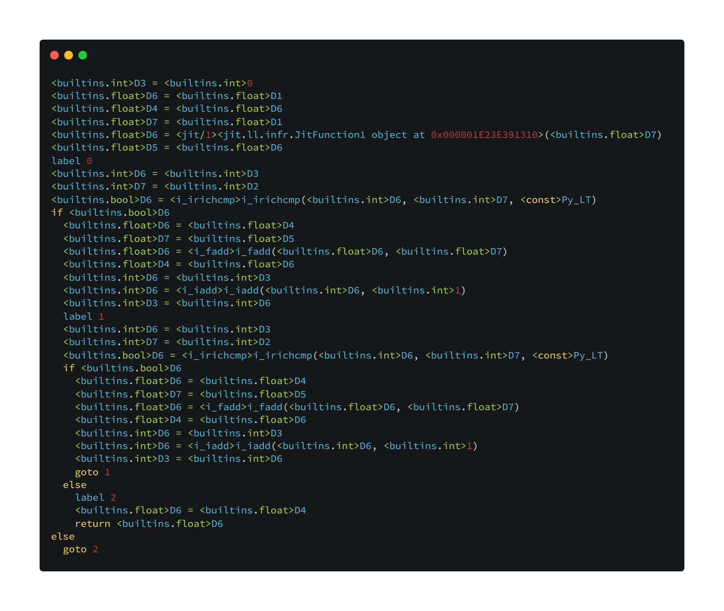
isinstance eliminated!
Type specialization contributes to eliminating redundant code and choosing the appropriate code!

Slide 6
How can?
Once we call pp with arguments x, n , we know the types of x and n:
Suppose
x :: int
n :: int
Inside pp, there is an inner function call one(x).
We can know the argument type of one is int, so that we can choose an appropriate specialization to
elim the stacked if-else inside def one(x), and
know the return type is int.

Slide 7
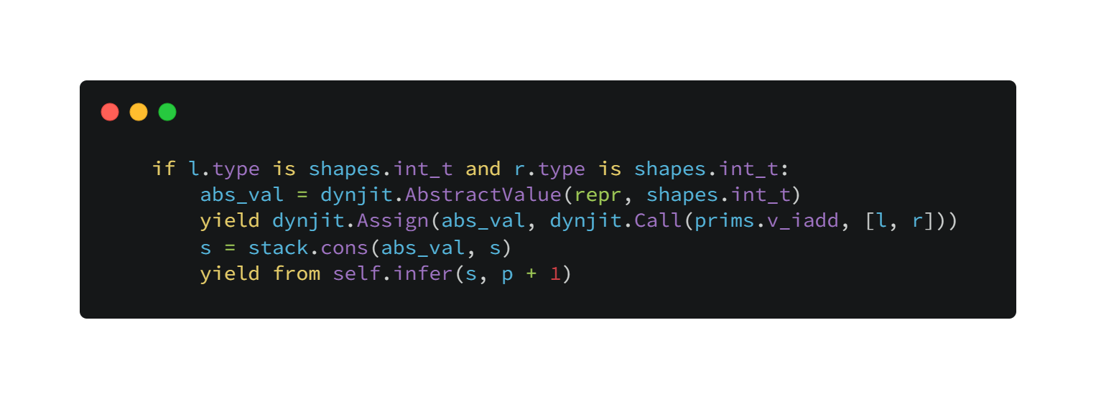
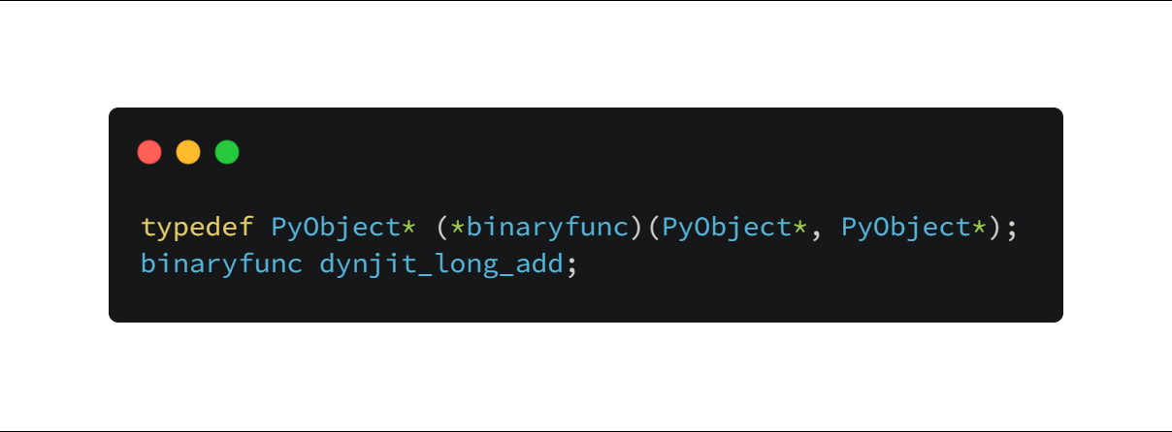
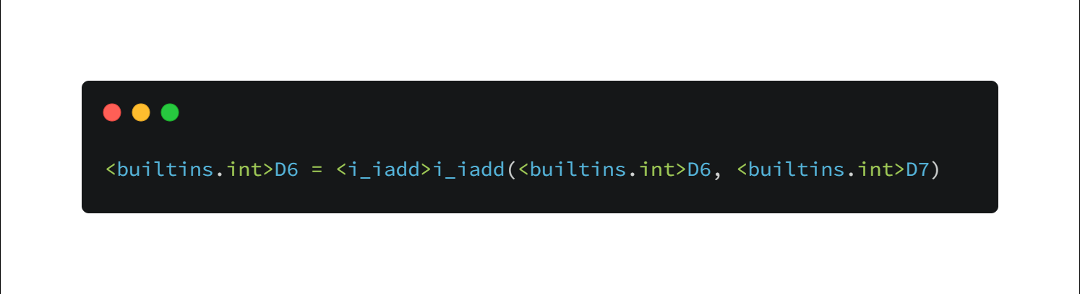
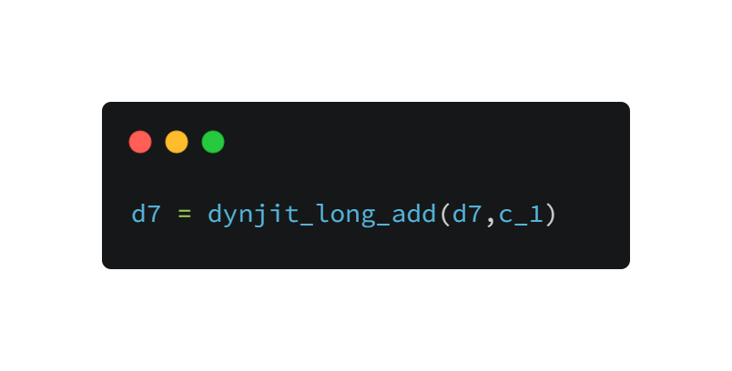
Choosing Specialized Methods
Write a type specialization case(at jit.call_prims)
Write corresponding C implementation
Specialize and generate dynjit IR
Use the specialization in C/Cython code

