Slide 1
Dynjit: A General-purpose Just-In-Time Compiler for Python Programming Language
システム情報工学研究科 情報理工学位プログラム
プログラム論理研究室 Zhao Wanghongxuan
指導教員：亀山幸義

Slide 2
Index
Background
Existing Attempts
Dynjit
Current Progress
Future Outlook

Slide 3
Index
Background
Existing Attempts
Dynjit
Current Progress
Future Outlook

Slide 4
Background
Python
is heavily used in industrial and educational world.

Slide 5
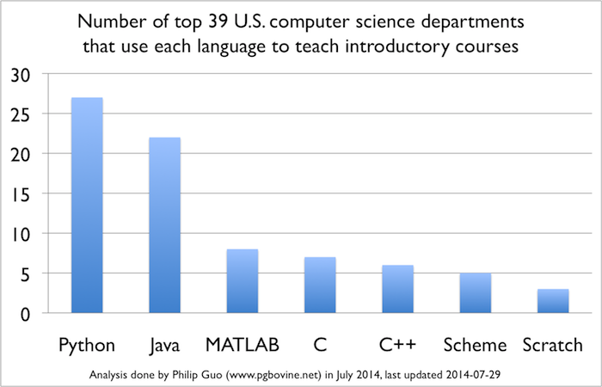
Python in Educational World
CACM Blog(2014): Python Is Now the Most Popular Introductory Teaching Language at Top ­U.S. ­Universities
There is an increasing popularity of using Python for teaching!
The Python official website also gives a record about the spread of Python among the schools around the world
(https://wiki.python.org/moin/SchoolsUsingPython)

Slide 6






Python in Industrial World
PopularitY of Programming Language Index(2020)
Rank | Change | Language | Share | Trend
1 |  | Python | 31.02 % | +2.2 %
2 |  | Java | 16.38 % | -2.8 %
TIOBE Index
Oct 2020 | Oct 2019 | Change | Programming Language | Ratings | Change
1 | 2 |  | C | 16.95% | +0.77%
2 | 1 |  | Java | 12.56% | -4.32%
3 | 3 |  | Python | 11.28% | +2.19%

Slide 7
However, Python is Slow

Slide 8
However, Python is Slow
Workarounds
Extensions by
C/C++/Others
Companies, Individual Developers
High Level Applications
Slow
Use Python For
Cause
Cause
"two-language Problem"

Slide 9

However, Python is Slow
Workarounds
Extensions by
C/C++/Others
Companies, Individual Developers
High Level Applications
Slow
Use Python For
Cause
Cause
Why?
"two-language Problem"
What’s this?

Slide 10
However, Python is Slow
Workarounds
Extensions by
C/C++/Others
Companies, Individual Developers
High Level Applications
Slow
Use Python For
Cause
Cause
Chaos
"two-language Problem"
There comes out the “two-language” problem!

Slide 11
"two-language" Considered Harmful

Slide 12



"two-language" Considered Harmful
Learn
Maintain
.c(pp) .h(pp)
.so
.py
Mastering Python C APIs
Mastering C/C++
Write C exts
Slow
“two-language” Problem
Using C exts
Write magic code for fitting exts, still not yet fast due to the limited features
User Application Requirements
Ext is Domain specific
similar case:
MATLAB
vectorization
notations

Slide 13
Make Python Faster

Slide 14
Make Python Faster
Python is dynamic
Python
Objects

Slide 15
Make Python Faster
Python is dynamic
Python
Objects
“Speed me up?”
Behaviors are decided at runtime

Slide 16
Make Python Faster
Python is dynamic
Python
Objects
“Speed me up?”
Behaviors are decided at runtime
Program behaviors decided by
I/O
Complex Runtime Computations
“Properties/Shapes/Types” known at runtime

Slide 17
Make Python Faster
Python is dynamic
Python
Objects
“Speed me up?”
Behaviors are decided at runtime
“Could you optimize me?”
Static Optimizer/Compiler
Program behaviors decided by
I/O
Complex Runtime Computations
“Properties/Shapes/Types” known at runtime

Slide 18
Make Python Faster
Python is dynamic
Python
Objects
“I’m sorry”
“Speed me up?”
Behaviors are decided at runtime
“Could you optimize me?”
Static Optimizer/Compiler
Program behaviors decided by
I/O
Complex Runtime Computations
“Properties/Shapes/Types” known at runtime

Slide 19
Make Python Faster
Python is dynamic
Runtime Compilation
There’s a limit to static compilation!
Static Optimizer/Compiler
I REJECT MY "STATIC"!

Slide 20
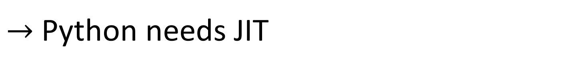
Make Python Faster
Python is dynamic
Runtime Compilation
There’s a limit to static compilation!
Static Optimizer/Compiler
I REJECT MY "STATIC"!
Referred as Just-In-Time(JIT) compilation
$→$Python needs JIT

Slide 21
The Whole World is Calling for Python JIT
Status
Python is heavily used in industrial and educational world
Python is slow and dynamic
JIT addressing dynamics

Slide 22
Index
Background
Existing Attempts
Dynjit
Current Progress
Future Outlook

Slide 23



Existing Attempts
Pyjion
Pyston
JAX
PyPy(most successful so far)
Numba
HOPE
JitPy
…

Slide 24
Existing Attempts
Pyjion
Pyston
JAX
PyPy
Numba
HOPE
JitPy
…
3 commits in last 2 years.
Suspended, or even died..

Slide 25
Existing Attempts
Pyjion
Pyston
JAX
PyPy
Numba
HOPE
JitPy
…
Unmaintained, unfunded.
It stopped immediately at 3 years ago when Dropbox stopped sponsoring.

Slide 26
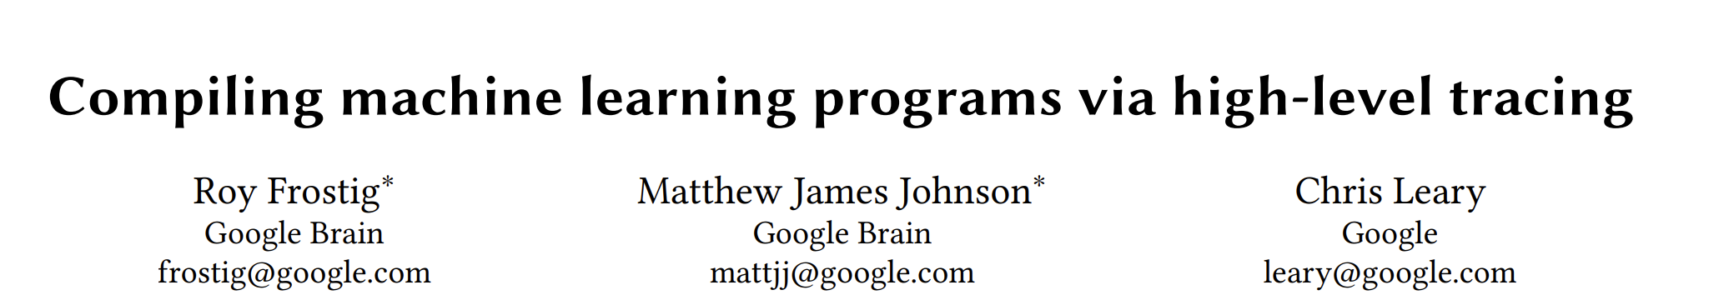
Existing Attempts
Pyjion
Pyston
JAX
PyPy
Numba
HOPE
JitPy
…
Not a general-purpose JIT.
It’s for AD(自動微分), and optimizations for machine learning.
Domain-specific, incomplete for general use.
https://mlsys.org/Conferences/2019/doc/2018/146.pdf

Slide 27
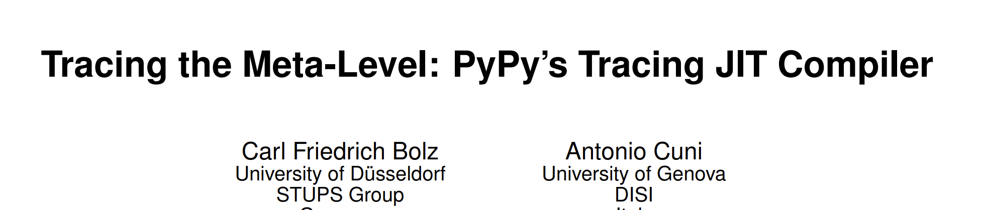
Existing Attempts
A new language.
Different runtime, incompatible object memory layouts, issues for adaptions to CPython C extensions.
Pyjion
Pyston
JAX
PyPy
Numba
HOPE
JitPy
…
https://dl.acm.org/doi/pdf/10.1145/1565824.1565827

Slide 28
Existing Attempts
For numerical computing.
Some Issues when mixing up Numba code with other pure python code.
(e.g., use dict in Numba code)
Pyjion
Pyston
JAX
PyPy
Numba
HOPE
JitPy
…
https://dl.acm.org/doi/pdf/10.1145/2833157.2833162

Slide 29
Existing Attempts
Pyjion
Pyston
JAX
PyPy
Numba
HOPE
JitPy
…
For astrophysical computing.
Much more limited than Numba.
https://doi.org/10.1016/j.ascom.2014.12.001

Slide 30
Existing Attempts
Pyjion
Pyston
JAX
PyPy
Numba
HOPE
JitPy
…
Emded PyPy into CPython.
Support built-in data types only.

Slide 31
Lessons Learnt from Existing Attempts

Slide 32

Lessons Learnt from Existing Attempts
Pyjion & Pyston:
1. Approaches that don't require patching CPython(C codebase) are probably preferable

Slide 33



Lessons Learnt from Existing Attempts
Pyjion & Pyston:
1. Approaches that don't require patching CPython(C codebase) are probably preferable
"Hi, community! I can do numeric computing! "
Numba & HOPE
2. A general-purpose JIT is expected
Real world
"it’s nothing to me.."
"wait, cannot use dicts in JIT? "
"Oh, nice! "

Slide 34
Lessons Learnt from Existing Attempts
Pyjion & Pyston:
1. Approaches that don't require patching CPython(C codebase) are probably preferable
"Hi, community! I can do numeric computing! "
Numba & HOPE
2. A general-purpose JIT is expected
Real world
"it’s nothing to me.."
"wait, cannot use dicts in JIT? "
"Oh, nice! "
"I do things right."
PyPy
3. A CPython-compatible JIT is expected
Real world
"You are incompatible to CPython, existing C extensions are slow or incomplete. "
"We have lots of in-production C extensions. "

Slide 35
Lessons Learnt from Existing Attempts
Pyjion & Pyston:
1. Approaches that don't require patching CPython(C codebase) are probably preferable
"Hi, community! I can do numeric computing! "
Numba & HOPE
2. A general-purpose JIT is expected
Real world
"it’s nothing to me.."
"wait, cannot use dicts in JIT? "
"Oh, nice! "
"I do things right."
PyPy
3. A CPython-compatible JIT is expected
Real world
"You are not compatible to CPython, existing C extensions are slow or incomplete. "
"We have lots of in-production C extensions. "
In nearly 30 years, many Python JIT projects failed for they started with a large implementation.
4. We should make a JIT implementation which is lightweight but extensible.

Slide 36
Lessons Learnt from Existing Attempts
Approaches that don't require patching CPython(C codebase) are probably preferable
A general-purpose JIT is expected
A CPython-compatible JIT is expected
We should make a JIT implementation lightweight but extensible
We hereby present Dynjit

Slide 37
Index
Background
Existing Attempts
Dynjit
Current Progress
Future Outlook

Slide 38
Dynjit
Why is Python so slow?
Dynjit Approach
By Case: What can Dynjit do?

Slide 39
Why is Python so slow?
Arguments
Generic Code
Dynamic Attribute Accessing
Dynamic Global Scoping
Interpretative Overhead
Functions
Whatever types
use the same
Generic Code
Numerous
Runtime Checks
Heavy
Method
Dispatch
choosing the correct methods
for corresponding data types

Slide 40
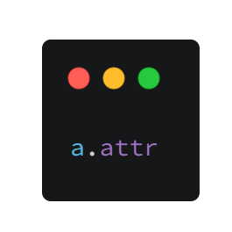
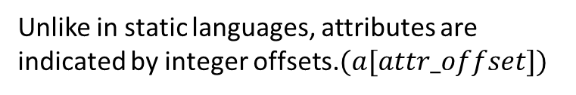
Why is Python so slow?
Generic Code
Dynamic Attribute Accessing
Dynamic Global Scoping
Interpretative Overhead
Always do hash lookups; use a string "attr"
Unlike in static languages, attributes are indicated by integer offsets.$(a[attr_offset])$

Slide 41
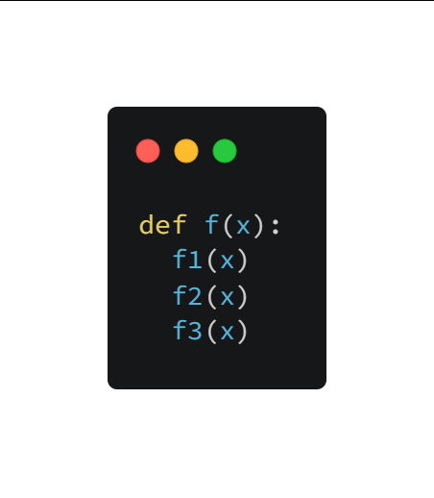
Why is Python so slow?
Generic Code
Dynamic Attribute Accessing
Dynamic Global Scoping
Interpretative Overhead
You can never know what f1, f2, f3 are, if they’re not local.
Global variables can be modified at any time.

Slide 42
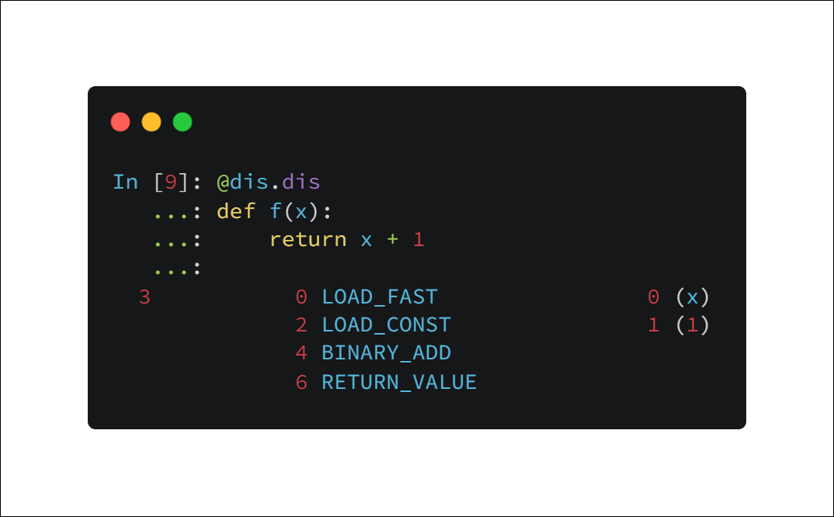
Why is Python so slow?
Generic Code
Dynamic Attribute Accessing
Dynamic Global Scoping
Interpretative Overhead
Python is interpreted, via a stack virtual machine(Python VM).
Push, Pop, …
Slow

Slide 43


Why is Python so slow?
Why is Python so slow?
Dynjit
Generic Code
Dynamic Attribute Accessing
Dynamic Global Scoping
Interpretative Overhead
Specializations
"Shape" Inference, Specializations
"__fix__"
Low level code(C/C++) generation

Slide 44
Why is Python so slow?
Why is Python so slow?
Dynjit
We’re to introduce this in the slides
Generic Code
Dynamic Attribute Accessing
Dynamic Global Scoping
Interpretative Overhead
Specializations
"Shape" Inference, Specializations
"__fix__"
Low level code(C/C++) generation

Slide 45
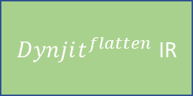
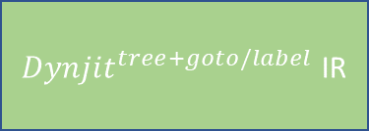
Dynjit’s Approach
Non-Nested Python Function Object
Runtime Call
Runtime Arguments
“Shapes” of Arguments
Cython
any backend interfacing with Python C APIs
C function
JIT Compiler
compile
Cached “Method”
Code generation
Get Python Bytecode,
Translate to
The function pointer address can be referenced in other functions
$Dynjit^{flatten}$ IR
Core CPY IR
User Assumptions 2. “Type” Specialization
Reloop: Remove goto/label
${Dynjit}^{tree+goto/label}$ IR
Partial Evaluation(Most Important)
3. Boolean Value Split 4. Union Type Split 5. Intrinsics

Slide 46
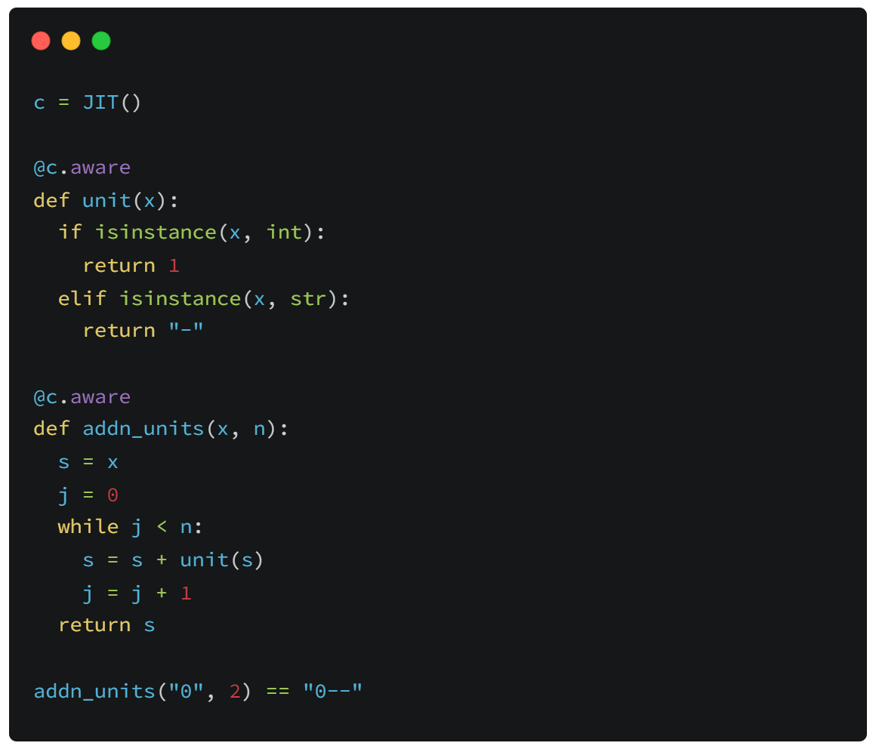
By Case: What can Dynjit do?
Python uses
isinstance(obj, type)
to do runtime type checks.

Slide 47
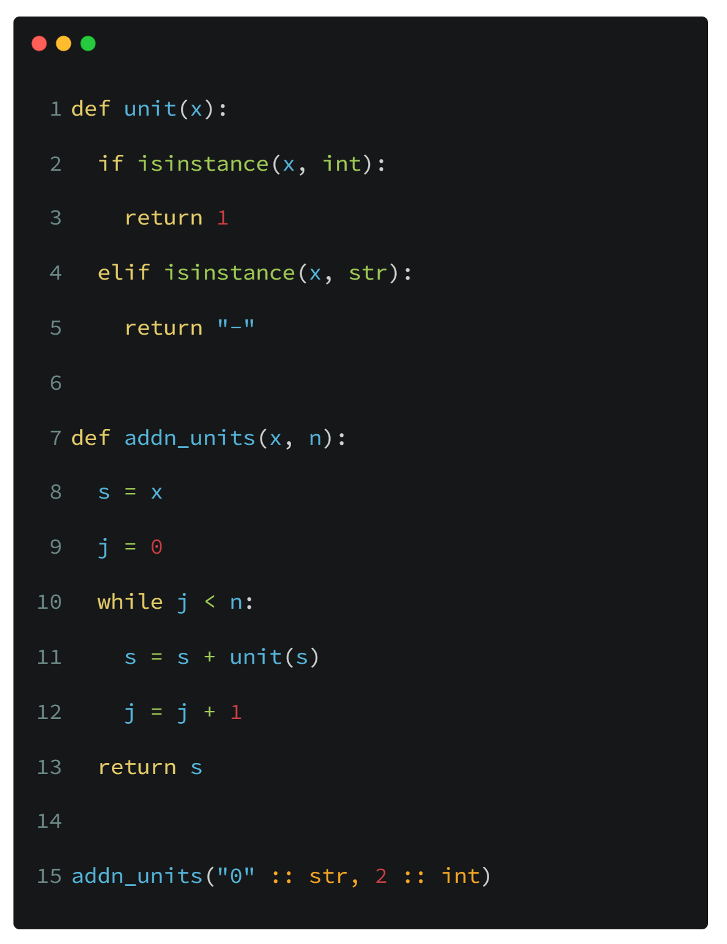
By Case: What can Dynjit do?
Partial Evaluation
Recorded Program States(for addn_units)

Slide 48
By Case: What can Dynjit do?
Partial Evaluation
Recorded Program States(for addn_units)

Slide 49
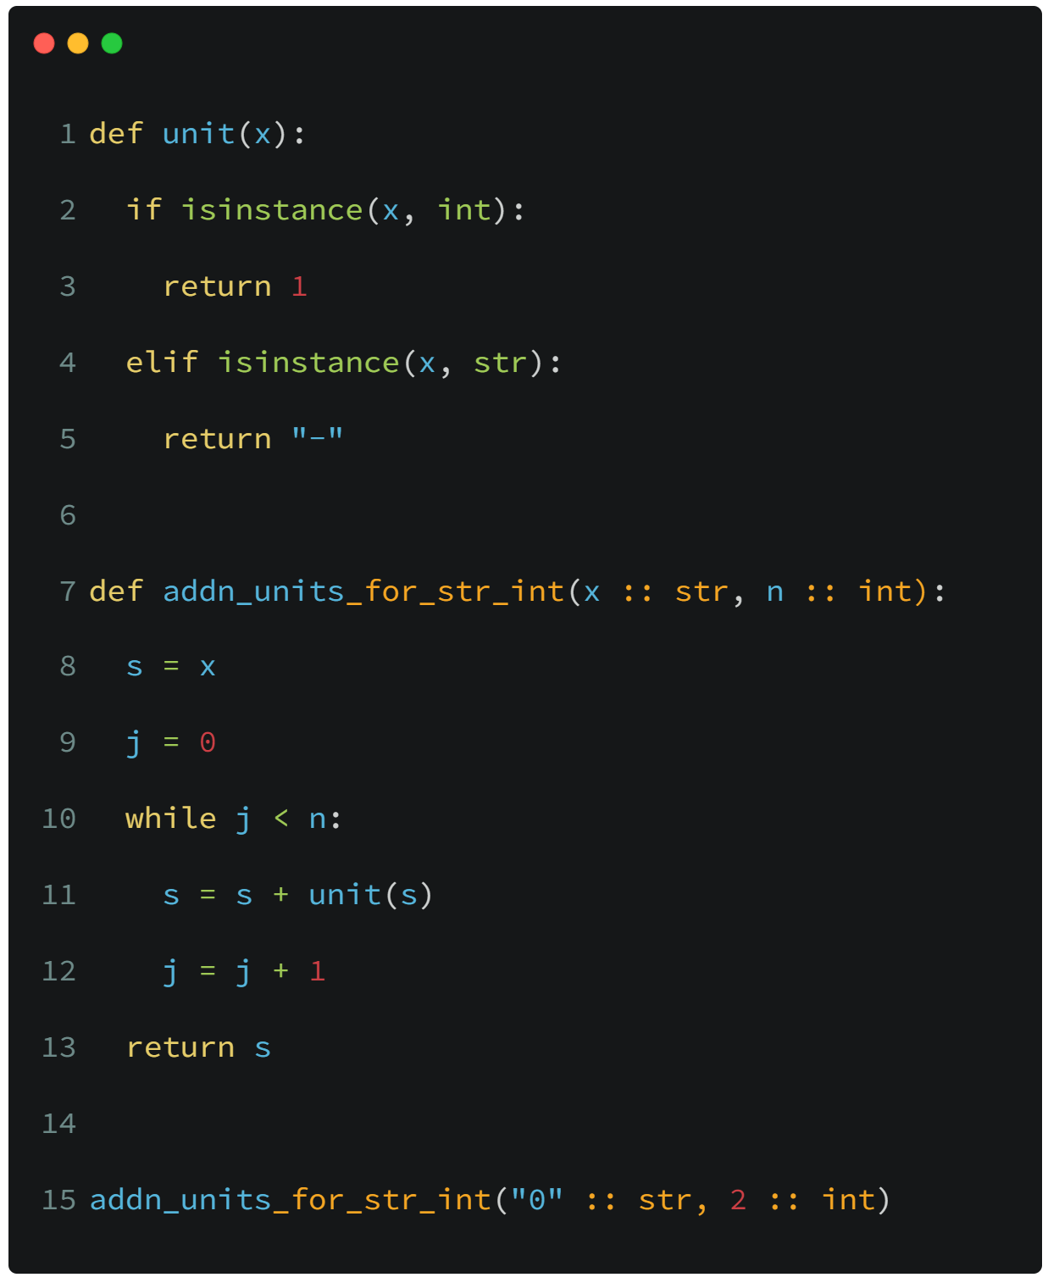

By Case: What can Dynjit do?
Partial Evaluation
Recorded Program States(for addn_units)
Line 7, $\{x=str, n=int\}$

Slide 50
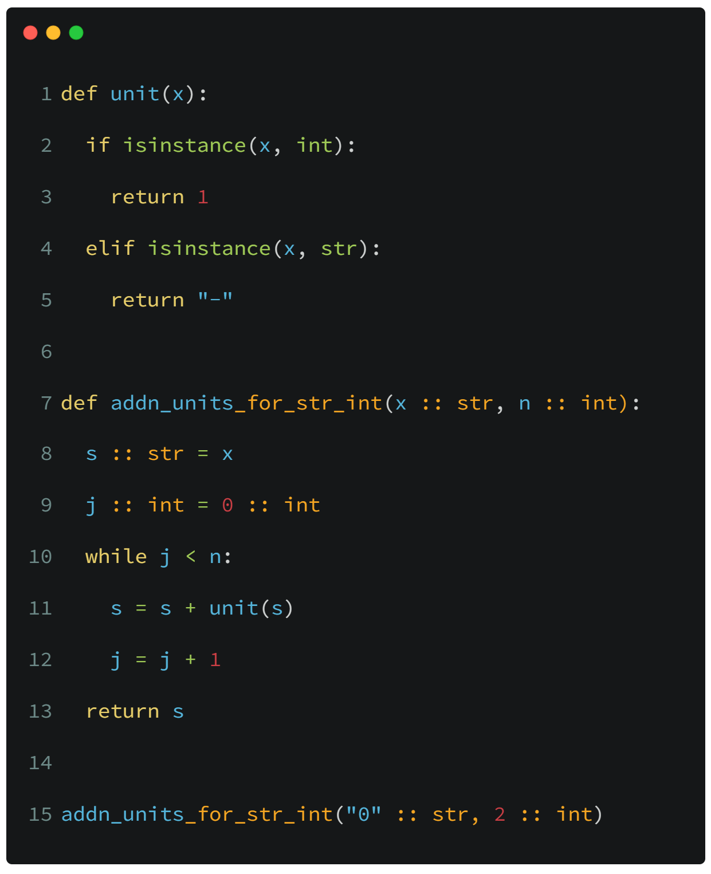

By Case: What can Dynjit do?
Partial Evaluation
Recorded Program States(for addn_units)
Line 7, $\{x=str, n=int\}$
Line 9, $\{x=str, n=int, j=int, s=str\}$

Slide 51
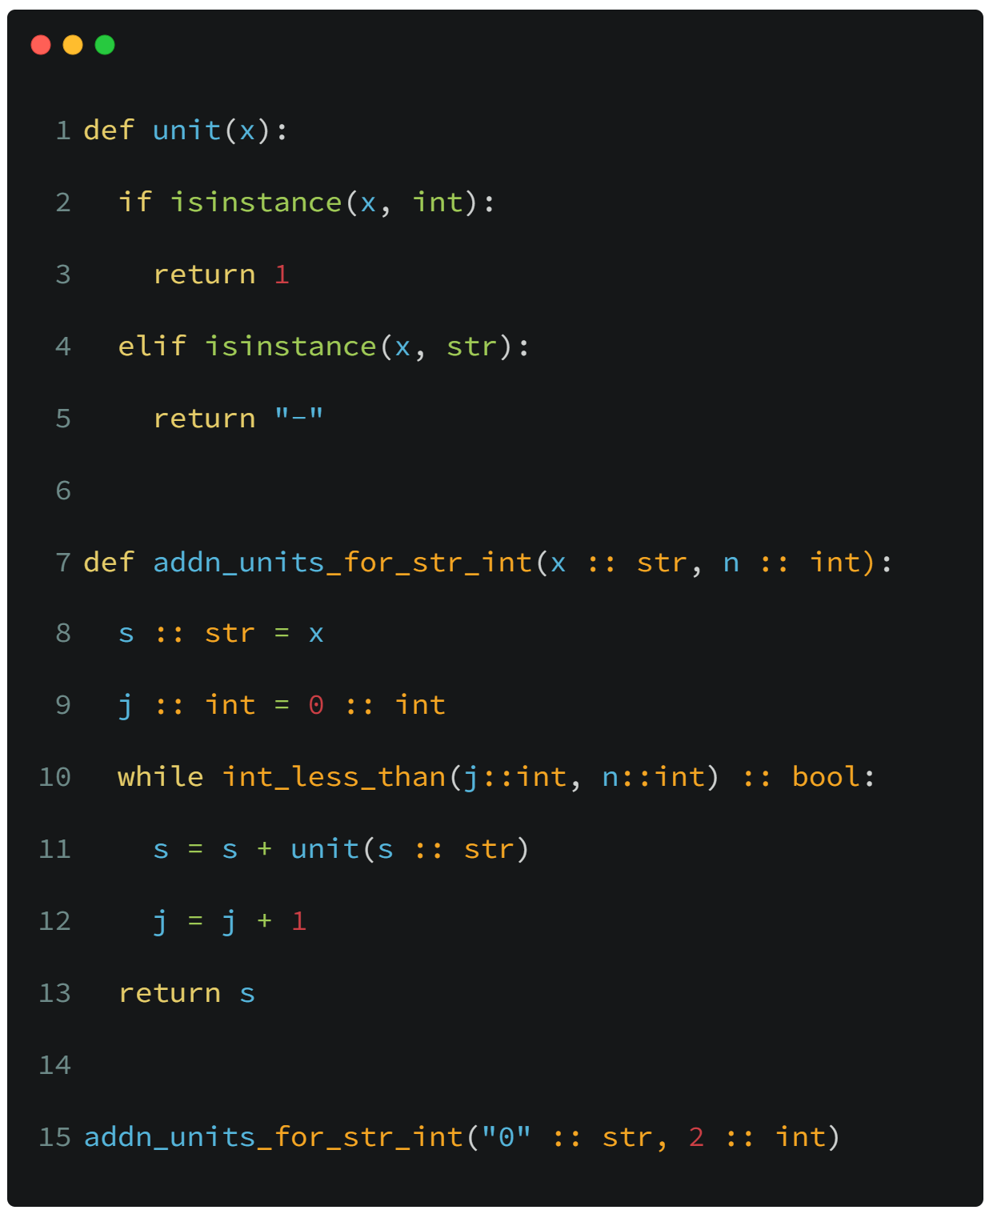

By Case: What can Dynjit do?
Partial Evaluation
Recorded Program States(for addn_units)
Line 7, $\{x=str, n=int\}$
Line 9, $\{x=str, n=int, j=int, s=str\}$
Line 10, $\{x=str, n=int, j=int, s=str\}$

Slide 52
By Case: What can Dynjit do?
Partial Evaluation
Recorded Program States(for addn_units)
Line 7, $\{x=str, n=int\}$
Line 9, $\{x=str, n=int, j=int, s=str\}$
Line 10, $\{x=str, n=int, j=int, s=str\}$

Slide 53
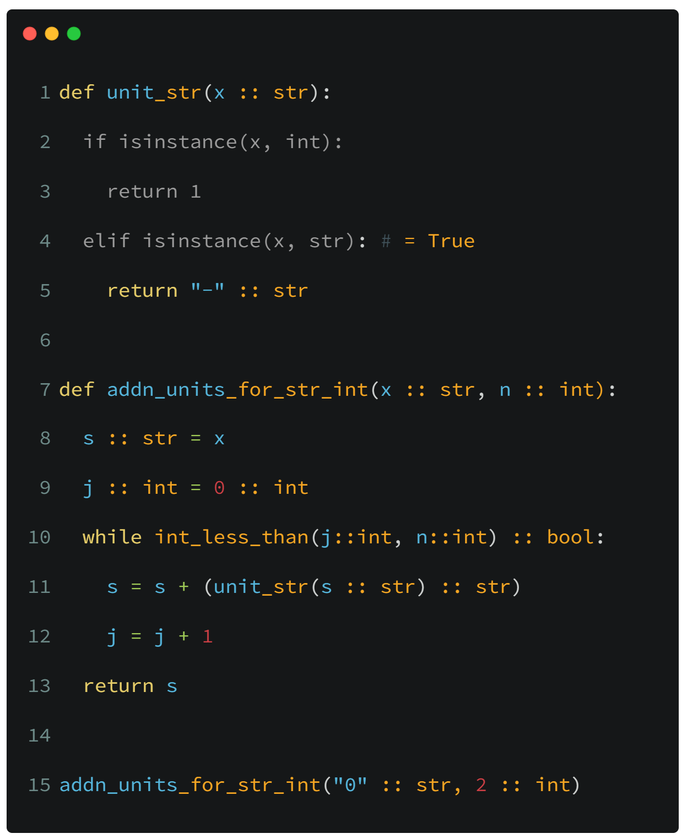
By Case: What can Dynjit do?
Partial Evaluation
Recorded Program States(for addn_units)
Line 7, $\{x=str, n=int\}$
Line 9, $\{x=str, n=int, j=int, s=str\}$
Line 10, $\{x=str, n=int, j=int, s=str\}$

Slide 54
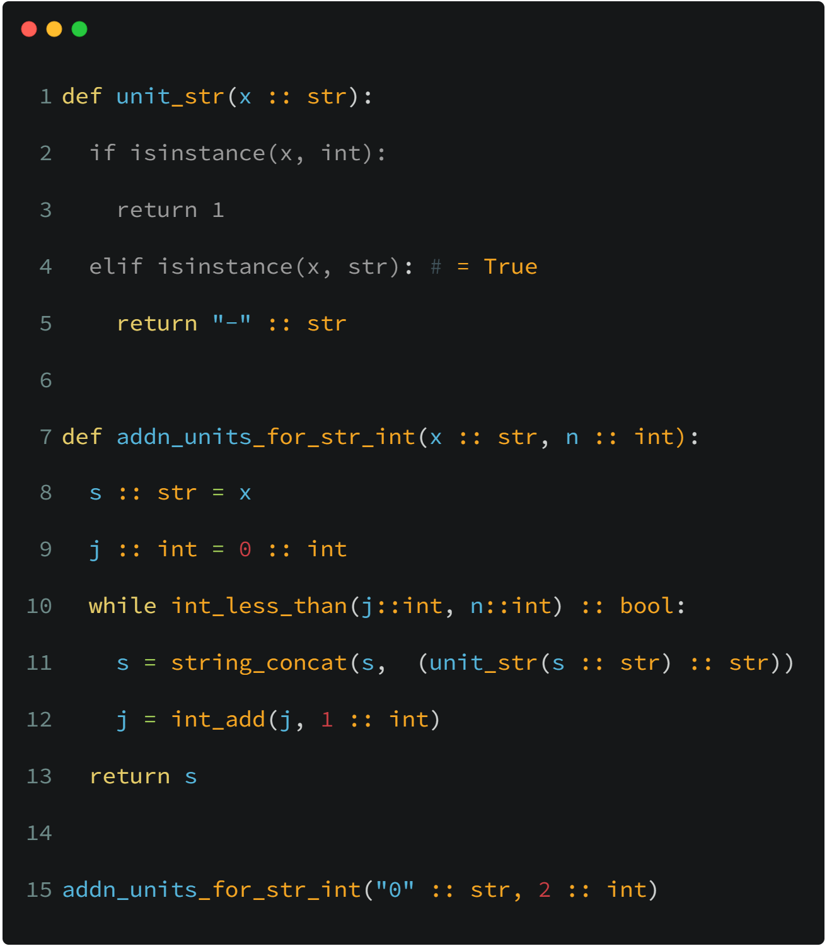

By Case: What can Dynjit do?
Partial Evaluation
Recorded Program States(for addn_units)
Line 7, $\{x=str, n=int\}$
Line 9, $\{x=str, n=int, j=int, s=str\}$
Line 10, $\{x=str, n=int, j=int, s=str\}$
Line 12, $\{x=str, n=int, j=int, s=str\}$

Slide 55

By Case: What can Dynjit do?
Partial Evaluation
Recorded Program States(for addn_units)
Line 7, $\{x=str, n=int\}$
Line 9, $\{x=str, n=int, j=int, s=str\}$
Line 10, $\{x=str, n=int, j=int, s=str\}$
Line 12, $\{x=str, n=int, j=int, s=str\}$
Line 9, $\{x=str, n=int, j=int, s=str\}$
Existed
We exit the loop, as its states were all partial evaluated.
Loop

Slide 56
By Case: What can Dynjit do?
Partial Evaluation
Recorded Program States(for addn_units)
Line 7, $\{x=str, n=int\}$
Line 9, $\{x=str, n=int, j=int, s=str\}$
Line 10, $\{x=str, n=int, j=int, s=str\}$
Line 12, $\{x=str, n=int, j=int, s=str\}$

Slide 57
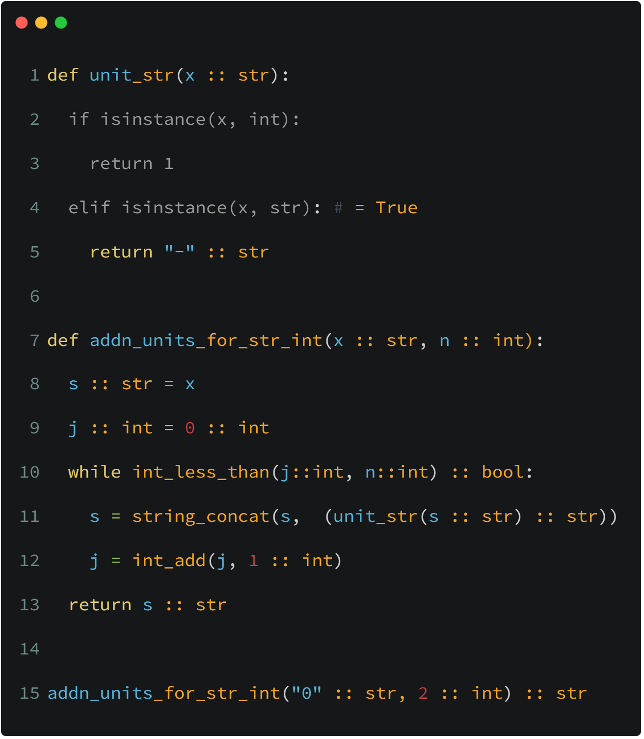
By Case: What can Dynjit do?
Partial Evaluation
Output ${Dynjit}^{tree+goto/label}$ IR
Other Passes;
Generate C/C++/Cython; Compilation
Load the pointer
Type Specialization

Slide 58
Index
Background
Existing Attempts
Dynjit
Current Progress
Future Outlook

Slide 59
Current Progress
We have already achieved many goals.
Here are some benchmarks, codes of which are provided in the GitHub repository.
Benchmark Filename | Benchmark Tags | Speed up | Notes
attribute.py | Reading attributes | >= 1.5x | Only for Python classes with "__slots__"; Dynjit eliminates hash lookup
nested_functions.py | Closures | >=1.5x | Special APIs for closure constructions are required; The closure cells should be typed and immutable.
typecheck.py | Generic calls, loops | >= 2.5x | A function called inside the loop contains runtime type checks
float_add_and_loop.py | Loops, numeric | >=3.5x
Project address: https://github.com/thautwarm/dynjit

Slide 60
Index
Background
Existing Attempts
Dynjit
Current Progress
Future Outlook

Slide 61
Future Outlook
Support for more Python features
Dynjit can now mix with full-featured CPython programs but unable to optimize all of them.
General
Paper works
Dynjit widely adopts ideas from many existing attempts and some other programming languages.
Addressing restrictions
such as slow recursive
functions and explosion
of generated code.
Stabilization
Evolution
Specific
Investigating the possibility to object unboxing
Dynjit is a general-purpose JIT compiler, Python object memory layouts are kept, and unboxing is missing. However if unboxing can be supported, Dynjit may match Numba in numeric computing scopes.

