Slide 1
Dynjit
A Just-In-Time Compiler for Python

Slide 2

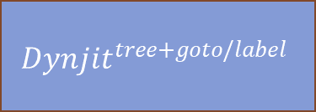
Approach
Non-Nested Python Function Object
Runtime Call
Runtime Arguments
“Shapes” of Arguments
Cython
any backend interfacing with Python C APIs
C function
JIT Compiler
compile
Cached “Method”
Code generation
Get Python Bytecode,
Translate to
The function pointer address can be referenced in other functions
$$Dynjit^{flatten}$$
Core CPY
User Assumptions 2. Type Specialization
Reloop: Remove goto/label
$${Dynjit}^{tree+goto/label}$$
Partial Evaluation
3. Boolean Value Split 4. Union Type Split 5. Intrinsics

Slide 3
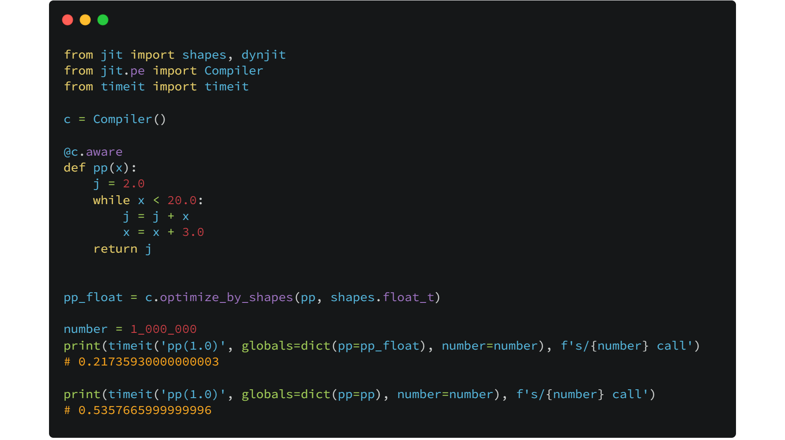
2.5x speed up without unboxing pyobjects
Original Python semantics are kept, big integers and exceptions

Slide 4
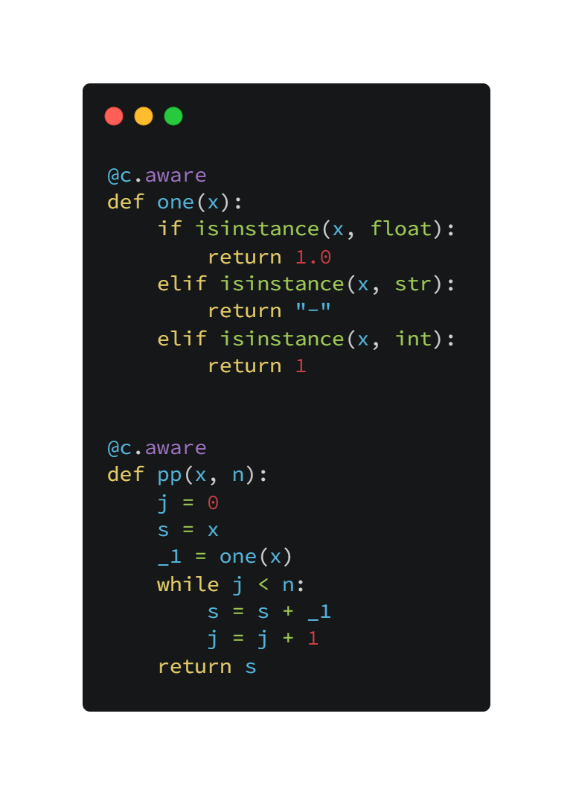
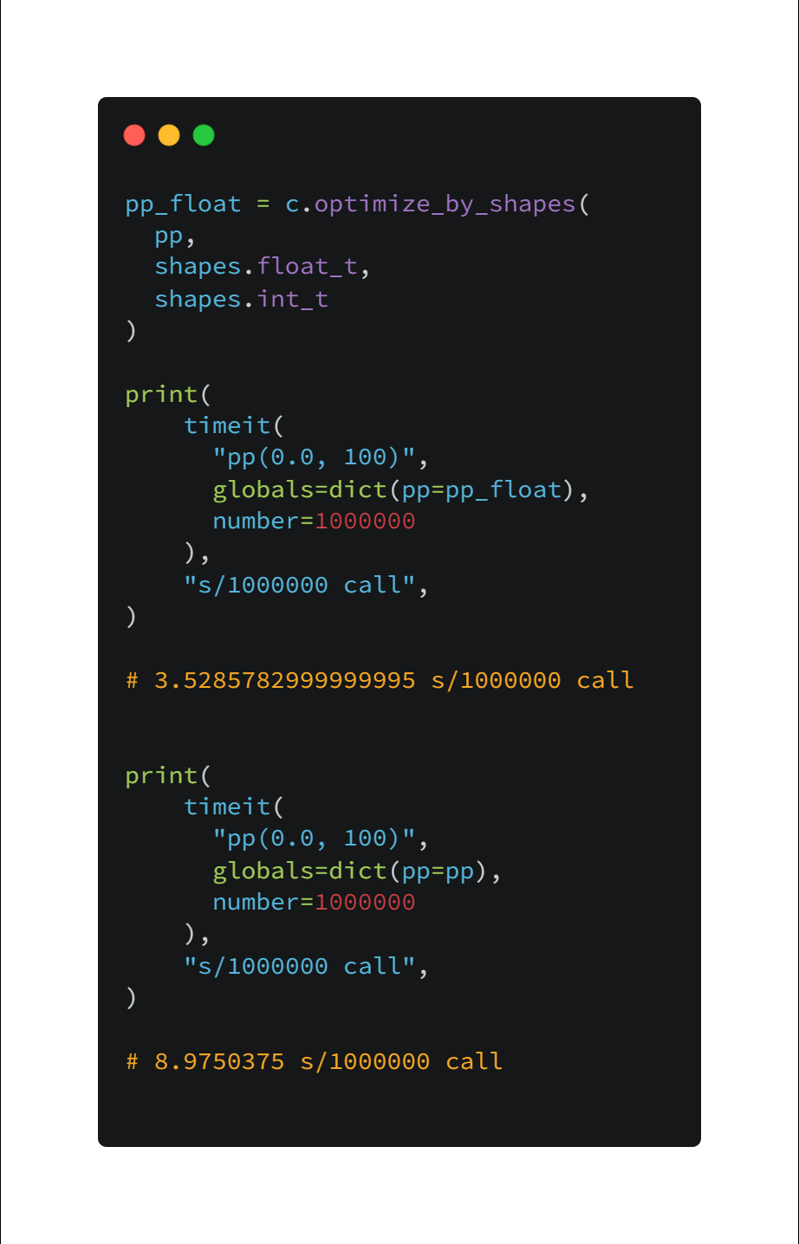

Slide 5
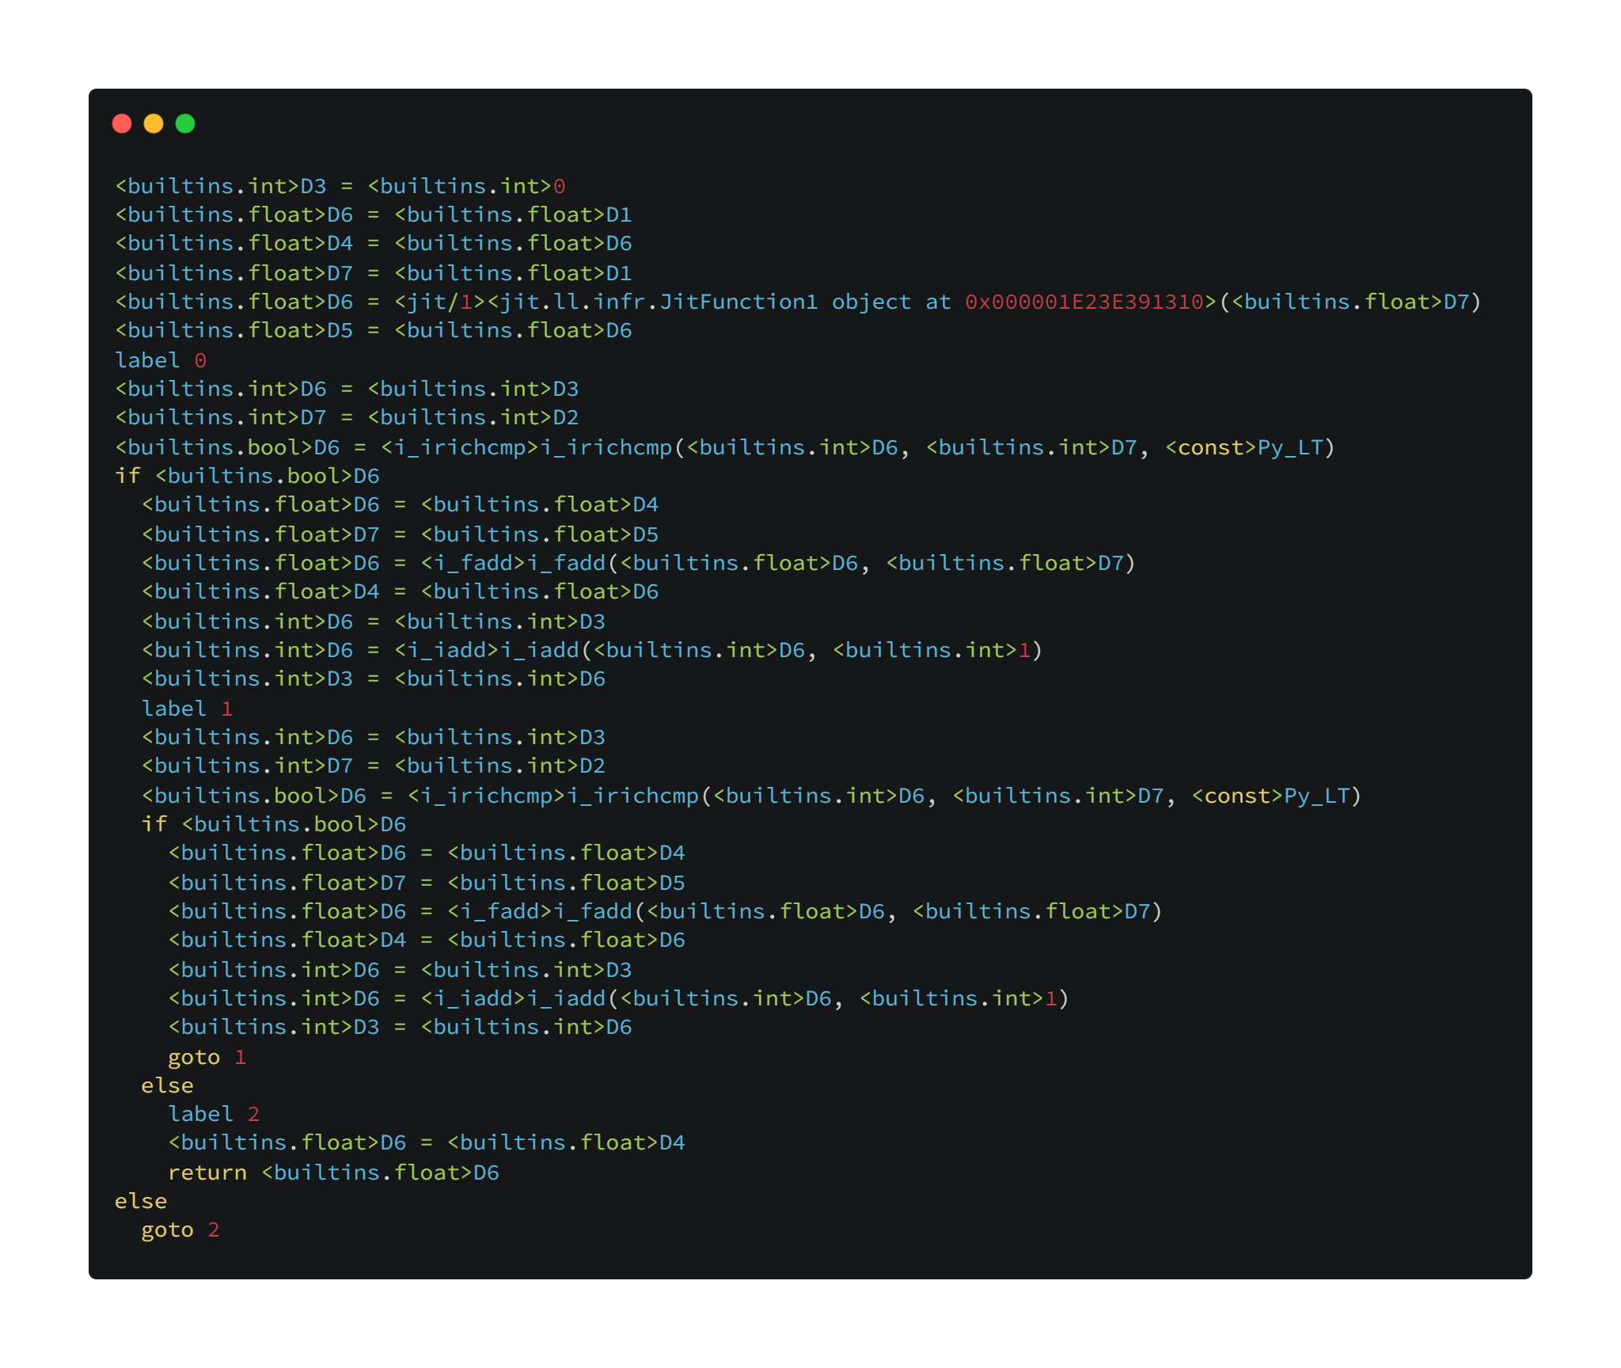
isinstance eliminated!
Type specialization contributes to eliminating redundant code and choosing the appropriate code!

Slide 6
How can?
Once we call pp with arguments x, n , we know the types of x and n:
Suppose
x :: int
n :: int
Inside pp, there is a inner function call one(x).
We can know the argument type of one is int, so that we can choose an appropriate specialization to
elim the stacked if-else inside def one(x), and
know the return type is int.

Slide 7
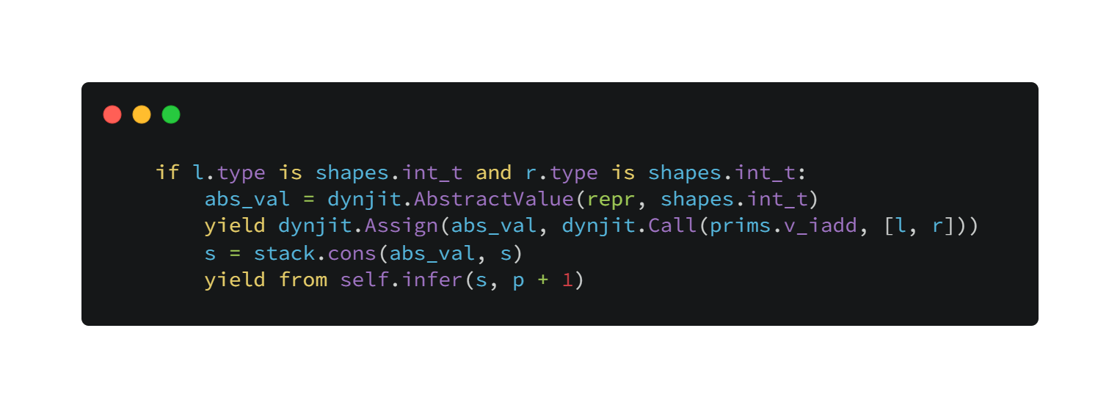
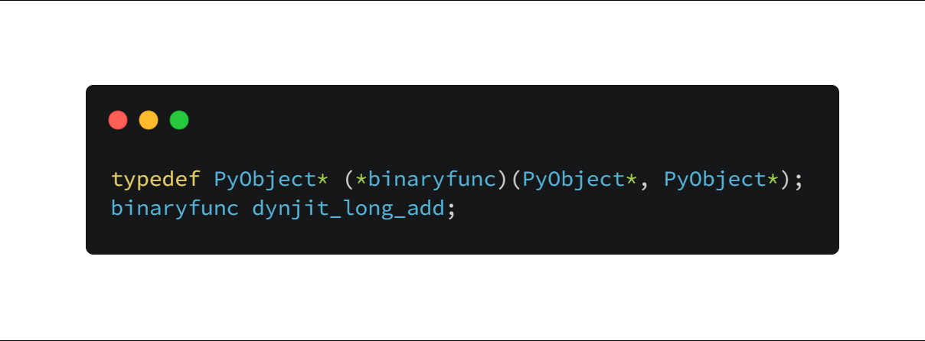
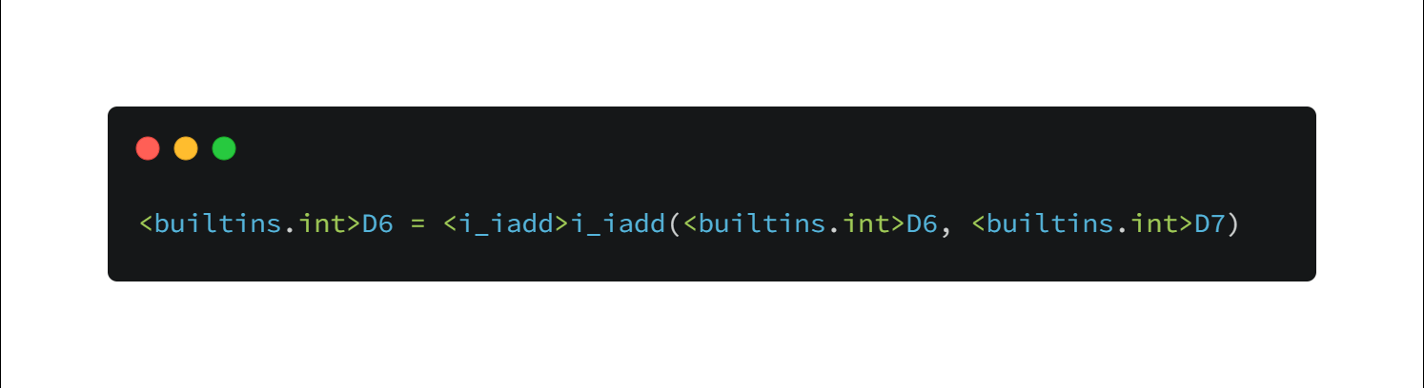
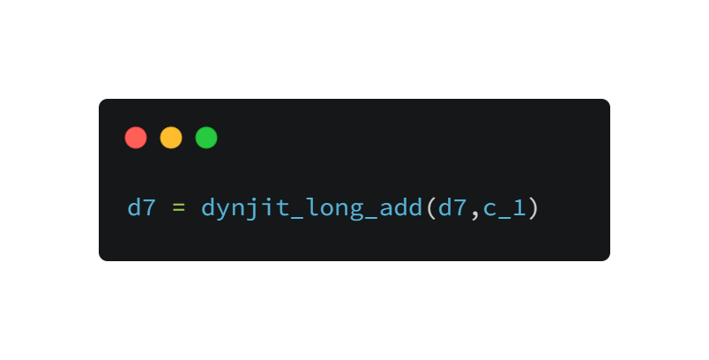
Choosing Specialized Methods
Write a type specialization case(at jit.call_prims)
Write corresponding C implementation
Specialize and generate dynjit IR
Use the specialization in C/Cython code

