Slide 1
Dynjit: A General-purpose Just-In-Time Compiler for Python Programming Language
システム情報工学研究科 情報理工学位プログラム
プログラム論理研究室 Zhao Wanghongxuan
指導教員：亀山幸義

Slide 2
Index
Background
Existing Attempts
Dynjit
Current Progress
Future Outlook

Slide 3
Index
Background
Existing Attempts
Dynjit
Current Progress
Future Outlook

Slide 4
Background
Python is important.
Python is heavily used in industrial and educational world.

Slide 5
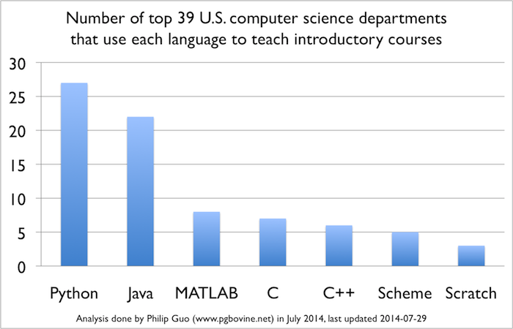
Python in Educational World
CACM Blog(2014): Python Is Now the Most Popular Introductory Teaching Language at Top ­U.S. ­Universities
There is an increasing popularity of using Python for teaching!
The Python official website also gives a record about the spread of Python among the schools around the world
(https://wiki.python.org/moin/SchoolsUsingPython)

Slide 6






Python in Industrial World
PopularitY of Programming Language Index(2020)
Rank | Change | Language | Share | Trend
1 |  | Python | 31.02 % | +2.2 %
2 |  | Java | 16.38 % | -2.8 %
TIOBE Index
Oct 2020 | Oct 2019 | Change | Programming Language | Ratings | Change
1 | 2 |  | C | 16.95% | +0.77%
2 | 1 |  | Java | 12.56% | -4.32%
3 | 3 |  | Python | 11.28% | +2.19%

Slide 7
Background
Python is important!
However…

Slide 8

However, Python is Slow
Workarounds
Extensions by
C/C++/Others
Companies, Individual Developers
High Level Applications
Slow
Use Python For
Cause
Cause
Chaos
"two-language Problem"
There comes out the “two-language” problem!

Slide 9



"two-language" Considered Harmful
Learn
Maintain
.c(pp) .h(pp)
.so
.py
Mastering Python C APIs
Mastering C/C++
Write C exts
Slow
“two-language” Problem
Using C exts
Write magic code for fitting exts, still not yet fast due to the limited features
User Application Requirements
Ext is Domain specific
similar case:
MATLAB
vectorization
notations

Slide 10
Make Python Faster
Python is dynamic
Python
Objects

Slide 11
Make Python Faster
Python is dynamic
Python
Objects
“I’m sorry”
“Speed me up?”
Behaviors are decided at runtime
“Could you optimize me?”
Static Optimizer/Compiler
Program behaviors decided by
I/O
Complex Runtime Computations
“Properties/Shapes/Types” known at runtime

Slide 12
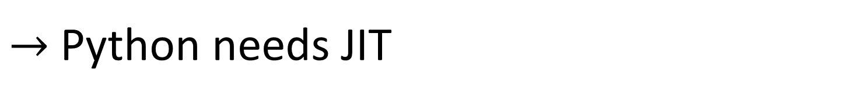
Make Python Faster
Python is dynamic
Runtime Compilation
There’s a limit to static compilation!
Static Optimizer/Compiler
I REJECT MY "STATIC"!
Referred as Just-In-Time(JIT) compilation
$→$Python needs JIT

Slide 13
The Whole World is Calling for Python JIT
Status
Python is heavily used in industrial and educational world
Python is slow and dynamic
JIT addressing dynamics

Slide 14
Index
Background
Existing Attempts
Dynjit
Current Progress
Future Outlook

Slide 15



Existing Attempts
Pyjion
Pyston
JAX
PyPy(most successful so far)
Numba
HOPE
JitPy
…
Due to the time limitation, we can only introduce part of them, about the status.

Slide 16
Existing Attempts
Pyjion
Pyston
JAX
PyPy
Numba
HOPE
JitPy
…
3 commits in last 2 years.
Suspended, or even died..

Slide 17
Existing Attempts
Pyjion
Pyston
JAX
PyPy
Numba
HOPE
JitPy
…
Unmaintained, unfunded.
It stopped immediately at 3 years ago when Dropbox stopped sponsoring.

Slide 18
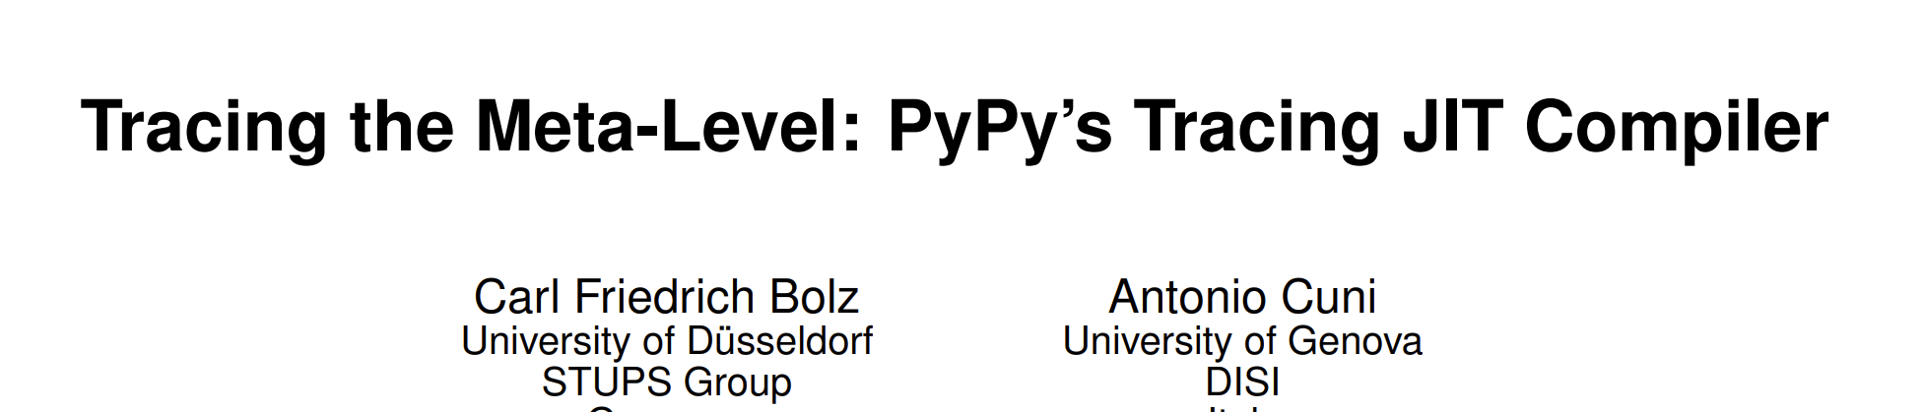
Existing Attempts
A new language.
Different runtime, incompatible object memory layouts, issues for adaptions to CPython C extensions.
Pyjion
Pyston
JAX
PyPy
Numba
HOPE
JitPy
…
https://dl.acm.org/doi/pdf/10.1145/1565824.1565827

Slide 19
Existing Attempts
For numerical computing.
Some Issues when mixing up Numba code with other pure python code.
(e.g., use dict in Numba code)
Pyjion
Pyston
JAX
PyPy
Numba
HOPE
JitPy
…
https://dl.acm.org/doi/pdf/10.1145/2833157.2833162

Slide 20
Existing Attempts
Pyjion
Pyston
JAX
PyPy
Numba
HOPE
JitPy
…
All have their own unavoidable issues!

Slide 21
Lessons Learnt from Existing Attempts
Pyjion & Pyston:
1. Approaches that don't require patching CPython(C codebase) are probably preferable
Numba & HOPE
2. A general-purpose JIT is expected
PyPy
3. A CPython-compatible JIT is expected
In nearly 30 years, many Python JIT projects failed for they started with a heavy implementation.
4. A JIT implementation which is lightweight but extensible.

Slide 22

Lessons Learnt from Existing Attempts
Approaches that don't require patching CPython(C codebase) are probably preferable
A general-purpose JIT is expected
A CPython-compatible JIT is expected
We should make a JIT implementation lightweight but extensible

Slide 23
Lessons Learnt from Existing Attempts
Approaches that don't require patching CPython(C codebase) are probably preferable
A general-purpose JIT is expected
A CPython-compatible JIT is expected
We should make a JIT implementation lightweight but extensible
We hereby present Dynjit

Slide 24
Index
Background
Existing Attempts
Dynjit
Current Progress
Future Outlook

Slide 25
Dynjit
Why is Python so slow?
Dynjit Approach
By Case: What can Dynjit do?

Slide 26
Why is Python so slow?
Arguments
Generic Code
Dynamic Attribute Accessing
Dynamic Global Scoping
Interpretative Overhead
Functions
Whatever types
use the same
Generic Code
Numerous
Runtime Checks
Heavy
Method
Dispatch
choosing the correct methods
for corresponding data types

Slide 27


Why is Python so slow?
Why is Python so slow?
Dynjit
Generic Code
Dynamic Attribute Accessing
Dynamic Global Scoping
Interpretative Overhead
Specializations
"Shape" Inference, Specializations
"__fix__"
Low level code(C/C++) generation

Slide 28
Why is Python so slow?
Why is Python so slow?
Dynjit
We’re to introduce this in the slides
Generic Code
Dynamic Attribute Accessing
Dynamic Global Scoping
Interpretative Overhead
Specializations
"Shape" Inference, Specializations
"__fix__"
Low level code(C/C++) generation

Slide 29
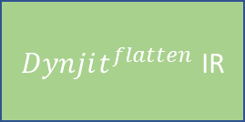
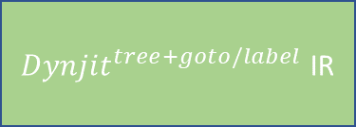
Dynjit’s Approach
Non-Nested Python Function Object
Runtime Call
Runtime Arguments
“Shapes” of Arguments
Cython
any backend interfacing with Python C APIs
C function
JIT Compiler
compile
Cached “Method”
Code generation
Get Python Bytecode,
Translate to
The function pointer address can be referenced in other functions
$Dynjit^{flatten}$ IR
Core CPY IR
User Assumptions 2. “Type” Specialization
Reloop: Remove goto/label
${Dynjit}^{tree+goto/label}$ IR
Partial Evaluation(Most Important)
3. Boolean Value Split 4. Union Type Split 5. Intrinsics

Slide 30
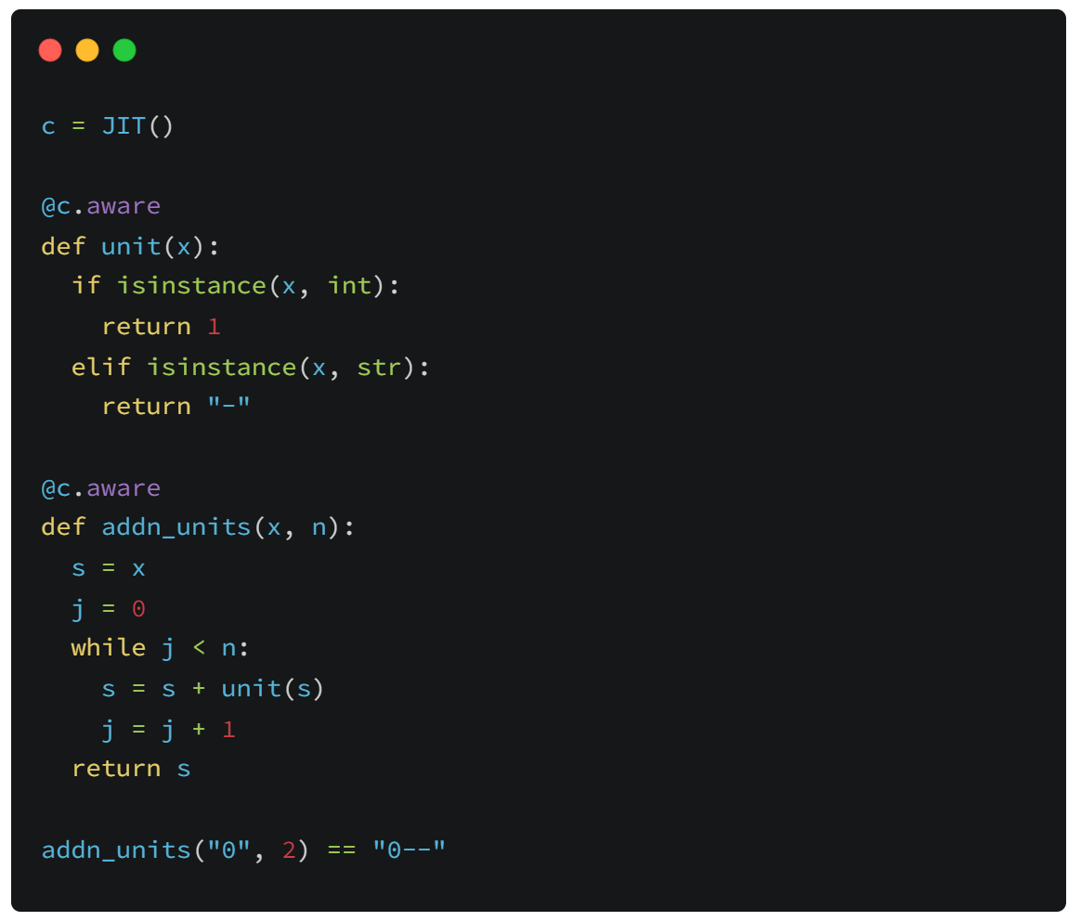
By Case: What can Dynjit do?
Python uses
isinstance(obj, type)
to do runtime type checks.

Slide 31
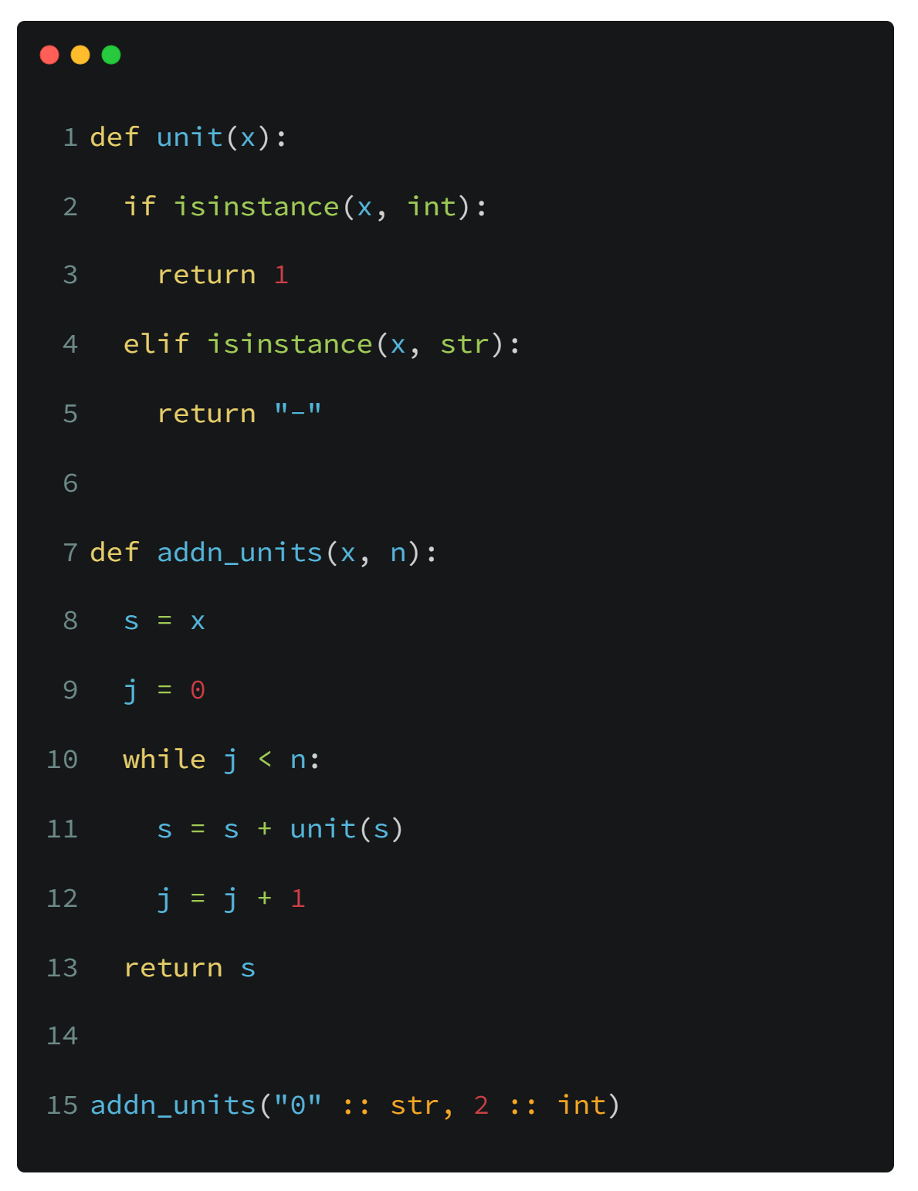
By Case: What can Dynjit do?
Partial Evaluation
Recorded Program States(for addn_units)
Orange is for indicating the specialized(optimized) code!

Slide 32
By Case: What can Dynjit do?
Partial Evaluation
Recorded Program States(for addn_units)

Slide 33
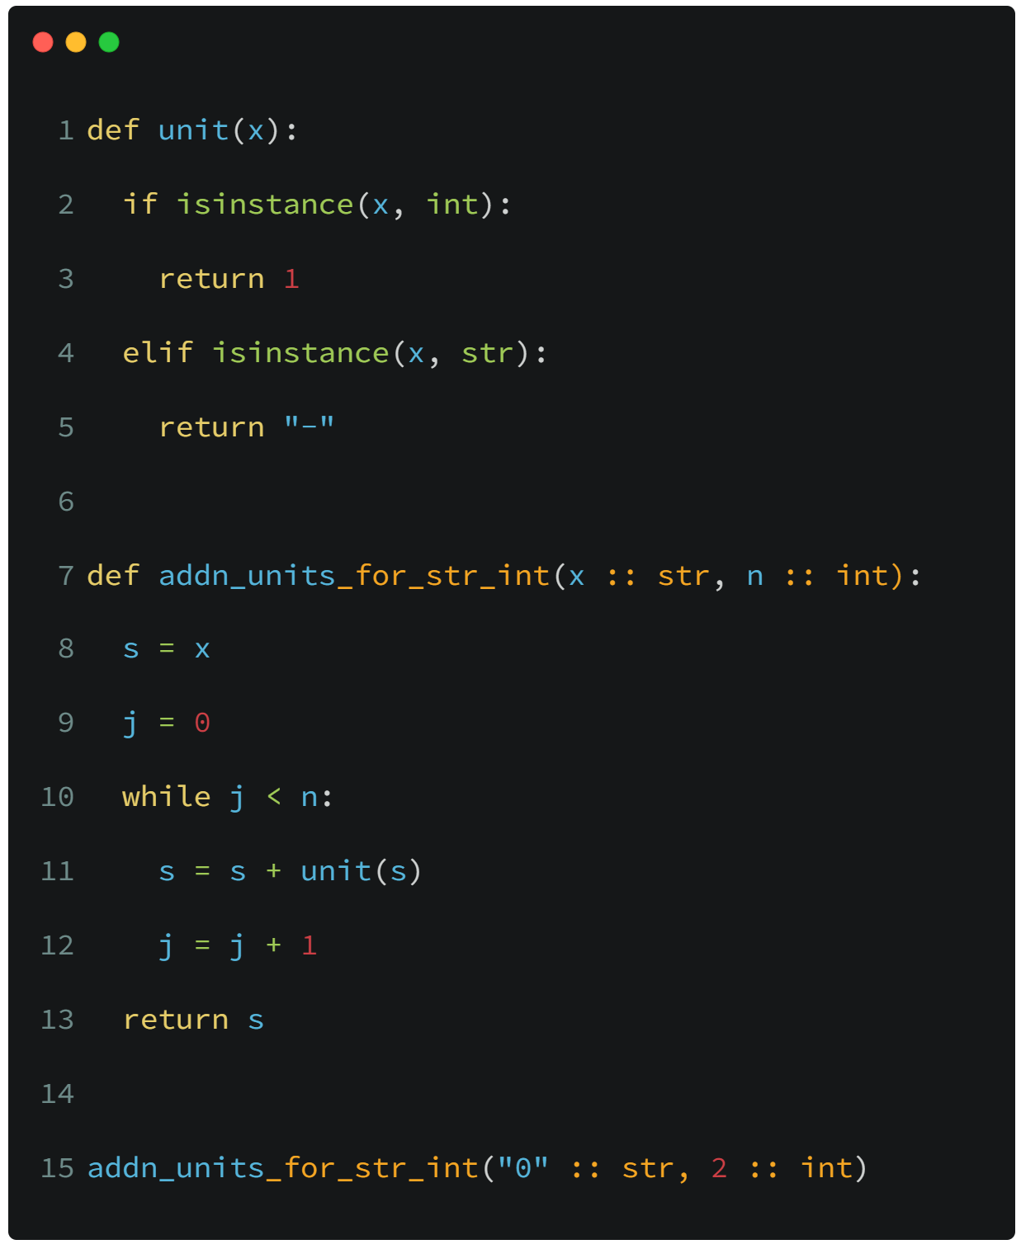

By Case: What can Dynjit do?
Partial Evaluation
Recorded Program States(for addn_units)
Line 7, $\{x=str, n=int\}$

Slide 34
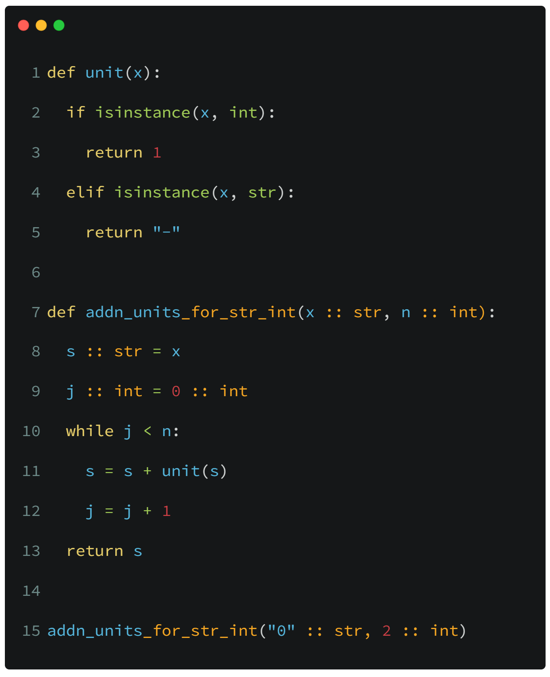

By Case: What can Dynjit do?
Partial Evaluation
Recorded Program States(for addn_units)
Line 7, $\{x=str, n=int\}$
Line 9, $\{x=str, n=int, j=int, s=str\}$

Slide 35
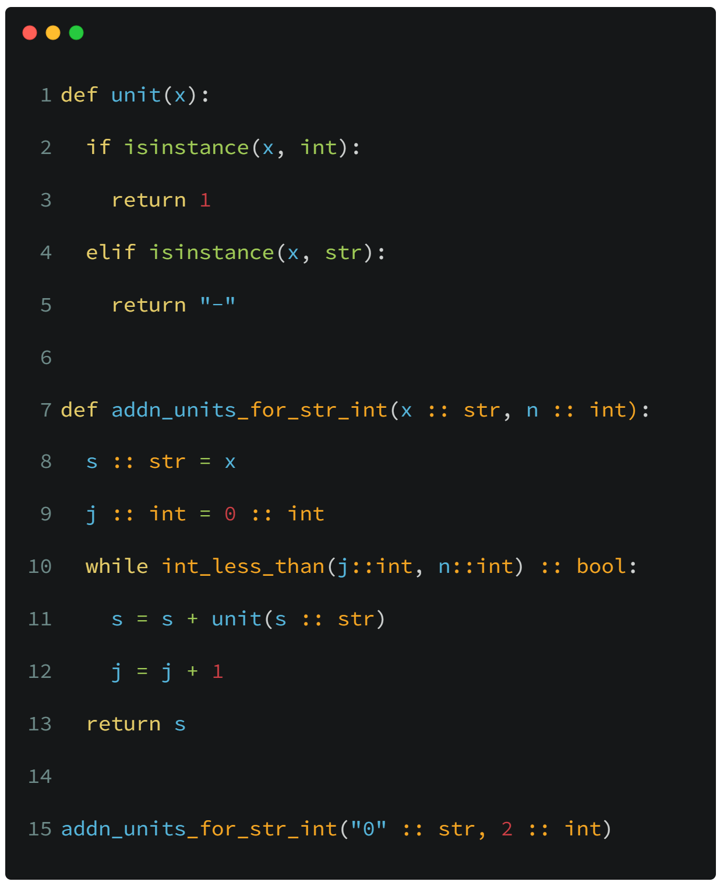

By Case: What can Dynjit do?
Partial Evaluation
Recorded Program States(for addn_units)
Line 7, $\{x=str, n=int\}$
Line 9, $\{x=str, n=int, j=int, s=str\}$
Line 10, $\{x=str, n=int, j=int, s=str\}$

Slide 36
By Case: What can Dynjit do?
Partial Evaluation
Recorded Program States(for addn_units)
Line 7, $\{x=str, n=int\}$
Line 9, $\{x=str, n=int, j=int, s=str\}$
Line 10, $\{x=str, n=int, j=int, s=str\}$

Slide 37
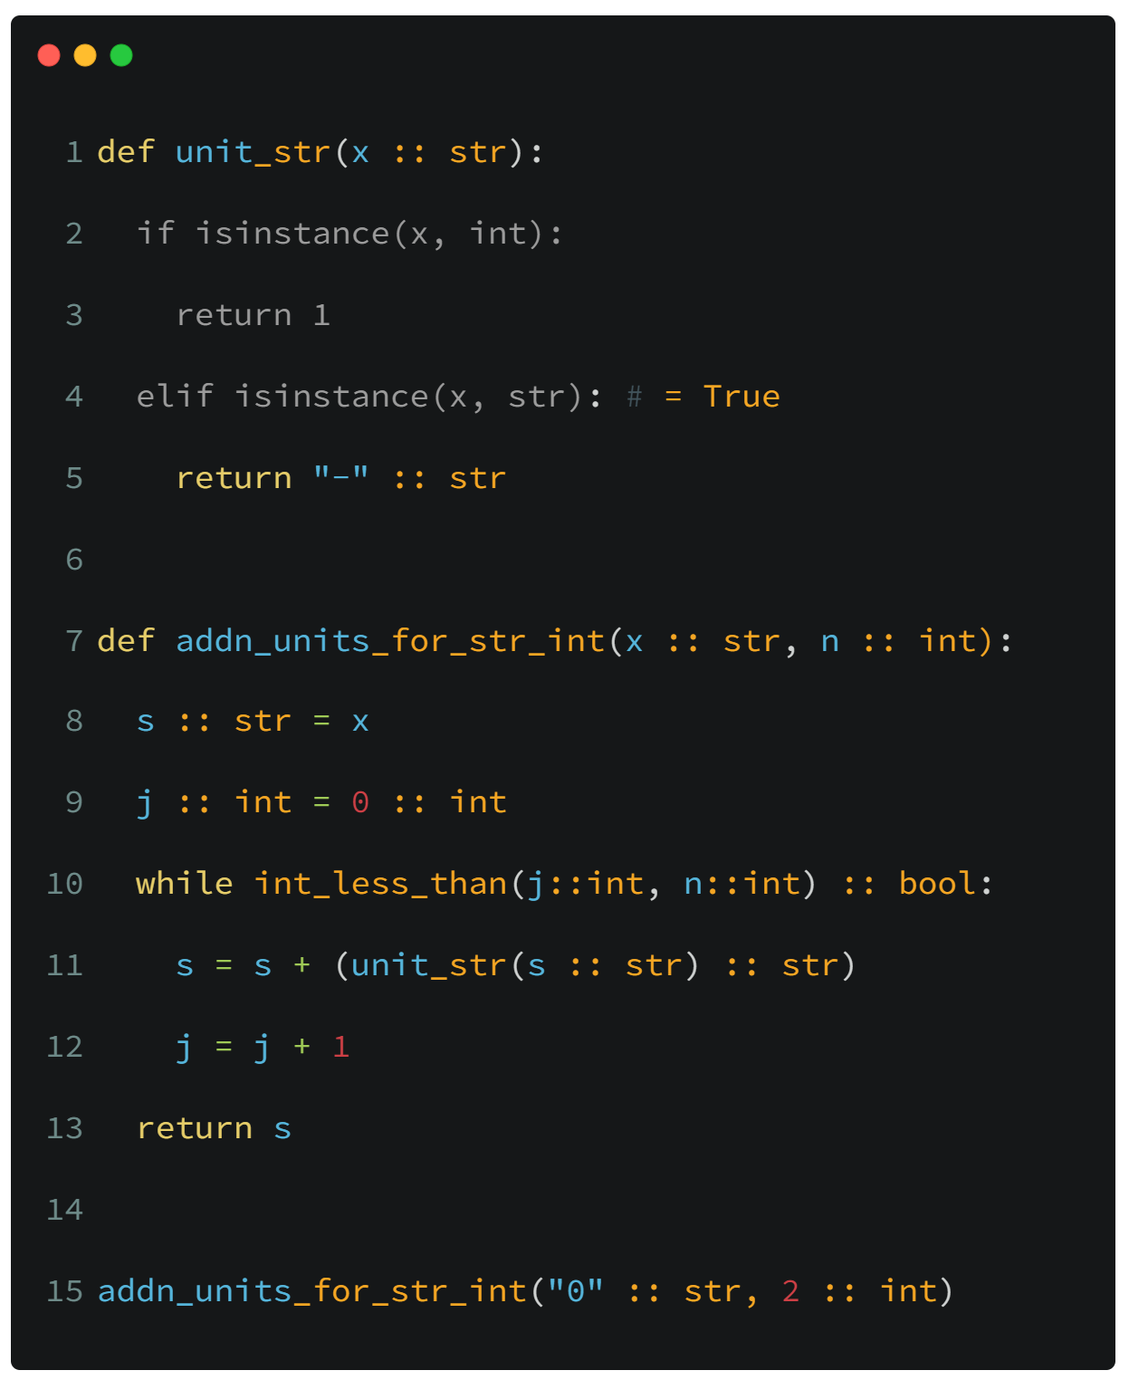
By Case: What can Dynjit do?
Partial Evaluation
Recorded Program States(for addn_units)
Line 7, $\{x=str, n=int\}$
Line 9, $\{x=str, n=int, j=int, s=str\}$
Line 10, $\{x=str, n=int, j=int, s=str\}$

Slide 38
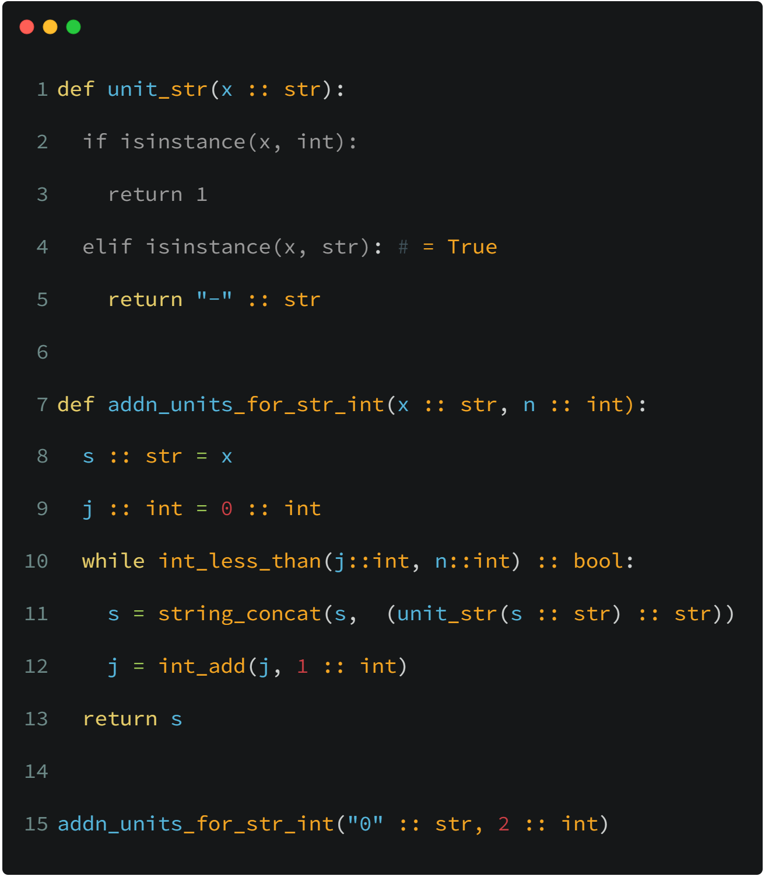

By Case: What can Dynjit do?
Partial Evaluation
Recorded Program States(for addn_units)
Line 7, $\{x=str, n=int\}$
Line 9, $\{x=str, n=int, j=int, s=str\}$
Line 10, $\{x=str, n=int, j=int, s=str\}$
Line 12, $\{x=str, n=int, j=int, s=str\}$

Slide 39

By Case: What can Dynjit do?
Partial Evaluation
Recorded Program States(for addn_units)
Line 7, $\{x=str, n=int\}$
Line 9, $\{x=str, n=int, j=int, s=str\}$
Line 10, $\{x=str, n=int, j=int, s=str\}$
Line 12, $\{x=str, n=int, j=int, s=str\}$
Line 9, $\{x=str, n=int, j=int, s=str\}$
Existed
We exit the loop, as its states were all partial evaluated.
Loop

Slide 40
By Case: What can Dynjit do?
Partial Evaluation
Recorded Program States(for addn_units)
Line 7, $\{x=str, n=int\}$
Line 9, $\{x=str, n=int, j=int, s=str\}$
Line 10, $\{x=str, n=int, j=int, s=str\}$
Line 12, $\{x=str, n=int, j=int, s=str\}$

Slide 41
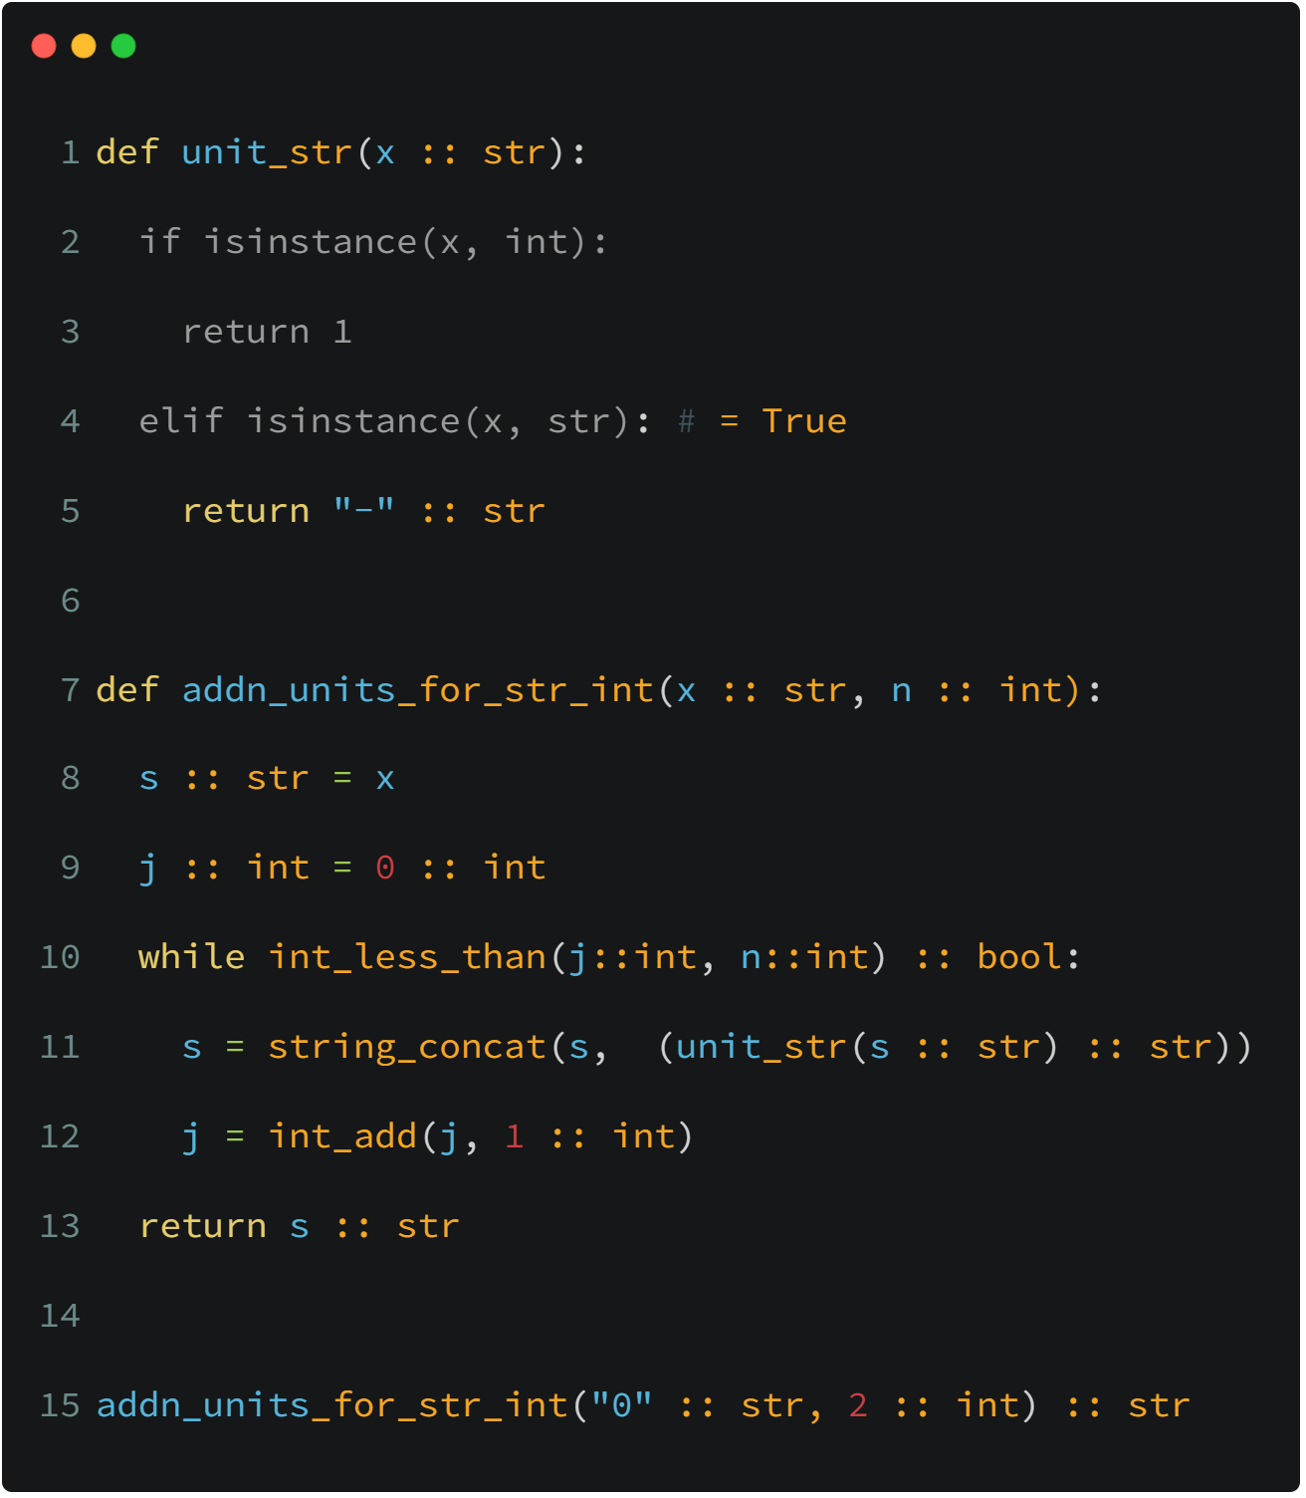
By Case: What can Dynjit do?
Partial Evaluation
Output ${Dynjit}^{tree+goto/label}$ IR
Other Passes;
Generate C/C++/Cython; Compilation
Load the pointer
Type Specialization

Slide 42
Index
Background
Existing Attempts
Dynjit
Current Progress
Future Outlook

Slide 43
Current Progress
We have already achieved many goals.
Here are some benchmarks, codes of which are provided in the GitHub repository.
Benchmark Filename | Benchmark Tags | Speed up | Notes
attribute.py | Reading attributes | >= 1.5x | Only for Python classes with "__slots__"; Dynjit eliminates hash lookup
nested_functions.py | Closures | >=1.5x | Special APIs for closure constructions are required; The closure cells should be typed and immutable.
typecheck.py | Generic calls, loops | >= 2.5x | A function called inside the loop contains runtime type checks
float_add_and_loop.py | Loops, numeric | >=3.5x
Project address: https://github.com/thautwarm/dynjit

Slide 44
Index
Background
Existing Attempts
Dynjit
Current Progress
Future Outlook

Slide 45
Future Outlook
Support for more Python features
Dynjit can now mix with full-featured CPython programs but unable to optimize all of them.
Addressing restrictions
such as slow recursive
functions and explosion
of generated code.
General
Paper works
Dynjit widely adopts ideas from many existing attempts and some other programming languages.
Stabilization
Evolution
Specific
Object unboxing
Dynjit is a general-purpose JIT compiler, Python object memory layouts are kept, and unboxing is missing. However if unboxing can be supported, Dynjit may match Numba in numeric computing scopes.

