Slide 1

A Just-In-Time Compiler for Python
Runtime Specialization

Slide 2


Approach
Python Bytecode
Global Variables
JIT Compiler State
compiler awared
wrap
Existing specialized code
Core CPY
$$R^{in}$$
Cython
Type Specialization
Assumptions of Python Builtins
Inline
$$R^{out}$$

Slide 3
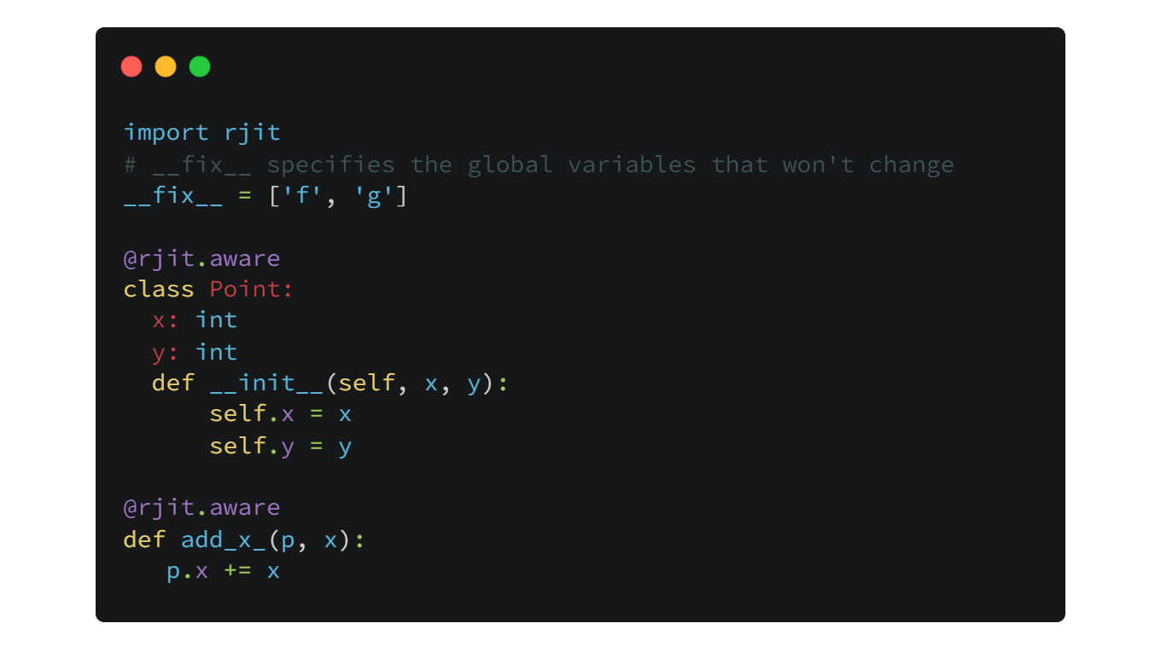
Expected Usage

Slide 4
Python Bytecode Instructions
Execution of Python
To execute Python source code, the Python compiler always compiles it into Python bytecode, interprets them with a stack virtual machine.
When interpreting bytecode, 2 parts are considered
Instructions
Runtime Objects(closure, default arguments, constant pools, etc.)
Python Bytecode Instructions
Python bytecode instructions are large, sophisticated and verbose.
We normalize Py instructions to a very concise set: Core CPY

Slide 5
Core CPY
$$VariableKind: localonly \left| cell \right| free | global$$

Slide 6
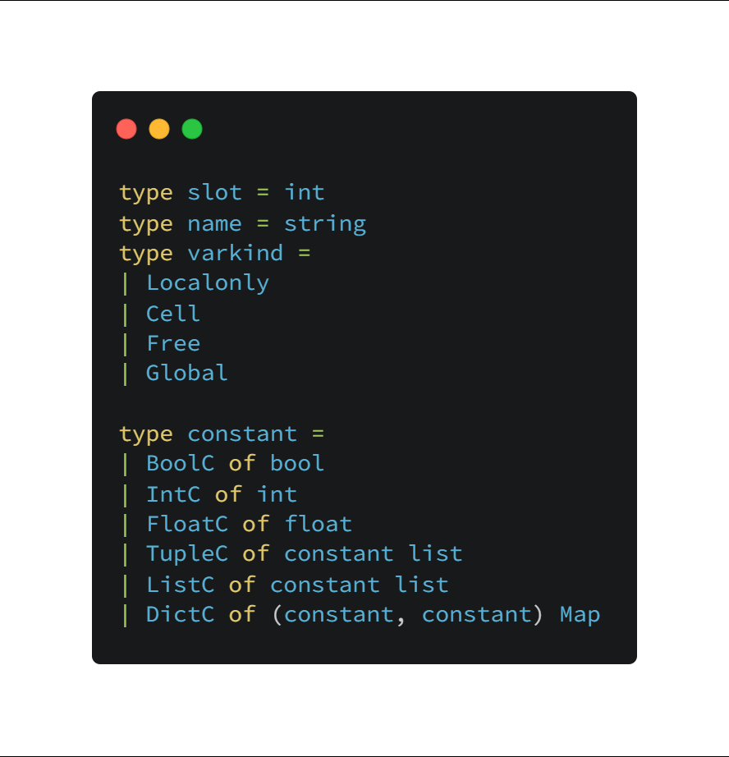
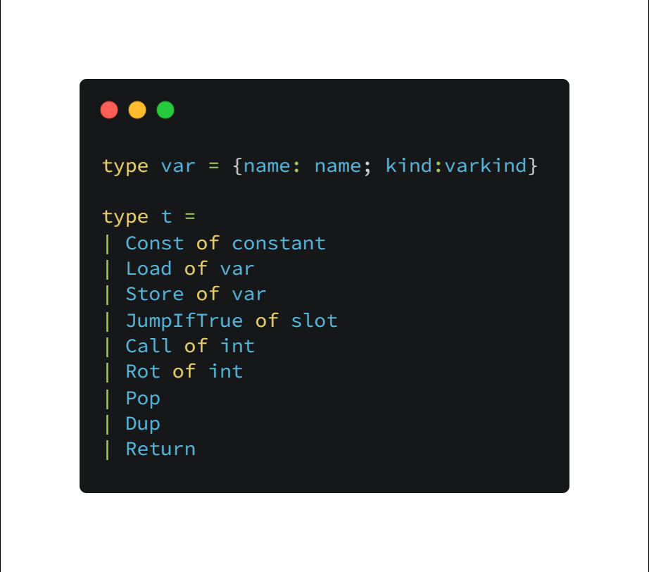
Core CPY

