Slide 1
Assembly Language for x86 Processors 7th Edition
Kip Irvine
Chapter 1: Basic Concepts
Slides prepared by the author
Revision date: 1/15/2014
(c) Pearson Education, 2015. All rights reserved. You may modify and copy this slide show for your personal use, or for use in the classroom, as long as this copyright statement, the author's name, and the title are not changed.

Slide 2
Chapter Overview
Welcome to Assembly Language
Virtual Machine Concept
Data Representation
Boolean Operations
Irvine, Kip R. Assembly Language for Intel-Based Computers 7/e, 2015.

Slide 3
Welcome to Assembly Language
Some Good Questions to Ask
Assembly Language Applications
Irvine, Kip R. Assembly Language for Intel-Based Computers 7/e, 2015.

Slide 4
Questions to Ask
Why am I learning Assembly Language?
What background should I have?
What is an assembler?
What hardware/software do I need?
What types of programs will I create?
What do I get with this book?
What will I learn?
Irvine, Kip R. Assembly Language for Intel-Based Computers 7/e, 2015.

Slide 5
Welcome to Assembly Language (cont)
How does assembly language (AL) relate to machine language?
How do C++ and Java relate to AL?
Is AL portable?
Why learn AL?
Irvine, Kip R. Assembly Language for Intel-Based Computers 7/e, 2015.

Slide 6
Assembly Language Applications
Some representative types of applications:
  Business application for single platform
  Hardware device driver
  Business application for multiple platforms
  Embedded systems & computer games
(see next panel)
Irvine, Kip R. Assembly Language for Intel-Based Computers 7/e, 2015.

Slide 7
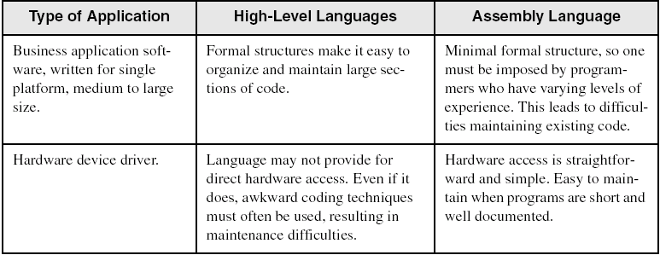
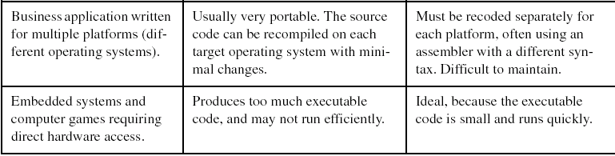
Comparing ASM to High-Level Languages
Irvine, Kip R. Assembly Language for Intel-Based Computers 7/e, 2015.

Slide 8
What's Next
Welcome to Assembly Language
Virtual Machine Concept
Data Representation
Boolean Operations
Irvine, Kip R. Assembly Language for Intel-Based Computers 7/e, 2015.

Slide 9
Virtual Machine Concept
Virtual Machines
Specific Machine Levels
Irvine, Kip R. Assembly Language for Intel-Based Computers 7/e, 2015.

Slide 10
Virtual Machines
Tanenbaum: Virtual machine concept
Programming Language analogy:
  Each computer has a native machine language (language L0) that runs directly on its hardware
  A more human-friendly language is usually constructed above machine language, called Language L1
Programs written in L1 can run two different ways:
  Interpretation – L0 program interprets and executes L1 instructions one by one
  Translation – L1 program is completely translated into an L0 program, which then runs on the computer hardware
Irvine, Kip R. Assembly Language for Intel-Based Computers 7/e, 2015.

Slide 11
Translating Languages
English: Display the sum of A times B plus C.
C++: cout << (A * B + C);
Assembly Language:
mov eax,A
mul B
add eax,C
call WriteInt
Intel Machine Language:
A1 00000000
F7 25 00000004
03 05 00000008
E8 00500000
Irvine, Kip R. Assembly Language for Intel-Based Computers 7/e, 2015.

Slide 12
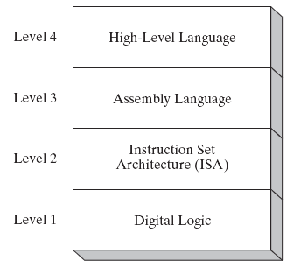
Specific Machine Levels
(descriptions of individual levels follow . . . )
Irvine, Kip R. Assembly Language for Intel-Based Computers 7/e, 2015.

Slide 13
High-Level Language
Level 4
Application-oriented languages
  C++, Java, Pascal, Visual Basic . . .
Programs compile into assembly language (Level 4)
Irvine, Kip R. Assembly Language for Intel-Based Computers 7/e, 2015.

Slide 14
Assembly Language
Level 3
Instruction mnemonics that have a one-to-one correspondence to machine language
Programs are translated into Instruction Set Architecture Level - machine language (Level 2)
Irvine, Kip R. Assembly Language for Intel-Based Computers 7/e, 2015.

Slide 15
Instruction Set Architecture (ISA)
Level 2
Also known as conventional machine language
Executed by Level 1 (Digital Logic)
Irvine, Kip R. Assembly Language for Intel-Based Computers 7/e, 2015.

Slide 16
Digital Logic
Level 1
CPU, constructed from digital logic gates
System bus
Memory
Implemented using bipolar transistors
next: Data Representation
Irvine, Kip R. Assembly Language for Intel-Based Computers 7/e, 2015.

Slide 17
What's Next
Welcome to Assembly Language
Virtual Machine Concept
Data Representation
Boolean Operations
Irvine, Kip R. Assembly Language for Intel-Based Computers 7/e, 2015.

Slide 18
Data Representation
Binary Numbers
  Translating between binary and decimal
Binary Addition
Integer Storage Sizes
Hexadecimal Integers
  Translating between decimal and hexadecimal
  Hexadecimal subtraction
Signed Integers
  Binary subtraction
Character Storage
Irvine, Kip R. Assembly Language for Intel-Based Computers 7/e, 2015.

Slide 19
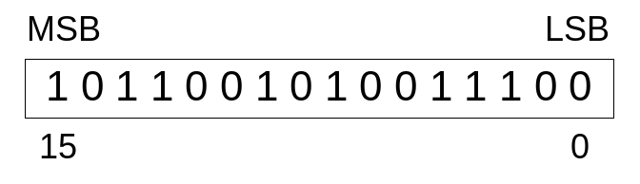
Binary Numbers
Digits are 1 and 0
  1 = true
  0 = false
MSB – most significant bit
LSB – least significant bit
Bit numbering:
Irvine, Kip R. Assembly Language for Intel-Based Computers 7/e, 2015.

Slide 20

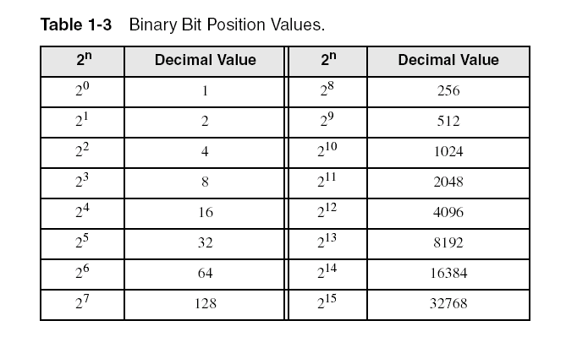
Binary Numbers
Each digit (bit) is either 1 or 0
Each bit represents a power of 2:
Every binary number is a sum of powers of 2
Irvine, Kip R. Assembly Language for Intel-Based Computers 7/e, 2015.

Slide 21
Translating Binary to Decimal
Weighted positional notation shows how to calculate the decimal value of each binary bit:
dec = (D_{n-1} × 2^{n-1}) + (D_{n-2} × 2^{n-2}) + ... + (D₁ × 2¹) + (D₀ × 2⁰)
D = binary digit
binary 00001001 = decimal 9:
(1 × 2³) + (1 × 2⁰) = 9
Irvine, Kip R. Assembly Language for Intel-Based Computers 7/e, 2015.

Slide 22
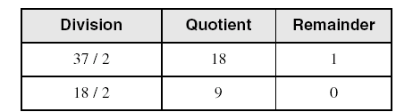
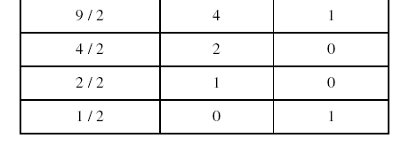
Translating Unsigned Decimal to Binary
Repeatedly divide the decimal integer by 2. Each remainder is a binary digit in the translated value:
37 = 100101
Irvine, Kip R. Assembly Language for Intel-Based Computers 7/e, 2015.

Slide 23
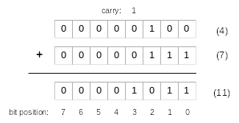
Binary Addition
Starting with the LSB, add each pair of digits, include the carry if present.
Irvine, Kip R. Assembly Language for Intel-Based Computers 7/e, 2015.

Slide 24

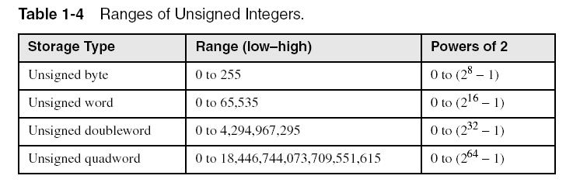
Integer Storage Sizes
Standard sizes:
What is the largest unsigned integer that may be stored in 20 bits?
Irvine, Kip R. Assembly Language for Intel-Based Computers 7/e, 2015.

Slide 25
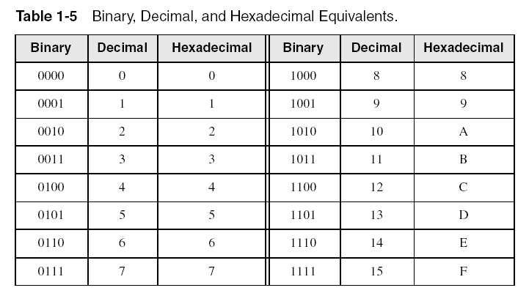
Hexadecimal Integers
Binary values are represented in hexadecimal.
Irvine, Kip R. Assembly Language for Intel-Based Computers 7/e, 2015.

Slide 26

Translating Binary to Hexadecimal
Each hexadecimal digit corresponds to 4 binary bits.
Example: Translate the binary integer 000101101010011110010100 to hexadecimal:
Irvine, Kip R. Assembly Language for Intel-Based Computers 7/e, 2015.

Slide 27
Converting Hexadecimal to Decimal
Multiply each digit by its corresponding power of 16:
  dec = (D₃ × 16³) + (D₂ × 16²) + (D₁ × 16¹) + (D₀ × 16⁰)
Hex 1234 equals (1 × 16³) + (2 × 16²) + (3 × 16¹) + (4 × 16⁰), or decimal 4,660.
Hex 3BA4 equals (3 × 16³) + (11 * 16²) + (10 × 16¹) + (4 × 16⁰), or decimal 15,268.
Irvine, Kip R. Assembly Language for Intel-Based Computers 7/e, 2015.

Slide 28
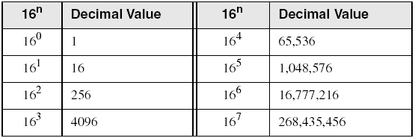
Powers of 16
Used when calculating hexadecimal values up to 8 digits long:
Irvine, Kip R. Assembly Language for Intel-Based Computers 7/e, 2015.

Slide 29
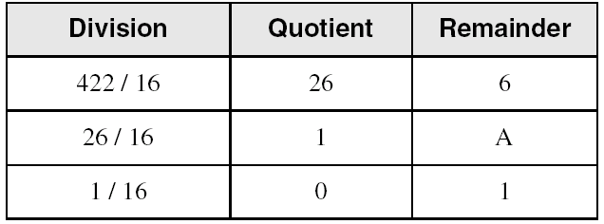
Converting Decimal to Hexadecimal
decimal 422 = 1A6 hexadecimal
Irvine, Kip R. Assembly Language for Intel-Based Computers 7/e, 2015.

Slide 30
Hexadecimal Addition
Divide the sum of two digits by the number base (16). The quotient becomes the carry value, and the remainder is the sum digit.
1
1
36 28 28 6A
42 45 58 4B
78 6D 80 B5
21 / 16 = 1, rem 5
Important skill: Programmers frequently add and subtract the addresses of variables and instructions.
Irvine, Kip R. Assembly Language for Intel-Based Computers 7/e, 2015.

Slide 31
Hexadecimal Subtraction
When a borrow is required from the digit to the left, add 16 (decimal) to the current digit's value:
16 + 5 = 21
−1
C6 75
A2 47
24 2E
Practice: The address of var1 is 00400020. The address of the next variable after var1 is 0040006A. How many bytes are used by var1?
Irvine, Kip R. Assembly Language for Intel-Based Computers 7/e, 2015.

Slide 32
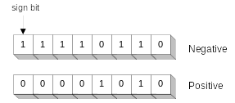
Signed Integers
The highest bit indicates the sign. 1 = negative,
0 = positive
If the highest digit of a hexadecimal integer is > 7, the value is negative. Examples: 8A, C5, A2, 9D
Irvine, Kip R. Assembly Language for Intel-Based Computers 7/e, 2015.

Slide 33
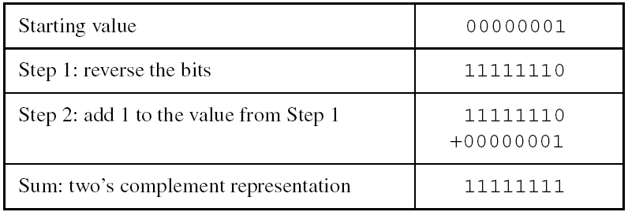
Forming the Two's Complement
Negative numbers are stored in two's complement notation
Represents the additive Inverse
Note that 00000001 + 11111111 = 00000000
Irvine, Kip R. Assembly Language for Intel-Based Computers 7/e, 2015.

Slide 34
Binary Subtraction
When subtracting A – B, convert B to its two's complement
Add A to (–B)
0 0 0 0 1 1 0 0 0 0 0 0 1 1 0 0
– 0 0 0 0 0 0 1 1 1 1 1 1 1 1 0 1
0 0 0 0 1 0 0 1
Practice: Subtract 0101 from 1001.
Irvine, Kip R. Assembly Language for Intel-Based Computers 7/e, 2015.

Slide 35
Learn How To Do the Following:
Form the two's complement of a hexadecimal integer
Convert signed binary to decimal
Convert signed decimal to binary
Convert signed decimal to hexadecimal
Convert signed hexadecimal to decimal
Irvine, Kip R. Assembly Language for Intel-Based Computers 7/e, 2015.

Slide 36
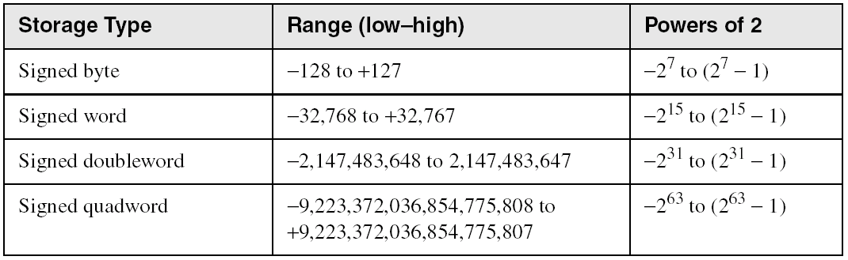
Ranges of Signed Integers
The highest bit is reserved for the sign. This limits the range:
Practice: What is the largest positive value that may be stored in 20 bits?
Irvine, Kip R. Assembly Language for Intel-Based Computers 7/e, 2015.

Slide 37
Character Storage
Character sets
  Standard ASCII (0 – 127)
  Extended ASCII (0 – 255)
  ANSI (0 – 255)
  Unicode (0 – 65,535)
Null-terminated String
  Array of characters followed by a null byte
Using the ASCII table
  back inside cover of book
Irvine, Kip R. Assembly Language for Intel-Based Computers 7/e, 2015.

Slide 38
Numeric Data Representation
pure binary
  can be calculated directly
ASCII binary
  string of digits: "01010101"
ASCII decimal
  string of digits: "65"
ASCII hexadecimal
  string of digits: "9C"
next: Boolean Operations
Irvine, Kip R. Assembly Language for Intel-Based Computers 7/e, 2015.

Slide 39
What's Next
Welcome to Assembly Language
Virtual Machine Concept
Data Representation
Boolean Operations
Irvine, Kip R. Assembly Language for Intel-Based Computers 7/e, 2015.

Slide 40
Boolean Operations
NOT
AND
OR
Operator Precedence
Truth Tables
Irvine, Kip R. Assembly Language for Intel-Based Computers 7/e, 2015.

Slide 41
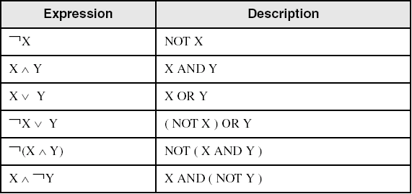
Boolean Algebra
Based on symbolic logic, designed by George Boole
Boolean expressions created from:
  NOT, AND, OR
Irvine, Kip R. Assembly Language for Intel-Based Computers 7/e, 2015.

Slide 42
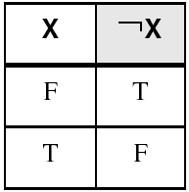
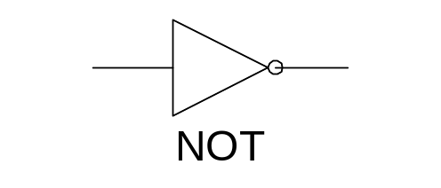
NOT
Inverts (reverses) a boolean value
Truth table for Boolean NOT operator:
Digital gate diagram for NOT:
Irvine, Kip R. Assembly Language for Intel-Based Computers 7/e, 2015.

Slide 43
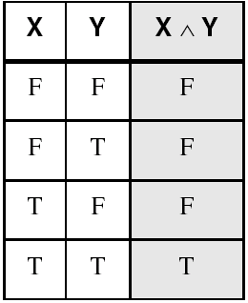
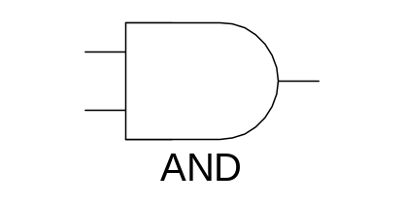
AND
Truth table for Boolean AND operator:
Digital gate diagram for AND:
Irvine, Kip R. Assembly Language for Intel-Based Computers 7/e, 2015.

Slide 44
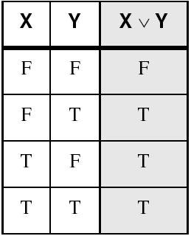
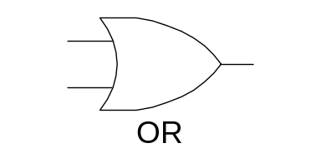
OR
Truth table for Boolean OR operator:
Digital gate diagram for OR:
Irvine, Kip R. Assembly Language for Intel-Based Computers 7/e, 2015.

Slide 45
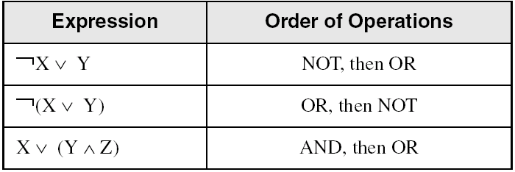
Operator Precedence
Examples showing the order of operations:
Irvine, Kip R. Assembly Language for Intel-Based Computers 7/e, 2015.

Slide 46
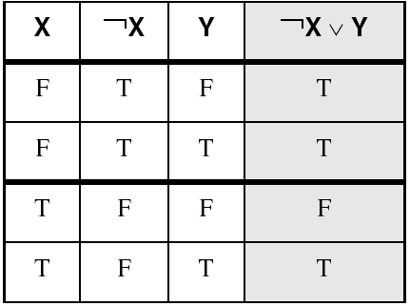
Truth Tables (1 of 3)
A Boolean function has one or more Boolean inputs, and returns a single Boolean output.
A truth table shows all the inputs and outputs of a Boolean function
Example: ¬X ∨ Y
Irvine, Kip R. Assembly Language for Intel-Based Computers 7/e, 2015.

Slide 47
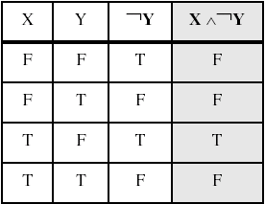
Truth Tables (2 of 3)
Example: X ∧ ¬Y
Irvine, Kip R. Assembly Language for Intel-Based Computers 7/e, 2015.

Slide 48
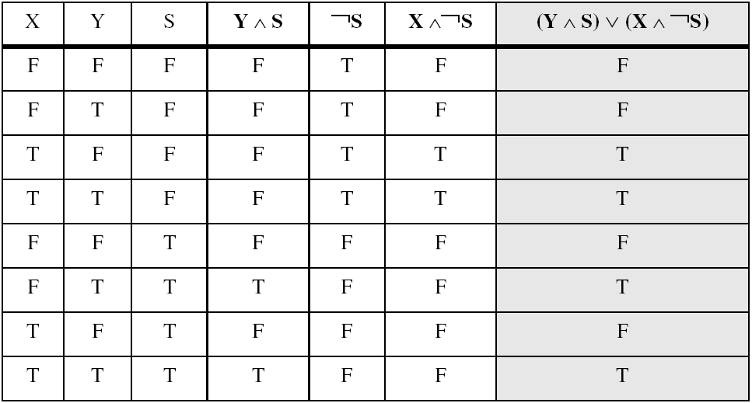
Truth Tables (3 of 3)
Example: (Y ∧ S) ∨ (X ∧ ¬S)
Two-input multiplexer
Irvine, Kip R. Assembly Language for Intel-Based Computers 7/e, 2015.

Slide 49
Summary
Assembly language helps you learn how software is constructed at the lowest levels
Assembly language has a one-to-one relationship with machine language
Each layer in a computer's architecture is an abstraction of a machine
  layers can be hardware or software
Boolean expressions are essential to the design of computer hardware and software
Irvine, Kip R. Assembly Language for Intel-Based Computers 7/e, 2015.

Slide 50

54 68 65 20 45 6E 64
What do these numbers represent?
Irvine, Kip R. Assembly Language for Intel-Based Computers 7/e, 2015.

