Slide 1

Welcome
Async best-practices
webinar
Notes:
Leaving the thread management to someone who knows better
Leave it to the professionals

Slide 2

Solution Architect
Enthusiastic Software Engineer
Microsoft MVP for systems integration
@danielmarbach
particular.net/blog / planetgeek.ch

Slide 3
Terminologies CPU-bound vs IO-bound
Threads and Tasks
Async best-practices
Goals
target

Slide 4
parallel
Multiple people sitting in cubicles working on a project
Work is distributed over threads
and processors
simultaneous
parallel
Notes:
A parallel program is one where independent subexpressions are evaluated at the same time on different processors or threads in order to finish computation faster
CPU bound work such as sorting algorithms, filter etc. Is an ideal candidate to be run in parallel. In order to do that sometimes the work has to be split into multiple
Inidivual subwork items

Slide 5
concurrent
A person juggling multiple balls concurrently
Work can be distributed over threads
and processors
concurrent
interleaved
concurrent
concurrent
concurrent
Notes:
It is important to note that concurrent programs might be run on just one processor using an interleaving scheduler and they are still just as concurrent as ones that are run on multiple processors
Parallel computation is not a special case of concurrency. One can achieve parallelism using concurrency constructs
Benefit of concurrent vs. thread?
Rampup of threadPool, resource usage…

Slide 6
Reading a book while doing the laundry
Worker is free until signal indicates external task is done
async
event-driven
Notes:
Asynchronous program dispatches tasks to devices that can take care of themselves, leaving the program free to do something else until it receives a signal that the results are finished
Asynchronous programming should be used for external operations which support reactive or event-driven callbacks when they are done. Usually that is the case for IO-bound work.
For example on windows IOCompletionPorts signal the result of a IO operation back to the initiator of the operation

Slide 7
The laundry machine in the previous example represented an external task
Represents the state and outcome of an asynchronous operation executed now, later or never
Task
uniform
Notes:
It is an abstraction layer which represents both CPU bound and IO-bound operations as a uniformed API
So the state of the task representing the laundry machine would be running, not running, completed
The outcome should be clean clothes
I can late start the machine with a timer, or the machine can decide to run a health check before the process starts
It is also possible that because of failures the machine never starts or my wife cancels the process while I’m reading my book because yet again I’ve chosen the wrong temperature

Slide 8
Me doing the laundry by hand like in medieval times
A worker responsible for getting Tasks done that are scheduled
Thread
physical

Slide 9
Task
Forget thread!
think
Notes:
Leaving the thread management to someone who knows better
Leave it to the professionals

Slide 10
A function that is scheduled for execution
Continuation
after its prerequisite function has completed
Notes:
It is an abstraction layer which represents both CPU bound and IO-bound operations as a uniformed API
ANT THE SEDENT

Slide 11
task.ContinueWith(t => {
continuation;
})

Slide 12
async/await
syntactic sugar
compiler magic
Notes:
Reduces christmas tree programming to code which looks much

Slide 13
task.ContinueWith(t => {
continuation;
});
Notes:
Repete

Slide 14
await task;
continuation;

Slide 15
Demo
await
Notes:
Reduces christmas tree programming to code which looks much

Slide 16
Use Task.Run, Factory.StartNew for CPU-bound work Use Task directly for IO-bound work
Use async Task instead of async void
Recap
reminder

Slide 17
Libraries and frameworks should use ConfigureAwait(false)
Async all the way, don’t mix blocking and asynchronous code
Recap
reminder

Slide 18
Slides, Links…
github.com/danielmarbach/02-25-2016-AsyncWebinar
Notes:
Questions that can be answered in blog posts

Slide 19
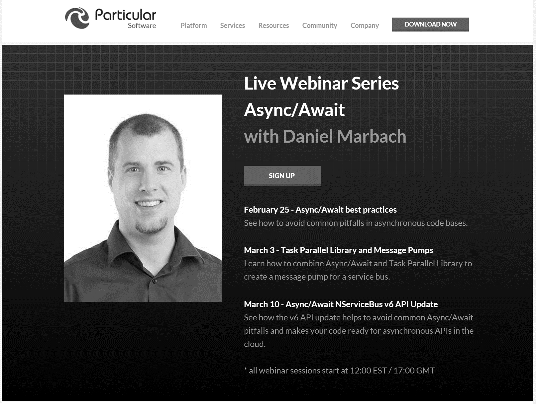
particular.net/async-await-webinar-series
Next
Notes:
Explain what’s next

Slide 20
Q & A
await
Notes:
Reduces christmas tree programming to code which looks much

Slide 21
Thanks
Notes:
Reduces christmas tree programming to code which looks much

