Slide 1

Welcome
Async best-practices
webinar
Notes:
A warm welcome to this first webinar in the async webinar series.
Today we talk about Async best-practices

Slide 2

Solution Architect
Enthusiastic Software Engineer
Microsoft MVP for systems integration
@danielmarbach
particular.net/blog / planetgeek.ch
Notes:
I’m Daniel, Solution Architect…
You can reach me on twitter under @danielmarbach
I blog on the particular blog and on my personal blog

Slide 3
Terminologies CPU-bound vs IO-bound
Threads and Tasks
Async best-practices
Goals
target
Notes:
In this webinar we will learn important terminologies
The difference between CPU-bound and IO-bound
The difference between Threads and Tasks
And a few async best-practices
Before we dive deep into async/await I would like to talk about the terminologies paralle, concurrent and async. They often get confused.

Slide 4

parallel
simultaneous
parallel
Notes:
Parallel can be compared to multiple employees working in cubicles at the same time for the same project.
In software this means
A parallel program is
Independent subexpression are evaluated simultaneously on different processors or thread
Goal: Finish computation faster
Ideally suited for CPU bound work such as sorting data in-memory, filter data
To be able to benefit from parallelism the problem needs to be dividable into induvial sub items which can be worked on independently

Slide 5

concurrent
concurrent
interleaved
concurrent
concurrent
concurrent
Notes:
Concurrent is like someone who is juggling multiple balls at the same time. The person is the coordinator of the balls and briefly interacts with the balls when they fall into their hands, i.e. for doing the necessary trajectory corrections.
In software this means
There is a coordinator called Scheduler which deals usually on a single thread with multiple concurrent work items
These work items can be interleaved
Depending on the scheduler work can still be distributed over threads and processors, but doesn’t have to
You can achieve parallelism using concurrency constructs but not the other way around

Slide 6

async
event-driven
Notes:
Asynchronous program dispatches tasks to devices that can take care of themselves, leaving the program free to do something else until it receives a signal that the results are finished
Asynchronous programming should be used for external operations which support reactive or event-driven callbacks when they are done. Usually that is the case for IO-bound work.
For example on windows IOCompletionPorts signal the result of a IO operation back to the initiator of the operation
Worker is free until signal indicates external task is done

Slide 7
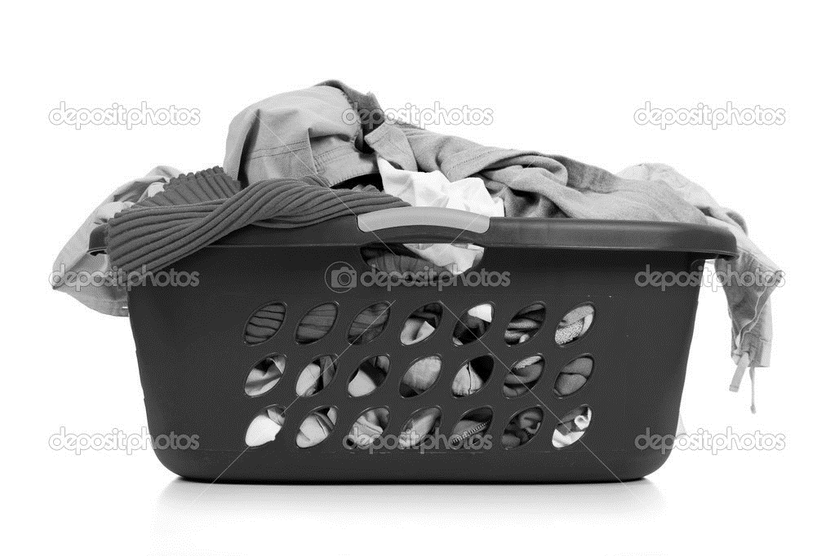
Represents the state and outcome of an asynchronous operation executed now, later or never
Task
uniform
Notes:
It is an abstraction layer which represents both CPU bound and IO-bound operations as a uniformed API
Like the task of washing clothes
If Task represents IO-bound then

Slide 8
Task
IO-bound
Notes:
So the state of the task representing the laundry machine would be running, not running, completed
The outcome should be clean clothes
I can late start the machine with a timer, or the machine can decide to run a health check before the process starts
It is also possible that because of failures the machine never starts or my wife cancels the process while I’m reading my book because yet again I’ve chosen the wrong temperature

Slide 9

Task
CPU-bound
Notes:
Threads are the workers responsible for getting Tasks done that are scheduled
A thread can handle multiple IO-bound tasks concurrently
But a thread can only handle one CPU-bound task at a time

Slide 10
Task
Forget thread!
think
Notes:
Leaving the thread management to someone who knows better
Leave it to the professionals

Slide 11
A function that is scheduled for execution
Continuation
after its prerequisite function has completed
Notes:
For example

Slide 12
cleanLaundry.ContinueWith(t => {
dryLaundry;
})

Slide 13
async/await
syntactic sugar
compiler magic
Notes:
Reduces christmas tree programming to code which looks much

Slide 14
cleanLaundry.ContinueWith(t => {
dryLaundry;
})
Notes:
So instead of we can write

Slide 15
await cleanLaundry;
dryLaundry;

Slide 16
Demo
await
Notes:
Reduces christmas tree programming to code which looks much

Slide 17
Use Task.Run, Factory.StartNew for CPU-bound work Use Task directly for IO-bound work
Use async Task instead of async void
Recap
reminder

Slide 18
Recap
Libraries and frameworks should use ConfigureAwait(false)
Async all the way, don’t mix blocking and asynchronous code
reminder

Slide 19
Slides, Links…
github.com/danielmarbach/02-25-2016-AsyncWebinar
Notes:
Questions that can be answered in blog posts

Slide 20
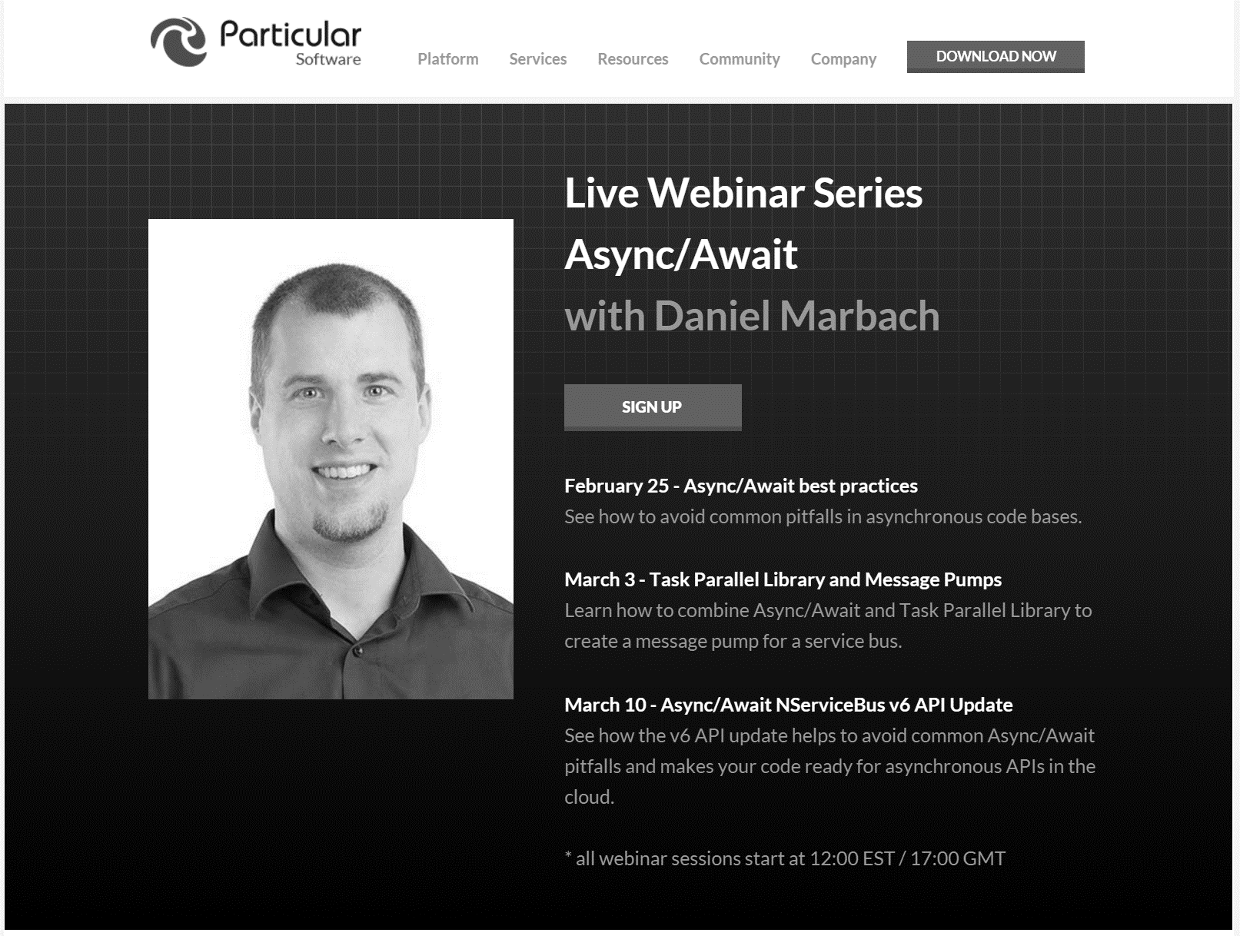
particular.net/async-await-webinar-series
Next
Notes:
Explain what’s next

Slide 21
Q & A
await
Notes:
Reduces christmas tree programming to code which looks much

Slide 22
Thanks
Notes:
Reduces christmas tree programming to code which looks much

