Slide 1

Welcome
Async / Await
Chain of Responsibility
Notes:
A warm welcome to this first webinar in the async webinar series.
Today we talk about Async best-practices

Slide 2

Solution Architect
Enthusiastic Software Engineer
Microsoft MVP for systems integration
@danielmarbach
particular.net/blog
planetgeek.ch
Notes:
I’m Daniel, Solution Architect…
I live in central Switzerland. If you want to know more about me listen to episode 77 of developer on fire
You can reach me on twitter under @danielmarbach
I blog on the particular blog and on my personal blog
Subscribe after this webinar

Slide 3
Chain of Responsibility
Threads and Tasks
Async best-practices
Why async is the future
Goals
target

Slide 4
Pattern
Why
WrapUp
Notes:
This webinar is divided into three parts
Terminology
Code and WrapUp including Q&A

Slide 5
Pattern
Why
WrapUp
Notes:
Before we dive deep into code I’m going to talk important terminologies.

Slide 6
Client
Link Element
Link Element
Link Element
Link Element
Notes:
There is a potentially variable number of "handler" or “link element" or "node" objects, and a stream of requests that must be handled. Need to efficiently process the requests without hard-wiring handler relationships and precedence, or request-to-handler mappings.

Slide 7

messaging
Link Element
Link Element
Link Element
Link Element
Host
Server
OWIN
Middleware
Application
Middleware
Middleware
Notes:
A chain of responsibility applies to more than just message-based architectures and emptying dishwashers. You'll find different variations of the pattern in frameworks and middleware like OWIN, FubuMVC, Express.js, Action Filters, and more. They usually share a common approach to the chain of responsibility implementation: nesting functions inside functions.

Slide 8
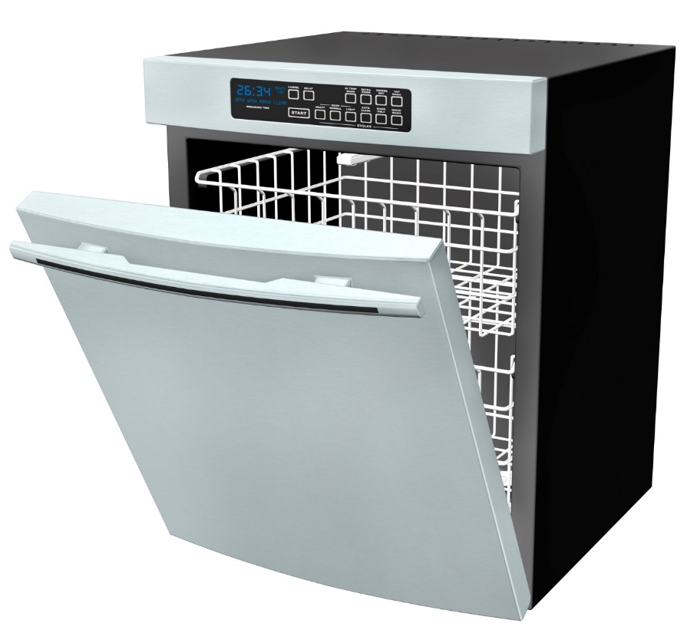
husband
wife
son
Notes:
In our house, cleaning out the dishwasher is a shared chore. My son starts the unloading process by removing a dish or utensil from the dishwasher. If he can put it away, then he does. If the proper location for the dish is out of his reach, then he passes it to his mother. She then goes through the same process; put the dish away if she can, or pass it off to the next person in line, which is me. When I get handed a dish I will put it away and, since I'm 6'4" (1.92m) tall, I can reach all of our cupboard space, which means that the process ends with me.
In our kitchen, the handing off of work can be thought of as an implementation of the chain of responsibility pattern. Each person in the family is a link in that chain. The chain of responsibility starts with my son removing a dish from the dishwasher and ends execution with me. The process of putting away dishes isn't all that different from the handling of messages in a message-based architecture. The system gets messages from a queue or stream and feeds them into the next transformation or piece of business logic.
Each person in our kitchen has a clearly defined set of questions that they ask themselves to determine if they should put the dish away or hand it off to the next process. With these clearly defined questions, each person, or link, has a well-encapsulated set of rules that they apply as they deal with each dish.

Slide 9
static void Person(Action next)
{
// Implementation
next();
}
Notes:
The process of unloading our dishwasher is, at its heart, a chain of responsibility. At our house, we have three steps in the chain and our output is an empty dishwasher. With this in mind, let's explore the code representation of our dishwasher-unloading chain so that we can see the chain and its links. A single person, a link in the chain, can be represented as just a method.
The method Person above has a single parameter called next of type Action. The Action type is a delegate that can point to any method returning void and accepting zero parameters. Passing in the delegate allows us to compose multiple individual elements together into a chain of responsibility.

Slide 10
public void ManualDishwasherUnloading()
{
Son(() => Wife(() => Husband(() => Done())));
}

Slide 11
Demo
await

Slide 12
next()
Son
next()
Wife
next()
Husband

Slide 13
cumbersome
Notes:
Of course, complex method-chaining like we've shown in ManualDishwasherUnloading isn't something we'd enjoy manually writing repeatedly. By itself, the code isn't complex. As the method chain grows, visualizing and understanding it becomes more and more difficult. Changing or adding to a large chaining sequence becomes a process that can easily introduce errors or create unintended side effects.
Luckily, there's an even more flexible and maintainable way of building a chain of responsibility.

Slide 14
Demo
await

Slide 15
Terminology
Why
WrapUp
Notes:
Now we set the baseline with the terminologies. Let’s dive into code.

Slide 16
Demo
await

Slide 17
Task
Forget thread!
think
Notes:
Stop thinking in threads. For most applications threads are no longer relevant. Think in Tasks. Rest assured the TPL runtime is heavily optimized for most production scenarios.

Slide 18
cast
The die
is

Slide 19
Will be Async all the way
Applies the shown best-practies like ConfigureAwait(false) consequently, checked with Roslyn analyzer
NSB v6
particular.net/blog/async-await-its-time
Notes:
But how does this relate to the yet to be release NServiceBus Version 6

Slide 20
Use Task.Run, Factory.StartNew for CPU-bound work Use Task directly for IO-bound work
Use async Task instead of async void
Recap
reminder

Slide 21
Recap
Libraries and frameworks should use ConfigureAwait(false)
Async all the way, don’t mix blocking and asynchronous code
reminder

Slide 22
Slides, Links…
github.com/danielmarbach/async-dolls
Notes:
Questions that can be answered in blog posts

Slide 23
Q & A
await

Slide 24
Thanks
Notes:
Thank you very much for listening and see you next time

