Slide 1
Optical Networks
Routing data as light through fiber — faster, farther, with more capacity than any cable
Fiber Physics
WDM & EONs
SDM Multi-Core
Advanced Networks Research Lab · UT Dallas · 2026

Slide 2
Seminar Roadmap
We build on Seminar 1's slice model and go deeper into the physical transport layer — the optical fiber network that carries all traffic.
01
Optical Fiber Basics
How light carries data — physics and engineering
02
Wavelength Division Multiplexing
Multiple colors of light, multiple data streams
03
Elastic Optical Networks (EONs)
Fine-grained flexible spectrum allocation
04
Space Division Multiplexing (SDM)
Multi-core fibers for massive capacity increase
05
RMCSA Problem
Routing, Modulation, Core and Spectrum Assignment
06
Lab Work — WMSM
Waypoint-assisted compute-aware slice mapping

Slide 3
Part 1: Optical Fiber Basics
Sending information as pulses of light through glass

Slide 4
Why Optical Fiber Beats Copper Cable
Optical fiber transmits data as pulses of light instead of electrical signals. This difference in physics gives fiber enormous advantages.
Speed
Light in fiber travels at ~200,000 km/s (~67% speed of light in vacuum). Data crosses continents in under 100 ms.
Bandwidth
A single fiber strand can carry 100+ Tbps — more than all the data generated globally in the early 2000s, per second.
Signal Loss
Optical fiber loses less than 0.2 dB/km of signal. Copper cable loses ~10 dB/km — 50× worse.
No EMI
Light is immune to electromagnetic interference. Copper is not — electrical lines, motors, and radios all create noise.
Reach
A single fiber segment can span 80–100 km before needing regeneration. Copper maxes out at ~100 meters for high-speed links.
Weight
Fiber is lighter and thinner than copper — easier to deploy in data centers, trenches, and submarine cables.

Slide 5
How Optical Fiber Works
An optical fiber is a thin strand of ultra-pure glass. Light bounces along the core via total internal reflection.
Core & Cladding Structure
Transmitter Side
Receiver Side
Outer Jacket (protection)
Electrical Signal
Laser Diode
EDFA
Photodetector
Cladding (lower refractive index)
Core (silica glass, 8-50 µm)
Laser diode converts electrical signal → light pulses
Pulse = “1” bit; no pulse = “0” bit
Modulation schemes (QPSK, QAM) encode multiple bits per symbol
More bits/symbol = more data per unit of spectrum
Photodetector converts light pulses → electrical signal
EDFA (Erbium-Doped Fiber Amplifier) amplifies signal
After ~80–100 km: OEO transponder regenerates signal
OEO = Optical–Electrical–Optical: restores signal integrity
💡 Total Internal Reflection traps light in core
Core: ultra-pure silica glass, 8–50 µm diameter
Cladding: lower refractive index than core
Light is trapped in core — propagates without touching cladding
Signal travels at ~200,000 km/s (~67% speed of light)

Slide 6
How Optical Fiber Works
Signal quality degrades over distance. Understanding impairments and regeneration is essential for long-haul networks.
Signal Impairments
Regeneration & OEO
⚡ Attenuation
Signal strength decreases with distance (0.2 dB/km). Limits how far a signal can travel before needing amplification.
Node A
~80–100 km
To Increase the range
Refreshed!
Node B
Optical Amplification
Optical Regeneration
🌈 Chromatic Dispersion
Different wavelengths travel at slightly different speeds, spreading out pulses over distance and causing inter-symbol interference.
EDFA
Light → Elec → Light
🌀 Nonlinear Effects
At high power, fiber behaves nonlinearly — limits usable symbol rates and constrains system design.
After max reach (~80–100 km), signal must be amplified/regenerated at an intermediate node
Optical amplification(uses EDFA) – boosts several simultaneously along with the noise.
OEO: light → electronics → light (new transmitter); restores signal quality
Enables longer multi-segment paths across cities or continents

Slide 7
Activity 1
A signal regeneration station is placed every 80–100 km along a long-haul fiber route.
What is the main reason for this?
A
The fiber cable must be spliced because it can only be manufactured in 100 km lengths
B
Light pulses weaken over distance due to attenuation, and must be electrically regenerated to restore signal integrity
C
The wavelength of light changes over distance and must be recalibrated to the correct color
D
Optical fiber requires cooling stations to prevent overheating at high data rates
💬 Hint: think about what "0.2 dB/km" means over 1000 km.

Slide 8
Activity 1 - Answers
A signal regeneration station is placed every 80–100 km along a long-haul fiber route.
What is the main reason for this?
A
The fiber cable must be spliced because it can only be manufactured in 100 km lengths
B
Light pulses weaken over distance due to attenuation, and must be electrically regenerated to restore signal integrity
C
The wavelength of light changes over distance and must be recalibrated to the correct color
D
Optical fiber requires cooling stations to prevent overheating at high data rates
✓ B — Attenuation (0.2 dB/km) accumulates. After ~100 km a signal can be too weak to read reliably. OEO regeneration (Optical→Electrical→Optical) restores full signal quality. The fiber itself is fine — it is the physics of light propagation that sets the limit.

Slide 9
Modulation Formats: Trading Reach for Capacity
Each format encodes a different number of bits per symbol. More bits = more capacity but shorter reach.
BPSK
QPSK
16-QAM
Q
1 bit/symbol
Max reach: ~2000 km
4 slots/Gbps
Q
2 bits/symbol
Max reach: ~1000 km
2 slots/Gbps
Q
4 bits/symbol
Max reach: ~500 km
1 slot/Gbps
I
I
I
Reach:
Reach: ~2000 km ★★★
Reach:
Reach: ~1000 km ★★
Reach:
Reach: ~500 km ★
🌊 Long-haul submarine & cross-continent
📡 Metro & long-distance backbone segments
🏙 Short-haul data-center interconnects & metro rings
The Segmentation Trick
Short segments → better modulation → fewer slots/Gbps → more slices per fiber
Key insight: a 1500 km path between City A and City B must use BPSK, consuming 4 slots/Gbps. But if we split it at a waypoint into two 750 km segments, each segment can use QPSK — 2 slots/Gbps. This halves the spectrum cost.

Slide 10
Activity 2
Pick Your Modulation Format
Use the modulation table from the slide to answer these scenarios. Work with a partner — no calculator needed.
Format | Max Reach | Slots/Gbps | Bits/Symbol
BPSK 2000 km 4 slots/Gbps 1 bit
QPSK 1000 km 2 slots/Gbps 2 bit
16-QAM 500 km 1 slot/Gbps 4 bit
Q1
A request needs 20 Gbps between two data centres 400 km apart. Which modulation format do you use? How many spectrum slots?
Q2
The same 20 Gbps request needs to travel 1200 km instead. Now which format? How many slots? How does the slot count change vs Q1?
Q3
A WMSM algorithm splits the 1200 km path into two 600 km segments. Which format can each segment now use? Total slot count?
Q4
Why does the WMSM segmentation approach in Q3 save slots compared to Q2? Write the ratio.

Slide 11
Activity 2 - Answer
Pick Your Modulation Format — Worked Answers
Q1
400 km ≤ 500 km → 16-QAM (1 slot/Gbps). Slots = 20 Gbps × 1 = 20 slots.
Q2
1200 km > 1000 km → BPSK (4 slots/Gbps). Slots = 20 Gbps × 4 = 80 slots. 4× more expensive than Q1.
Q3
Each segment is 600 km ≤ 1000 km → QPSK (2 slots/Gbps). Slots per segment = 20 × 2 = 40. Total = 40 slots (both segments run in parallel — you need 40 contiguous slots, not 80).
Q4
BPSK uses 80 slots; WMSM with QPSK uses 40 slots. Ratio: 2:1 saving. With 16-QAM segments ≤ 500 km the ratio would reach 4:1. This is the core efficiency gain from waypoint segmentation.

Slide 12
Part 2: WDM and Elastic Optical Networks
Multiple colors of light, flexible spectrum grids

Slide 13
Wavelength Division Multiplexing (WDM)
A single optical fiber can carry many independent data streams simultaneously — each on a different wavelength (color) of light. This is WDM, and it multiplies fiber capacity by the number of channels.
λ1 (1530nm)
λ2 (1535nm)
λ3 (1540nm)
λ4 (1545nm)
λ5 (1550nm)
Optical Fiber
DWDM Standard (ITU-T)
Flex-Grid (Elastic)
Capacity Numbers
Dense WDM: channels spaced at 50 GHz or 100 GHz
Up to 80–160 channels per fiber
Fixed grid: channels have fixed positions and widths
Efficient for homogeneous traffic but wastes spectrum for variable-size demands
Channels can be any width in multiples of 6.25 GHz
Smaller channels for low-bandwidth flows
Wider channels for high-bandwidth flows
Spectrum slots are the basic unit — like pixels on a screen
Single channel: up to 400 Gbps with modern coherent optics
Per fiber (80 channels): up to 32 Tbps total
Transoceanic cable: dozens of fiber pairs per cable
Global Internet backbone: uses hundreds of WDM fiber links

Slide 14
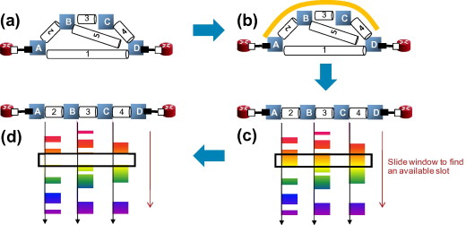
Elastic Optical Networks: Fine-Grained Spectrum
Elastic Optical Networks (EONs) use a flex-grid where the spectrum is divided into 6.25 GHz slots. Connections are allocated a contiguous block of slots — no fixed channel positions.
Spectrum (C-band, ~4.8 THz total, 768 slots of 6.25 GHz)
Flow A
2 slots
B
1 slot
gap
Flow C
3 slots
gap
Flow D
2 slots
gap
E
Spectrum Continuity
Spectrum Contiguity
Spectrum Fragmentation
A lightpath must use the same slot block on every link along its route — from source to destination
This is the "continuity constraint" — it limits spectrum reuse
OEO conversion at a waypoint breaks this: each segment has its own independent spectrum block
The slots allocated to a connection must be adjacent — they form one contiguous block
A 20 Gbps flow on QPSK needs 40 GHz = ceil(40/6.25) = 7 contiguous slots
Non-contiguous slots cannot be used for one connection in standard EON hardware
As connections arrive and depart, gaps appear between allocated blocks
Small gaps may not fit new connections even if total free spectrum is sufficient
Fragmentation reduces effective capacity and increases blocking probability
Segment-wise allocation (WMSM) helps by using shorter segments more efficiently
RSA = Routing and Spectrum Assignment. Jointly choosing a path and slot block for each request is NP-hard.

Slide 15
Activity 3
A 30 Gbps request needs to be routed over QPSK (2 slots/Gbps) on a flex-grid EON.
Which slot assignment is valid?
A
Slots 1, 3, 5, 7, 9, 11 — six non-contiguous slots across the spectrum
B
Slots 10–12 on Link 1, and slots 15–17 on Link 2 (different blocks on each link)
C
Slots 10–69 — a contiguous 60-slot block on every link along the path
D
Slots 10–69 on Link 1 only — the other links can use any free slots independently
💬 Recall: 30 Gbps × 2 slots/Gbps = 60 slots needed. Two constraints to satisfy.

Slide 16
Activity 3 - Answer
A 30 Gbps request needs to be routed over QPSK (2 slots/Gbps) on a flex-grid EON.
Which slot assignment is valid?
A
Slots 1, 3, 5, 7, 9, 11 — six non-contiguous slots across the spectrum
B
Slots 10–12 on Link 1, and slots 15–17 on Link 2 (different blocks on each link)
C
Slots 10–69 — a contiguous 60-slot block on every link along the path
D
Slots 10–69 on Link 1 only — the other links can use any free slots independently
✓ C — 30 Gbps × 2 slots/Gbps = 60 contiguous slots. A violates contiguity (non-adjacent). B violates continuity (different slots on different links). D violates continuity (same block required on ALL links). C satisfies both constraints.

Slide 17
Part 3: Space Division Multiplexing
Adding a third dimension — spatial cores — to multiply fiber capacity

Slide 18
From Single-Core to Multi-Core Fiber
Traditional fiber has one glass core. SDM packs multiple cores into one cable — each core independently carrying WDM channels.
Single-Core Fiber
7-Core MCF
19-Core MCF
1 core
7 cores
19 cores
Baseline: 1× capacity
7× capacity
19× capacity
● center ○ ring
center / inner ring / outer ring
Capacity multiplication: A 7-core MCF with 120 slots per core provides 7× the capacity of a single-core fiber with the same slot count.

Slide 19
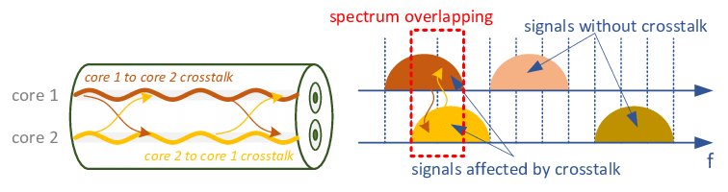
The Challenge: Inter-Core Crosstalk (IC-XT)
When cores in a multi-core fiber are placed adjacent to each other, light leaks from one core into its neighbors. This is inter-core crosstalk — it degrades signal quality and limits capacity.
What Causes Crosstalk?
Light propagating in a core creates an evanescent field that extends slightly beyond the core boundary
Adjacent cores that are physically close pick up a small fraction of this field
This crosstalk accumulates over the fiber length
Higher crosstalk = more noise = lower SNR = must use lower-order modulation format
Crosstalk Geometry
Center core (core 7 in 7-MCF) is adjacent to all 6 outer cores — highest crosstalk
Outer cores are adjacent to the center and 2 other outer cores
Non-adjacent cores have negligible crosstalk
Key: if we assign a connection to core 1, we should avoid assigning another connection to any adjacent core on the same link
Why This Matters for Slice Embedding
Crosstalk awareness is a hard constraint — not a soft preference
An algorithm that ignores IC-XT may produce solutions that look feasible on paper but fail in practice

Slide 20
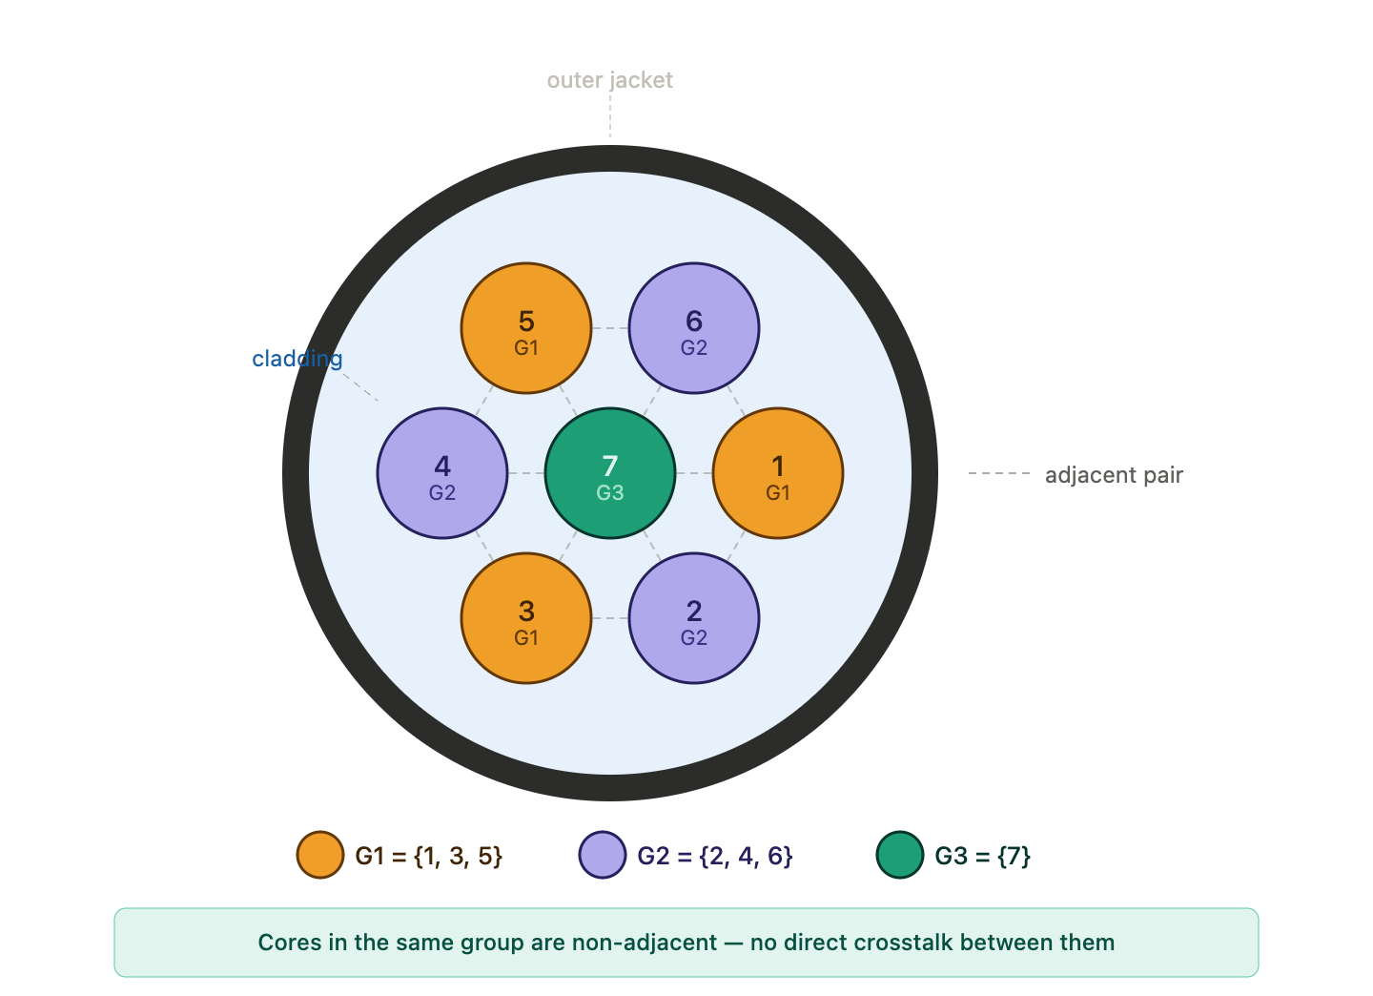
Activity 4
Can These Slices Share the Link?
A 7-core fiber partitions cores into three non-adjacent groups: G1 = {1, 3, 5} · G2 = {2, 4, 6} · G3 = {7 — center core}
Q1
Slice A uses core group G1. Slice B uses core group G2 on the same link. Is this safe from crosstalk? Why?
Q2
Slice C uses core group G1. Slice D also wants core group G1 on the same link, same spectrum slot. Is this possible?
Q3
Slice E is assigned G3 (the center core). The network also wants to assign Slice F to G1 on the same link. Is there a crosstalk problem? Explain.
Q4
A new request arrives and only core group G3 has free slots. The previous operator always avoided G3. Should they accept the request? What is the trade-off?

Slide 21
Activity 4 - Answer
Can These Slices Share the Link? — Answers
Q1
Yes — G1 and G2 use non-adjacent cores by design ({1,3,5} and {2,4,6} never share a boundary). The group strategy exists precisely to allow this safe co-use.
Q2
No — the same group on the same link with the same spectrum slot would mean two signals on the same core. That is a direct collision, not a crosstalk issue — it is simply impossible. Different slot blocks on G1 could co-exist, but same slot = blocked.
Q3
G3 is the center core (core 7) which is adjacent to ALL six outer cores. G1 uses cores 1, 3, 5 — all adjacent to core 7. There IS a crosstalk risk between G3 and any G1/G2 assignment on the same link. This is why G3 is used cautiously.
Q4
Trade-off: accepting gives the request capacity but exposes G3 and any co-located groups to higher crosstalk. The operator must weigh revenue vs signal quality degradation. In practice, G3 is often reserved for low-priority or short-reach flows where SNR headroom exists.

Slide 22
Part 4: The RMCSA Problem
Routing · Modulation · Core · Spectrum Assignment — all at once

Slide 23
RMCSA: Four Coupled Decisions per Slice Request
For each incoming slice request, four interrelated decisions must be made simultaneously. Solving them independently leads to infeasible or suboptimal allocations.
Request Arrives
Routing: Find path(s)
Modulation: per segment
Core: assign group
Spectrum: allocate slots
R — Routing
M — Modulation
C — Core Selection
SA — Spectrum Assignment
Find a feasible path from source s to destination d in the physical topology. For long paths: may split into segments at compute-capable waypoints.
Select the modulation format for each segment based on segment length. Longer → BPSK (4 slots/Gbps). Shorter → 16-QAM (1 slot/Gbps). Determines slot count.
Assign a non-adjacent core group to the request. Must avoid placing adjacent-core requests simultaneously on the same link (IC-XT constraint).
Allocate a contiguous block of slots on the selected core, on every link along the segment. The same slot block must be used on all links in the segment (continuity).
Why jointly? Routing determines segment lengths → segment lengths determine modulation → modulation determines slot count → slot count determines feasibility. Each decision depends on all others.

Slide 24
Virtual Network Embedding in SDM-EONs
A slice request is a virtual network: virtual compute nodes (hosting VNFs) and virtual links (requiring bandwidth). Embedding means mapping this virtual topology onto the physical SDM-EON.
The Embedding Problem
Virtual nodes → physical compute-capable nodes (respecting capacity)
Virtual links → physical paths with spectrum allocated on each link (respecting capacity and continuity)
End-to-end: latency, availability, and SLA must all be satisfied
Prior work: one virtual node maps to exactly one physical node (1:1 mapping)
Why This Is Hard (NP-Hard)
RSA alone is NP-hard (proven reduction from graph coloring)
Adding compute placement, crosstalk constraints, and modulation selection makes it harder
Exact ILP is only feasible for tiny static instances
Real networks process 50,000+ dynamic requests — need fast heuristics

Slide 25
Virtual Network Embedding in SDM-EONs
A slice request is a virtual network: virtual compute nodes (hosting VNFs) and virtual links (requiring bandwidth). Embedding means mapping this virtual topology onto the physical SDM-EON.
Our Extension: Controlled Co-location
Multiple virtual nodes can be mapped to the same physical node (co-location)
Reduces the number of virtual links needing physical provisioning
Lowers total cost and improves utilization
Risk: single point of failure — handled by capacity checks and SLA constraints
Sequential Heuristic Strategy
Instead of joint optimization: solve stages in sequence but couple them
Stage 1: enumerate paths. Stage 2: place compute at waypoints. Stage 3: select modulation. Stage 4: allocate spectrum.
Each stage's output constrains the next — coupling is preserved without exponential complexity

Slide 26
Baseline: Direct Path-Driven Slice Mapping (DPSM)
DPSM is our baseline algorithm. It finds a direct end-to-end path, places compute greedily at the first feasible node, and allocates spectrum based on total path modulation.
Request: (s, d, BW, Creq)
Dijkstra: k=3 shortest paths
Check compute: first node meeting Creq
Modulation: based on full path length
Allocate spectrum end-to-end
What DPSM Does Well
DPSM Weaknesses
Simple and fast: straightforward Dijkstra + greedy compute placement
Works well when compute is abundant and paths are short
Reasonable baseline for lightly loaded networks
Greedy compute placement can create hot spots — one node gets overloaded
No awareness of segment-level spectrum fragmentation
Blocking rises sharply at moderate-to-high loads
DPSM-Balanced variant
Balances placement by choosing the compute node closest to the path midpoint — maximizing the chance that both segments qualify for higher-order modulation

Slide 27
Waypoint-Assisted Multi-Segment Slice Mapping (WMSM)
Instead of one end-to-end path with one modulation, WMSM splits the path at compute-capable waypoints and optimizes each segment independently.
WITHOUT WMSM
S
1500 km → BPSK → 4 slots/Gbps (expensive!)
D
WITH WMSM (waypoint at midpoint)
S
750 km → 16-QAM → 1 slot/Gbps
VNF
Waypoint
750 km → 16-QAM → 1 slot/Gbps
D

Slide 28
WMSM: Algorithm Walkthrough
Given request (s, d, BW, Creq), WMSM executes these stages in order. Each stage uses the output of the previous stage.
1
1. Waypoint Enumeration
Identify all compute-capable nodes W ⊆ V_{c} such that total available compute capacity ≥ C_{req}. Restrict to at most 2 waypoints for tractability.
2
2. Segment Path Computation
For each waypoint configuration, compute up to k=2 shortest paths per segment (s→w₁), (w₁→w₂), (w₂→d). Estimate segment length D_{i}.
3
3. Modulation Selection
Assign modulation per segment based on D_{i}: 16-QAM if D_{i} ≤ 500 km, QPSK if D_{i} ≤ 1000 km, BPSK otherwise. Compute slot count S_{i} = BW × η(M_{i}).
4
4. Configuration Selection
Choose the waypoint configuration W* that minimizes total slot usage ΣS_{i}. WMSM-B also penalizes segment imbalance λ·δW (balanced placement).
5
5. Spectrum Allocation
For each segment: select core group with highest available slot ratio. Allocate S_{i} contiguous slots on the first eligible core. If any segment fails, try next configuration.
6
6. Compute Allocation
Distribute C_{req} across selected waypoint nodes. Update network state. If all configurations fail: block the request.

Slide 29
WMSM Results: ICCCN 2026
Evaluated on 14-node NSFNET, 7 cores, 120 slots/core, 50,000 requests, 30 independent runs. High compute capacity scenario (4000 units/node).
↓ 27%
↓ 47%
10⁻⁸
Reduction in blocking
probability vs DPSM at high load
Lower provisioning cost
vs Sorted/Greedy baselines
Blocking probability with
WMSM + Balanced Placement
Why WMSM Wins
What We Compare Against
Multi-segment decomposition lets each segment use 16-QAM — up to 4× fewer slots than BPSK
Balanced placement maximizes the probability both segments qualify for high-order modulation
Compute-spectrum coupling ensures routes with sufficient compute are prioritized — avoiding infeasible allocations
Effect persists under limited compute (400 units/node): WMSM sustains 10⁻⁵ blocking vs 10⁰ for DPSM
DPSM: our direct-path baseline — one segment, greedy compute
DPSM-B: balanced placement variant of DPSM
Sorted: sort requests by demand, rank nodes by compute, assign spectrum greedily
Greedy (FCFS): first-come-first-served, greedy compute and spectrum assignment
WMSM and WMSM-B consistently outperform all baselines across all load levels

Slide 30
Activity 5
Reflect & Connect
Trade-off
WMSM achieves 47% lower cost than the baseline — but it adds complexity (waypoints, OEO regeneration, more transceivers). At what scale of network does this trade-off become worthwhile? A 5-node campus? A national backbone? A transoceanic cable?
Fragmentation over time
After thousands of requests arrive and depart, the spectrum on each fiber will fragment into scattered free gaps. WMSM allocates segments shorter paths — does this help or hurt fragmentation? What would a defragmentation routine look like?
Connecting to Seminar 1
In Seminar 1, the RL agent did admission control — deciding whether to accept a slice at all. Now we have WMSM deciding how to embed a slice into optical fiber. Could you combine these two? What would the RL agent need to know about the optical layer?
Looking Ahead
Seminar 3 covers quantum networking — entangled photons distributed over the same optical fiber. Photons cannot be amplified or regenerated (no-cloning theorem). How do you think that constraint will change the routing and spectrum problem?

Slide 31
Seminar 2 — Key Takeaways
01. Optical fiber transmits data as light — terabits per second, continent-scale reach, minimal loss.
02. WDM lets multiple wavelengths share one fiber. Flex-grid EONs allocate spectrum in 6.25 GHz slots.
03. SDM adds spatial cores — 7× to 19× capacity per cable — but introduces inter-core crosstalk constraints.
04. RMCSA (Routing, Modulation, Core, Spectrum Assignment) must be solved jointly — individual stages can produce infeasible solutions.
05. WMSM splits slice paths at VNF waypoints, enabling higher-order modulation per segment — up to 47% lower provisioning cost.
06. Next: Seminar 3 — Quantum Networking, where we take the optical layer into the quantum regime.

