Slide 1
Quantum Networking
Using quantum physics to build the next-generation internet — where security is a law of nature
Quantum Basics
EPR & Entanglement
Joint RSA + Lab Work
Advanced Networks Research Lab · UT Dallas · 2026

Slide 2
Seminar Roadmap
We build on Seminars 1 and 2. The optical fiber network is now the physical layer for quantum photon transmission. The "spectrum" is still real — we allocate the same 6.25 GHz flex-grid slots.
01
Quantum Mechanics Crash Course
Superposition, measurement, qubits, and no-cloning
02
Quantum Entanglement
What it is, why it matters, and EPR pairs
03
Quantum Networks
Architecture, components, and current state of deployment
04
Entanglement Distribution
Routing two photons from a source to consumer nodes
05
Joint RSA Problem
Why routing and spectrum must be solved together
06
Lab Work & Future Research
Our RCH heuristic results + multi-source placement problem

Slide 3
Part 1: Quantum Mechanics Crash Course
The physics that makes quantum networking possible — and provably secure

Slide 4
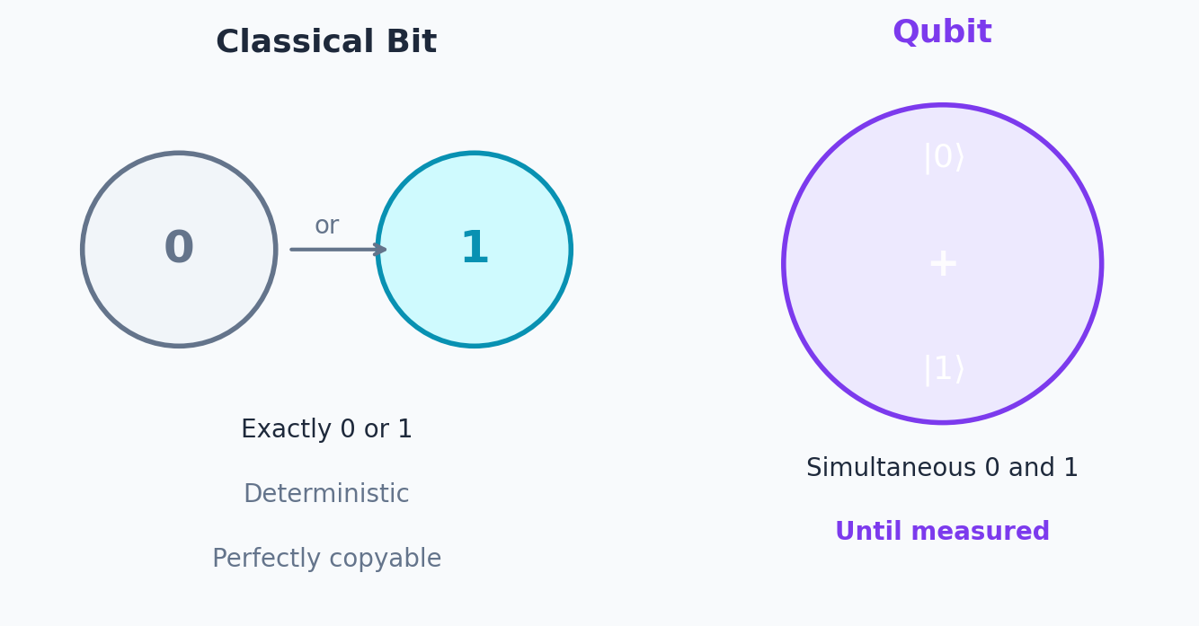
From Classical Bits to Qubits
Classical bits are deterministic and copyable. Qubits obey quantum mechanics — enabling a new paradigm for computing and communication.
Classical Bit
Can be exactly 0 or exactly 1 — nothing in between
Reading a bit does not change it — completely deterministic
Can be perfectly copied: send the same bit to a thousand places
Security is based on computational hardness: RSA relies on the difficulty of factoring large numbers
Quantum computers (once mature) can factor large numbers efficiently → RSA is vulnerable
Examples: every transistor in your CPU or phone stores a classical bit
Qubit (Quantum Bit)
Can be in a superposition: simultaneously "0" and "1" — until measured
Superposition is a real physical state, not just "we don't know which it is"
The act of measurement collapses the qubit to either 0 or 1 — and destroys the superposition
Cannot be perfectly copied — this is the no-cloning theorem (a proven law of physics)
No-cloning → any eavesdropper attempting to intercept a qubit disturbs it detectably
Examples: photon polarization, electron spin, superconducting circuits

Slide 5
Activity 1
What Makes a Qubit Strange?
Qubits break two things we take for granted about information. Discuss these thought experiments in pairs:
The Coin Analogy
A spinning coin is "heads and tails at once" — is this the same as superposition? Why or why not? (Hint: what happens when the coin lands vs. when you measure a qubit?)
The Copy Machine Test
You receive a sealed envelope with a qubit inside. You want to open it, read it, copy it, reseal it, and forward it without the sender knowing. Why is this impossible for qubits but trivially easy for classical bits?
The Security Implication
Your bank currently relies on RSA encryption. A quantum computer that can run Shor's algorithm is turned on tomorrow. What does that mean for your savings account? What would the bank need to do?

Slide 6
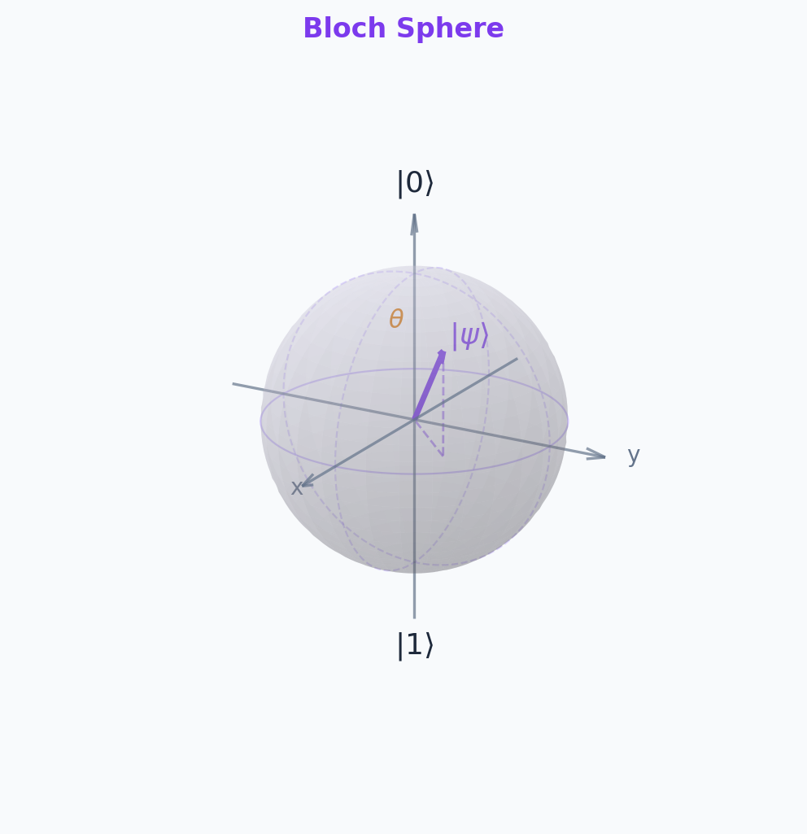
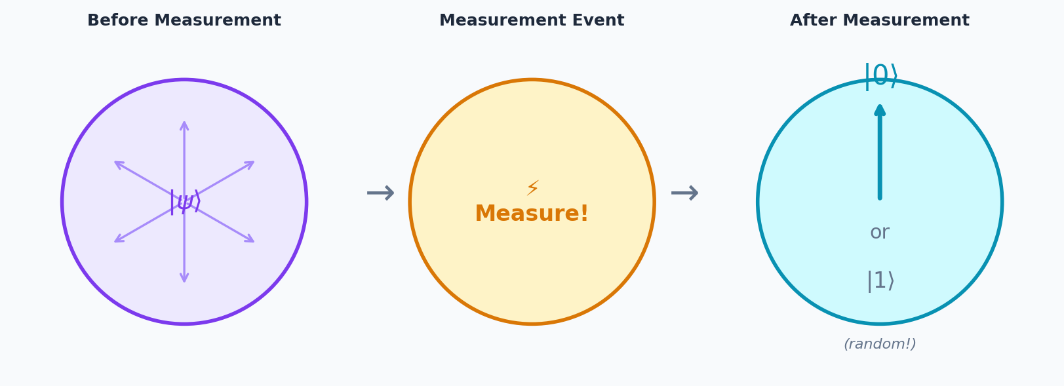
Superposition, Measurement, and the Bloch Sphere
A qubit exists in superposition of |0⟩ and |1⟩. Measurement collapses it — irreversibly — to one classical outcome.
Superposition State
|ψ⟩ = α|0⟩ + β|1⟩ where |α|² + |β|² = 1
|α|² = probability of measuring 0 ; |β|² = probability of measuring 1
Before measurement: the qubit is genuinely in both states at once — not just "unknown"
Measurement Collapses the State
Once measured, |ψ⟩ collapses to |0⟩ or |1⟩ — never seen as ½ |0⟩ + ½ |1⟩
The probabilistic outcome is fundamentally random — not due to ignorance
This irreversibility is why no-cloning holds: to clone, you would need to know the full state
Why This Matters for Networking
Any attempt to eavesdrop on a qubit = measure it = collapse its state = detectable disturbance

Slide 7
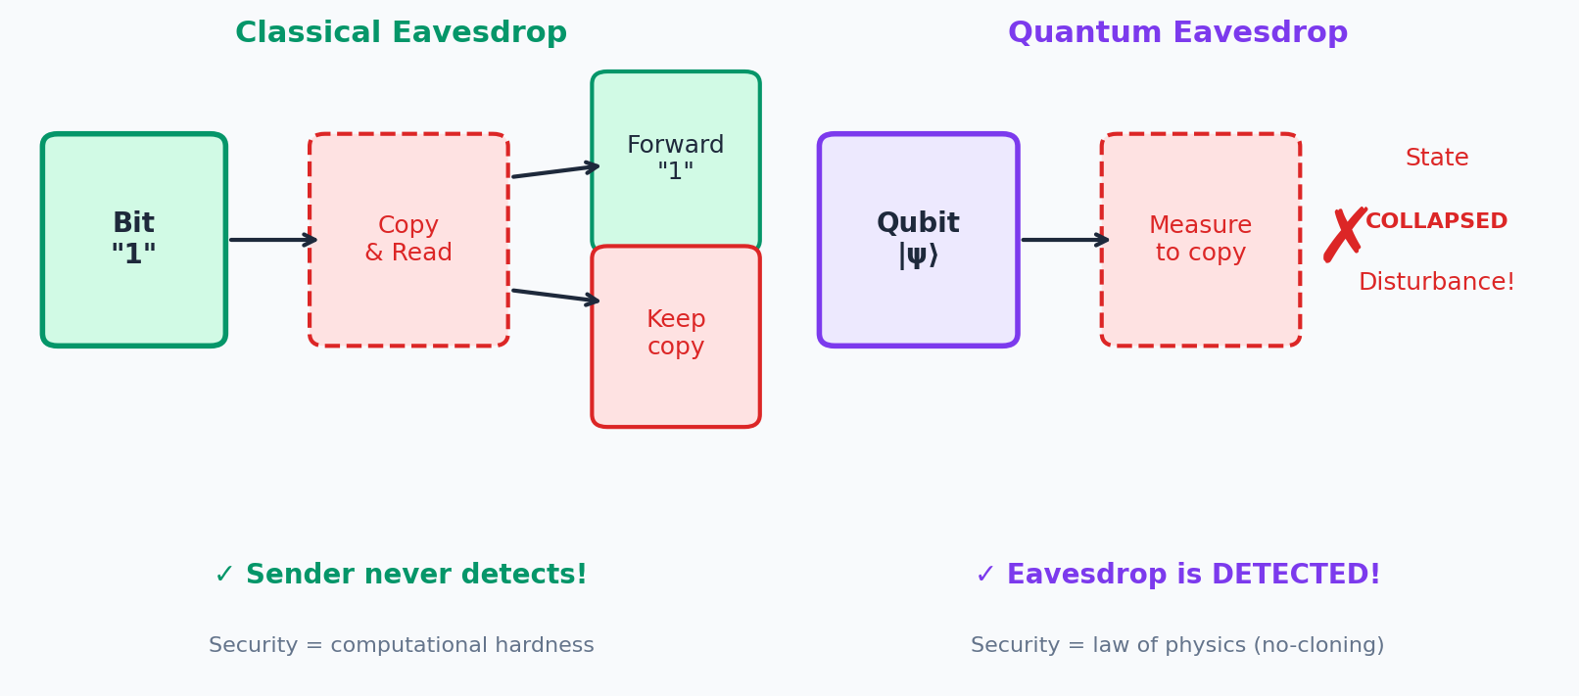
The No-Cloning Theorem: Why Quantum = Secure
Classical information can be copied freely. Quantum information cannot — this is the no-cloning theorem, proven in 1982 by Wootters and Zurek.
The Theorem (Informal)
Why It Matters for Security
It is physically impossible to create a perfect independent copy of an unknown quantum state
Any copying attempt requires measuring the qubit — which collapses it
After measurement, you get one classical bit (0 or 1), not the full superposition state
The original qubit has been irreversibly disturbed
Classical eavesdrop: attacker copies the bit, reads it, forwards the copy — sender never knows
Quantum eavesdrop: attacker must measure the qubit — which collapses it and disturbs the state
The legitimate receiver detects the disturbance — the eavesdrop is revealed
Security is guaranteed by physics, not by computational hardness

Slide 8
The No-Cloning Theorem: Why Quantum = Secure
Quantum Key Distribution (QKD)
QKD uses quantum states to establish a shared secret key between two parties
BB84 protocol (1984): uses photon polarization to distribute key bits
Any eavesdropper disturbs the photons — detected by a statistical test
Result: unconditionally secure key exchange (proven against all attacks)
The RSA Threat
Today's internet security (HTTPS, banking, VPNs) relies on RSA or Elliptic Curve Cryptography
These are secure against classical computers
But Shor's quantum algorithm (1994) can factor large numbers in polynomial time
A sufficiently powerful quantum computer breaks RSA — QKD is post-quantum secure

Slide 9
Activity 2
An attacker intercepts a qubit being transmitted over a quantum network. They measure it, record the result, and forward it.
What is the consequence?
A
Nothing — a qubit is just a bit, so the attacker gets the bit value and the receiver gets an identical copy
B
The attacker learns the bit value, but the qubit arrives at the receiver unchanged, so the eavesdrop goes undetected
C
Measuring the qubit collapses its superposition — the receiver detects a disturbed state, revealing the eavesdrop
D
The qubit is destroyed in transit — the receiver gets nothing and knows the link is broken
💬 Think about what "measurement collapses superposition" means for a qubit already in a known state.

Slide 10
Activity 2 - Answer
An attacker intercepts a qubit, measures it, records the result, and forwards it.
What is the consequence?
A
Nothing — a qubit is just a bit, so the attacker gets the bit value and the receiver gets an identical copy
B
The attacker learns the bit value, but the qubit arrives at the receiver unchanged, so the eavesdrop goes undetected
C
Measuring the qubit collapses its superposition — the receiver detects a disturbed state, revealing the eavesdrop
D
The qubit is destroyed in transit — the receiver gets nothing and knows the link is broken
✓ C — The attacker must measure to learn the state. Measurement irreversibly collapses the qubit. The receiver receives a collapsed (not superposed) qubit — statistically detectable. A is wrong: qubits cannot be cloned. B is wrong: the disturbance is real. D is wrong: the qubit is forwarded, not destroyed.

Slide 11
Part 2: Quantum Entanglement
Einstein's "spooky action at a distance" — and how we use it

Slide 12
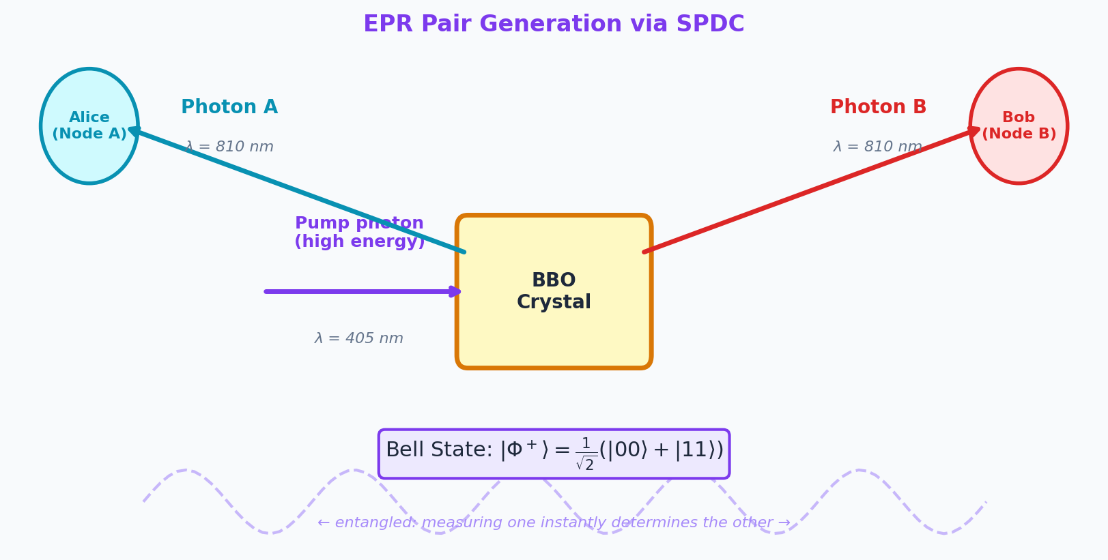
What Is Quantum Entanglement?
Entangled qubits share correlated states across any distance. Measuring one instantly determines the other — tested at 1,200 km!
Creating Entanglement
Two qubits can be entangled by a quantum gate operation
One common method: apply a Hadamard gate to qubit 1, then a CNOT gate using qubit 1 as control and qubit 2 as target
Result: |Φ+⟩ = (|00⟩ + |11⟩) / √2 — a Bell state
In photonics: Spontaneous Parametric Down-Conversion (SPDC) produces entangled photon pairs from a single pump photon

Slide 13
What Is Quantum Entanglement?
The Bell State |Φ+⟩
Before measurement: neither photon is 0 or 1 — they are in superposition together
When photon A is measured and found to be 0 → photon B instantly collapses to 0
When photon A is measured and found to be 1 → photon B instantly collapses to 1
This holds regardless of the distance between the photons — tested at 1200 km!
Is This Faster-Than-Light Communication?
No. The correlations are real, but you cannot use them to send information faster than light
You learn the result of qubit B's measurement only after receiving a classical message from the sender
The classical communication channel is still required — and is limited by the speed of light
What entanglement provides is correlated randomness — not a communication shortcut
Applications of Entanglement
Quantum Key Distribution: entangled pairs create shared secret keys that are physically impossible to intercept undetected
Distributed Quantum Computing: entanglement links quantum processors across locations
Quantum Teleportation: transfer a qubit's state using entanglement + classical channel (no physical matter transported)
Quantum Sensing: entangled sensors achieve precision beyond the classical limit

Slide 14
ACTIVITY 3
True or False? Sort These Statements
With your partner, mark each statement TRUE or FALSE. Be ready to explain your reasoning — some are common misconceptions.
1
Measuring one photon of an entangled pair instantly determines the other — regardless of the distance between them.
T
4
Once an entangled photon is measured, re-entangling it with its partner restores the original state.
T
F
F
2
Entanglement allows you to send a message faster than the speed of light.
T
5
An EPR pair generated by SPDC sends one photon toward Node A and one toward Node B — both photons originated from a single pump photon.
T
F
F
3
Before measurement, neither photon in an entangled pair has a definite polarization value.
T
6
If I measure photon A and get "horizontal", photon B will always give "vertical" — the outcomes are always opposite.
T
F
F

Slide 15
ACTIVITY 3 - Answer
True or False? — Answers
1
4
Measuring one instantly collapses the joint state — the partner's outcome is determined. Distance is irrelevant.
Measurement is irreversible. The original superposition state is gone — you cannot "re-entangle" after collapse.
TRUE
FALSE
2
5
You cannot transmit information this way. You only learn the result after a classical message confirms it — still limited by speed of light.
SPDC splits one high-energy pump photon into two correlated lower-energy photons — that's the source of entanglement.
FALSE
TRUE
3
6
The Bell state |Φ+⟩ = (|00⟩+|11⟩)/√2 — neither photon has a definite value until one is measured.
For |Φ+⟩, both photons give the SAME outcome (both 0 or both 1). For |Ψ+⟩, they give opposite outcomes. It depends on which state is prepared.
TRUE
FALSE — depends on the Bell state used

Slide 16
EPR Pairs and SPDC: Generating Entangled Photons
An EPR pair (Einstein-Podolsky-Rosen) is a specific entangled two-qubit state. In optical quantum networks, EPR pairs are generated as pairs of entangled photons using SPDC.
Spontaneous Parametric Down-Conversion (SPDC)
A high-energy pump photon enters a nonlinear crystal (e.g., BBO crystal)
With some probability, the pump photon splits into two lower-energy photons
These two photons are entangled in polarization — measuring one determines the other
They travel in opposite directions — one photon to each consumer node
SPDC is the most practical and mature method for generating EPR pairs today

Slide 17
EPR Pairs and SPDC: Generating Entangled Photons
Why Photons Are Used in Networks
Photons travel naturally through optical fiber — the same infrastructure from Seminar 2
Photon polarization (horizontal/vertical) encodes the qubit state
Photons interact minimally with the environment — low decoherence over fiber
Wavelength-division multiplexing can carry quantum and classical channels on the same fiber
Compatibility with existing optical network infrastructure is crucial for near-term deployment
The Transmission Challenge
Both photons of an EPR pair must reach their respective consumer nodes — one photon to Node A, one photon to Node B
They must travel on edge-disjoint paths (no shared fiber links) — otherwise both photons could be lost if that link fails
They must use the same wavelength channel — otherwise they cannot be identified as a matched pair at the receivers
Longer paths attenuate the signal more — transmittance η = 10^{(-l/10)} decreases exponentially with path length l

Slide 18
Activity 4
To distribute an EPR pair from source S to consumer nodes A and B, the two photons must travel along paths that are:
A
The shortest possible paths — even if they share the same fiber links — because shorter paths mean higher transmittance
B
Edge-disjoint paths that share no fiber links, and must use the same spectrum channel
C
Edge-disjoint paths that share no fiber links, each on a different spectrum channel to avoid interference
D
Any two paths of equal length — channel assignment does not matter as long as no path exceeds 100 km
💬 Recall: both photons are matched — they must arrive as a correlated pair at the receivers.

Slide 19
Activity 4 - Answer
To distribute an EPR pair from source S to consumer nodes A and B, the two photons must travel along paths that are:
A
The shortest possible paths — even if they share the same fiber links — because shorter paths mean higher transmittance
B
Edge-disjoint paths that share no fiber links, and must use the same spectrum channel
C
Edge-disjoint paths that share no fiber links, each on a different spectrum channel to avoid interference
D
Any two paths of equal length — channel assignment does not matter as long as no path exceeds 100 km
✓ B — The two paths must be edge-disjoint (no shared fiber, so one failure doesn't lose both photons) AND share the same spectrum channel (so receivers can identify them as a matched pair). C is wrong: different channels mean the photons cannot be correlated. A ignores disjointness. D ignores channel assignment.

Slide 20
Part 3: Quantum Network Architecture
Components, topology, and current deployment landscape

Slide 21
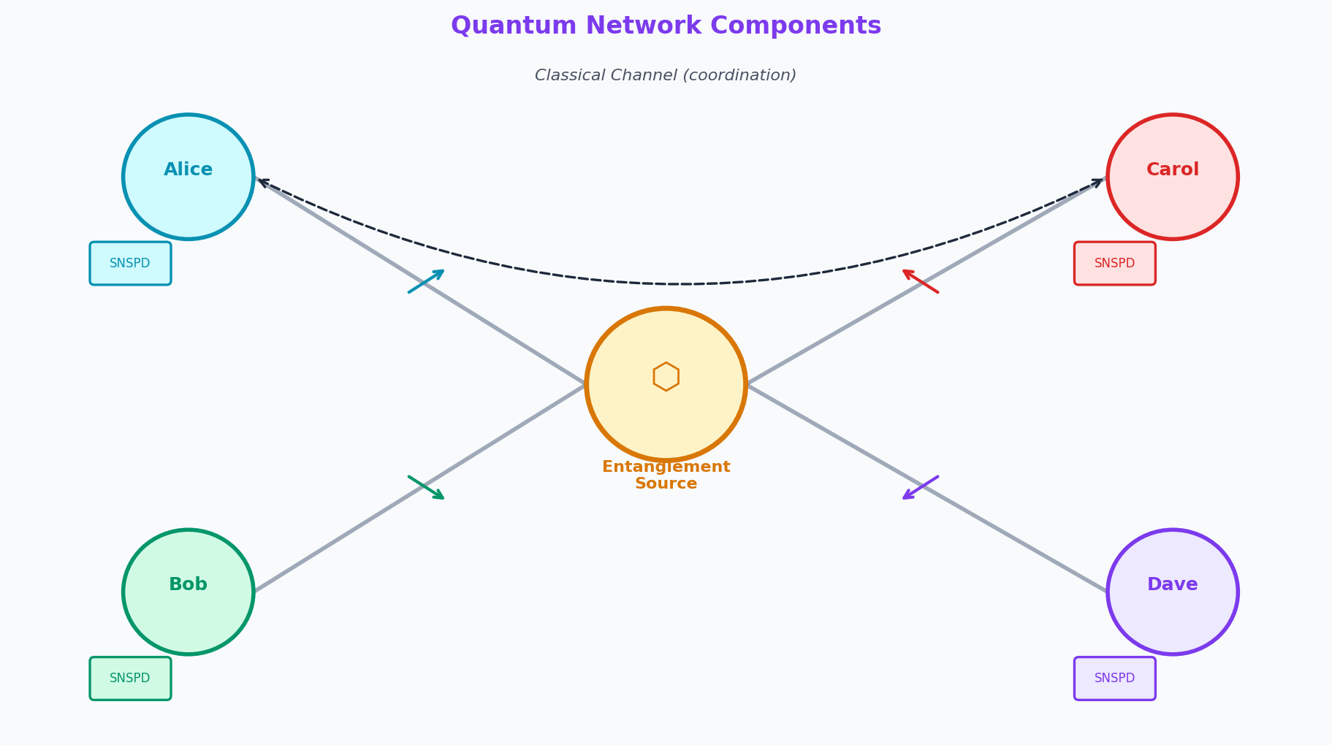
Building Blocks of a Quantum Network
Quantum networks share classical fiber infrastructure, augmented with quantum-specific components for generating, routing, and detecting entangled photons.
Entanglement
Source
A node containing a nonlinear crystal (SPDC). Generates EPR pairs. Sends one photon to each consumer.
Consumer Node
Any network node that wishes to share entanglement with another node (for QKD, distributed computing, etc.). Pairs of consumer nodes request EPR distribution.
Quantum Channel
An optical fiber path carrying a photon. Must be low-loss and low-noise. Can share the fiber with classical WDM channels on different wavelengths.
Photon Detector
Single-photon avalanche diode (SPAD) or superconducting nanowire (SNSPD) at the consumer. Detects the arriving photon and collapses its state by measurement.
Classical Channel
A separate classical fiber path used to coordinate: communicate which photon pairs were successfully received, compare measurement bases (for QKD), etc.
Quantum Repeater
Stores qubits in quantum memory and performs entanglement swapping to extend range.

Slide 22
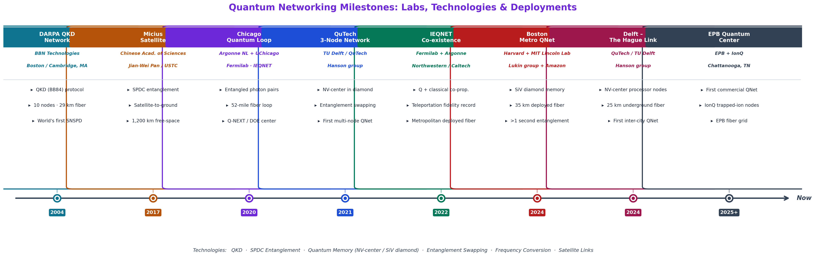
The State of Quantum Networking Today
Quantum networking is transitioning from lab experiments to early real-world deployments — with rapid progress over the last decade.
Current Limitations
No quantum repeaters: limited to ~100–200 km terrestrial links without satellites
Low photon generation rates: SPDC is probabilistic — many pump pulses yield no pair
Detector efficiency: best single-photon detectors are ~95% efficient — still lose 5%
Decoherence: photon states degrade over time in fiber — quantum memory is immature

Slide 23
Part 4: Joint Routing and Spectrum Allocation
Why routing and spectrum cannot be solved separately in quantum networks

Slide 24
The Quantum RSA Problem
Given a set of consumer node pairs, all wanting EPR distribution from a single source, find: (1) edge-disjoint path pairs for each consumer pair, and (2) a spectrum channel for each — maximizing the minimum throughput.
What We Must Decide Per Consumer Pair (i, j)
Constraints
Path pair R = (p_{i}, p_{j}): two edge-disjoint paths from source s to nodes i and j
Both paths in R must use the same spectrum channel x (they carry matched photons)
Y_{R,(i,j)} = 1 if pair (i,j) uses path pair R
X_{x,R} = 1 if channel x is used for path pair R
Edge disjointness: p_{i} and p_{j} share no fiber link (path-level constraint, precomputed)
Channel capacity: at most ⌊W/W_{c}⌋ channels per link (W = total bandwidth, W_{c} = channel width)
No contention: if two path pairs R and R' share any fiber link, they cannot use the same channel x
Each consumer pair gets exactly one path pair (routing decision)
Objective: Maximize Minimum Throughput
Throughput for pair (i,j) = Σx Σr X_{x,R} × Y_{R,(i,j)} × ηR where ηR = 10^{(-l(i,j)/10)}
We maximize T = min over all (i,j) of their throughput — a max-min (fairness) objective
This ensures every consumer pair receives at least T EPR pairs per time unit
The bilinear product X_{x,R} × Y_{R,(i,j)} requires the McCormick envelope technique to linearize into an ILP

Slide 25
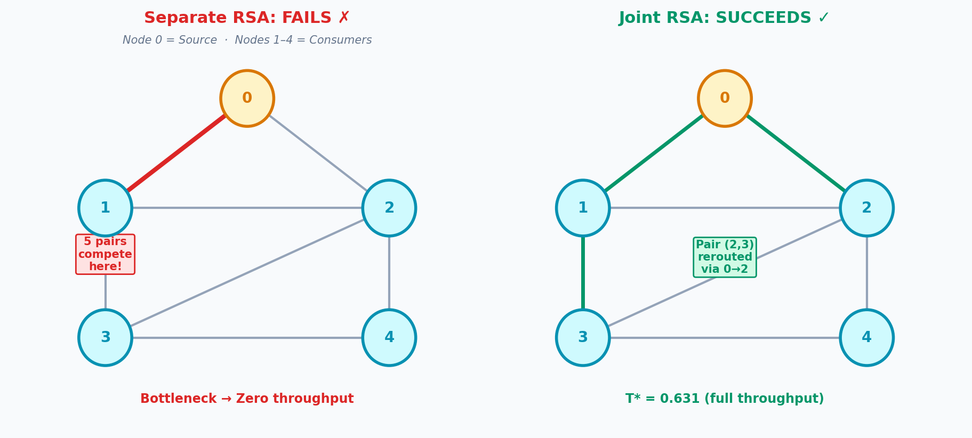
Why Separate Routing + Spectrum Fails
The Motivating Example (from our paper)
5-node topology: nodes 0–4. Node 0 = entanglement source.
Fibers (0,1) and (1,2) are very short (weight 0.1). All others have weight 1.0.
Consumer pairs: (1,2), (1,3), (1,4), (2,3), (2,4), (3,4) — all 6 pairs.
Shortest path approach: pairs (1,3), (1,4), (2,3), (2,4) all want to use the short path 0→1→2.
Result: 5 consumer pairs compete for fiber (0,1). With only 3 channels available → infeasible.
The algorithm finds no valid spectrum assignment — reports zero throughput.
Joint optimization: reroutes (2,3) via 0→2 instead — avoids the bottleneck fiber.
Result: feasible assignment with T = 0.631 (full throughput restored).
Lesson: Routing and Spectrum Are Coupled
The spectrum assignment depends on which links are used (routing)
But routing must account for whether spectrum will be available (spectrum)
Solving them in sequence guarantees neither feasibility nor optimality
The only correct approach is joint optimization — or a heuristic that couples both decisions
Our contribution: formulate the joint problem as an ILP + propose the RCH heuristic to solve it scalably

Slide 26
Our Solution: Random Clique Heuristic (RCH)
Suurballe's
Seed Pairs
Build Conflict
Graph
Find Max
Clique
Stochastic
Augmentation
Lagrangian
ILP Solve
Stage 1: Seed Pairs
Stage 2: Conflict Graph
Stage 3: Augmentation
For each consumer pair (i,j): use Suurballe's algorithm to find the minimum-cost pair of edge-disjoint paths from source s to both i and j
This gives the "best" natural routing for each pair without any awareness of contention
These seed pairs are the starting point — they may conflict with each other on shared links
Build a conflict graph H: two consumer pairs are adjacent in H if their seed path pairs share at least one fiber link
Edges in H indicate contention risk — these pairs compete for the same spectrum
Find the maximum clique K in H (the most mutually conflicting group) using a greedy approximation
For each pair in the max clique K (selected with probability p_{clique}):
Inflate edge weights of already-known path pairs to discourage reuse
Rerun Suurballe's on inflated graph → new detour pair (forced to avoid known edges)
Repeat up to k times — adds diverse alternative routes
Final ILP has richer routing options precisely where contention is worst
After augmentation: solve the joint RSA ILP using Lagrangian relaxation — dualizing the contention constraint and solving with a subgradient algorithm.

Slide 27
Solving the ILP: Lagrangian Relaxation
The joint RSA ILP is hard to solve directly due to the contention constraint coupling all path pairs. Lagrangian relaxation moves this constraint into the objective.
What Is Lagrangian Relaxation?
The Subgradient Algorithm
A technique for large-scale optimization: "relax" one hard constraint by adding it to the objective with a penalty
For our problem: the contention constraint (no two overlapping pairs share a channel) is dualized
Adding a penalty λ × (violation) to the objective makes the remaining problem much easier to solve
The resulting "relaxed" problem gives an upper bound on the true optimal T*
Iteratively update the penalty multipliers λ using the Polyak step-size rule
At each iteration: solve the relaxed LP, apply a greedy primal heuristic to recover a feasible integer solution
The primal heuristic gives a lower bound LB; the relaxed LP gives an upper bound UB
When the optimality gap (UB-LB)/(1+|LB|) < ε, stop. Otherwise continue up to budget.
Greedy Primal Heuristic
Why This Works Well Here
After each LP solve: round the fractional LP solution to an integer feasible solution
Assign exactly one channel to each chosen path pair (start with one channel per pair)
Add channels in round-robin order — prioritizing weaker pairs (lower η) first
Continue until no further conflict-free channel assignment is possible
This gives a valid lower bound at every iteration — and the best LB is kept
The contention constraint is the only "hard" coupling — once relaxed, the remaining ILP decomposes nicely per path pair
The conflict graph structure helps: only pairs with shared edges actually couple through the contention constraint
With RCH providing richer routing options, the relaxed problem explores a better feasible region
Computational cost scales with the number of conflicts — manageable in practice

Slide 28
ACTIVITY 5
Calculate the Throughput
Use the transmittance formula η = 10^{(−l/10)} where l is total path length. Work through each scenario with a partner.
Formula: η = 10^{(−l/10)} | l = length of path p_{i} + length of path p_{j} | Throughput T = η for one pair
Q1
Consumer pair (A, B): photon 1 travels 1.0 unit to Node A, photon 2 travels 1.0 unit to Node B. What is η? What fraction of EPR pairs are successfully delivered?
Q2
Consumer pair (C, D): photon 1 travels 2.0 units, photon 2 travels 3.0 units. Total l = 5.0. What is η? Compare to Q1 — how much worse is it?
Q3
The network operator can choose between two routings for pair (E, F):
Option X: paths of 1.5 and 1.5 units (l = 3.0)
Option Y: paths of 0.5 and 4.0 units (l = 4.5)
Which routing gives higher throughput? Calculate both η values.
Q4
If 3 channels are available and 4 consumer pairs all want to use the same bottleneck fiber link, how many can be served simultaneously? What happens to the other pair?

Slide 29
ACTIVITY 5 - Answers
Calculate the Throughput — Worked Answers
Q1
l = 1.0+1.0 = 2.0 → η = 10^(−2.0/10) = 10^(−0.2) ≈ 0.631. About 63% of EPR pairs successfully delivered.
Q2
l = 2.0+3.0 = 5.0 → η = 10^(−0.5) ≈ 0.316. Only 32% delivered — about half as efficient as Q1. Longer paths hurt substantially.
Q3
Option X: l = 3.0 → η = 10^(−0.3) ≈ 0.501. Option Y: l = 4.5 → η = 10^(−0.45) ≈ 0.355. Option X wins. Even though Y has one very short segment, the total length is what matters — balance helps!
Q4
With 3 channels and 4 pairs competing for the same link: at most 3 pairs can be served simultaneously (one per channel). The 4th pair is blocked — receives zero throughput. This is the contention scenario that motivated our joint RSA problem.

Slide 30
Part 5: Lab Results & Future Research
RCH results on ILEC topology + our next open problem

Slide 31
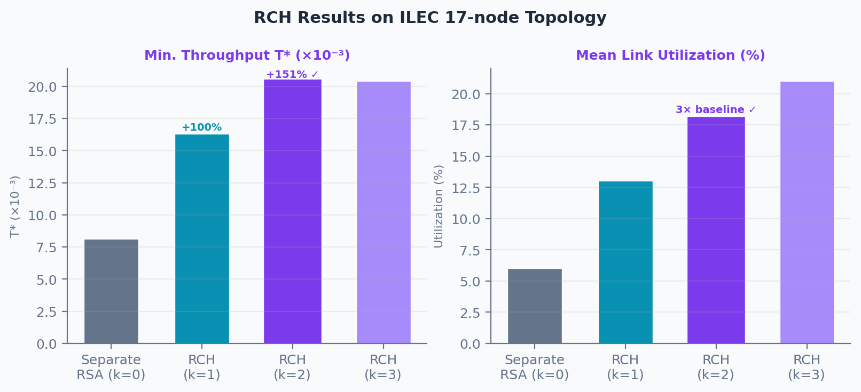
Lab Results: RCH vs Separate RSA Baseline
ILEC 17-node topology · 15 consumer nodes · Node A = entanglement source · 6.25 GHz flex-grid slots
Method | Detour Depth k | Min Throughput T* | Mean Link Utilization
Separate RSA (baseline) | 0 | 8.14 × 10⁻³ | 0.06 (6%)
RCH — Our Approach | 1 | 1.63 × 10⁻² (+100%) | 0.13 (13%)
RCH — Our Approach | 2 | 2.04 × 10⁻² (+151%) ✓ | 0.18 (18%) ✓
RCH — Our Approach | 3+ | 2.04 × 10⁻² (no further gain) | 0.20–0.21
Key finding: k=2 is optimal. Beyond k=2, detour paths are either too long (low η) or simply don't exist — diminishing returns. Over-augmenting (k≥5) hits computational budget limits before convergence.

Slide 32
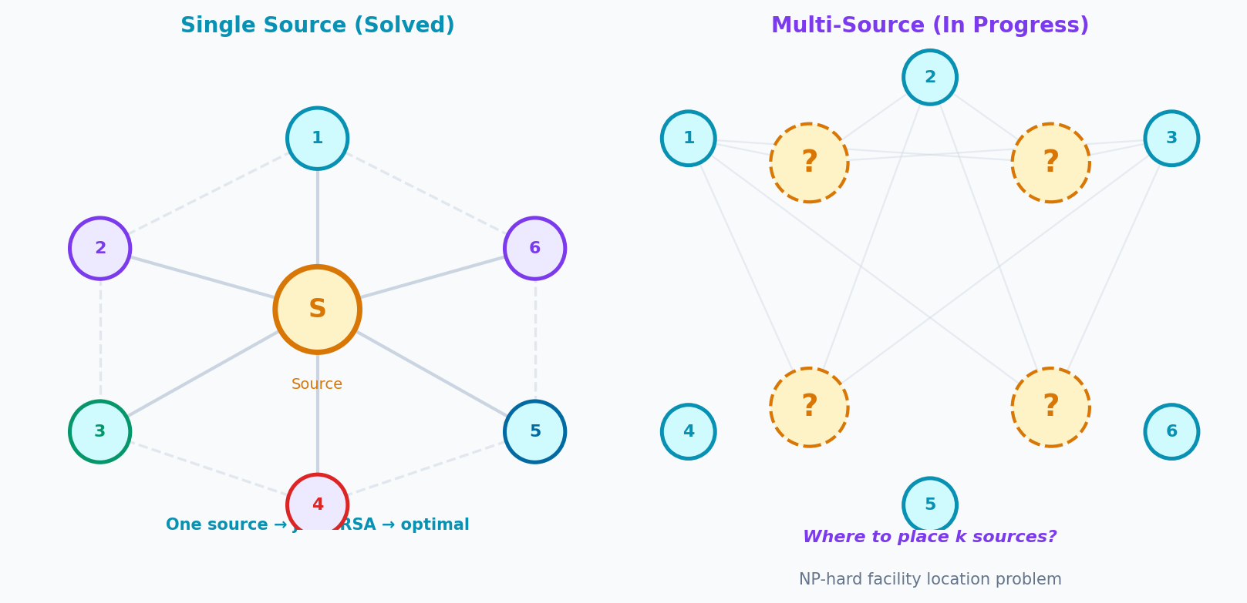
Our Next Research Problem: Multi-Source Placement
Single-Source Problem (Solved)
Multi-Source Problem (In Progress)
One fixed entanglement source at a known node
All consumer pairs request EPR distribution from this source
Routing: find edge-disjoint path pairs from the source to each consumer pair
Spectrum: jointly assign channels — maximize minimum throughput
Solution: RCH heuristic + Lagrangian relaxation ILP
Result: 2.5× better minimum throughput vs separated RSA baseline
Published/submitted to IEEE JSAC
Multiple potential source locations in the network
Decision: which nodes should host entanglement sources?
Assignment: which consumer pairs should be served by which source?
Routing & spectrum: jointly across all source-pair assignments
Load balancing: distribute demand across sources to prevent bottlenecks
This adds a source placement layer on top of the RSA problem
Open question: is greedy source placement + RSA close to optimal?

Slide 33
How All Three Seminars Connect
Three seminars, one research vision: intelligent, efficient, quantum-capable future networks.
Service Layer
Who gets access? When? How do we prevent peak-state blocking while maximizing revenue?
RL/PPO admission control (journal paper)
Network Slicing + Admission Control
Transport Layer
How do we route slices through fiber, assign spectrum, and place compute — efficiently?
WMSM — ICCCN 2026
Optical Networks + SDM-EON Embedding
Physical Layer
How do we distribute entangled photons for quantum-secure communication?
RCH heuristic + multi-source
Quantum Networking + RSA
Common tools across all three: graph algorithms, ILP optimization, simulation, and increasingly reinforcement learning.

Slide 34
Activity 6
Reflect Across All Three Seminars
Connecting the Layers
Seminar 1 had an RL agent deciding whether to admit a network slice. Seminar 2 had WMSM deciding how to embed it into optical fiber. Now Seminar 3 has the quantum RSA problem deciding how to route entangled photons. Could one unified RL agent control all three layers? What would it need to observe and decide?
The Repeater Gap
The biggest limitation in quantum networking today is the absence of practical quantum repeaters. If quantum repeaters existed tomorrow, how would the RSA problem change? Would edge-disjoint paths still be required?
Security in Practice
QKD is theoretically unbreakable — but real deployments still get hacked (side-channel attacks, imperfect detectors, trusted nodes). Does "provably secure by physics" still mean secure in a real network? What additional engineering challenges remain?
Your Research Question
If you could add one research problem to this lab's agenda — combining ideas from any of the three seminars — what would it be? Write one sentence: "I want to know how to [do X] in order to [achieve Y]."

Slide 35
Seminar 3 — Key Takeaways
01. Qubits exploit quantum superposition. Measurement collapses the state — irreversibly.
02. The no-cloning theorem makes quantum communication provably secure: eavesdropping is physically detectable.
03. EPR pairs are entangled photons generated by SPDC. Each photon must reach a different consumer node — via edge-disjoint paths on the same spectrum channel.
04. Transmittance decreases exponentially with path length — routing must balance path length against spectrum congestion.
05. Separate routing then spectrum fails under congestion. Our joint RSA formulation (ILP + RCH heuristic + Lagrangian relaxation) achieves 2.5× better minimum throughput.
06. Next step: multi-source placement — where to put entanglement sources in the network to serve all consumer pairs optimally.
Thank you for attending all three seminars · NSF Grant CNS-2008856

