Slide 1
How to Have a Bad Career in Research/Academia
Professor David A. Patterson
Feburary 2002
www.cs.berkeley.edu/~pattrsn/talks/nontech.html

Slide 2
Outline
Part I: Key Advice for a Bad Career
Part II: Key Advice on Alternatives to a Bad Career
Topics covered in Part II
  Selecting a Problem
  Picking a Solution
  Performing the Research
  Evaluating the Results
  Communicating Results
  Transferring Technology
Career Advice from Richard Hamming and Ivan Sutherland
Notes:
Key Advice on a bad career
Send part alternatives
First point is selecting a problem. Those who know the university promotion system know that promotion committees ask the question:
Is this person the leading person in their field?
How do you do that? First piece of bad advice

Slide 3
Bad Career Move #1: Be THE leading expert
Invent a new field!
  Make sure its slightly different
Be the real Lone Ranger: Don’t work with others
  No ambiguity in credit
  Adopt the Prima Donna personality
Research Horizons
  Never define success
  Avoid Payoffs of less than 20 years
  Stick to one topic for whole career
  Even if technology appears to leave you behind,
  stand by your problem
Notes:
Can’t have more than one leading expert, so make up your own field
Don’t want ambiguity in credit for promotion committees
Prima Donna personality helps 2 ways; Answer the question: How can strangers know you are THE leader of a field ; secondly, your personality can drive colleagues away from your field
Need lots of flexibility in the definition of success
Making sure there is no pay-off in less than 20 years means no one can accuse you of doing development vs. research
Technology is like fashion; bell bottom pants were in style 20 years ago, and they are again today; save those clothes
Technology will come back to you, and then you’ll have an even greater lead
For example, my UCLA dissertation was on microprogramming; had I just followed this advice, I would be absolutely the leader today, especially since all companies have abandoned microprogramming.

Slide 4
Announcing a New Operating System Field:
“Disability-Based Systems”
Computer Security is increasingly important
  Insight: capability-based addressing almost right
Idea: Create list of things that process CANNOT do!
Key Question:
should you store disabilities with each user
or with the objects they can’t access?
Other topics: encrypted disabilities,
disability-based addressing
Start a new sequence of courses and new journal on Theory and Practice of Disability-Based Systems
Notes:
If you stuck to this topic for 20 years, you can be sure to be the leading expert!
Start a new journal where I can be the editor-in-chief

Slide 5
Bad Career Move #2: Let Complexity Be Your Guide
(Confuse Thine Enemies)
Best compliment:
“Its so complicated, I can’t understand the ideas”
Easier to claim credit for subsequent good ideas
  If no one understands, how can they contradict your claim?
It’s easier to be complicated
  Also: to publish it must be different; N+1st incremental change
If it were not unsimple then how could distinguished colleagues in departments around the world be positively appreciative of both your extraordinary intellectual grasp of the nuances of issues as well as the depth of your contribution?
Notes:
We’ll come back to publications later
Last paragraph really captures the essence

Slide 6
Bad Career Move #3: Never be Proven Wrong
Avoid Implementing
Avoid Quantitative Experiments
  If you’ve got good intuition, who needs experiments?
  Why give grist for critics’ mill?
  Takes too long to measure
Avoid Benchmarks
Projects whose payoff is ≥ 20 years
gives you 19 safe years
Notes:
You should never implement anything;
but if some out-of-control student goes and implement things, then
In fact, Avoid Quantitative Experiments of any kind
Since you know you are right, Why help your critics?
If you’ve got good intuition, who needs experiments?
Just announce the results
Takes too long to measure; more ideas/career if don’t
Look at what has happened to computer design; everyone runs the same experiments to evaluate systems; perfectly fine architecture are disappearing just because someone makes computers that are faster and cheaper
Avoid Benchmarks; if someone else runs benchmarks on your system, just say
These systems are different; why run the same programs?
This system is for future programs, not current programs!
In fact, don’t do anything that can be measured in less than 20yeras! Projects whose payoff is ≥ 20 years gives you 19 safe years;

Slide 7
Bad Career Move #4:
Use the Computer Scientific Method
Obsolete Scientific Method
Hypothesis
Sequence of experiments
Change 1 parameter/exp.
Prove/Disprove Hypothesis
Document for others to
reproduce results
Computer Scientific Method
Hunch
1 experiment
& change all parameters
Discard if doesn’t support hunch
Why waste time? We know this
Notes:
This avoidance has been perfected as a method
Computer Science is not like other sciences, hence we have invented a new method
Take much less time, do things in parallel
Get more results in field if no one has to reproduce results
Overlays are funny

Slide 8
Bad Career Move #5:
Don’t be Distracted by Others (Avoid Feedback)
Always dominate conversations: Silence is ignorance
  Corollary: Loud is smart
Don’t read
Don’t be tainted by interaction with users, industry
Reviews
  If it's simple and obvious in retrospect => Reject
  Quantitative results don't matter if they just show you what you already know => Reject
  Everything else => Reject
Notes:
Even when you don’t know what to say, dominate conversations!
If it's simple and obvious in retrospect, reject it. You wouldn't want to embarrass the previous authors in the area that they didn't think of it!
Also, quantitative results don't matter if they just show you what you already know.
Reject everything. If asked why, say "we're working on that topic, and the paper just says what we were already going to do anyway!"
You are the leading expert, so how can other work be worth reading?
Don’t be tainted by interaction with users, industry; how good tainted ideas be?

Slide 9
Bad Career Move #6:
Publishing Journal Papers IS Technology Transfer
Target Archival Journals: the Coin of the Academic Realm
  It takes 2 to 3 years from submission to publication=>timeless
As the leading scientist, your job is to publish in journals;
its not your job to make you the ideas palatable to the ordinary engineer
Going to conferences and visiting companies just uses up valuable research time
  Travel time, having to interact with others, serve on program committees, ...
Notes:
Must be valuable otherwise deans and promotion committees wouldn’t value it
Proving that timeliness is irrelevant in archival journals; not timely so must be timeless research
Next Communication Strategies

Slide 10
Bad Career Move #7:
Writing Tactics for a Bad Career
Papers: It’s Quantity, not Quality
  Personal Success = Length of Publication List
  “The LPU (Least Publishable Unit) is Good for You”
1
idea
4
journal papers
“Publication
pyramid
of
success”
16
extended abstracts
64
technical reports
Student productivity = number of papers
  Number of students: big is beautiful
  Never ask students to implement: reduces papers
Legally change your name to Aaaanderson
Notes:
Rule of 4 as move down hierarchy
How could 1 person write 84 papers? you don’t, but its possible
Miracle of word processing:
New title, new introduction, new conclusion; cut and paste from previous papers
20 students are 5 times as good as 4
Moreover, to be the first name on all off
Papers by Aaaanderson et al; Swedish spelling
Get down to writing the paper

Slide 11
5 Writing Commandments for a Bad Career
I. Thou shalt not define terms, nor explain anything.
II. Thou shalt replace “will do” with “have done”.
III. Thou shalt not mention drawbacks to your approach.
IV. Thou shalt not reference any papers.
V. Thou shalt publish before implementing.
Notes:
Proving that timeliness is irrelevant in archival journals; timeless
I. Thou shalt not define terms; that’s why there are dictionaries. Thou shalt not explain anything; its insults the readers.
III. Thou shalt replace the (“I will build”) Future Conditional with (“has been built”)Past Perfect.
After all, someone is likely to build it in the 2 to 3 years it takes before the paper is published
VIII. Thou shalt not mention drawbacks to your approach; that’s not your job; let others find the flaws
X. Thou shalt not reference any papers (besides your own); if they were good people, they’d be at your institution ; help the little people
IV. Thou shalt publish before Implementing (highest performance)

Slide 12
7 Talk Commandments for a Bad Career
I. Thou shalt not illustrate.
II. Thou shalt not covet brevity.
III. Thou shalt not print large.
IV. Thou shalt not use color.
V. Thou shalt cover thy naked slides.
VI. Thou shalt not skip slides in a long talk.
VII. Thou shalt not practice.
Notes:
I. THOU SHALT NOT ILLUSTRATE. Confucius says ``A picture = 10K words,'' but Dijkstra says ``Pictures are for weak minds.'' Who are you going to believe?
II. THOU SHALT NOT COVET BREVITY. Do you want to continue the stereotype that engineers can't write? Always use complete sentences, never just key words. If possible, use whole paragraphs and read every word.
III. THOU SHALT NOT PRINT LARGE. Be humble -- use a small font. Important people sit in front. Who cares about the riff-raff?
IV. THOU SHALT NOT USE COLOR. Flagrant use of color indicates uncareful research. It's also unfair to emphasize some words over others. See how ugly it is?
VI. THOU SHALT NOT SKIP SLIDES IN A LONG TALK. You prepared the slides; people came for your whole talk; so just talk faster. Skip your summary and conclusions if necessary.
IV. THOU SHALT COVER THY NAKED SLIDES. You need the suspense! Overlays are too flashy.
X. Last Commandment is most important. EVEN IF YOU BREAK THE OTHERS, THIS ONE CAN SAVE YOU.
THOU SHALT NOT PRACTICE. Why waste research time practicing a talk? It could take several hours out of your two years of research. How can you appear spontaneous if you practice? Besides if you are a teacher, you have lots of experience talking for hours when you don’t know what to say
Ideally you follow all the commandments in a talk

Slide 13
Following all the commandments
We describe the philosophy and design of the control flow machine, and present the results of detailed simulations of the performance of a single processing element. Each factor is compared with the measured performance of an advanced von Neumann computer running equivalent code. It is shown that the control flow processor compares favorably in the program.
We present a denotational semantics for a logic program to construct a control flow for the logic program. The control flow is defined as an algebraic manipulator of idempotent substitutions and it virtually reflects the resolution deductions. We also present a bottom-up compilation of medium grain clusters from a fine grain control flow graph. We compare the basic block and the dependence sets algorithms that partition control flow graphs into clusters.
A hierarchical macro-control-flow computation allows them to exploit the coarse grain parallelism inside a macrotask, such as a subroutine or a loop, hierarchically. We use a hierarchical definition of macrotasks, a parallelism extraction scheme among macrotasks defined inside an upper layer macrotask, and a scheduling scheme which assigns hierarchical macrotasks on hierarchical clusters.
We apply a parallel simulation scheme to a real problem: the simulation of a control flow architecture, and we compare the performance of this simulator with that of a sequential one. Moreover, we investigate the effect of modeling the application on the performance of the simulator. Our study indicates that parallel simulation can reduce the execution time significantly if appropriate modeling is used.
We have demonstrated that to achieve the best execution time for a control flow program, the number of nodes within the system and the type of mapping scheme used are particularly important. In addition, we observe that a large number of subsystem nodes allows more actors to be fired concurrently, but the communication overhead in passing control tokens to their destination nodes causes the overall execution time to increase substantially.
The relationship between the mapping scheme employed and locality effect in a program are discussed. The mapping scheme employed has to exhibit a strong locality effect in order to allow efficient execution
Medium grain execution can benefit from a higher output bandwidth of a processor and finally, a simple superscalar processor with an issue rate of ten is sufficient to exploit the internal parallelism of a cluster. Although the technique does not exhaustively detect all possible errors, it detects nontrivial errors with a worst-case complexity quadratic to the system size. It can be automated and applied to systems with arbitrary loops and nondeterminism.
Notes:
Example; cover with paper that has a hole in it that just uncovers the slide
First say: follow the first commandments;
Show how to cover slides
“I can see that I’m running out of time, I’ll just talk faster”
Say; “Let’s see, why did I put this on the slide”
This concludes the advice

Slide 14
7 Poster Commandments for a Bad Career
I. Thou shalt not illustrate.
II. Thou shalt not covet brevity.
III. Thou shalt not print large.
IV. Thou shalt not use color.
V. Thou shalt not attract attention to thyself.
VI. Thou shalt not prepare a short oral overview.
VII. Thou shalt not prepare in advance.
Notes:
I. THOU SHALT NOT ILLUSTRATE. Confucius says ``A picture = 10K words,'' but Dijkstra says ``Pictures are for weak minds.'' Who are you going to believe?
II. THOU SHALT NOT COVET BREVITY. Do you want to continue the stereotype that engineers can't write? Always use complete sentences, never just key words. If possible, use whole paragraphs and read every word.
III. THOU SHALT NOT PRINT LARGE. Be humble -- use a small font. Important people sit in front. Who cares about the riff-raff?
IV. THOU SHALT NOT USE COLOR. Flagrant use of color indicates uncareful research. It's also unfair to emphasize some words over others. See how ugly it is?
VI. THOU SHALT NOT SKIP SLIDES IN A LONG TALK. You prepared the slides; people came for your whole talk; so just talk faster. Skip your summary and conclusions if necessary.
IV. THOU SHALT COVER THY NAKED SLIDES. You need the suspense! Overlays are too flashy.
X. Last Commandment is most important. EVEN IF YOU BREAK THE OTHERS, THIS ONE CAN SAVE YOU.
THOU SHALT NOT PRACTICE. Why waste research time practicing a talk? It could take several hours out of your two years of research. How can you appear spontaneous if you practice? Besides if you are a teacher, you have lots of experience talking for hours when you don’t know what to say
Ideally you follow all the commandments in a talk

Slide 15

Following all the commandments
How to Do a Bad Poster
David Patterson
University of California
Berkeley, CA 94720
We describe the philosophy and design of the control flow machine, and present the results of detailed simulations of the performance of a single processing element. Each factor is compared with the measured performance of an advanced von Neumann computer running equivalent code. It is shown that the control flow processor compares favorably in the program.
We present a denotational semantics for a logic program to construct a control flow for the logic program. The control flow is defined as an algebraic manipulator of idempotent substitutions and it virtually reflects the resolution deductions. We also present a bottom-up compilation of medium grain clusters from a fine grain control flow graph. We compare the basic block and the dependence sets algorithms that partition control flow graphs into clusters.
Our compiling strategy is to exploit coarse-grain parallelism at function application level: and the function application level parallelism is implemented by fork-join mechanism. The compiler translates source programs into control flow graphs based on analyzing flow of control, and then serializes instructions within graphs according to flow arcs such that function applications, which have no control dependency, are executed in parallel.
A hierarchical macro-control-flow computation allows them to exploit the coarse grain parallelism inside a macrotask, such as a subroutine or a loop, hierarchically. We use a hierarchical definition of macrotasks, a parallelism extraction scheme among macrotasks defined inside an upper layer macrotask, and a scheduling scheme which assigns hierarchical macrotasks on hierarchical clusters.
We apply a parallel simulation scheme to a real problem: the simulation of a control flow architecture, and we compare the performance of this simulator with that of a sequential one. Moreover, we investigate the effect of modeling the application on the performance of the simulator. Our study indicates that parallel simulation can reduce the execution time significantly if appropriate modeling is used.
We have demonstrated that to achieve the best execution time for a control flow program, the number of nodes within the system and the type of mapping scheme used are particularly important. In addition, we observe that a large number of subsystem nodes allows more actors to be fired concurrently, but the communication overhead in passing control tokens to their destination nodes causes the overall execution time to increase substantially.
Medium grain execution can benefit from a higher output bandwidth of a processor and finally, a simple superscalar processor with an issue rate of ten is sufficient to exploit the internal parallelism of a cluster. Although the technique does not exhaustively detect all possible errors, it detects nontrivial errors with a worst-case complexity quadratic to the system size. It can be automated and applied to systems with arbitrary loops and nondeterminism.
The relationship between the mapping scheme employed and locality effect in a program are discussed. The mapping scheme employed has to exhibit a strong locality effect in order to allow efficient execution. We assess the average number of instructions in a cluster and the reduction in matching operations compared with fine grain control flow execution.
Notes:
Example; cover with paper that has a hole in it that just uncovers the slide
First say: follow the first commandments;
Show how to cover slides
“I can see that I’m running out of time, I’ll just talk faster”
Say; “Let’s see, why did I put this on the slide”
This concludes the advice

Slide 16
Outline
Part I: Key Advice for a Bad Career, Post Ph.D.
Part II: Key Advice on Alternatives to a Bad Career, Post Ph.D.
Topics covered in Parts II
  Selecting a Problem
  Picking a Solution
  Performing the Research
  Evaluating the Results
  Communicating Results
  Transferring Technology
Post Tenure Research Agenda
Notes:
Key Advice on a bad career
Send part alternatives
First point is selecting a problem. Those who know the university promotion system know that promotion committees ask the question:
Is this person the leading person in their field?
How do you do that? First piece of bad advice

Slide 17
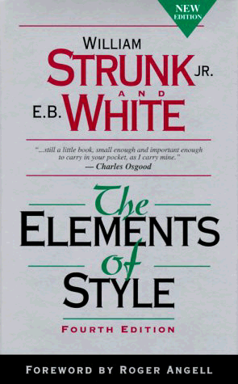
Alternatives to Bad Papers
Do opposite of Bad Paper commandments
  Define terms, distinguish “will do” vs “have done”,
  mention drawbacks, real performance, reference other papers.
Find related work via Melvyl/INSPEC
online search/paper retrieval vs. www only
www.dbs.cdlib.org
First read Strunk and White, then follow these steps;
  1. 1-page paper outline, with tentative page budget/section
  2. Paragraph map
    1 topic phrase/sentence per paragraph, handdrawn figures w. captions
  3. (Re)Write draft
    Long captions/figure can contain details ~ Scientific American
    Uses Tables to contain facts that make dreary prose
  4. Read aloud, spell check & grammar check
  (MS Word; Under Tools, select Grammar, select Options, select “technical” for writing style vs. “standard”; select Settings and select)
  5. Get feedback from friends and critics on draft; go to 3.
www.cs.berkeley.edu/~pattrsn/talks/writingtips.html

Slide 18
Alternatives to Bad Talks
Do opposite of Bad Talk commandments
  I. Thou shalt not illustrate.
  II. Thou shalt not covet brevity.
  III. Thou shalt not print large.
  IV. Thou shalt not use color.
  V. Thou shalt cover thy naked slides.
  VI. Thou shalt not skip slides in a long talk.
  VII. Thou shalt not practice.
Allocate 2 minutes per slide, leave time for questions
Don’t over animate
Do dry runs with friends/critics for feedback,
  including tough audience questions
Tape a practice talk (audio tape or video tape)
    Don’t memorize speech, but have notes ready
Bill Tetzlaff, IBM: “Giving a first class ‘job talk’ is the single most important part of an interview trip. Having someone know that you can give an excellent talk before hand greatly increases the chances of an invitation. That means great conference talks.”

Slide 19
Alternatives to Bad Posters (from Randy Katz)
Answer Five Heilmeier Questions
  1. What is the problem you are tackling?
  2. What is the current state-of-the-art?
  3. What is your key make-a-difference concept or technology?
  4. What have you already accomplished?
  5. What is your plan for success?
Do opposite of Bad Poster commandments
  Poster tries to catch the eye of person walking by
9 page poster might look like
Problem
Statement
State-of-
the-Art
Key
Concept
Accomplish
-ment # 1
Title and
Visual logo
Accomplish
-ment # 2
Accomplish
-ment # 3
Plan for Success
Summary &
Conclusion

Slide 20
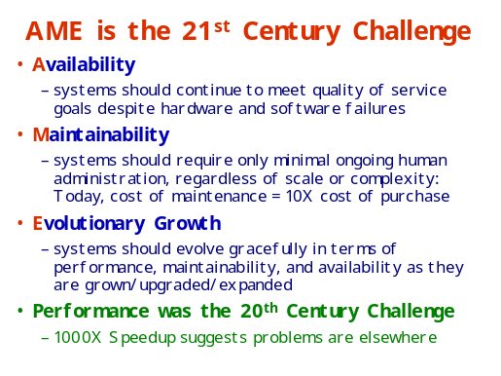
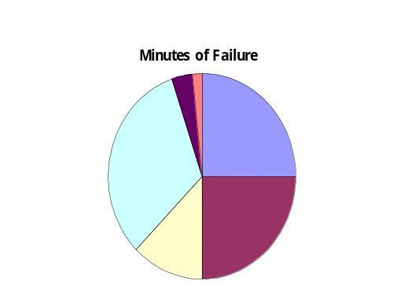
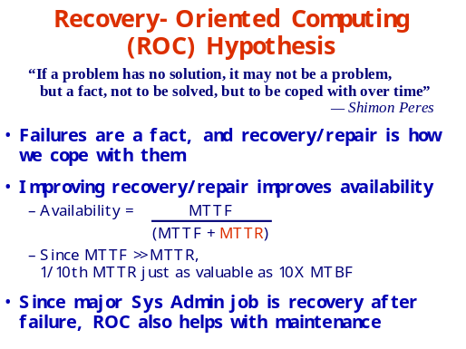
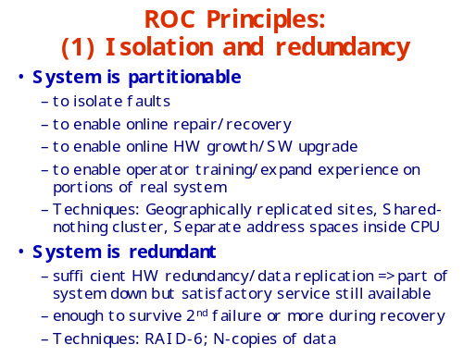
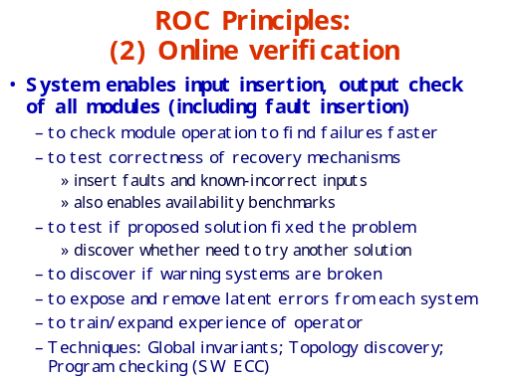
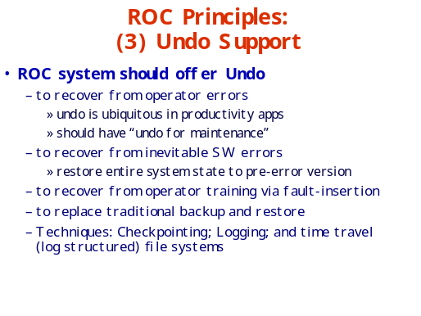
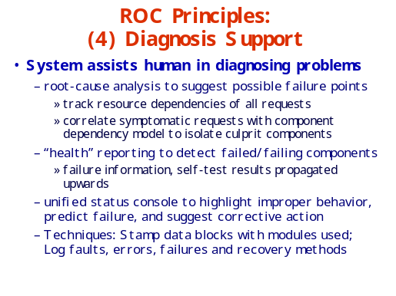
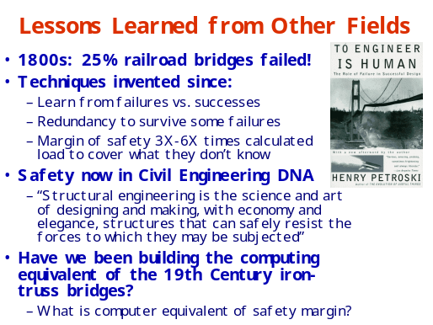
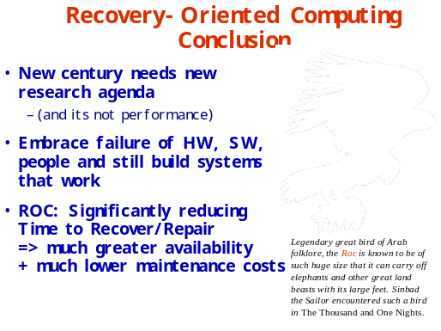
ROC: Recovery-Oriented Computing
Aaron Brown and David Patterson
ROC Research Group, EECS Division, University of California at Berkeley
For more info: http://roc.cs.berkeley.edu

Slide 21
One Alternative Strategy to a Bad Career
Caveats:
  From a project leader’s point of view
  Works for me; not the only way
  Primarily from academic, computer systems perspective
Goal is to have impact:
Change way people do Computer Science & Engineering
  Academics have bad benchmarks: published papers
6 Steps
1) Selecting a problem
2) Picking a solution
3) Running a project
4) Finishing a project
5) Quantitative Evaluation
6) Transferring Technology
Notes:
Goal is not papers, its impact
This is advice I wish I had been given when I started; had to learn it the hard way
NOte that leader's role changes during effort

Slide 22
1) Selecting a Problem
Invent a new field & stick to it?
No! Do “Real Stuff”: solve problem that someone cares about
No! Use separate, short projects
  Always takes longer than expected
  Matches student lifetimes
  Long effort in fast changing field???
  Learning: Number of projects vs. calendar time
  If going to fail, better to know soon
Strive for multi-disciplinary, multiple investigator projects
  1 expert/area is ideal (no arguments)
Match the strengths and weaknesses of local environment
Make sure you are excited enough to work on it for 3-5 years
  Prototypes help
Notes:
someone cares (besides yourself)
More chances for opportunity

Slide 23
My first project
Multiprocessor project with 3 hardware faculty (“Xtree”)
1977: Design our own instruction set, microprocessor, interconnection topology, routing, boards, systems, operating system
Unblemished Experience:
  none in VLSI
  none in microprocessors
  none in networking
  none in operating systems
Unblemished Resources:
  No staff
  No dedicated computer (used department PDP-11/70)
  No CAD tools
  No applications
  No funding
Results: 2 journal papers, 12 conference papers, 20 TRs
Impact?
Notes:
Then took sabbaticalhat I thought others wanted me to do

Slide 24
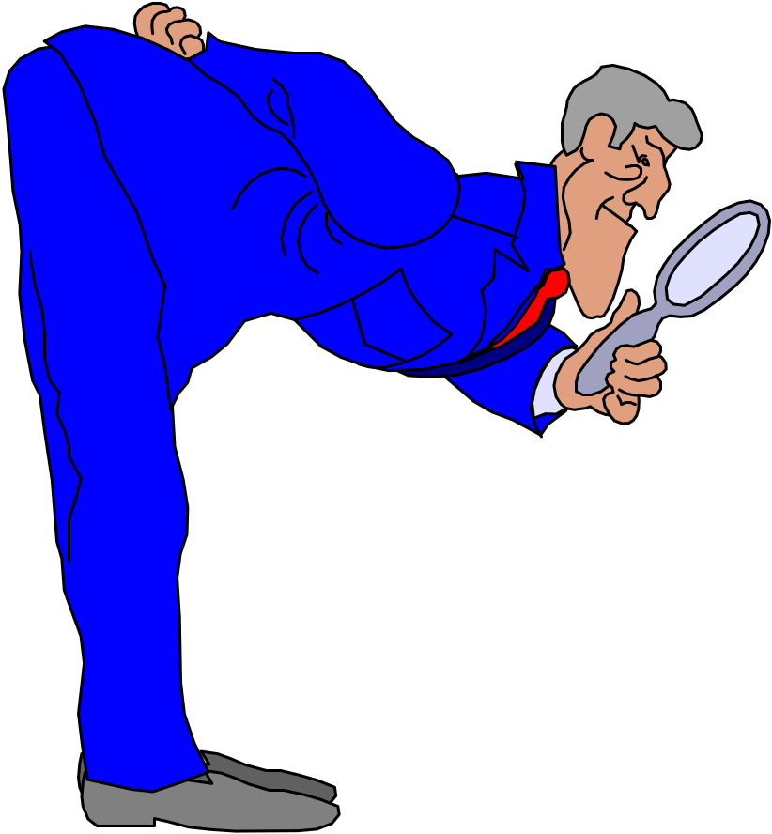
2) Picking a solution
Let Complexity Be Your Guide?
No! Keep things simple unless a very good reason not to
  – Pick innovation points carefully,
  and be compatible everywhere else
  Best results are obvious in retrospect
  “Anyone could have thought of that”
Complexity cost is in longer design, construction, test, and debug
  Fast changing field + delays
  => less impressive results
Use the Computer Scientific Method?
No! Run experiments to discover real problems
Use intuition to ask questions,
not to answer them
Notes:
Now leader is the detective
Not only pick a solution, but another key ....

Slide 25
(And Pick A Good Name!)
Reduced
I nstruction
Set
Computers
Redundant
Array of
I nexpensive
Disks
Recovery
Oriented
Computing
…

Slide 26
3) Running a project
Avoid Feedback?
No! Periodic Project Reviews with Outsiders
  Twice a year: 3-day retreat
  faculty, students, staff + guests
  Key piece is feedback at end
  Helps create deadlines, team spirit
  Give students chance to give
  many talks, interact with others industry
Consider mid-course correction
  Fast changing field & 3-5 year projects => assumptions changed
Pick size and members of team carefully
  Tough personalities are hard for everyone
  Again, 1 faculty per area reduces chance of disagreement
P
Notes:
Now the coach
For 10 years had retreats
Had a multiprocessing project in 1983-1987; built multiprocessors & Os from scratch
Prior to RISC machines; 1/2 way through visitor said should use emerging RISC processors; I felt it was a conflict of interest and not keeping to originalorkstations mid-wya through the design
Next step: didn’t even realize it was important

Slide 27
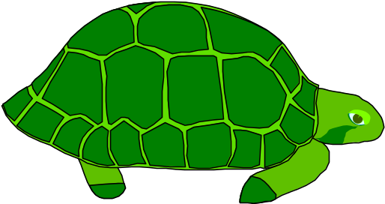
4) Finishing a project
People count projects you finish, not the ones you start
Successful projects go through an unglamorous, hard phase
Design is more fun than making it work
  “No winners on a losing team;
  no losers on a winning team.”
  “You can quickly tell whether or not the authors have ever built something and made it work.”
Reduce the project if its late
  “Adding people to a late project makes it later.”
Finishing a project is how people acquire taste in selecting good problems, finding simple solutions
Notes:
Quotes:
UNC basketball coach
Hennessy
Brooks :MMM

Slide 28
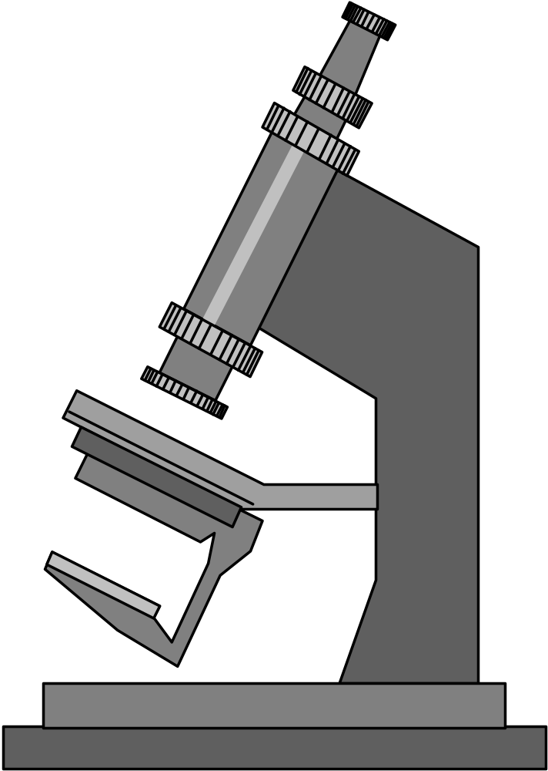
5) Evaluating Quantitatively
Never be Proven Wrong?
No! If you can’t be proven wrong,
then you can’t prove you’re right
Report in sufficient detail for
others to reproduce results
  can’t convince others
  if they can’t get same results
For better or for worse,
benchmarks shape a field
Good ones accelerate progress
  good target for development
Bad benchmarks hurt progress
  help real users v. help sales?
Notes:
Look at language design; your favorite programming language is obviously the best programming language; those who don’t use it are just idiots

Slide 29
6) Transferring
Publishing Journal Papers IS Technology Transfer?
No! Missionary work: “Sermons” first, then they read papers
  Selecting problem is key: “Real stuff”
    Ideally, more interest as time passes
    Change minds with believable results
    Prima Donnas interfere with transfer
My experience: industry is reluctant to embrace change
  Howard Aiken, circa 1950:
  “The problem in this business isn’t to keep people from stealing your ideas; its making them steal your ideas!”
  Need 1 bold company (often not no. 1) to take chance and be successful
    RISC with Sun, RAID with (Compaq, EMC, …)
  Then rest of industry must follow
Notes:
RISC II convinces some skeptics
May have invented drum memory;
45 years ago
Sun: shooting fish in a barrel
IF you can convince others, another option

Slide 30

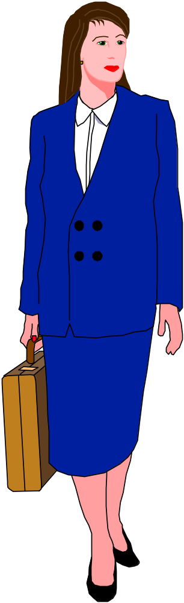
6) Transferring Technology
Pros
  Personal satisfaction: seeing your product used by others
  Personal $$$ (potentially)
  Fame
Cons
  Learn about business plans, sales vs. marketing, financing, personnel benefits, hiring, …
  Spend time doing above vs. research/development
  Only 10% of startups really make it
  Fame if company unsuccessful too
  (e.g., dot.com backlash)

Slide 31
Summary: Leader’s Role Changes during Project
P
Notes:
Role changes,
Key is selection problem and finishing the project; I didn’t realize either was a role when I started academics

Slide 32
“Technology And Courage” Ivan Sutherland, 1996
Courage: to perceive risk and proceed in spite of it
  Technology: risks to reputation and pride
  Research: high probability that an attempt will fail
  If inadequate courage, Work up courage,
  reduce risk, reduce perception of risk, or don’t do it
External Encouragement (rewards and punishment)
  Deadlines, groups of people, mentors, seminars, tenure, taking / teaching classes, starting companies, stock
Self Encouragement
  Getting started: warm-up project, break into tasks and do 1st one
  To continue: refuse to let urgent drive out the important
Rewards
  Thrill of discovery, following curiosity, beauty, simplicity
  Personal joy of playing with technology
http://research.sun.com/techrep/Perspectives

Slide 33
Richard Hamming’s Advice: “You and Your Research”
(Latter in your Research Career)
Doing Nobel Quality Research
  Search Google for transcript of 1986 talk at Bell Labs
Luck? “Luck favors the prepared mind.” Pasteur
Important Problems: “Great Thoughts Time” Friday afternoons
Courage: think about important, unsolved problems
  Big results usually to problems not recognized as such,
  and people usually did not get encouragement
Working conditions: can use creatively to lead to original solutions
  Bell labs didn’t have acres of programmers
Drive: what distinguishes the great scientists
  Not brains; commitment vs. dabbling; compound interest over time
Open doors (vs. closed offices): short term vs. long term benefit
Selling the work: not only published, but people must read it
  as much work spent on polish and presentation as on the work itself
Age: After 1st big success, hard to work on small problems
  So change field at least every 10 years
Educate your boss, Stimulation, right amount of Library work

Slide 34
Conclusion: Alternatives to a Bad Career
Goal is to have impact:
Change way people do Computer Science & Engineering
  Many 3 - 5 year projects gives more chances for impact
Feedback is key: seek out and value critics
Do “Real Stuff”: make sure you are solving some problem that someone cares about
Taste is critical in selecting research problems, solutions, experiments, and communicating results;
  Taste acquired by feedback and completing projects
Faculty real legacy is people, not paper:
  create environments that develop professionals of whom you are proud
Students are the coin of the academic realm

Slide 35
Acknowledgments
Many of these ideas were borrowed from (inspired by?) Tom Anderson, David Culler, Al Davis, Ken Goldberg,
John Hennessy, Steve Johnson, John Ousterhout,
Randy Katz, Bob Sproull, Carlo Séquin, Bill Tetzlaff
and many others

Slide 36
Backup Slides to Help Answer Questions

Slide 37
Applying the Computer Scientific Method to OS
Create private, highly tuned version for testing
  take out all special checks: who cares about crashes during benchmarks?
Never give out code of private version
  might be embarrassing, no one expects it
Run experiments repeatedly, discarding runs that don’t confirm the generic OS hypothesis
  Corollary
Notes:
Generic OS hypothesis

