Slide 1
Cucumber or pickle
Jackson MaltbY
Anastasiya Rylova
Whitney Wishart

Slide 2
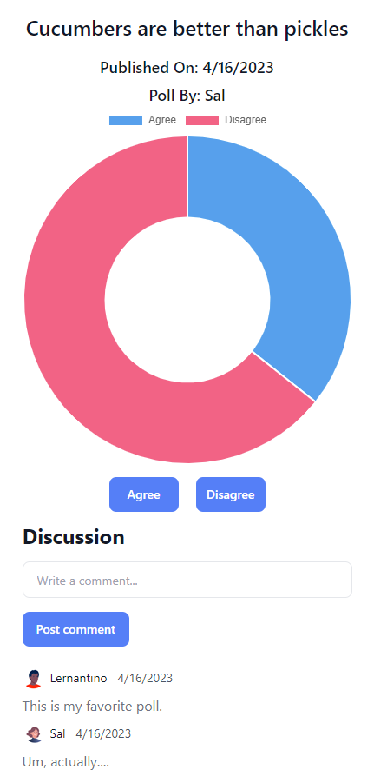
Concept
Cucumber or Pickle gathers opinions with simple polls, and displays the response data in dynamically generated charts
User story
AS A bored person
I WANT to be able to entertain myself by comparing my opinions to those of others, and quickly assess the data
SO THAT I can pass the time with mild joy
Acceptance criteria
GIVEN an online poll
WHEN I visit the poll, I should see several simple polls with agree or disagree buttons
THEN I have the option to login or signup
WHEN I have created a profile
THEN I can post, delete, comment and add my respose to polls
WHEN poll responses are gathered, the response data is displayed in a dynamically generated chart
Notes:
Load slide (description, chart image and user story)
Cucumber or Pickle is a fun way to post and answer simple poll questions, then easily evaluate the responses in an automatically generated chart
Click (acceptance criteria)
When visiting the site, polls and poll response data is visible to unregistered users
Once a user is registered, they can add poll questions and respond to polls
The chart of response data updates in real time, and hovering over the chart sections will reveal the current response count

Slide 3
Process
Technologies used
Bcrypt | Chart.js | Connect Session Sequelize | dotenv | Express.js | Handlebars.js | MySQL | Node.js | npm | Sequelize | Tailwind
Breakdown of tasks and roles
Jackson Maltby
Identified and implemented the Chart.js npm package to assemble data and generate dynamic charts
Agree and disagree button functionality
Anastasiya Rylova
Created the initial MVC structure and added initial file setup
Designed and built the layout and color scheme for all pages
Login and logout button functionality
Routes
Whitney Wishart
Initial routes and data model setup
Table design and data relationship setup, seed data setup
Comment functionality
Presentation author
Challenges
Git merging issues
Learning the new chart package functionality
Getting all data to display as expected
Successes
Getting the charts to generate was the coolest
Notes:
Load slide (show technologies)
We used 11 unique packages and technologies to complete our project
Click one (highlight chart.js as new technology)
For the new-to-us technology, we selected the npm package Chart.js, which allowed to us dynamically generate charts based on poll responses
Click two (show task breakdown, challenges and successes)
Jackson describes contributions
Anastasiya describes contributions
Whitney describes contributions and wraps up with the challenges and successes
This group was really exceptional, and I want to thank Jackson and Anastasiya for working so hard, having great ideas, and being flexible. All members showed up 100% and it was super great.
I also want to thank Kayla and Brooke for their invaluable help and support – both of them helped us quickly and successfully. Troubleshooting the random code of others is a tremendous skill.
For my contributions
I took a swipe at setting up the initial routing, but Anastasiya really drove them home to our MVP
I set up the models and table relationships for our users, polls, and comments SQL tables, wrote the seed data and created this presentation
Challenges
There was a bit of a learning curve on how to breakup our efforts to avoid merging issues
Successes
Overcoming the merge issues
Using a new-to-us package and getting it working was super satisfying

Slide 4
Directions for Future Development
Demo
Directions for future development
User profile photo for signed in users, and enable photos to display with user comments and polls
Edit comment functionality
Aggregate all poll data and filter results functionality
Dark mode option
Add optional notifications when a user poll has a response
Add validator that will limit count of votes in a given timeframe

Slide 5
Links
Heroku deployment
https://cucumber-or-pickle.herokuapp.com/
GitHub repo
https://github.com/anryl050/cucumber-or-pickle

