Slide 1
MODULE 1 - PROJECT
Control vs. Treated:
Tracing a Gene Expression Response
An end-to-end Raw Files → Bash → Python → R → Results → Interpretation workflow, from raw sequence files to a ranked list of responding genes.
Name: Ansa Aslam
1

Slide 2
The Question Behind the Pipeline
20 genes were measured across 3 control and 3 treated replicates. The goal: build a reproducible pipeline that goes from raw files to a defensible answer — which genes actually respond to treatment?
Raw Files
↓
01
Linux / Bash
Organize project folders, stage raw data, log input summary
↓
02
Python
Parse FASTA / FASTQ / GFF3 / VCF into clean summary tables
Guiding question
“How does the treatment affect gene expression compared with the control condition, and which genes respond the most?”
↓
03
R (tidyverse + ggplot2)
Reshape, join, summarise, compute log2FC, visualize
↓
Biological Interpretation
2

Slide 3
Step 1: Setting up a reproducible project structure
With Linux /Bash script “set.sh”, I created a clean project structure with folders for raw data, scripts, results, and figures.I then copied files into the /Module1/Project/raw directory (genes.fasta, sample_reads.fastq, annotations.gff3, variants.vcf, gene_expression.csv, sample_metadata.csv) and then generated a summary of the input files to ensure all required datasets were available before analysis.
FOLDER STRUCTURE
Project/
├── raw/ # raw/unedited input files (copied here by set.sh, never edited)
├── scripts/ # set.sh, parse.py, analysis.R
├── results/ # summary tables produced by parse.py + analysis.R
├── figures/ # the 4 ggplot2 figures, saved at 300 dpi
└── README.md
3

Slide 4
Step 2: Parsing the Raw Files
Python then parsed each supporting file into a summary table saved under results/.
Python script “scripts/parse.py” — goes through the four supporting files one at a time:
- FASTA → counts sequences and computes average GC%
- FASTQ → counts reads, mean Phred quality, and how many reads pass Q30
- GFF3 → counts each feature type (gene/mRNA/exon)
- VCF → counts variant records
8
2,000
32
20
sequences in genes.fasta
reads in sample_reads.fastq
annotated features (GFF3)
variants called (VCF)
avg. GC content 51.5%
mean Phred quality 29.9 — 1,711 passed QC (85.6%)
8 gene, 8 mRNA, 16 exon records
one variant record per gene, on average
Summary: Python extracted useful information from the biological sequence and annotation files.
3

Slide 5
Step 3–4: Wrangling the Expression Matrix in R
R was used to prepare the expression and metadata for analysis.
Top responding genes (by |log2FC|)
Pipeline
UP in treated
crp | +1.92
ompA | +1.64
rpoB | +1.62
lacZ | +0.89
recA | +0.88
DOWN in treated
emrB | −2.29
dnaA | −1.75
tolC | −1.74
marA | −0.72
sodA | −0.65
1
read_csv() — import expression matrix + sample metadata
2
pivot_longer() — 20 genes × 6 samples → tidy long format
3
left_join() on sample — attach condition, batch, RIN
4
group_by(gene_id, condition) + summarise() — mean & SD
5
Computed the log2 fold change to identify genes that were upregulated or downregulated after treatment.

Slide 6
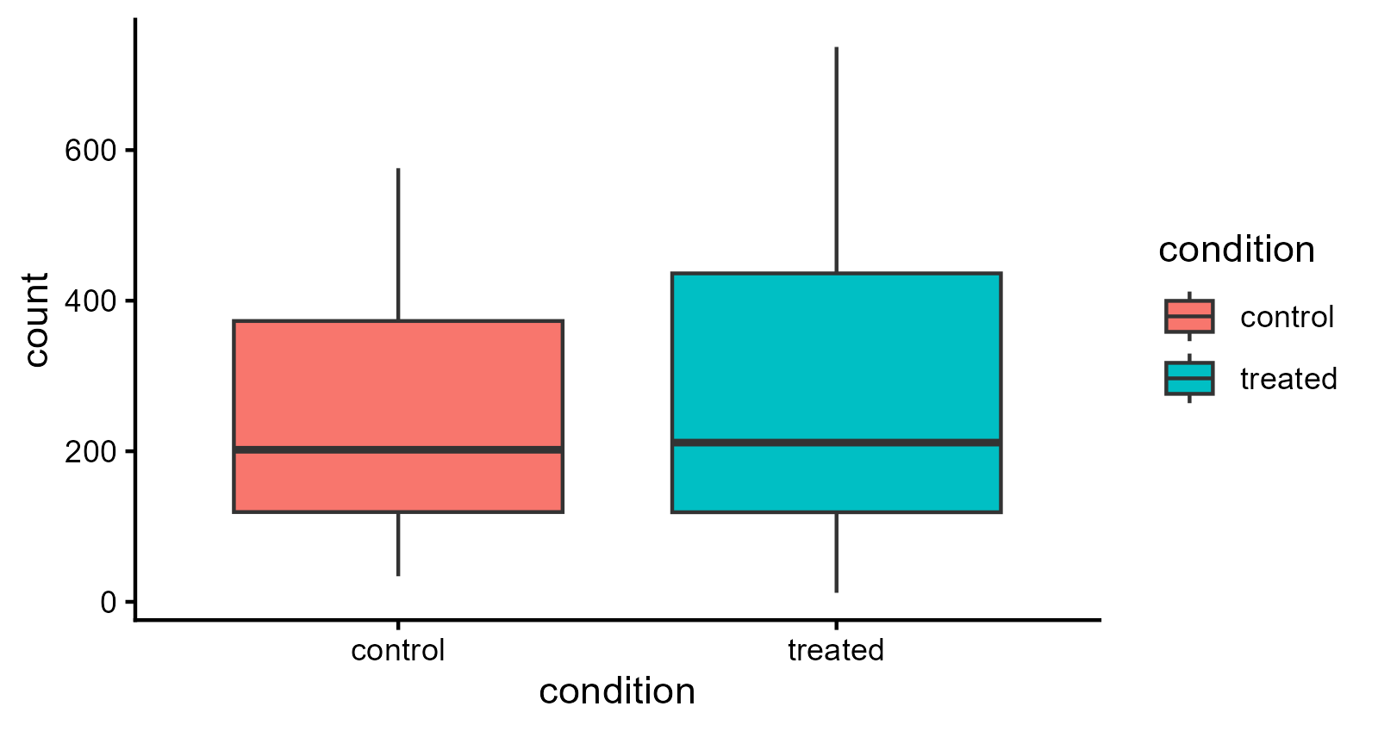
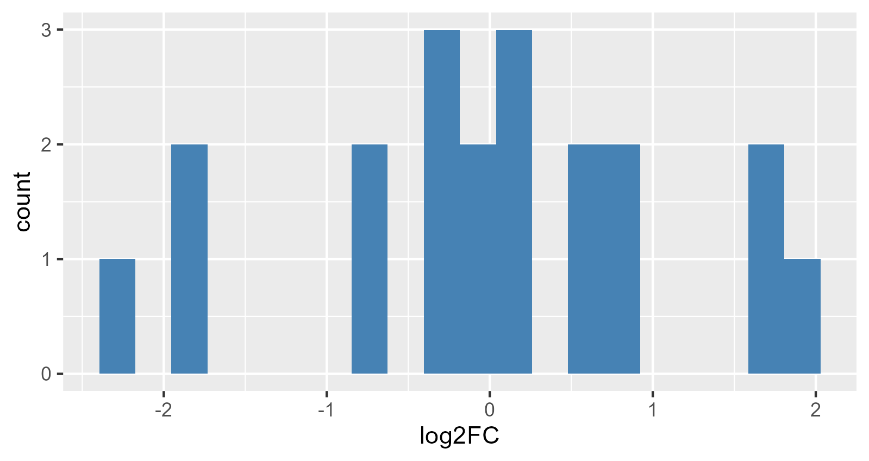
Figures : Overall Spread & Distribution
Boxplot — expression by condition
Histogram — log2 fold-change distribution
Treated samples show a slightly higher median and a wider spread than control, meaning most genes stay steady while a subset responds strongly. Biologically, this points to the treatment switching specific genes on or off rather than shifting the whole genome equally.
Most genes cluster close to a log2FC of zero, meaning their expression barely changes after treatment. A small number of genes show strong positive or negative fold-changes instead. Biologically, this is the signature of a targeted response rather than a global one — likely genes tied to stress response, adaptation, or metabolism rather than the whole transcriptome reacting at once.
5

Slide 7
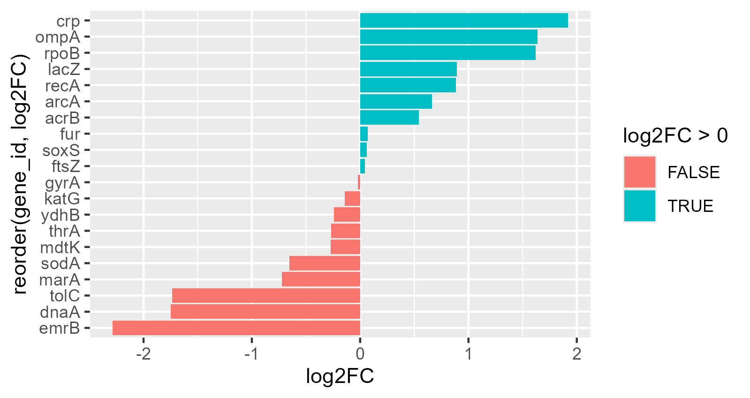
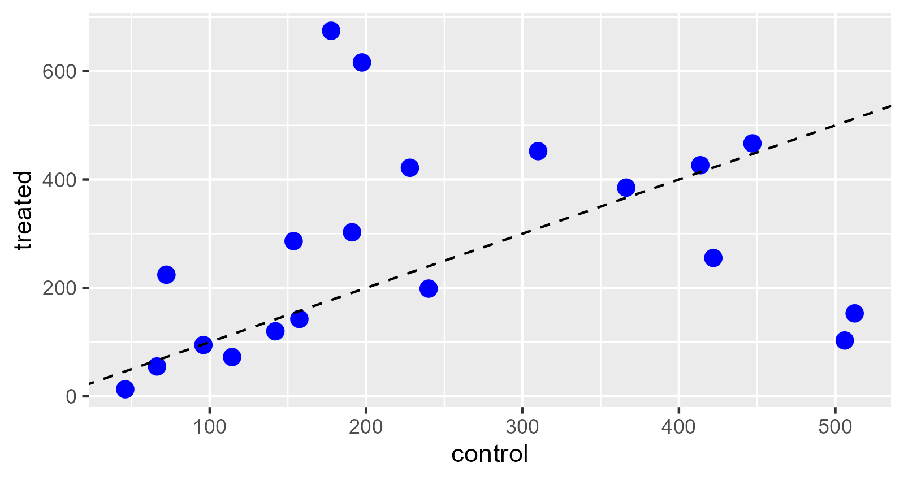
Figures : The Responders
Bar plot — all genes ranked by log2FC
Scatter — mean control vs. mean treated
Most genes sit close to the y=x line, meaning treated and control expression are similar. A few genes (ompA, crp) sit well above it and others (emrB, tolC) sit well below it, visually confirming the up/down calls from the bar plot.
crp, ompA, rpoB, lacZ, and recA are the strongest upregulated genes; emrB, dnaA, tolC, marA, and sodA are the strongest downregulated ones. These are the treatment's clearest responders — upregulated genes may support protective/regulatory pathways, downregulated ones may mark processes suppressed by treatment.
6

Slide 8
What the Data Suggests
Reproduce it
The treatment produces a targeted transcriptional response, not a uniform shift — most genes show little to no change.
A consistent subset stands out clearly across every figure: crp, ompA, rpoB up; emrB, tolC, dnaA down.
These are the strongest candidate genes for involvement in the cellular response to treatment.
Biological read
bash scripts/set.sh
python scripts/parse.py
Rscript scripts/analysis.R
→ figures/*.png + results/*.csv
Note: Modify the file paths in `set.sh`, `parse.py`, and `analysis.R` to match your own directory structure before running the workflow.
Full pipeline, scripts, and README are in the project repository.
Thank you
7

