Slide 1

Safe Until It Isn't
Correlation Spikes, Portfolio Fragility, and True Diversification
Does diversification survive precisely when it is needed most?
Andrea Saliola Bucelli · Florian Säwert · Timo Baumgartner
Advanced Seminar: Data Science in Finance — Technical University of Munich
Notes:
- One-line pitch: portfolios that look diversified in calm markets can lose that protection exactly in stress; we measure how much, and whether it is structural.
- Full pipeline: DuckDB + Python, two ETF panels, a Markov-switching stress regime, and three measurement layers (correlations, PCA concentration, Forbes-Rigobon).
- Everything shown is reproducible: scripts/run_all.py + notebooks regenerate every figure and table.
- 12-15 minutes; questions at the end.

Slide 2
PART 01 · THE QUESTION
01
Does diversification survive when it is needed most?
Why a full-sample correlation is the wrong lens for crisis risk.

Slide 3
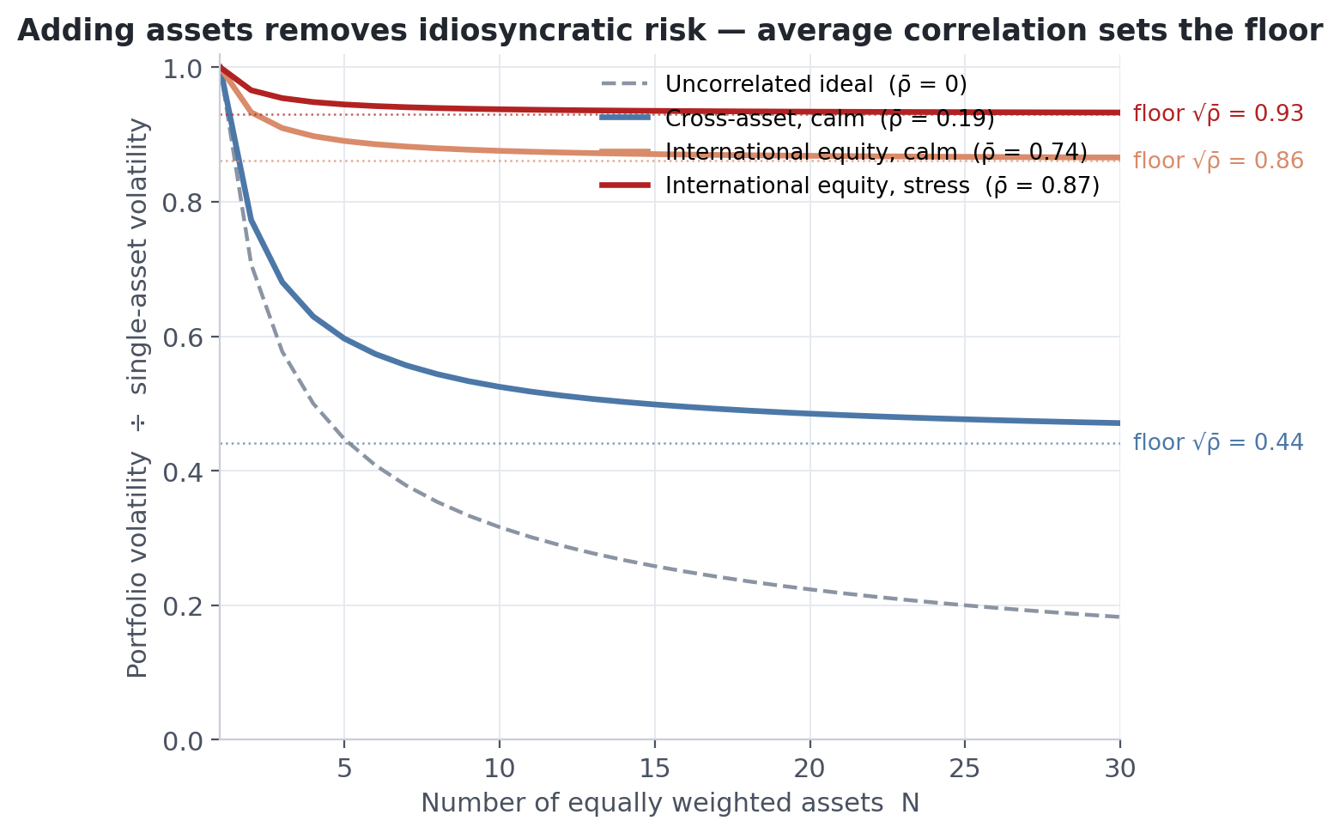
THE PROMISE
One free lunch — with a floor set by average correlation
• Portfolio risk is driven by co-movement, not by the number of holdings (Markowitz, 1952)
• Adding assets removes idiosyncratic risk — the average correlation ρ̄ sets the floor: σₚ → √ρ̄ · σ
• At the calm cross-asset ρ̄ = 0.20 the floor is 0.44 σ; at the stress international-equity ρ̄ = 0.87 it is 0.93 σ
• The whole promise rests on ρ̄ staying put when stress arrives — that is this paper's question
Notes:
- Markowitz: portfolio risk depends on co-movement, not the number of assets.
- Equal-weight formula (report appendix): idiosyncratic risk dies at 1/N, but sigma_p converges to sqrt(rho-bar) x sigma.
- With the measured calm cross-asset rho-bar of 0.20 the floor is 0.44; at the stress international-equity rho-bar of 0.87 it is 0.93 — adding markets buys almost nothing.
- So the entire question is whether rho-bar stays where the calm sample says it is.

Slide 4
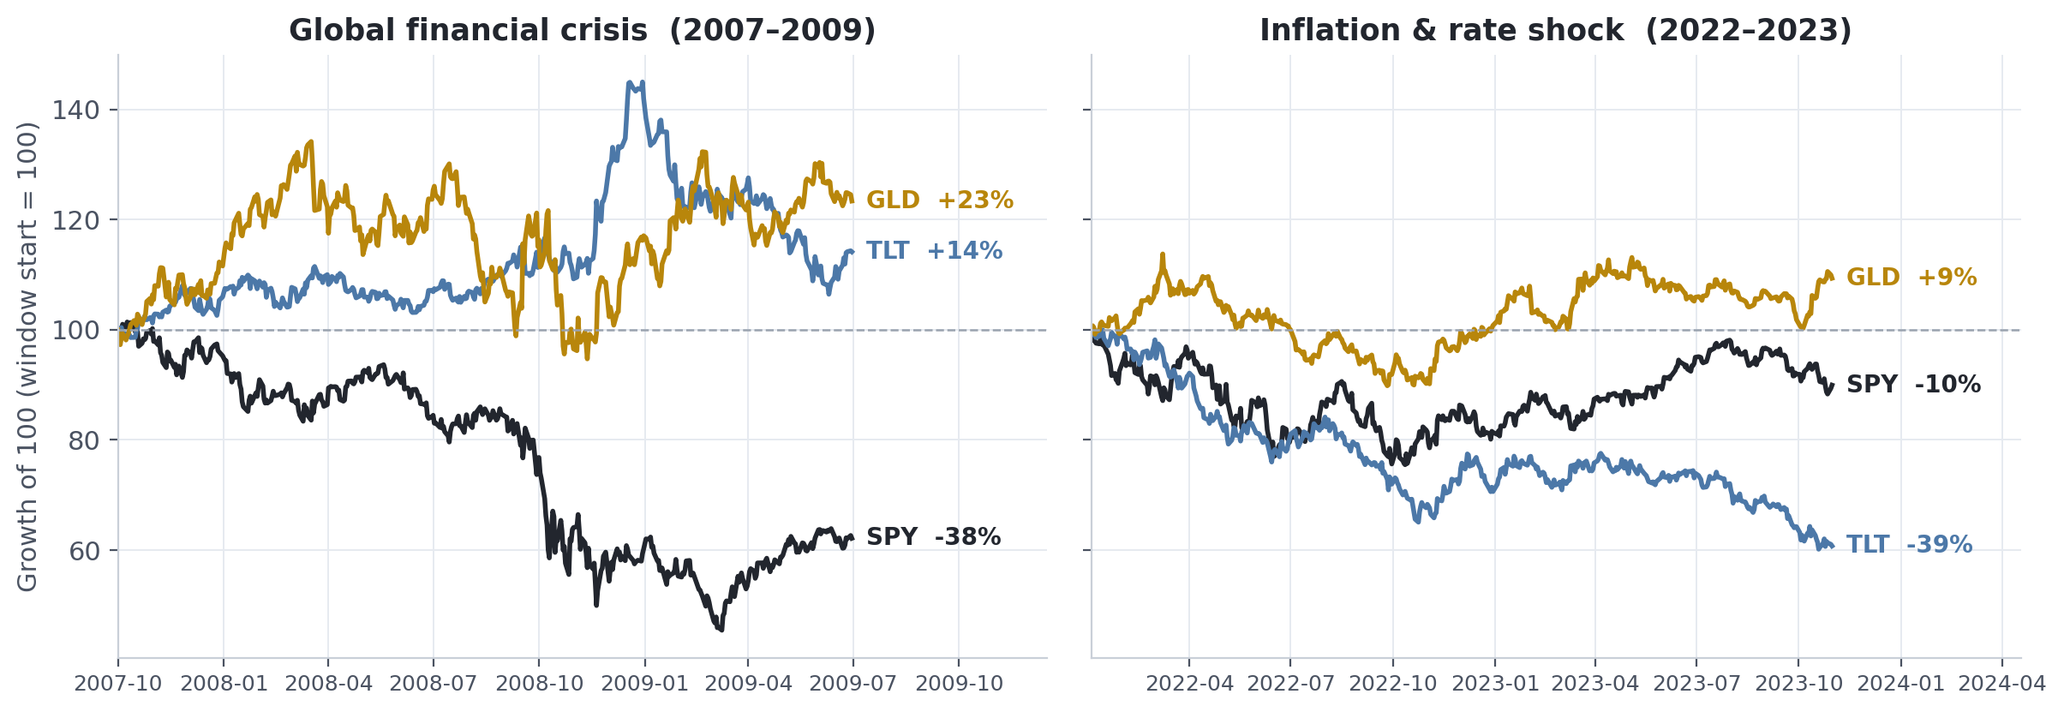
THE WARNING
Two stress episodes, two different failure modes
2008: Treasuries +14% and gold +23% cushioned a 38% equity fall. 2022–23: long Treasuries −39% — deeper than equities — and only gold held (+9%). Same “stress”, different anatomy.
Notes:
- GFC window (Oct 2007 - Jun 2009): SPY -38% at window end, TLT +14%, GLD +23% — the textbook flight-to-quality hedge worked.
- 2022-23 window: SPY recovered to -10%, but TLT finished -39% — deeper than equities; only gold held (+9%).
- Same word 'stress', opposite hedge behaviour -> motivates regime-conditional, episode-aware analysis instead of one full-sample correlation.

Slide 5
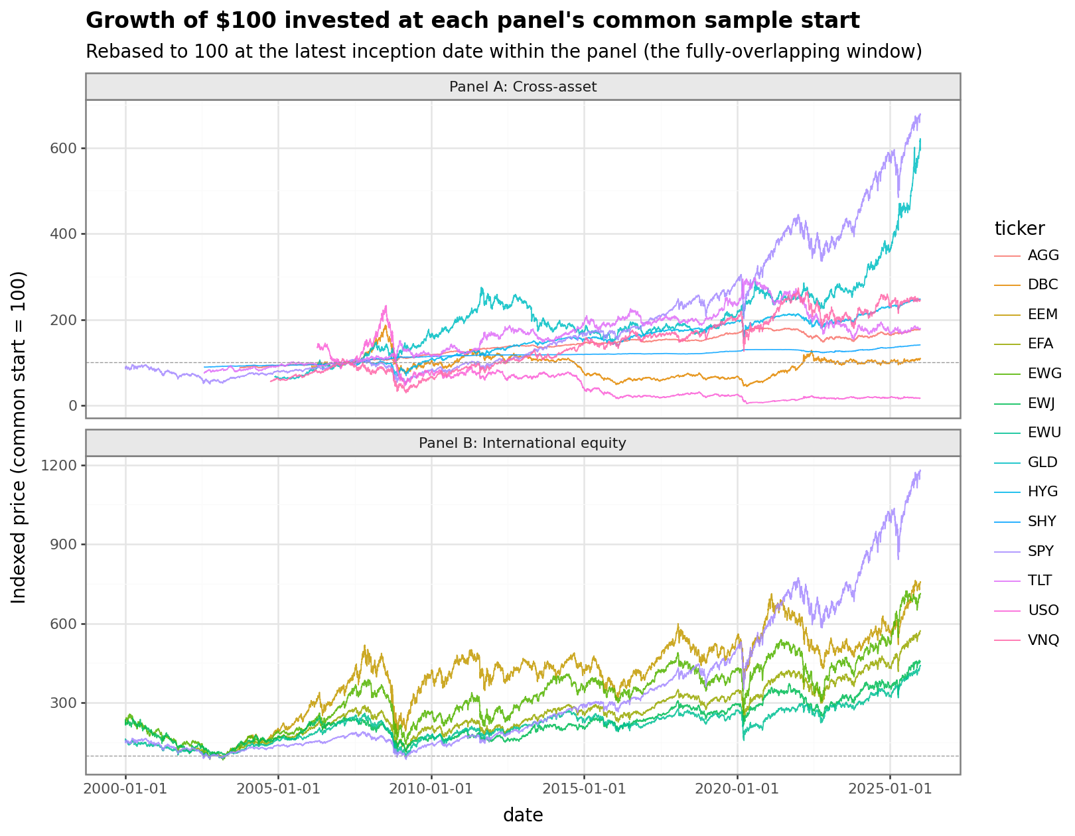
MOTIVATION
Diversification looks safe in calm markets — and thins out exactly in stress
Unconditional correlations blend calm and crisis; they understate co-movement when it matters
2008, 2020, 2022: broad drawdowns hit most asset sleeves at once
Which pairwise correlations rise under stress — and which hedges keep working?
Our approach: condition the whole dependence structure on an explicit, data-driven stress regime
Notes:
- Growth of $100 from each panel's common start: every drawdown hits nearly all lines together.
- The classic investor complaint: correlations 'go to one' in a crisis. We test how literally that is true, per asset pair.
- Key design idea: don't average over calm and crisis - condition on a stress regime and compare the two dependence structures.
- Research question on record: does diversification survive when it is needed most, and is the deterioration structural or mechanical?

Slide 6
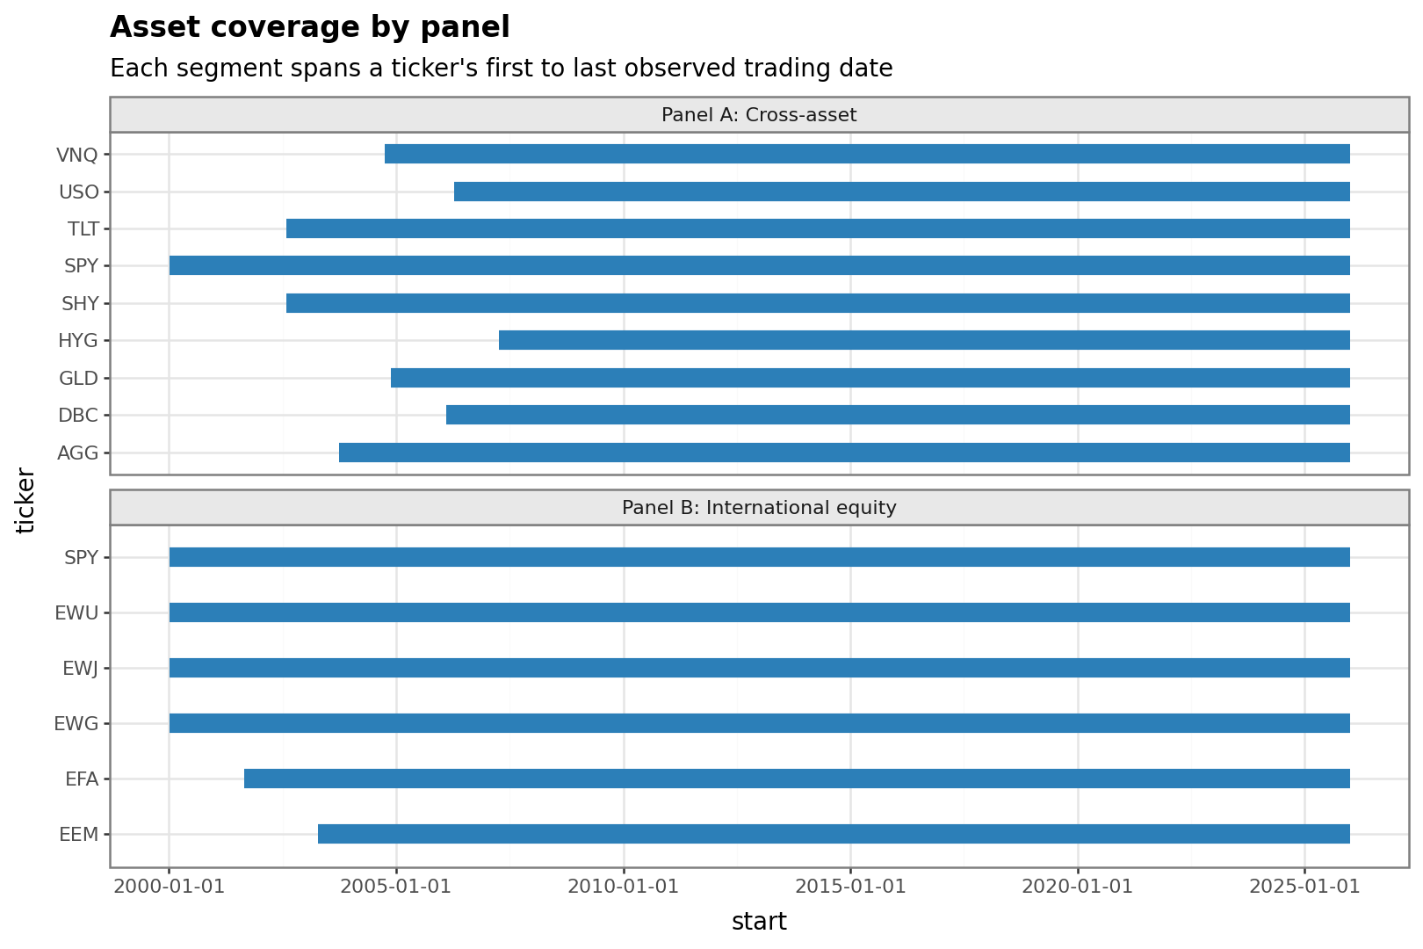
DATA
Two deliberately different ETF panels on one balanced daily window
Panel A — cross-asset (9 ETFs): SPY, SHY, TLT, AGG, HYG, GLD, DBC, USO, VNQ
Panel B — international equity (6 ETFs): SPY, EFA, EEM, EWG, EWU, EWJ
Daily log returns from adjusted closes (Yahoo Finance), stored in a DuckDB pipeline
Balanced window 12 Apr 2007 – 30 Dec 2025: 4,711 trading days (2,443 calm / 2,268 stress)
Notes:
- Panel A spans the classic diversification menu: equity, short/long Treasuries, aggregate + high-yield credit, gold, commodities, oil, listed real estate.
- Panel B asks a different question: does geographic equity diversification survive stress?
- US-listed ETFs mean synchronous NYSE closes - no asynchronicity bias in daily correlations.
- HYG is the latest entrant (Apr 2007) and anchors the balanced window; all universes share the same 4,711 days and the same calm/stress mix.
- Returns are heavily non-Gaussian (excess kurtosis up to 55) - motivates regime-based analysis.

Slide 7
PART 02 · DATING THE REGIME
02
A data-driven calm-versus-stress split of the market
A two-state Markov-switching model on monthly SPY returns.

Slide 8
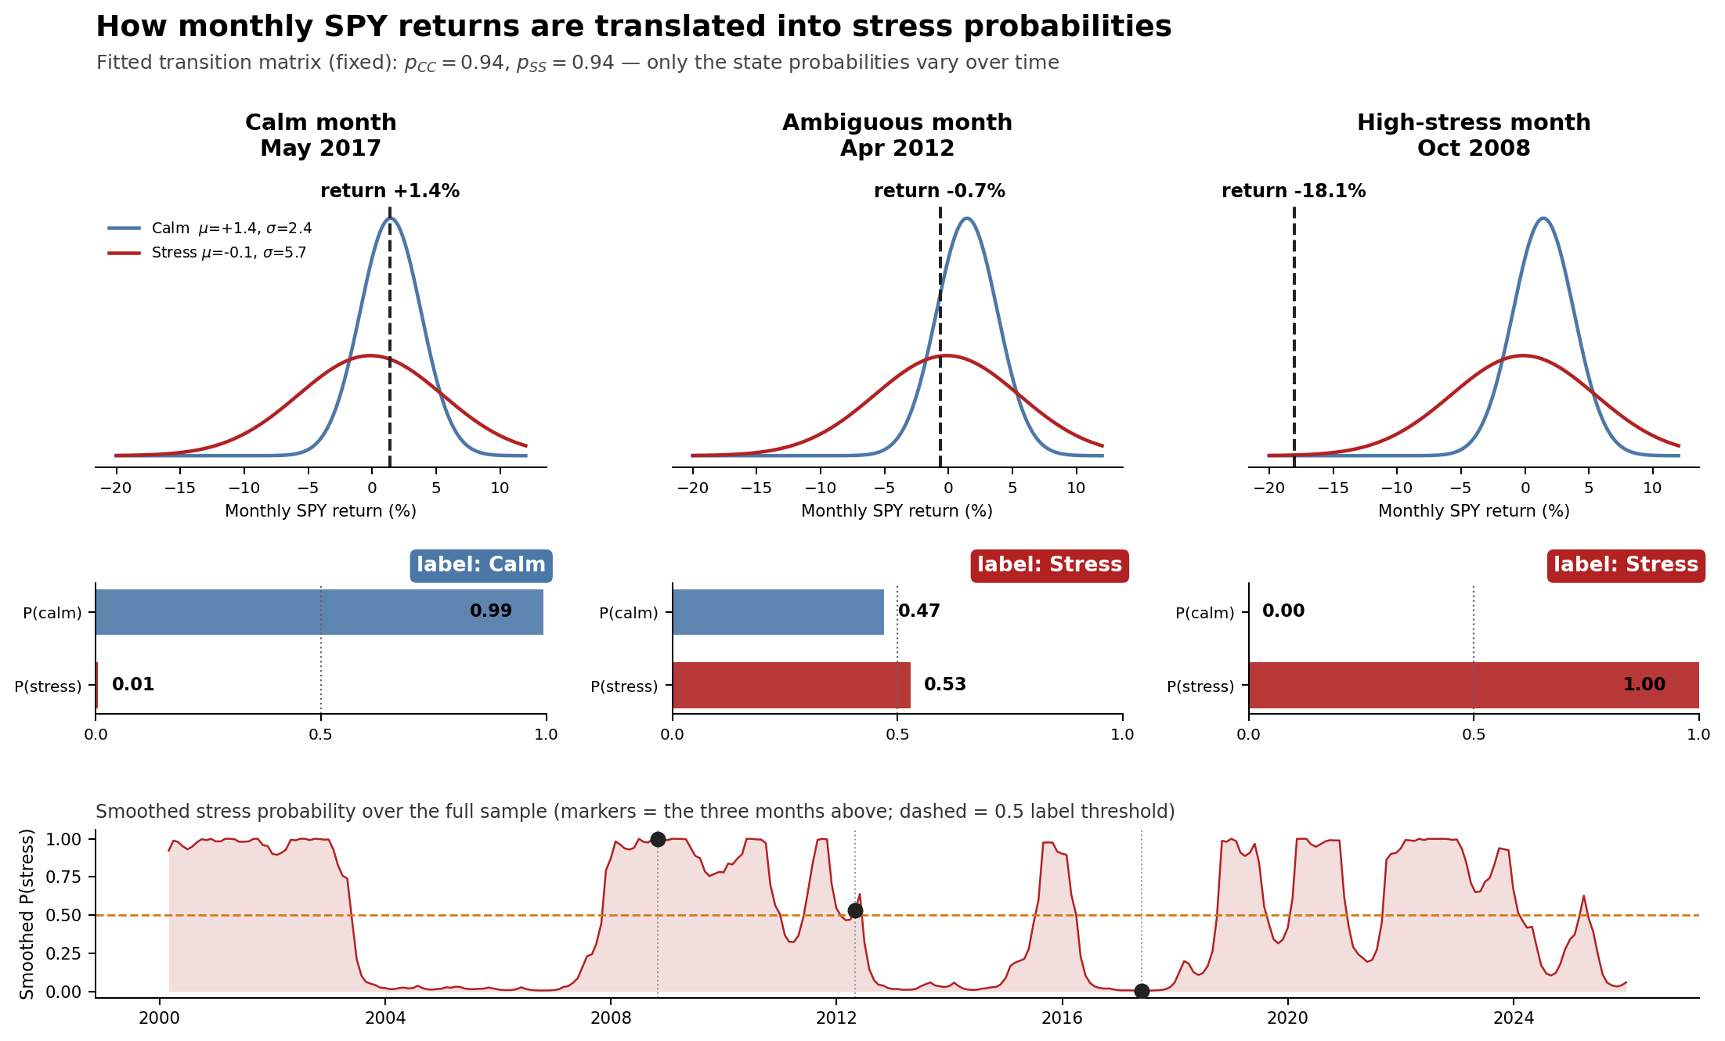
REGIME IDENTIFICATION
How monthly returns are translated into stress probabilities
Notes:
- Caption: the model evaluates each month's return under the calm and stress state distributions and combines this with regime persistence. The fitted transition matrix is FIXED - only the probability of being in the stress state changes over time.
- May 2017: +1.4% is typical calm-state behaviour -> P(stress) 0.01 -> Calm.
- Apr 2012: -0.7% is ambiguous on its own (both densities overlap) - Markov persistence from neighbouring stress months tips it to P(stress) 0.53 -> Stress. This is the pedagogical core: the label is not a per-month threshold on returns.
- Oct 2008: -18.1% is essentially impossible under the calm density -> P(stress) 1.00.
- Animated version of this figure available (GIF/HTML in outputs/figures) - can be swapped onto this slide for the live talk.

Slide 9
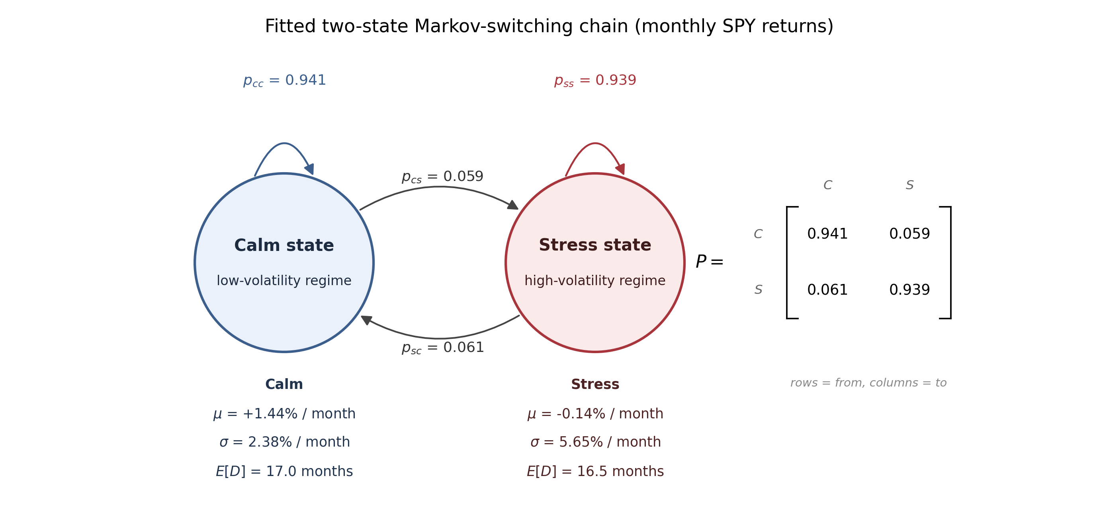
REGIME IDENTIFICATION
Stress = the high-variance state of a two-state Markov-switching model on monthly SPY returns
n = 311 months (2000–2025) · stress share 47% · expected spell ≈ 17 months · BIC-preferred specification
Notes:
- Two latent states, each with its own mean and variance: calm mu +1.44%/sigma 2.38% per month; stress mu -0.14%/sigma 5.65%.
- Stress is defined ex post as the higher-variance state; labels use smoothed probabilities with the 0.5 maximum-probability rule.
- Both states are persistent (p_CC = 0.941, p_SS = 0.939) - regimes last about 17 months on average, so 'stress' is a high-volatility era, not a crash day.
- Specification is BIC-preferred against variance-only, mean-only and three-state alternatives; robust to threshold (0.75), weekly frequency, and optimizer initialization.
- Validation: agrees with an independent VIX + drawdown rule well beyond chance (Cohen's kappa about 0.5 at weekly frequency).

Slide 10


Slide 11
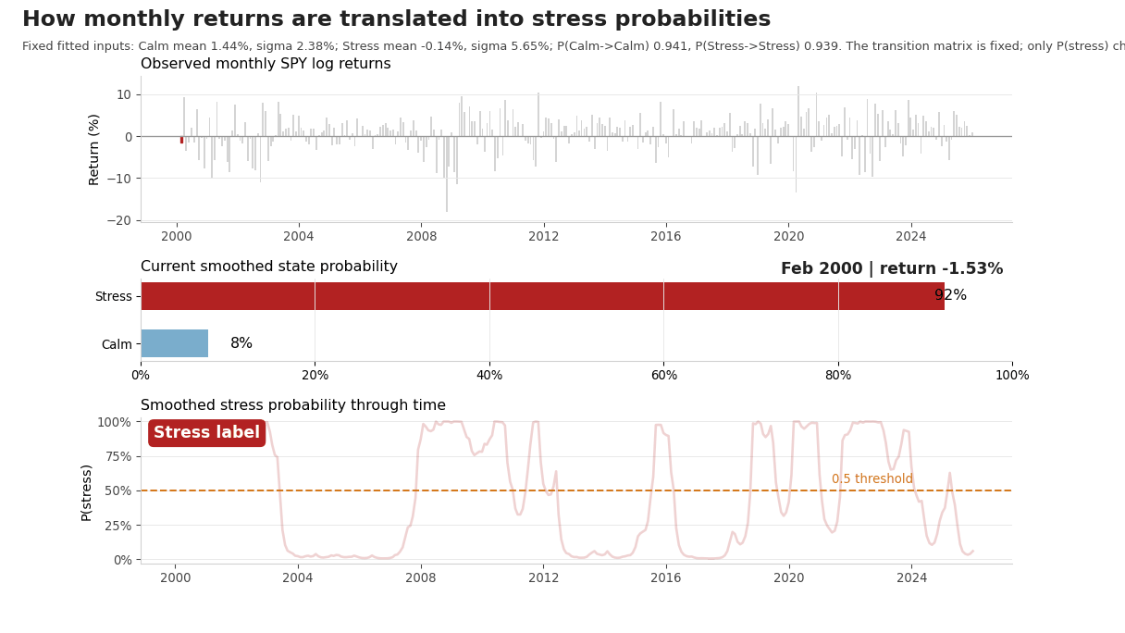

Slide 12
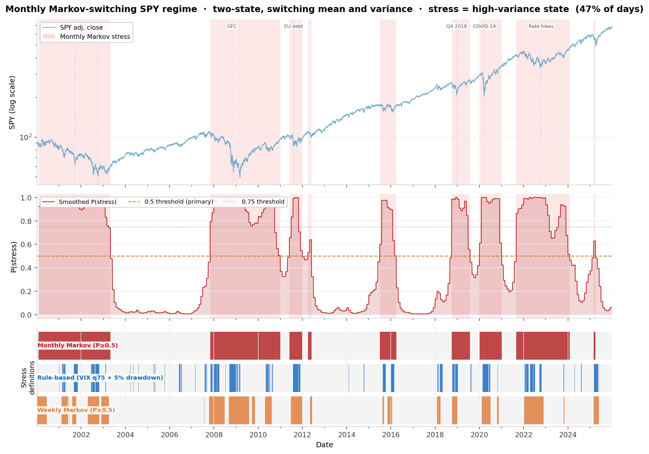
BACKUP
Regime dating: SPY with stress shading, probabilities, and label agreement
Notes:
- Top: SPY (log scale) with monthly Markov stress shading; middle: smoothed P(stress) with both thresholds; bottom: agreement swim-lanes.
- The monthly Markov, weekly Markov, and the rule-based VIX+drawdown label identify the same episodes (kappa about 0.5, 'moderate', well beyond chance).
- Stress covers 47% of months - long high-volatility eras (dot-com, GFC, euro-area, 2015-16, 2018, COVID, 2022 rate shock), not crash days.

Slide 13
PART 03 · WHAT BREAKS, AND WHAT HOLDS
03
Correlations, concentration, and the volatility correction
From pairwise co-movement to portfolio-level fragility.

Slide 14
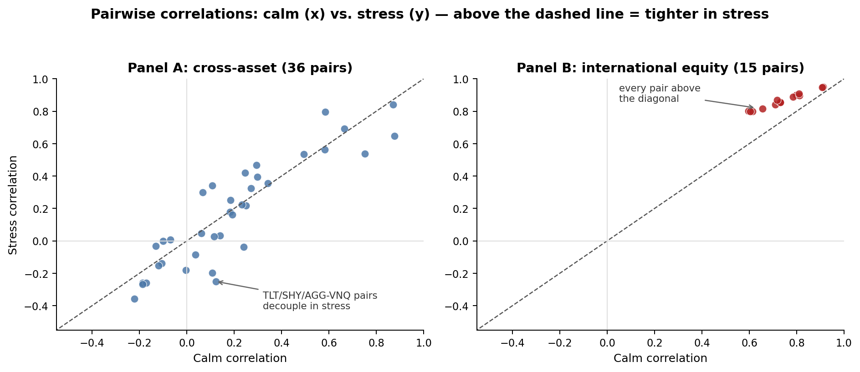
RESULT 1 — REGIME-CONDITIONAL CORRELATIONS
International equity tightens uniformly in stress; the cross-asset panel reshuffles
Panel B: 0.74 → 0.87 (Δ +0.124) Panel A: 0.195 → 0.170 (Δ −0.025) Combined: +0.029
Notes:
- Same balanced days, Pearson correlations computed separately on calm and stress days.
- Panel B: all 15 pairs above the diagonal - a uniform tightening, average 0.74 -> 0.87. Geographic equity diversification compresses toward one factor.
- Panel A: the average is flat (slightly negative) but that hides a reshuffle: risk-on pairs (SPY/DBC/USO with VNQ) tighten, while Treasury and gold pairs DECOUPLE further - TLT-VNQ falls by 0.37.
- 61% of Panel A pairs see their correlation FALL in stress - the opposite of the textbook breakdown.
- These are raw descriptive numbers; next two slides ask what survives inference and what survives the volatility correction.

Slide 15
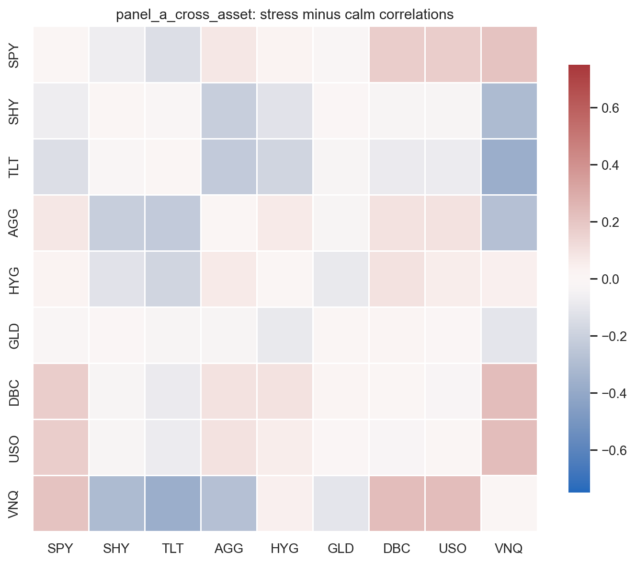
RESULT 1 — THE RESHUFFLE
A flat average hides a rotation: risk-on tightens, hedges decouple
• Warm block — the risk-on complex converges: SPY–VNQ +0.21, DBC–VNQ and USO–VNQ ≈ +0.23
• Cool block — the safe-haven sleeve decouples: TLT–VNQ −0.37, SHY–VNQ −0.31, TLT–AGG −0.23
• 61% of cross-asset pairs see their correlation fall in stress — the opposite of the textbook story
• Both moves load the same risk-on/risk-off axis: the average barely moves while the structure rotates
Notes:
- Stress-minus-calm difference matrix for the cross-asset panel.
- Warm block: SPY-VNQ +0.21, DBC/USO-VNQ ~ +0.23 — the risk-on complex converges.
- Cool block: TLT-VNQ -0.37, TLT-AGG -0.23 — duration decouples further.
- 61% of the 36 pairs FALL in stress; both moves load one risk-on/risk-off axis, so the average stays flat while the structure rotates.

Slide 16
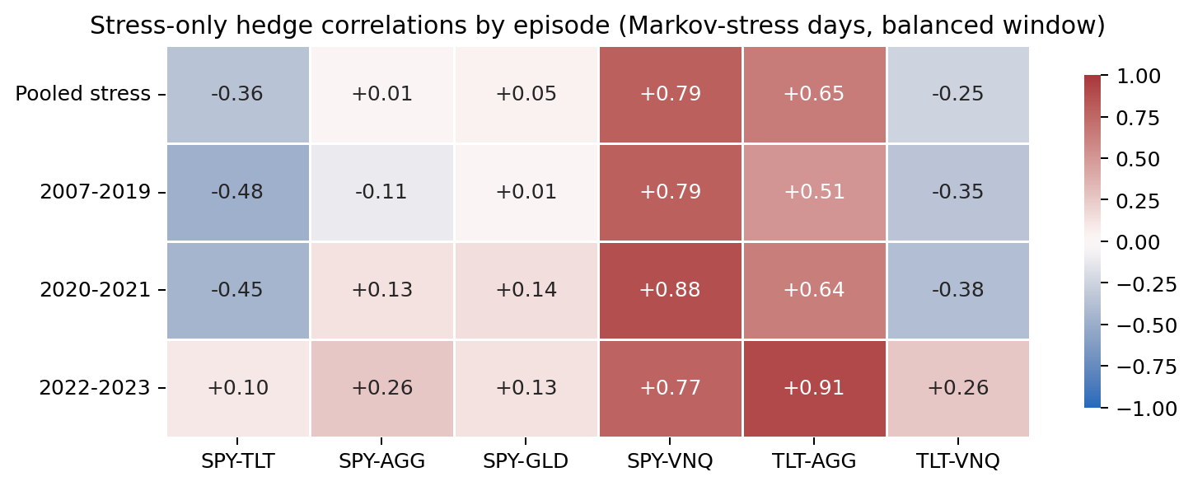
NUANCE — STRESS-EPISODE SPLIT (DESCRIPTIVE)
The Treasury hedge is episode-dependent — it flipped in the 2022 inflation stress; gold was not
SPY–TLT on stress days: −0.48 (2007–19), −0.45 (2020–21) → +0.10 (2022–23); ~76% of stress days predate 2022.
Descriptive split only — same window, same labels, no new inference. It qualifies the pooled result; it does not overturn it.
Notes:
- The Markov label says WHEN markets are stressed, not WHICH macro shock causes the stress.
- Splitting stress days by broad era: the whole duration sleeve flips sign in 2022-23 (SPY-TLT, TLT-VNQ, and TLT-AGG rises to 0.91), consistent with inflation-driven stock-bond comovement (Campbell-Pflueger-Viceira 2020).
- Gold is the exception: SPY-GLD stays within [+0.01, +0.15] in EVERY episode - its diversification is episode-robust.
- Because ~76% of stress days predate 2022, the pooled Treasury-hedge estimate is dominated by deflationary-type episodes.
- Framing: average stress-regime property, not an unconditional hedge guarantee. No formal inference on the split (501 vs 1,387 days).

Slide 17
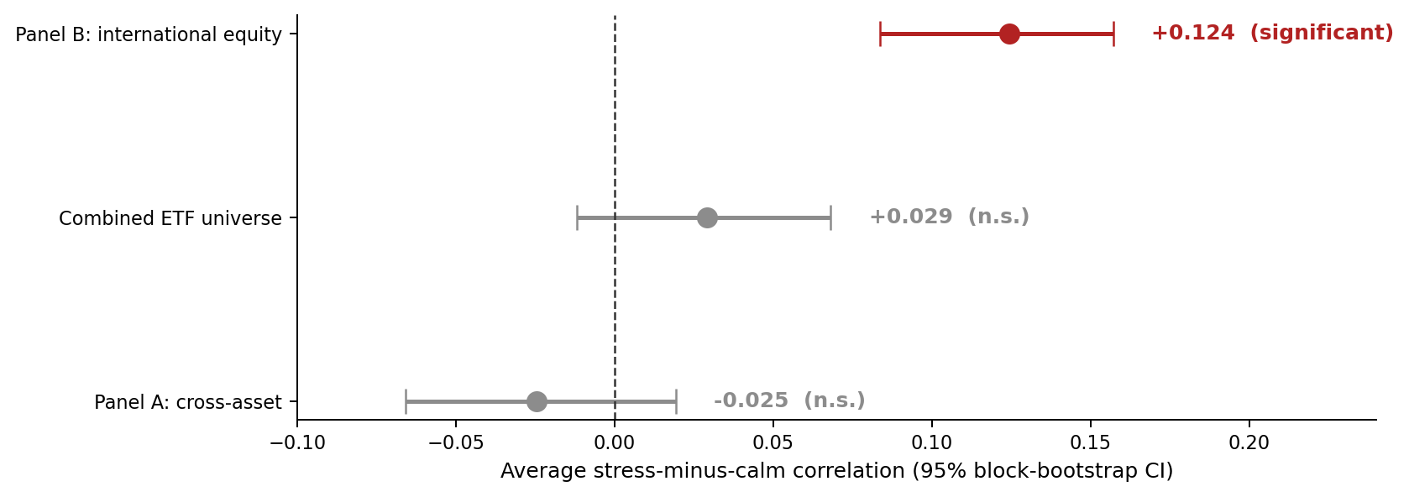
RESULT 1 — INFERENCE
Only the international-equity increase survives sampling uncertainty
Circular block bootstrap (B = 2,000, 21-day blocks) preserves volatility clustering and regime persistence
Panel A's flat average hides offsetting moves: 6 significant increases vs. 8 significant decreases (11 FDR-significant pairs)
A classical Fisher-z test would flag 73 of 91 combined pairs; the block bootstrap retains 50 after FDR control
Notes:
- Whole cross-sectional rows are resampled in chronological blocks together with their regime labels; regime counts vary naturally across replicates.
- Panel B: +0.124 with CI [+0.084, +0.157], p < 0.001, and all 15 pairs FDR-significant - the one unambiguous universe-level result.
- Panel A and combined averages are NOT distinguishable from zero (p = 0.27 and 0.16) - but pair-level significance shows the reshuffle is real.
- Methodological point for this course: respecting serial dependence removes about a third of the 'discoveries' a naive iid test would claim.
- Inference is conditional on the estimated regime labels (stated limitation).

Slide 18
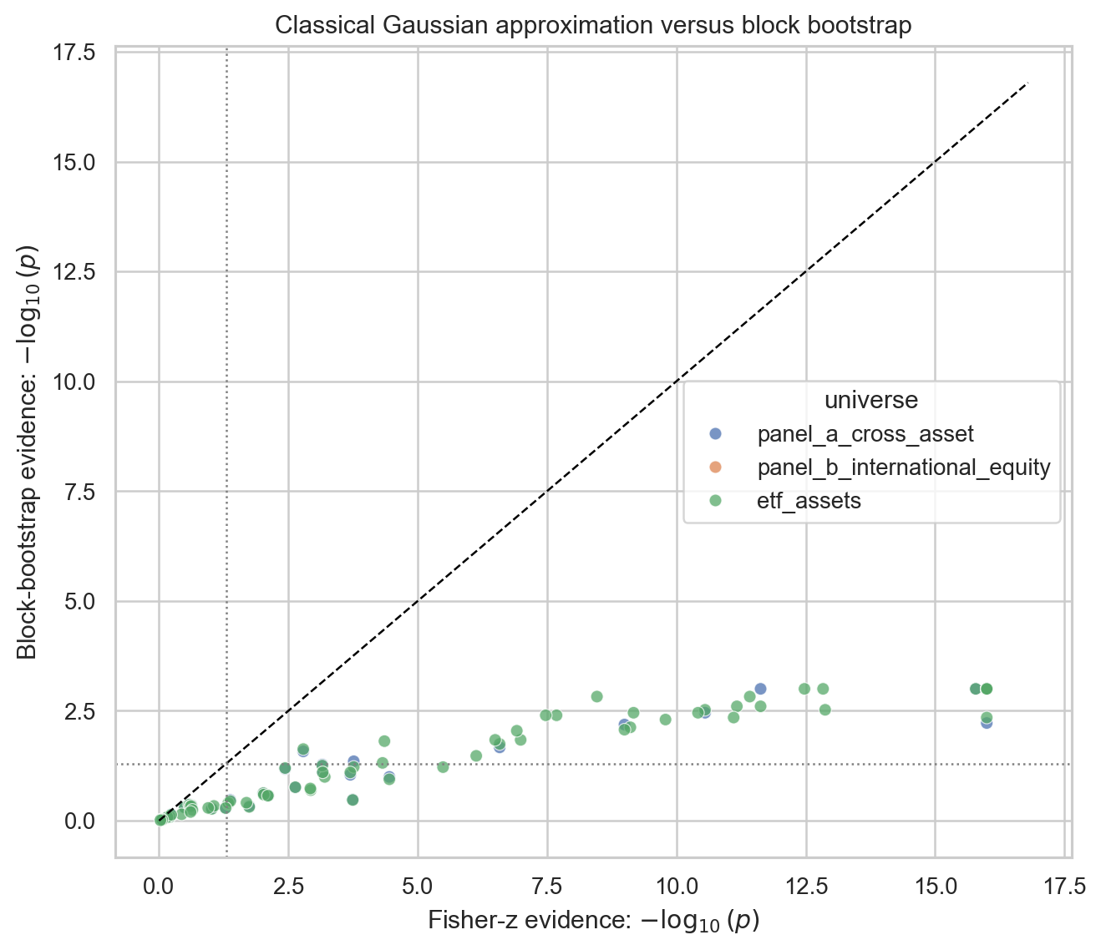
RESULT 1 — HONEST INFERENCE
Respecting serial dependence deletes a third of the “discoveries”
• The classical Fisher-z test treats 4,711 clustered days as independent: 73 of 91 pairs look significant
• The 21-day block bootstrap keeps volatility clustering and regime persistence: 50 survive FDR control
• All 50 are also Fisher discoveries — the other 23 exist only under the i.i.d. illusion
• Example: SPY–AGG Δρ = +0.08 → Fisher p = 0.008, but bootstrap p = 0.27
Notes:
- Fisher-z assumes i.i.d. Gaussian days: flags 73 of 91 combined pairs as significant.
- The 21-day circular block bootstrap keeps volatility clustering: 50 survive FDR control.
- Every bootstrap discovery is also a Fisher discovery — the extra 23 are what the i.i.d. assumption fabricates.
- Concrete case: SPY-AGG delta +0.08 -> Fisher p = 0.008, bootstrap p = 0.27.

Slide 19
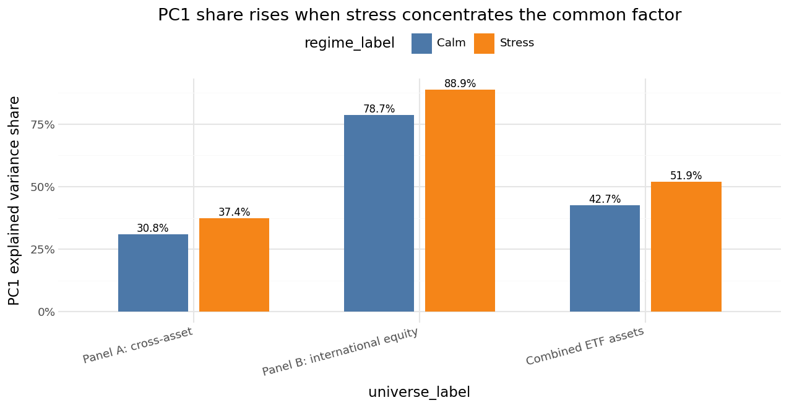
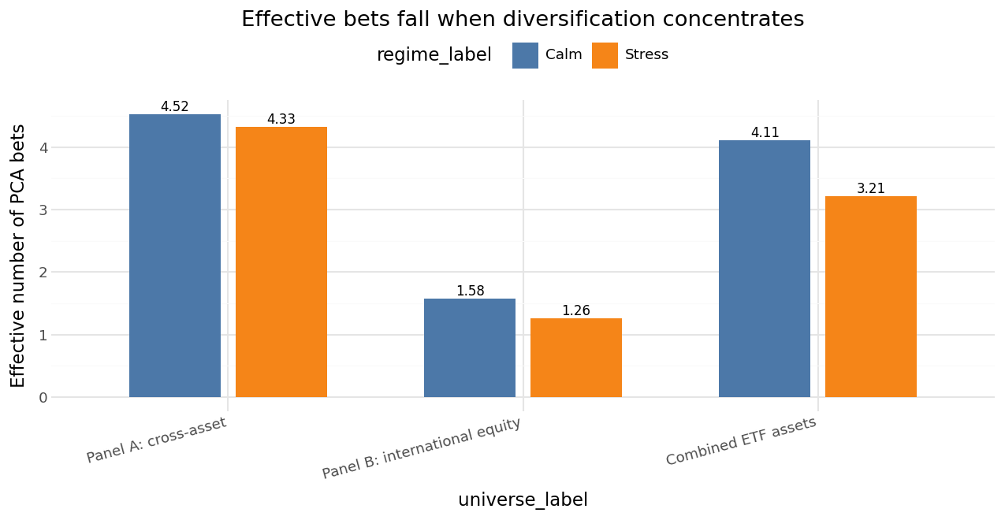
RESULT 2 — CONCENTRATION
Stress concentrates every universe onto fewer independent bets
1.58 → 1.26
Panel B effective bets: six markets ≈ one bet in stress (PC1 share 89%)
0.31 → 0.37
Panel A PC1 share: variance reallocates into one risk-on/risk-off axis (N_eff 4.52 → 4.33)
Notes:
- Eigendecomposition of the regime-conditional correlation matrices on the same balanced window; effective bets = participation ratio of eigenvalue shares.
- Every universe concentrates in stress: PC1 share up, effective bets down.
- Panel B is nearly degenerate in stress: PC1 explains 89% of variance, 1.26 effective bets across six markets.
- Panel A is subtler: average correlation was flat, yet concentration still rises - the reshuffle loads risk-on and safe-haven blocks onto the SAME leading axis.
- Portfolio reading: you lose roughly one-fifth of an independent bet in the cross-asset panel, and almost everything in international equity.

Slide 20
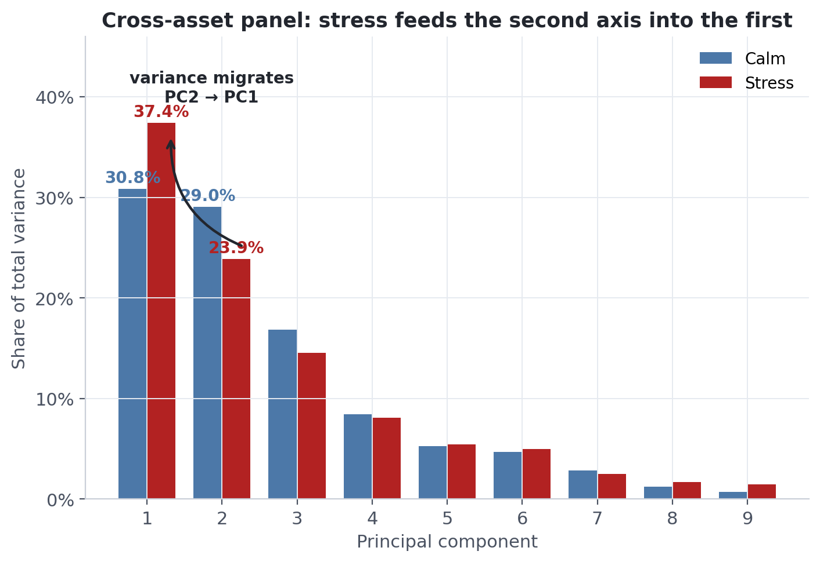
RESULT 2 — MECHANICS
Stress does not create risk directions — it feeds the second axis into the first
• Calm: the panel genuinely runs two axes side by side — a risk axis (30.8%) and a rates axis (29.0%)
• Stress: the leading axis pulls away — 37.4% vs 23.9%
• Top-3 cumulative share is unchanged (≈ 76%): variance migrates between axes, it is not created
• Effective bets fall 4.52 → 4.33 — the portfolio quietly loses a fifth of an independent bet
Notes:
- Calm cross-asset panel: two comparable axes — risk (30.8%) and rates (29.0%).
- Stress: the leading axis pulls away (37.4% vs 23.9%).
- Top-3 cumulative share barely moves (~76%): variance is reallocated, not created.
- Effective bets fall 4.52 -> 4.33: about one-fifth of an independent bet lost.

Slide 21
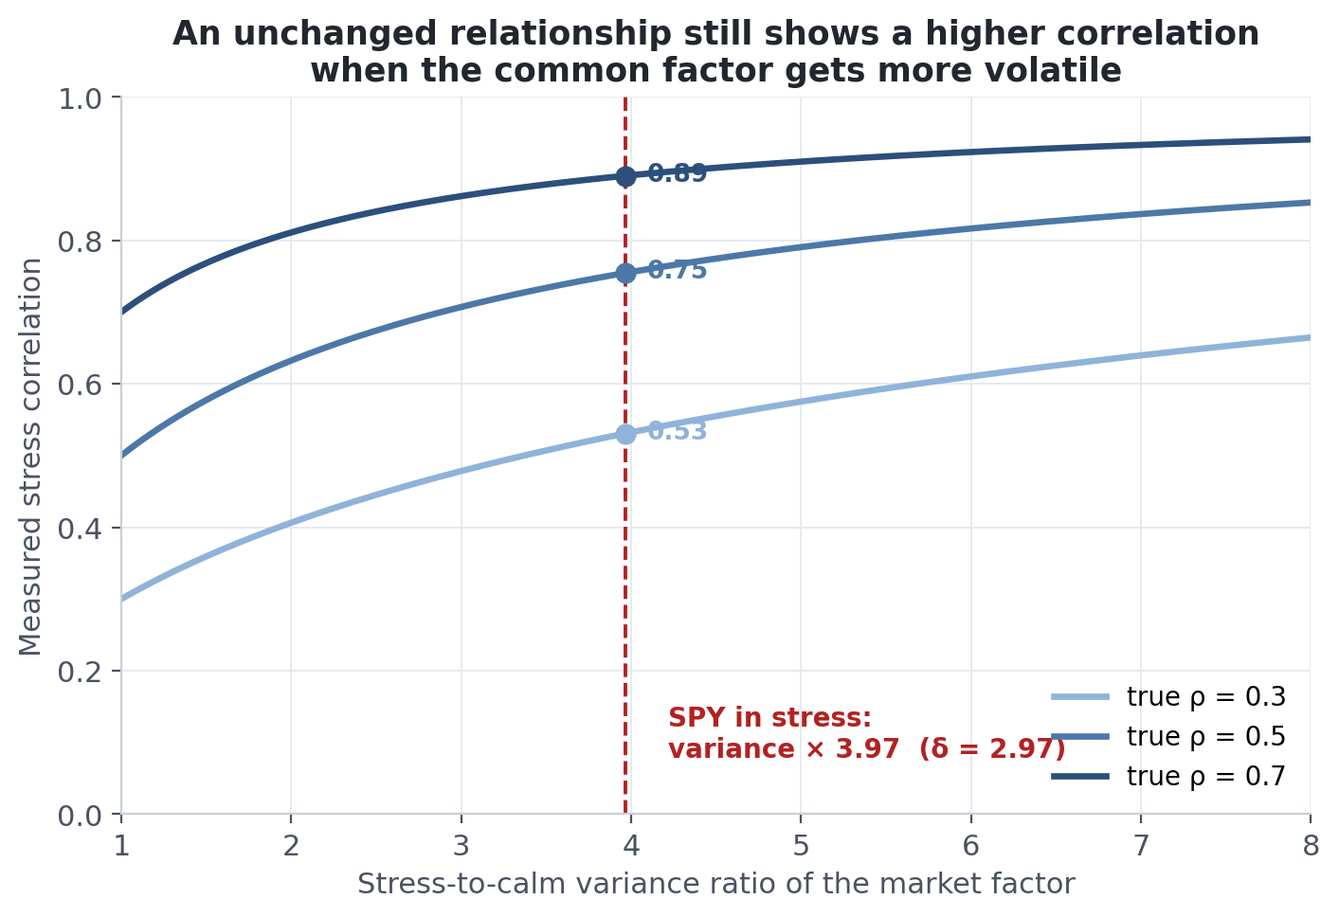
RESULT 3 — THE MECHANISM
Why higher volatility alone inflates measured correlation
• Keep the relationship fixed and only raise the market factor's variance — the measured correlation rises anyway (Forbes–Rigobon, 2002)
• SPY's variance is × 3.97 higher in stress (δ = 2.97)
• At that shock, a true ρ = 0.50 is measured as ≈ 0.75 — with no change in dependence at all
• So every stress correlation is deflated by its variance shock before we call anything “contagion”
Notes:
- Forbes-Rigobon (2002): with an unchanged linear relationship, a more volatile common factor mechanically raises the measured correlation.
- SPY's stress variance is x3.97 its calm variance (delta = 2.97).
- At that shock a true rho of 0.50 is MEASURED as 0.75 with zero change in dependence.
- Hence the adjustment: deflate each stress correlation by its variance shock before calling anything contagion.

Slide 22
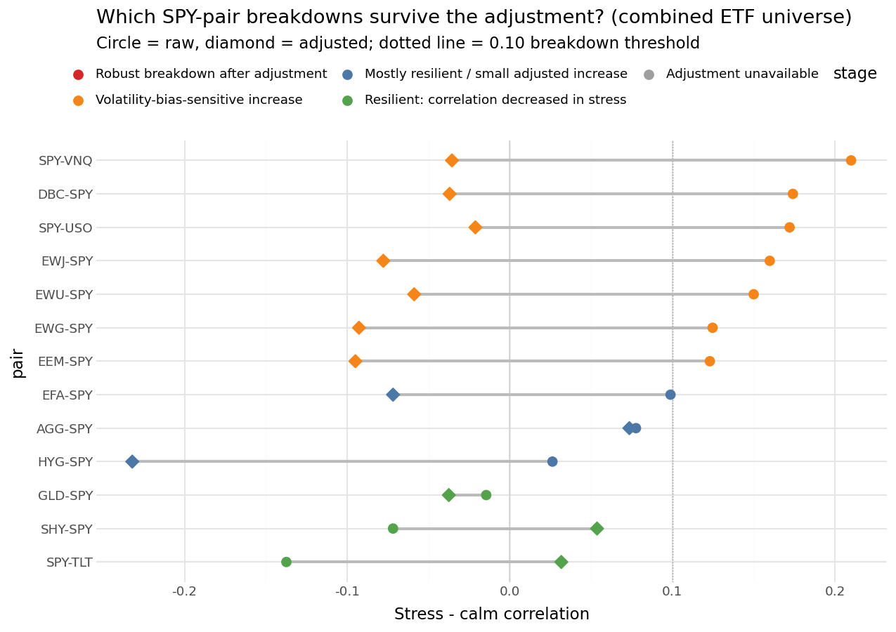
RESULT 3 — FORBES–RIGOBON ADJUSTMENT
No robust breakdown survives the volatility correction — interdependence, not contagion
Higher stress variance mechanically inflates correlations; Forbes–Rigobon deflates each pair by its variance shock (SPY shock δ = 2.97)
Zero robust breakdowns — in every universe, under both adjustment variants (market_spy and conservative pair_max)
Panel A non-SPY pairs: 19 of 28 genuinely resilient — their correlations fall in stress (Treasuries, gold)
Panel B: no resilient pair — the equity tightening is volatility-driven interdependence
Notes:
- Forbes-Rigobon (2002): a measured correlation rises automatically when common-factor variance rises, even with an unchanged relationship.
- Figure: circles = raw stress-minus-calm change, diamonds = after deflating by the SPY variance shock; every raw 'breakdown' slides back below the 0.10 threshold.
- Language matters: what investors experience is real comovement, but it is INTERDEPENDENCE in a high-volatility state, not a structural break (contagion).
- The asymmetry is the practical finding: fragility is concentrated in equities; the cross-asset hedges keep - and even strengthen - their diversifying role.
- Honest caveat: the correction is exact only under a single-factor, variance-only regime shift.

Slide 23
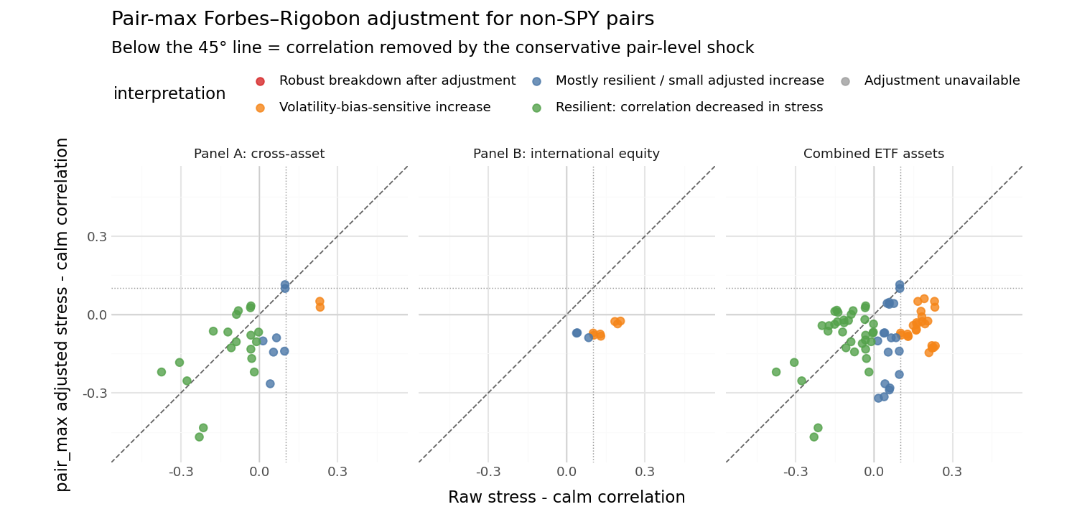
RESULT 3 — WHERE RESILIENCE LIVES
Resilience is a cross-asset property, not a geographic one
Conservative pair-max adjustment, non-SPY pairs · green = correlation fell in stress (resilient)
Cross-asset: 19 of 28 pairs genuinely resilient — Treasuries and gold de-correlate in stress. International equity: 0 of 10 resilient.
Notes:
- Conservative pair-max adjustment, non-SPY pairs only.
- Cross-asset panel: 19 of 28 pairs are genuinely resilient (green) — their correlation FELL in stress; only 2 volatility-sensitive.
- International equity: 0 of 10 resilient, 7 volatility-bias-sensitive.
- Diversification that survives adjustment lives across asset classes, not across borders.

Slide 24
SUPPLEMENT — INTERACTIVE DEMO
A Streamlit dashboard over the same DuckDB pipeline (in development)
Overview
Headline KPIs: stress share, calm vs. stress correlations, effective bets per universe
Regime explorer
Stress-probability chart with 0.5 / 0.75 threshold slider; monthly vs. weekly regime
Correlation explorer
Calm / stress / Δ heatmaps; pair drill-down with regime-coloured scatter + rolling correlation
Concentration (PCA)
Eigenvalue spectra and effective-bets comparison by regime
Forbes–Rigobon
Raw vs. adjusted Δρ and breakdown-survival view
Data quality
Coverage timeline, descriptive moments, QQ diagnostics
Status: page structure defined; reads the project database read-only — no recomputation in the app. TODO: add screenshots once implemented (nothing here is a mocked result).
Notes:
- Position this as a supplement/demo, not a result: same DuckDB, read-only, purely for exploring the published numbers.
- The two interactions worth demoing live: the regime-threshold slider and the pair drill-down with rolling correlation (the 2022 SPY-TLT flip is visible to the naked eye there).
- Deployment plan: Streamlit Community Cloud; the 25 MB DuckDB ships with the repo.
- Be explicit that screenshots are TODO - the deck contains no mocked dashboard output.

Slide 25
SYNTHESIS
A stress scorecard for the classic diversifiers
Long Treasuries (TLT) — conditional hedge
Resilient on average: stress correlation with SPY of −0.36, decoupling further when equities fall. But episode-dependent — it flips to +0.10 in the 2022–23 inflation stress.
Gold (GLD) — the steady one
Comparatively stable across stress types: SPY–GLD stays within [+0.01, +0.15] in every episode. No sign flips, no drama — episode-robust diversification.
Listed real estate (VNQ) — equity in disguise
Behaves like the risk-on complex: tightens with equities in stress (SPY–VNQ +0.21) while the true hedges decouple from it (TLT–VNQ −0.37).
International equity — no crisis diversifier
All 15 pairs tighten in stress; the common factor absorbs 89% of variance. Six markets deliver barely more than one effective bet exactly when breadth should pay.
Stress-robust diversification needs genuinely different risk drivers — not more assets, and not more countries.
Notes:
- TLT: resilient on average (stress rho vs SPY -0.36) but episode-dependent — +0.10 in 2022-23.
- GLD: steady across every episode ([+0.01, +0.15]).
- VNQ: equity in disguise — tightens with stocks, hedges decouple from it.
- International equity: uniform tightening, PC1 89%, no resilient pair.
- Takeaway: different risk drivers, not more assets or more countries.

Slide 26
CONCLUSION
Diversification must be stress-regime tested
1
Stress concentrates risk
Correlations rise and independent bets shrink — international equity compresses to nearly one factor (PC1 ≈ 89%)
2
It is interdependence, not contagion
After the Forbes–Rigobon volatility correction, no pair in any universe survives as a robust breakdown
3
Cross-asset hedges are resilient on average
Duration and gold de-correlate further in most stress episodes — though the stock–Treasury hedge weakened in the 2022 inflation episode
Judge a diversifier by its stress-regime behaviour, not by full-sample averages.
Backup: regime timeline · pipeline flow. Reproducible end-to-end: scripts/run_all.py + notebooks 01–06.
Notes:
- Three-sentence summary: stress concentrates risk in realized terms; the rise is volatility-driven interdependence rather than structural contagion; and the exposures that keep diversifying are genuinely different assets - sovereign duration and gold - not more equities.
- Keep claims diagnostic, not prescriptive: we evaluate diversification under regimes; we do not propose an allocation rule.
- The 2022 qualification shows the honest limit: the regime label does not identify the macro shock behind the stress.
- Close with reproducibility: one command rebuilds the database, all figures, and the report tables.

