Slide 1
MINOR PRESENTATION FINAL REPORT
UNDER GUIDANCE OF:
PARDEEP SINGH
BY,
MEHUL THAWRE RAJ ANSAL
500053289 500053294
R134216081 R134216109

Slide 2
TOPIC:
OPTIMIZATION OF JOB SCHEDULING PROBLEM USING GENETIC ALGORITHM

Slide 3
ABSTRACT
Scheduling is considered as an important topic in production management and combinatorial optimization in which it ubiquitously exists in most of the real-world applications.
The Aim is to obtain efficient scheduler able to allocate a large number of jobs originated for large scale applications.
This project describes the development of a genetic algorithm for solving the non-preemptive job shop scheduling problems with the objective of minimizing makespan and flowtime.

Slide 4
INTRODUCTION
JOB SCHEDULING PROBLEM:
Process of assigning a group of tasks/jobs to a single machine or resource.
The tasks are arranged so that one or many performance measures may be optimized.

Slide 5
GENETIC ALGORITHM:
Genetic algorithms are commonly used to generate high-quality solutions to optimization and search problems by relying on bio-inspired operators such as
selection
crossover
mutation

Slide 6
Pseudocode
Begin
1. Initialize random population.
2. Evaluate fitness for each population.
3. Generation of different iterations.
4. While(stopping GA criteria not satisfied) Repeat
{
5. for 1 to (number of iterations)
{
7. Select Chromosomes(by using the Roulette wheel Selection method)
8. Remove Chromosome with lowest fitness value
9. Crossover (Create new chromosomes)
10. Evaluate new chromosome
11. }
12. Mutation
13. Evaluate(mutated chromosomes)
14. }
15. Return the best solution found.
End

Slide 7
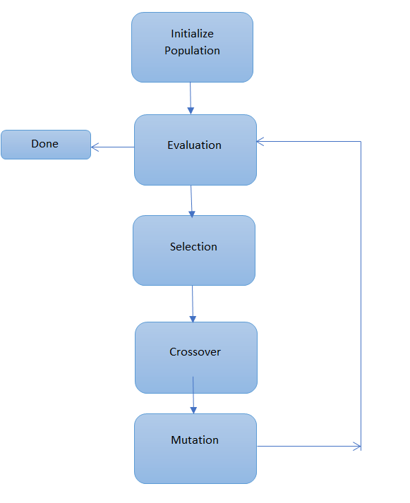
GA FLOW CHART

Slide 8
Implementing GA in Job Scheduling Problem.
Let, There are 5 jobs which are to be consider. The number of possible sequences are 5!. The total 10 sequence is selected out of 120 for the 5 jobs. Considering the number of jobs as 5 and the crossover point is 2 .
let us consider following two individuals which are marked as fit to generate next generation.
3 1 2 4 5 and 4 3 5 1 2
After cross over -> 3 1 5 1 2
This offspring is not a valid sequence because 4 is not there in new individual and job 1 appears twice such individual is discarded .
So to avoid this type of individual after crossover, we are using the modified cross over . In the modified crossover we get proper sequence order individual.
let assume two individual which are marked as fit and use for the next generation .
5 1 2 4 3 and 3 4 2 1 5
After modified crossover -> 5 1 3 4 2
this individual is accepted because there is no repetition of any job in this sequence.

Slide 9
Terminating Conditions :
(the point where GA will stop)
Common terminating conditions are:
A solution is found that satisfies minimum criteria
Fixed number of generations reached

Slide 10
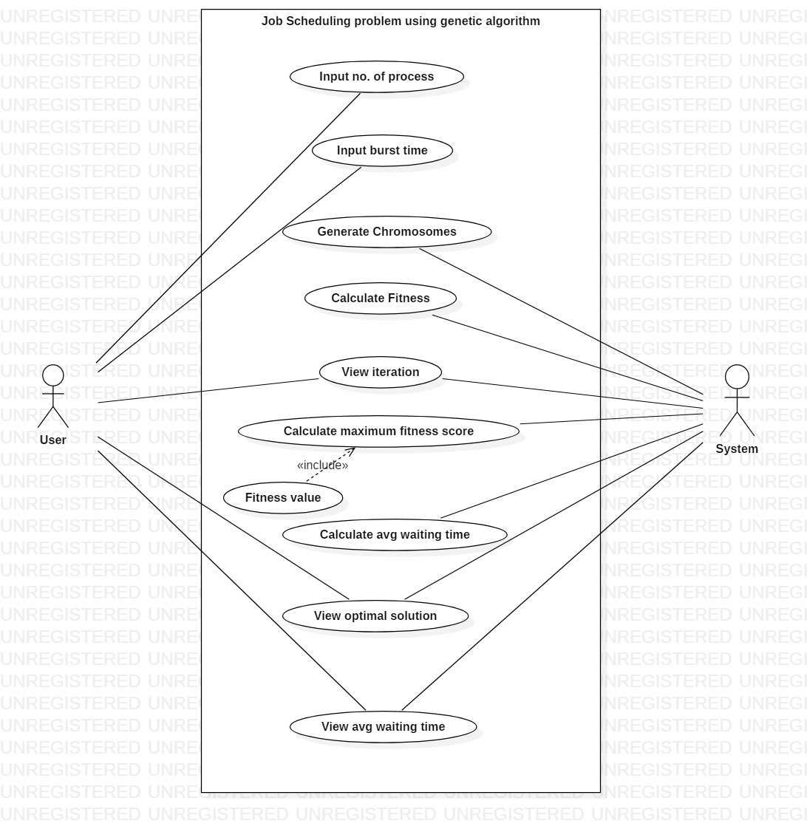
USE CASE

Slide 11
CONCLUSION:
Genetic algorithms for the CPU Scheduling.
The Experiment results will clearly show that the proposed approach is able to find optimized solution.
The work can be extended so that technique can be implemented for dynamic process scheduling and sequencing.

Slide 12
REFRENCES
Goldberg, D. E., Korb, B., & Deb, K. (1989). Messy genetic Algorithms.
Genetic algorithms and the optimal allocation _{of trials.}
SIAM Journal on Computing; Holland, J. H. (1973).
Genetic Algorithm approach to Operating system process scheduling problem;
Ranjeet Ranjan Kumar, Ashwani Kaushik sept (2010)

Slide 13
THANK YOU

