Slide 1

CU CONNECT – A Social Media App
Rabbaniyeh Neakakhtar CIIT/FA19-BCS-013/ATD
Malik Abdul Hadi Awan CIIT / FA19-BCS-034 /ATD
Muhammad Ansar Javaid CIIT/ FA19-BCS-011 /ATD
Supervisor Dr. Osman Khalid
Department of Computer Science
COMSATS University Islamabad, Abbottabad Campus

Slide 2
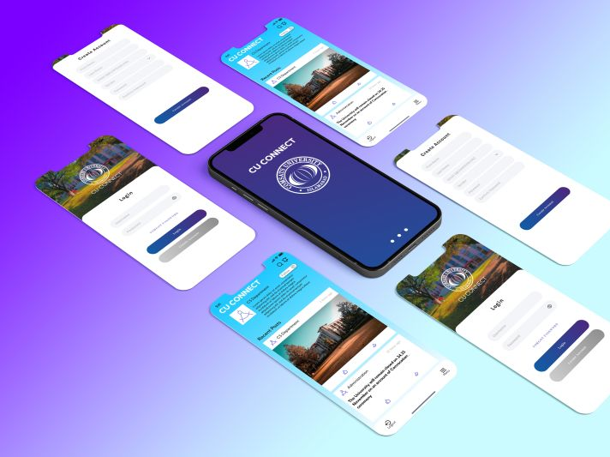
CU Connect

Slide 3
Agenda of the Presentation
Brief Introduction & Demo
Scope
Functional Requirements
Non-Functional Requirements
User Goals
Technologies Used
Sequence Diagram
Use Case Model
Class Diagram
Gantt Chart
1st Iteration 60%
ER Diagram
Technologies Used
Project Architecture
Activity Diagram

Slide 4

Brief Introduction
This Presentation aims to provide information about the system, “CU Connect ”. The purpose of this presentation is to display the system design and requirements for development according to user’s point of view.

Slide 5




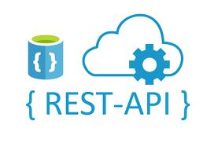
Technologies Used
React Native
ASP .NET Core
MS SQL SERVER
AZURE
Restful Apis

Slide 6
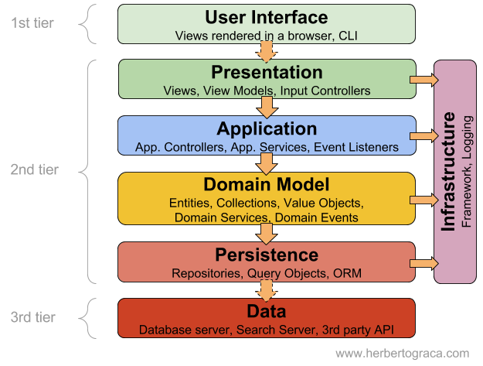
Layered Architecture

Slide 7
UI Mockup

Slide 8
Scope
The CU Connect will be campus based social media application
A reliable, centralized platform for campus
Posts/updates can be shared by campus which can be viewed or utilized by students
Only smart phone application service will be available in this scope
Class CR can also post in relation with required Class.

Slide 9
Functional Requirements
Login According to User Role.
Admin can post
Super Admin can
Create / delete Profiles
User can view, React / share posts
User can follow desired profiles & Classes
Admin view post reactions & impressions
Super admin can set the priority level of the posts

Slide 10
Non-Functional Requirements
The Application is
Extensible (we can add more features in next version Upgrade
The Application shall allow Users to stay connected
The Application should have a smooth user flow
The application is mobile responsive
The application should be user friendly
System must respond to user search within 10 seconds.
System must not have any fatal errors on run time.
If the application/site crash, it should behave perfectly normal when reloaded again.

Slide 11
User Goals
The aim of this system is to distribute only authentic and valid information to users
The Aim is to connect everyone on campus and spread the value able news on time
In the next versions of this system we are planning to add more modules and introduce some new features.
This application is currently serving the CUI Abbottabad Campus and we are planning to expand it further in future.

Slide 12
Use Cases
Login/Register
Verify Email
Create a Post
Set Priority
See Impressions
Add Pictures / Documents
Share Post
React on Posts
Create Profiles
View Profiles / Posts
Delete Posts/ Profiles
Follow Profiles

Slide 13
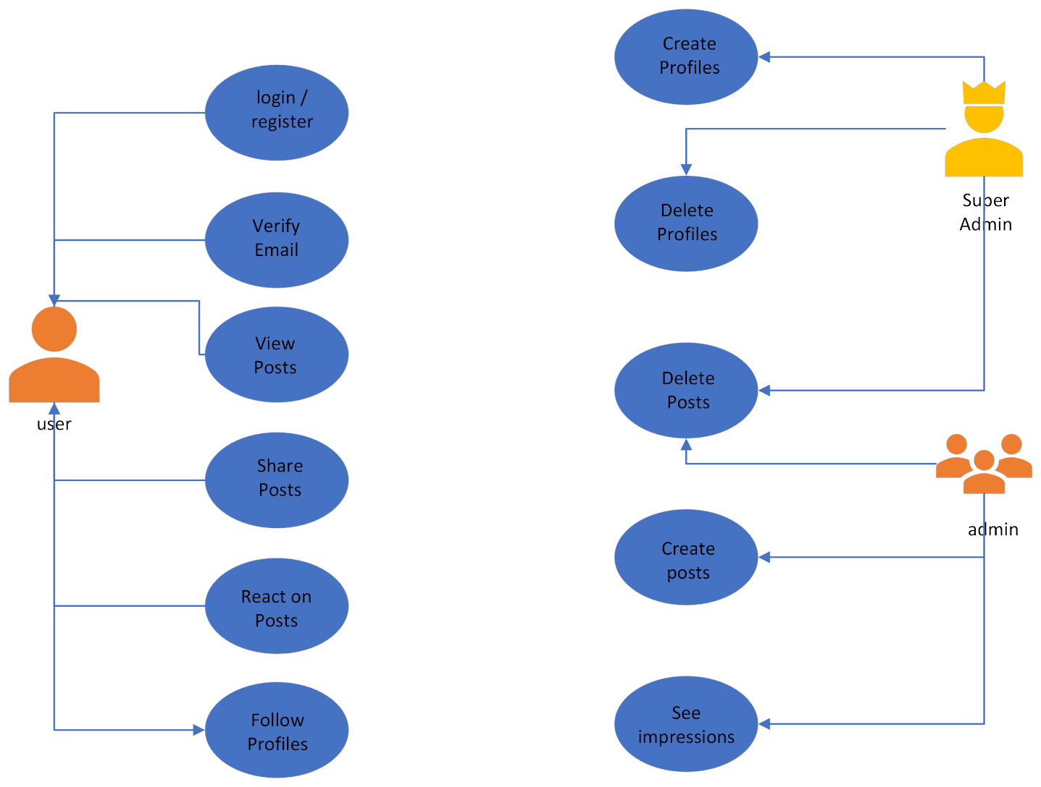
Use Case Diagram

Slide 14
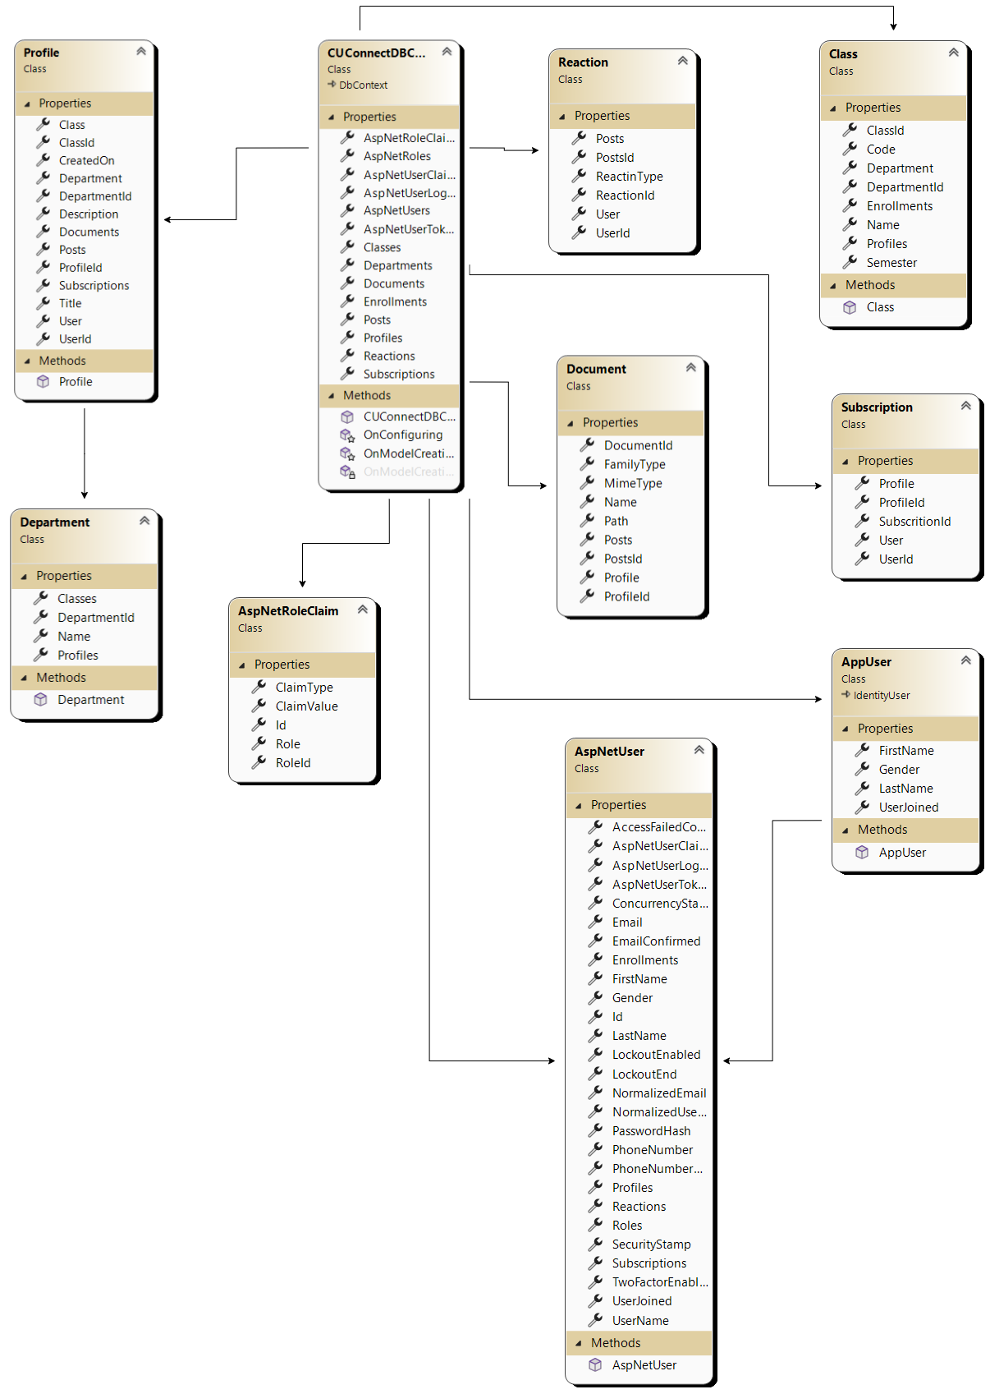
Class Diagram

Slide 15
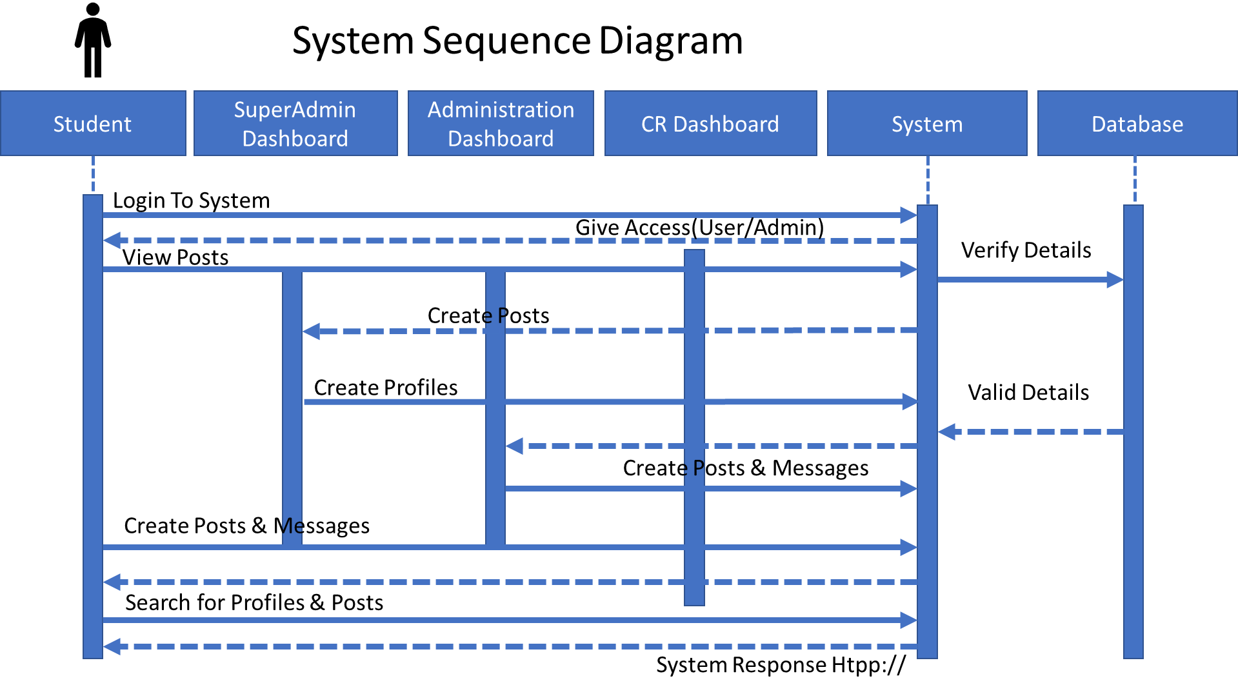
System Sequence Diagram

Slide 16
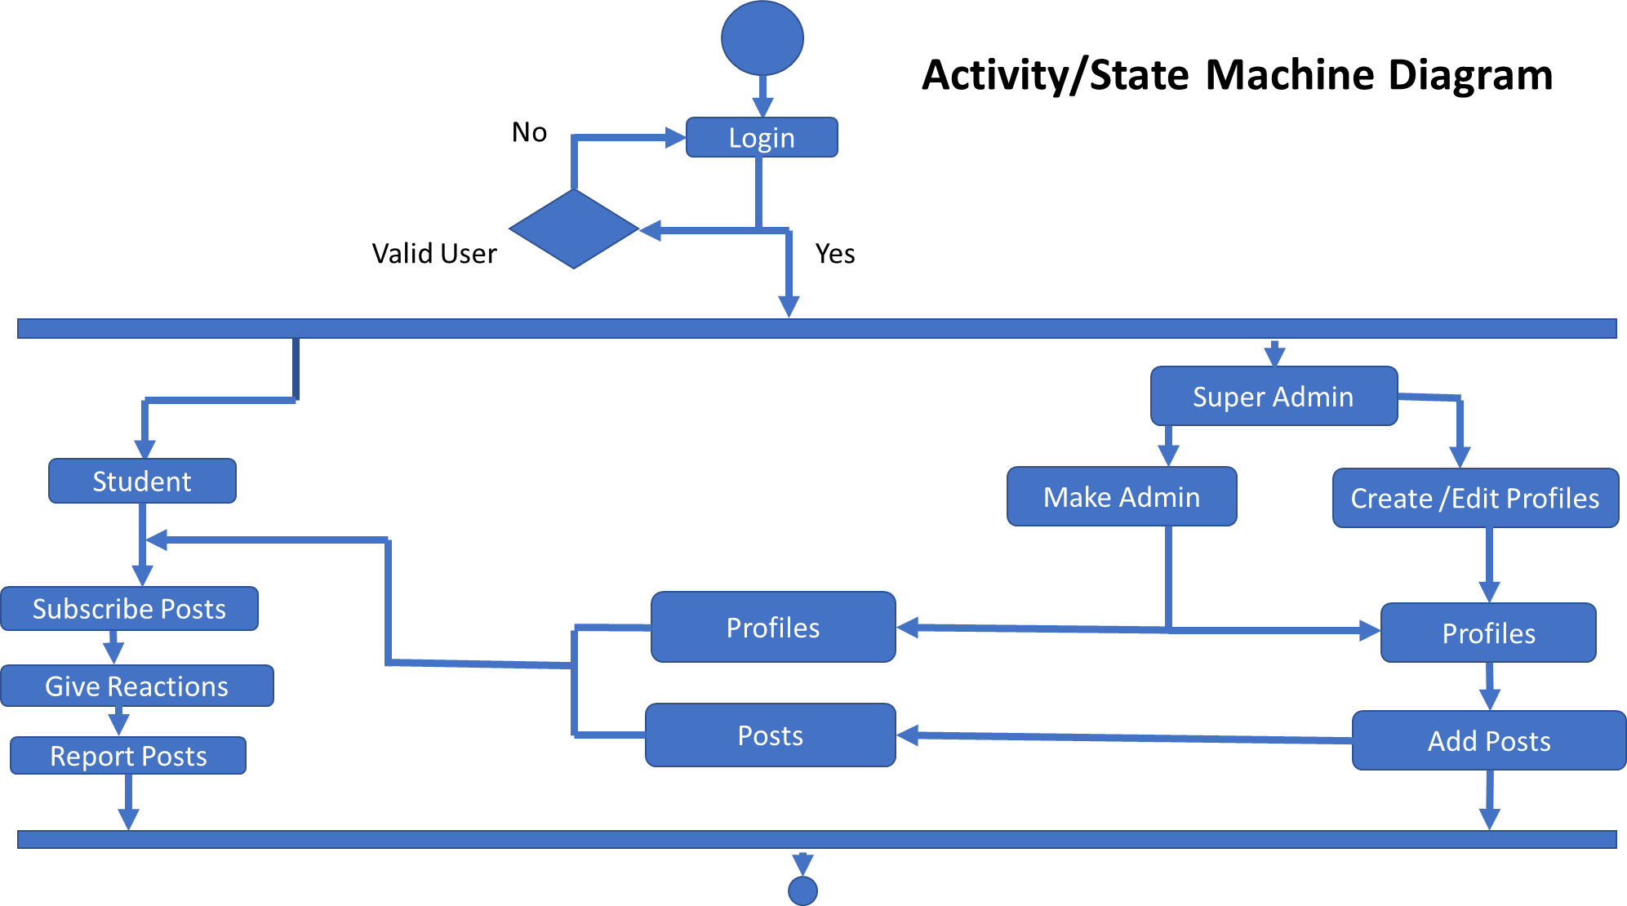
Activity State Diagram

Slide 17
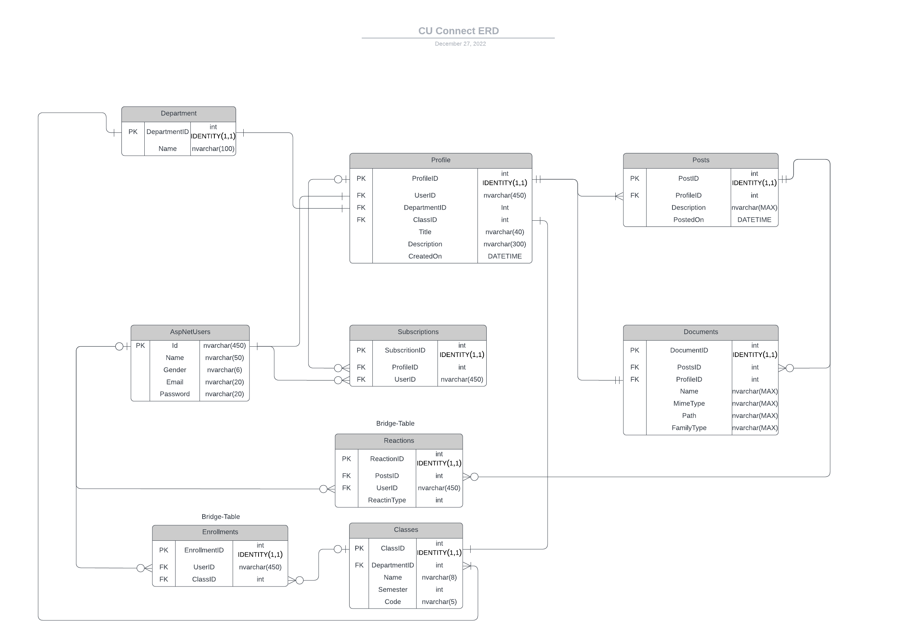
ER Diagram

Slide 18
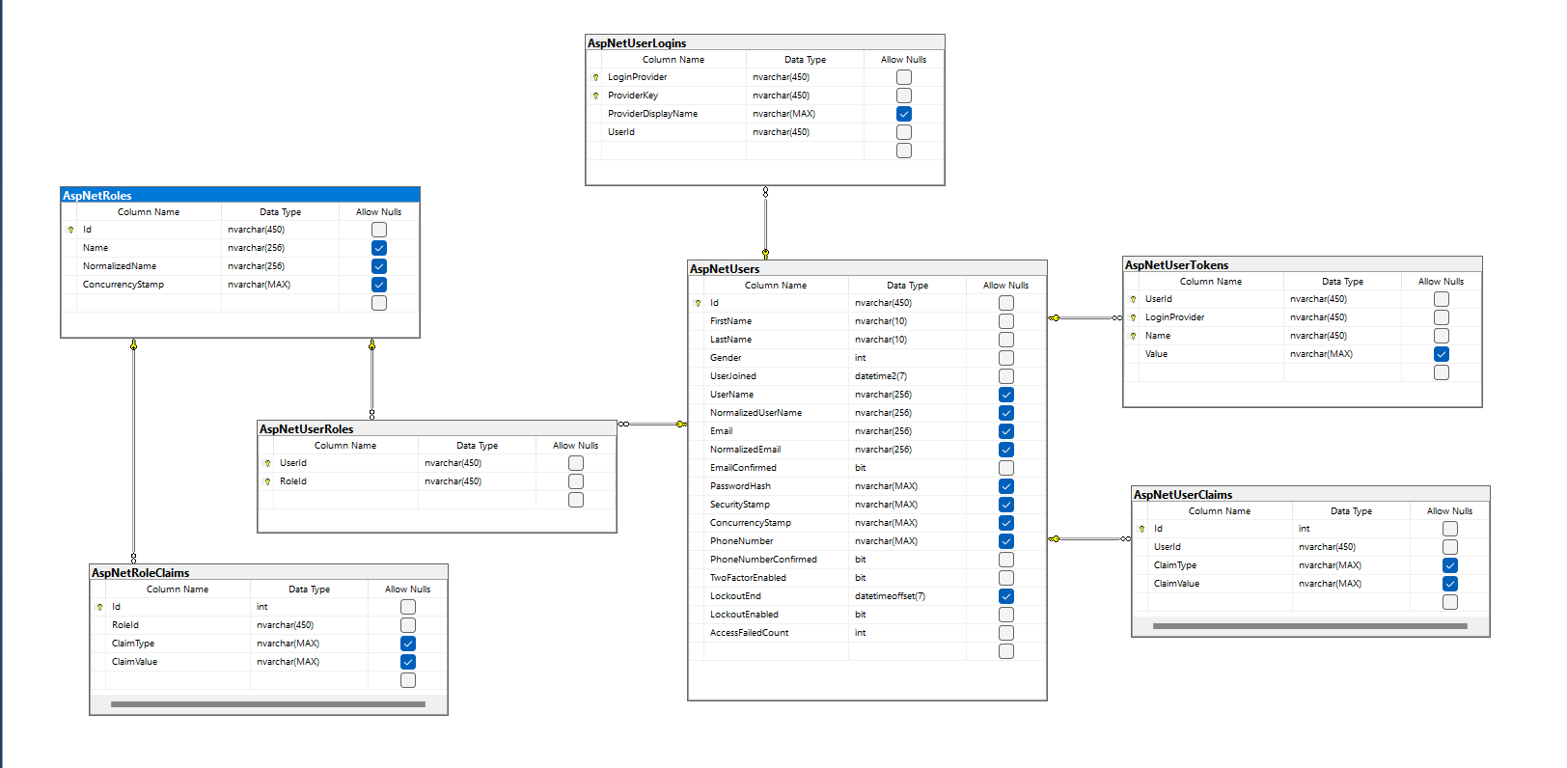
Identity ERD

Slide 19
Schedule

Slide 20
Details of 30%
SRS Documentation
Layered Architect along Restful APIS
Designing Database
Frontend: Static Design, Sign in & Login
Backend: Registration, Login, JWT Authentication, Profile Creation & etc.

Slide 21
Conclusion
We have developed a secure system.
User can easily access the system using their mobile.
User can login and interact with system easily.

