Slide 1

Revolutionizing Big Data Analytics through Distributed Computing and Clustering Techniques
Parallel and Distributed Computing
Submitted By:
2020-CS-420
Submitted To:
Sir Noman Qureshi
This Photo by Unknown Author is licensed under CC BY-NC-ND

Slide 2
Abstract
This project focuses on Big Data Analytics utilizing Distributed Computing and Clustering techniques. The project involves analysing Non-Deterministic Finite Automata (NFA), Labelled Transition Systems (LTS), Simple Traces of LTS, Completed Traces of LTS, and language equations to gain insights from the process of Big Data Analytics. Distributed Ccomputing is used to parallelize the processing of the data and speed up the analysis. Distributed Cclustering is used to group the data into clusters based on similarities or patterns. The results of the analysis will be used to make decisions or take actions based on the insights gained from the data. The future impact of this project could be to improve the efficiency and accuracy of big data analytics in various domains. This could include but not limited to software engineering, network security, and business intelligence.

Slide 3
Introduction
Big Data analytics has become crucial in decision-making across industries, requiring efficient techniques that can handle large volumes of data.
Parallel and distributed computing provide a solution to the complexity and scale of Big Data, enabling concurrent processing across multiple computing resources.
This project proposes a novel approach to Big Data analytics using distributed computing and clustering techniques, including constructing an LTS, determining weak and strong bi-simulation, and deriving the Behavioural Benchmark Lemma for each process.
The approach is implemented using Open MPI and MPI programming paradigms to distribute data and computational tasks across multiple nodes in a cluster.
The proposed technique lays the groundwork for future research in the field of parallel and distributed computing for Big Data analytics, including potential integration with existing frameworks and real-world applications.

Slide 4
Literature Review
Big data analytics involves extracting valuable insights from massive volumes of data in various domains, posing technical challenges such as data heterogeneity, inconsistency, incompleteness, privacy, scale, and timeliness.
Parallel and distributed computing is a key technique to address these challenges, improving the performance, scalability, and efficiency of big data analytics applications.
Existing works on parallel and distributed computing related to big data analytics focus on developing new concepts, patterns, technologies, and platforms.
Some works focus on developing new concepts and patterns of distributed computing that can be applied to different big data scenarios, such as the fundamental concepts presented by (Mazumder, Bhadoria, & Deka, 2017) and the distributed computing patterns taxonomy proposed by Anjos et al.3.

Slide 5
Literature Review
Other works focus on developing new technologies and platforms that leverage the concepts and patterns of distributed computing for big data analytics, such as the distributed computing technologies surveyed by (Amato, 2017), including Hadoop, Spark, Storm, Flink, Kafka, and Cassandra.
(Amato, 2017) also discusses the challenges and opportunities of integrating these technologies for building end-to-end big data solutions, while (Amato5) proposes a simulator for MapReduce applications executing on hybrid distributed infrastructures composed of cloud and desktop grid resources.

Slide 6
Methodology
Labelled Transition System
Trace Equivalence
Deterministic Labelled Transition System and Language Equivalence
Strong and Weak Bi-simulation
Reactive System

Slide 7
Labelled Transition System
A labelled transition system (LTS) is a mathematical model used in computer science and related fields to describe the behaviour of a system as a set of states and the transitions between those states, where each transition is associated with a label.
In an LTS, a state represents a particular configuration or condition of the system, and a transition between states represents a change in the system's state. The labels associated with transitions describe the actions or events that cause the system to change state.

Slide 8
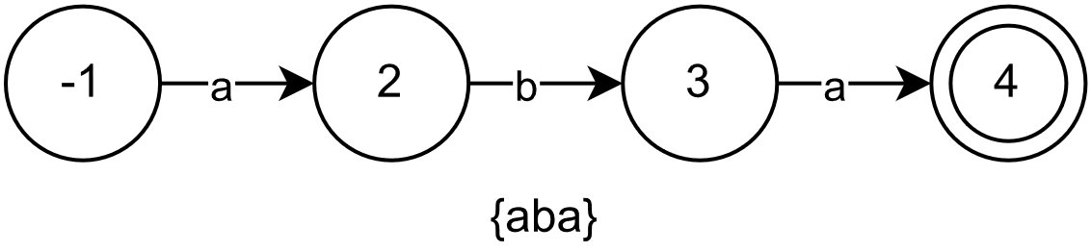
Labelled Transition System (Cont….)
A labelled transition system representing “Data Storage” in Big Data Analytics. (Ansari, 2023)

Slide 9
Trace Equivalence
A trace is a sequence of labels associated with transitions in a labelled transition system (LTS) that describes the sequence of events or actions taken by the system.
Simple trace equivalence is a notion of equivalence between LTSs that considers only the traces that can be observed by external agents interacting with the system. Two LTSs are said to be simply trace equivalent if they have the same set of observable traces.
Completed trace equivalence, on the other hand, considers not only the observable traces, but also the traces that can be generated by internal actions that are not directly observable by external agents. Two LTSs are said to be completed trace equivalent if they have the same set of observable and internal traces.

Slide 10
Trace Equivalence (Cont…)
A labelled transition system representing distribution of data storage across computers (Ansari, 2023).
The LTS (Data Storage) and the current LTS are simple trace equivalent and completed trace equivalent to each other.

Slide 11
Deterministic Labelled Transition System and Language Equivalence
A Deterministic Labelled Transition System (DLTS) is a type of Labelled Transition System (LTS) that has the property that for any given state and label, there is only one possible transition with that state and label.
(Groote & Mousavi, 2013) defined language equivalence as
Let A = (S,Act ,−→, s, T ) be a labelled transition system.
We define the language Lang(t) of a state t ∈ S as the
minimal set satisfying:
• ǫ ∈ Lang(t) if t ∈ T, and
• if t a −→ t′ and σ ∈ Lang(t′) then aσ ∈
Lang(t).

Slide 12
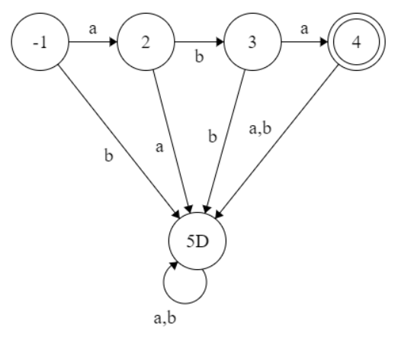
Trace Equivalence (Cont...)
A deterministic labelled transition system representing distribution of data storage across computers (Ansari, 2023).

Slide 13
Strong Bi-simulation and Weak Bi-simulation
Strong bi-simulation is a relation between two labelled transition systems (LTSs) that captures the notion of behavioural equivalence between them. Two LTSs are said to be strongly bi-similar if they have the same behaviour, i.e., they behave in the same way in all possible environments (Ansari, 2023).
Weak bi-simulation is a relation between two labelled transition systems (LTSs) that captures a coarser notion of behavioural equivalence than strong bi-simulation. Two LTSs are said to be weakly bi-similar if they have the same observable behaviour but may differ in their internal behaviour.

Slide 14
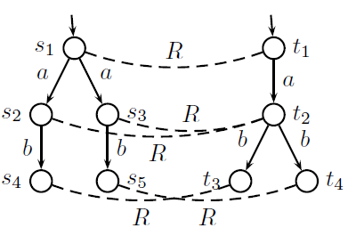
Strong Bi-simulation and Weak Bi-simulation (Cont…)
Strong Bi-simulation of two LST’s (Groote & Mousavi, 2013).

Slide 15
Reactive System
Reactive systems consist of several components which continuously interact with each other (most of the time, do not terminate). In the most basic case such a system would consist of two components, namely a controller program and its environment. (Thomas, 2003).
Open MPI (Open Message Passing Interface) is an open-source implementation of the Message Passing Interface (MPI) standard, which is a widely used programming model for parallel computing. MPI allows programmers to write distributed-memory parallel programs that can run on clusters of computers (Ansari, 2023).

Slide 16
Conclusion
This project aims to improve Big Data Analytics by using distributed computing and clustering techniques to analyse the traces of Labelled Transition Systems (LTSs). The project explores the Language Equivalence and bi-simulation between different LTSs and their inert transitions, and derives the final regular expression of the Reactive system. The project shows the benefits of using advanced computational methods to optimize data processing, storage, and analysis, and provides a basis for future work in this field.

Slide 17
References
Amato, A. (2017). On the Role of Distributed Computing in Big Data Analytics. In S. Mazumder, R. S. Bhadoria, & G. C. Deka (Eds.), Distributed Computing in Big Data Analytics. Springer.
Ansari, A. T. (2023, March). Revolutionizing Big Data Analytics through Distributed Computing and Clustering Techniques.
Groote, J. F., & Mousavi, M. R. (2013). Actions, behaviour, equivalence and abstraction. In J. F. Groote, & M. R. Mousavi, Modelling and Analysis of Communicating Systems.
Thomas, W. (2003). Automata and Reactive Systems. Retrieved from https://www.cmi.ac.in/~aiswarya/teaching/2020/thomas-infinite.pdf

