Slide 1
HICA MEDICAL
Developed By : Team HICA

Slide 2
Project Contains
Project Specification
Introduction
SDLC
Data Flow Diagram
E-R Diagram
Data Dictionary
Screen Layout
Limitations
Bibliography
Future Enhancements

Slide 3
Project Specifications
Project Title : HICA MEDICALS
Front End Tools : HTML, CSS, Java Script Back End Tool : IIS Operating System : Microsoft windows 7,10,and 11 Web Server : IIS Web Browser : chrome Editor : VS CODE Hardware : 64-bit processor, 1.70 GHz, 4.00 GB RAM

Slide 4
System Development Strategy
As per the requirement of the project, We have choose
the Spiral as a strategy of developing the project, because
in Spiral-SDLC model starts with a small set of requirement
and goes through each development phase for those set of
requirements, so the appropriate strategy is spiral model.

Slide 5
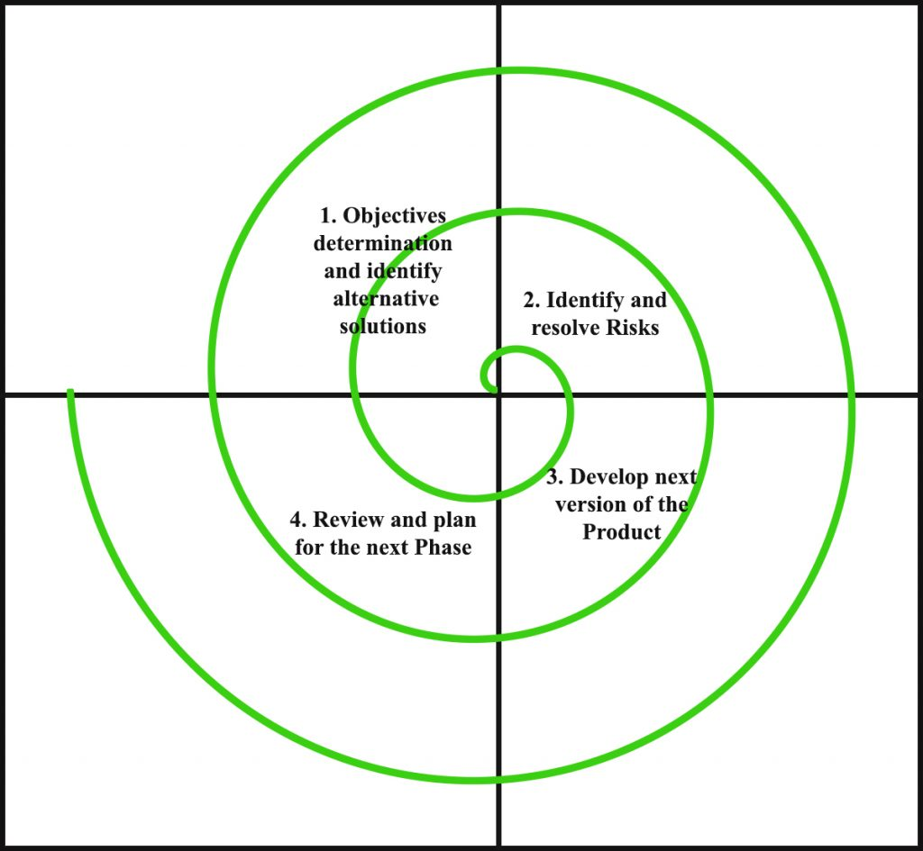
Spiral Module

Slide 6
Data Flow Diagram
A data-flow diagram (DFD) is a graphical representation of the "flow" of data through an information system. DFDs can also be used for the visualization of data processing (structured design).
On a DFD, data items flow from an external data source or an internal data store to an internal data store or an external data sink, via an internal process.

Slide 7
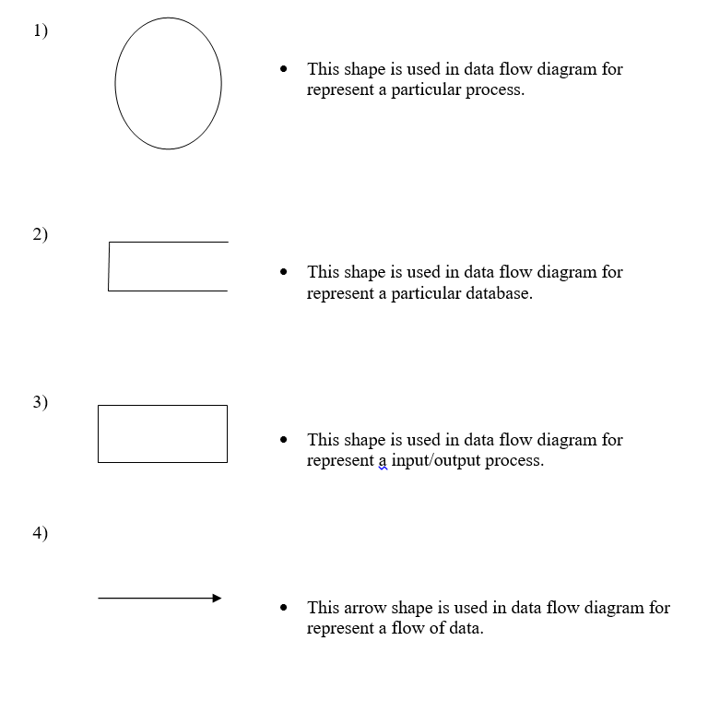

Slide 8

UserPanel : Home

Slide 9
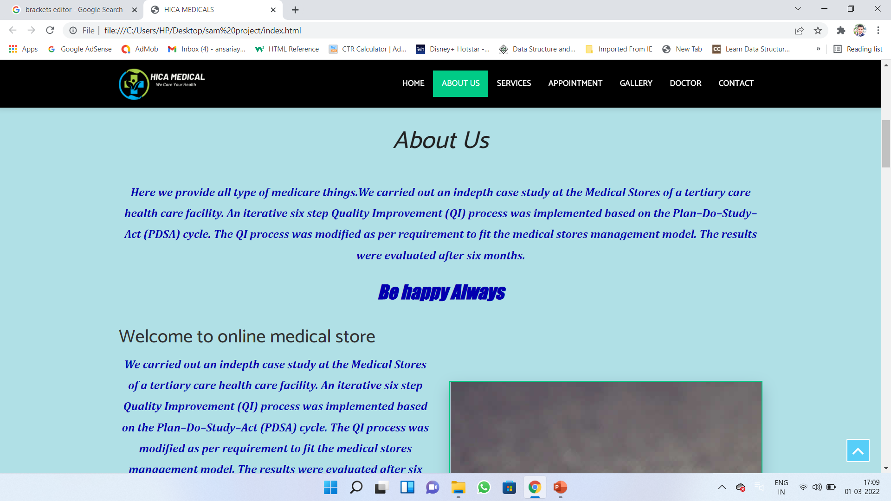
User Panel : About Us

Slide 10
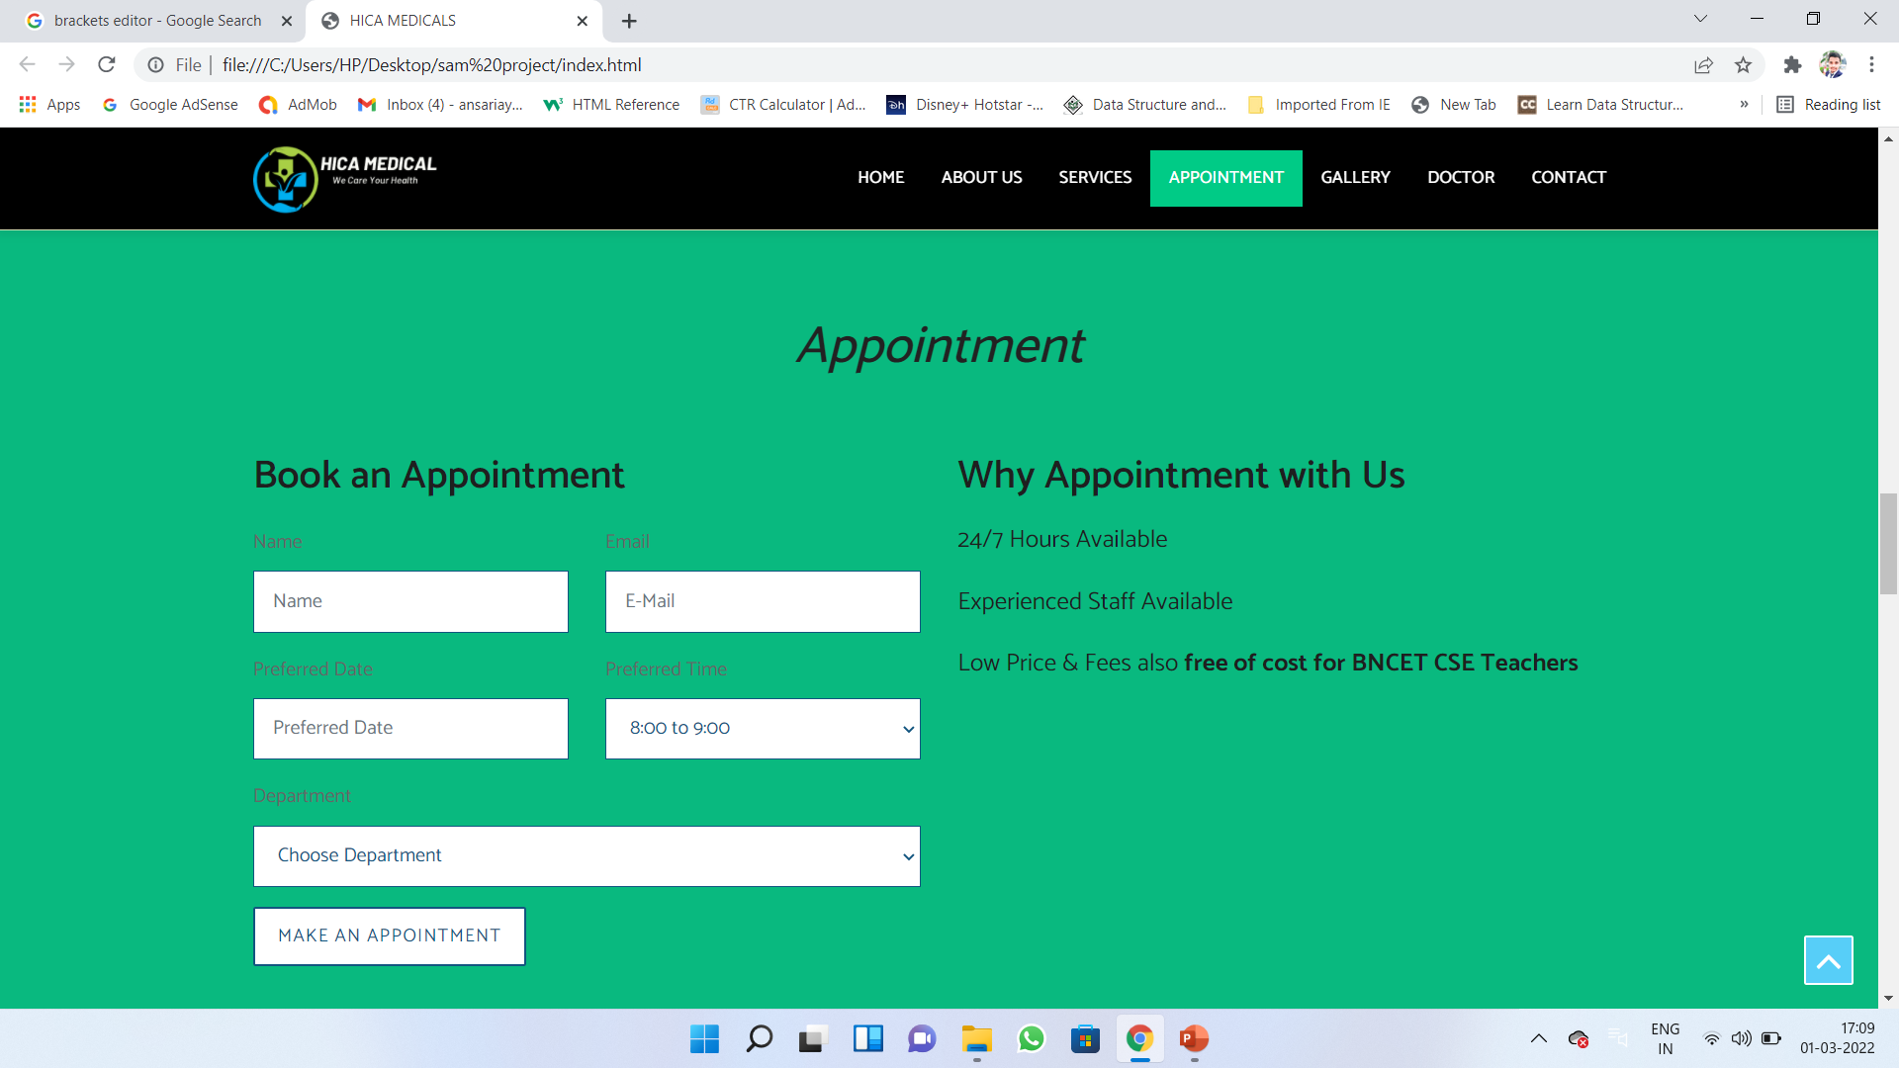
User Panel : Appointment

Slide 11
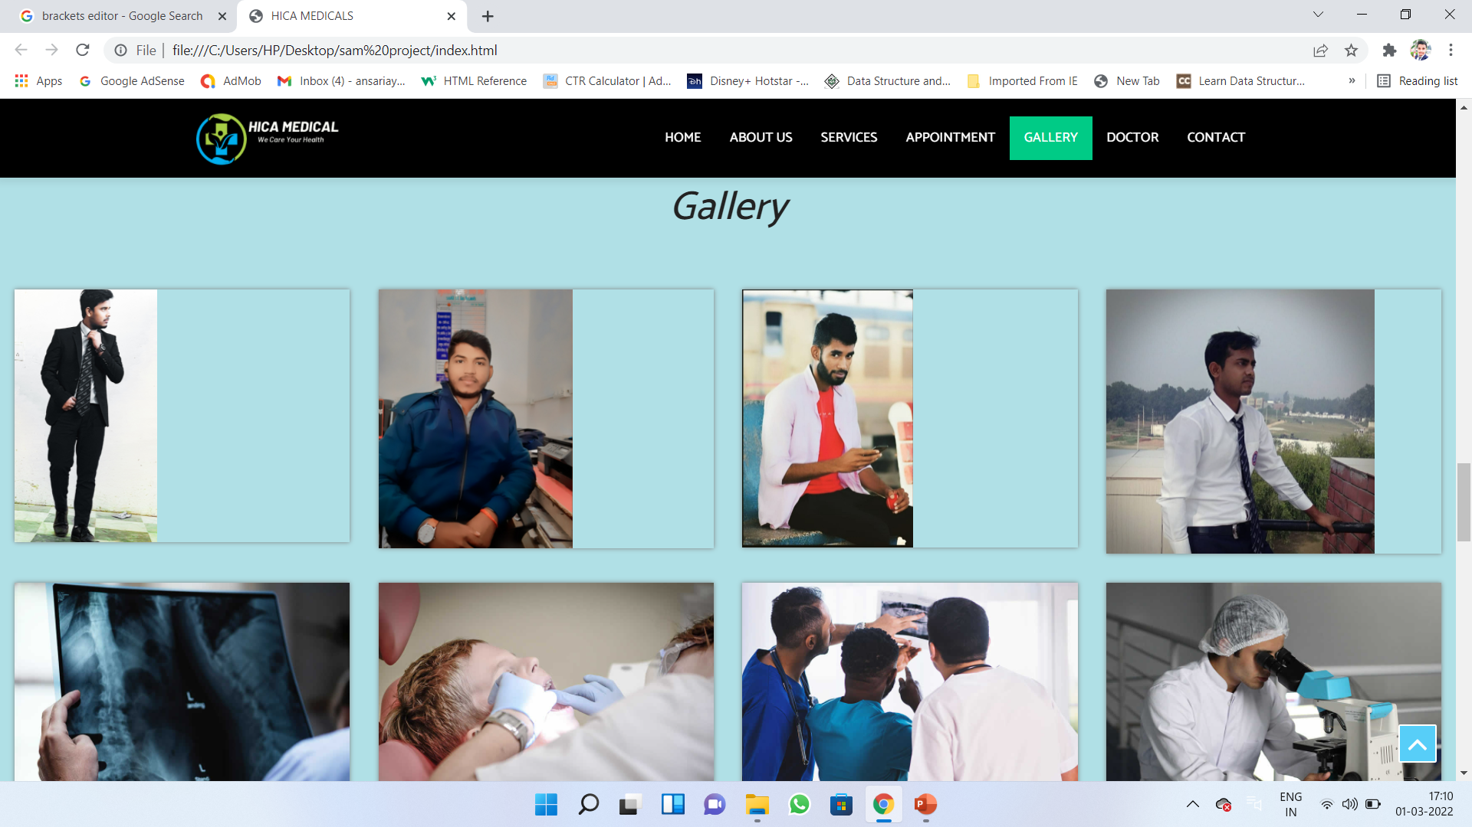
User Pannel:Gallery

Slide 12
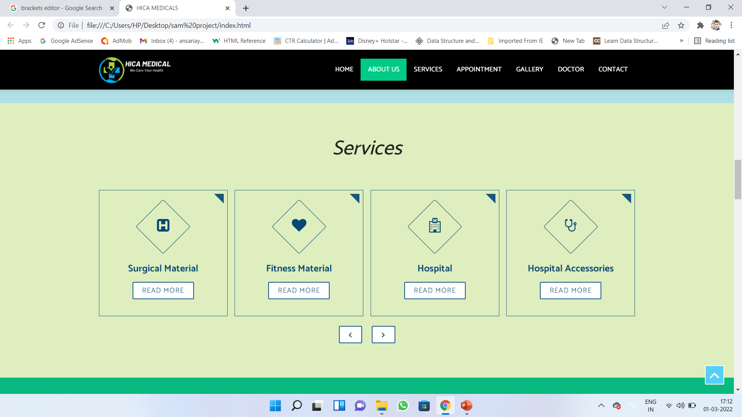
User Pannel: Service

Slide 13
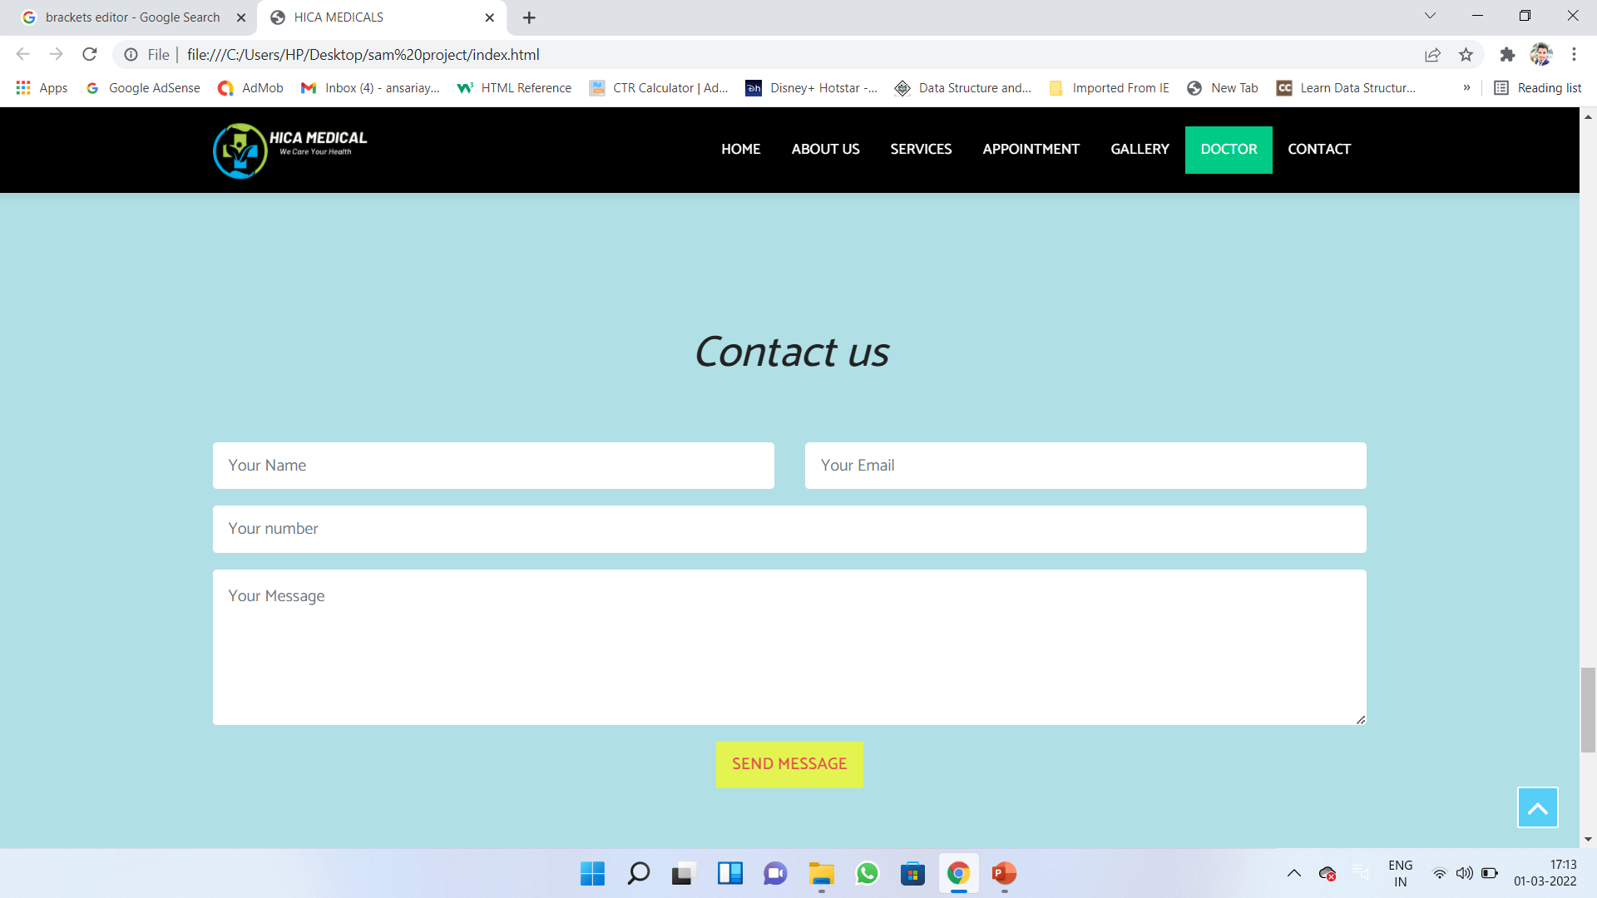
User Pannel: Contact Us

Slide 14
Thank You..!

