Slide 1
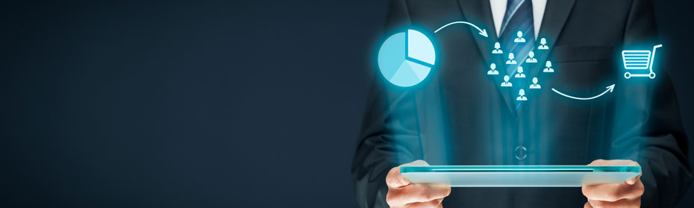

Customer Market Segmentation

Slide 2
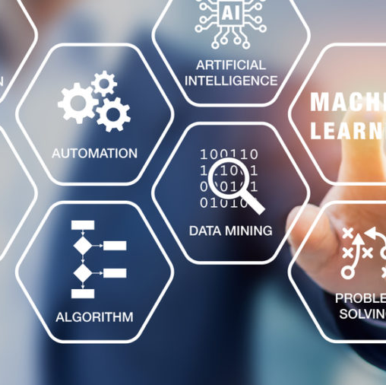
Technology Used
Technologies Used
- List the technologies and libraries used in the project.
- Python
- Streamlit
- Scikit-learn
- Plotly
- Matplotlib
- Seaborn

Slide 3
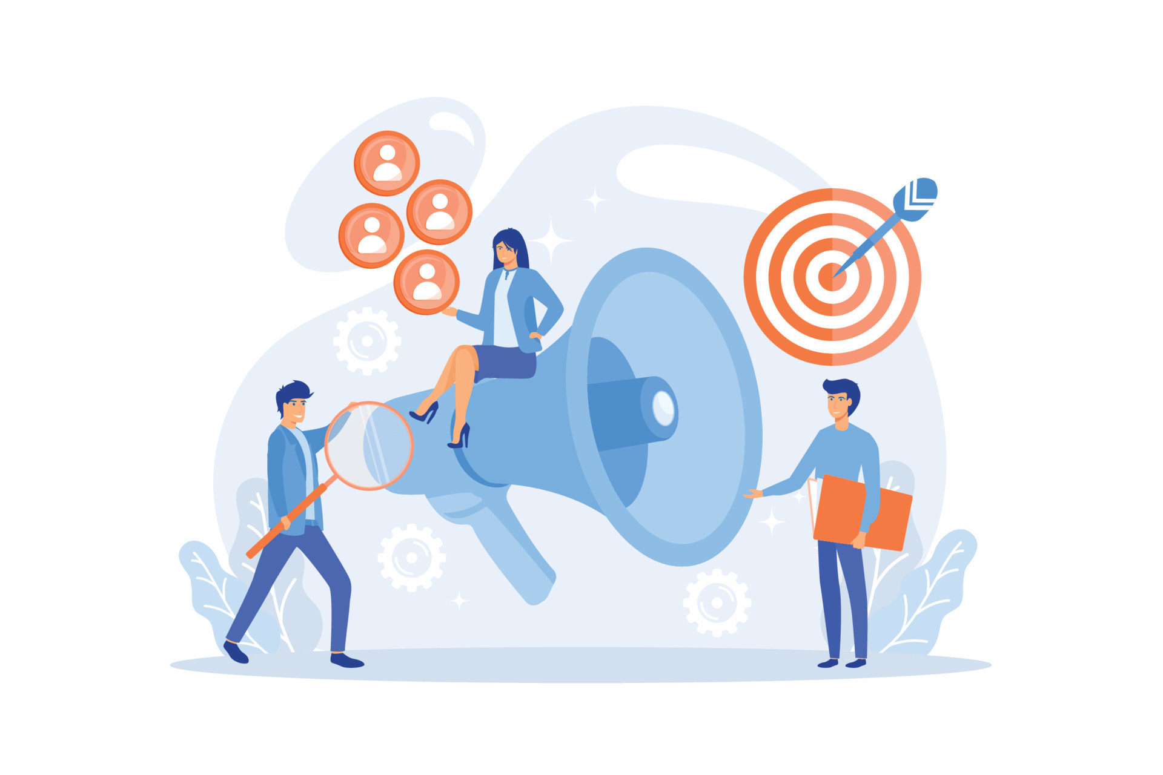
Introduction
In the fast-paced world of business, understanding your customers is paramount.
From tailoring marketing strategies to enhancing customer experiences, the ability to segment customers effectively and predict their behaviors can be a game-changer.
This is precisely where our app comes into play.

Slide 4

Customer Segmentation for Strategic Recommendations:
Objective is twofold:
Customer Segmentation: Develop a reliable segmentation system to categorize customers effectively.
Strategic Recommendations: Offer personalized recommendations, be it in the form of saving plans, loans, wealth management, or other financial services, based on the identified customer segments.

Slide 5
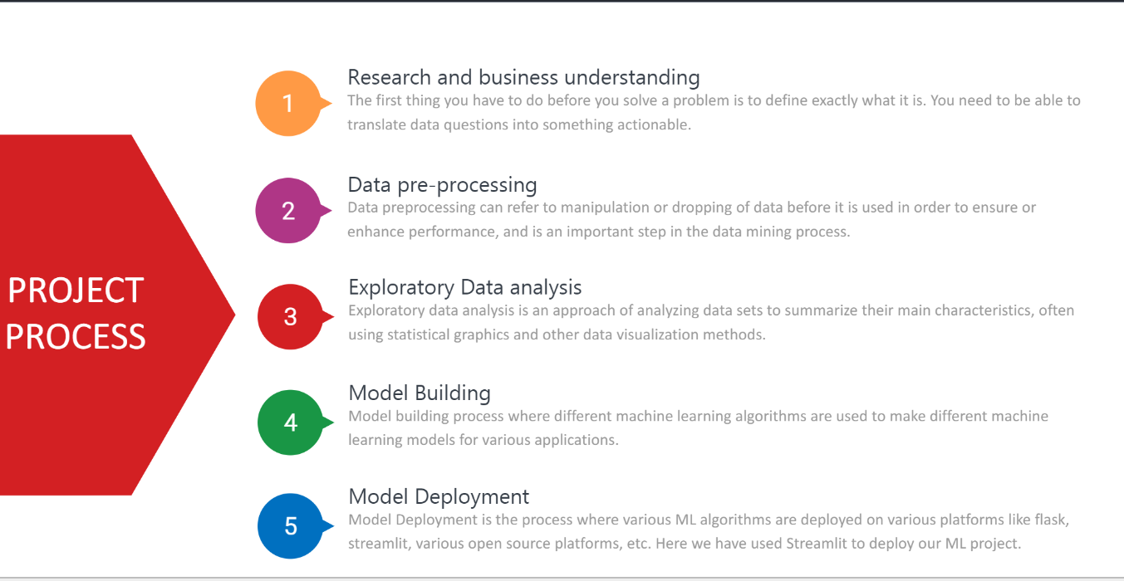
Flow of Process

Slide 6
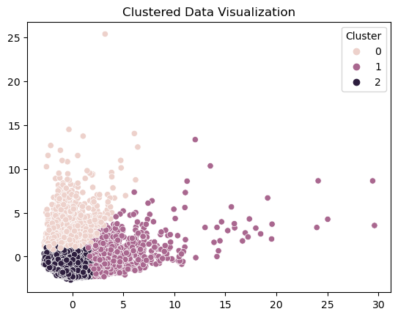
Features
Enumerate the key features of the app.
Predicts customer segments using K-Means clustering.
Provides individual predictions with a Decision Tree model. User-friendly interface for easy data input.

Slide 7
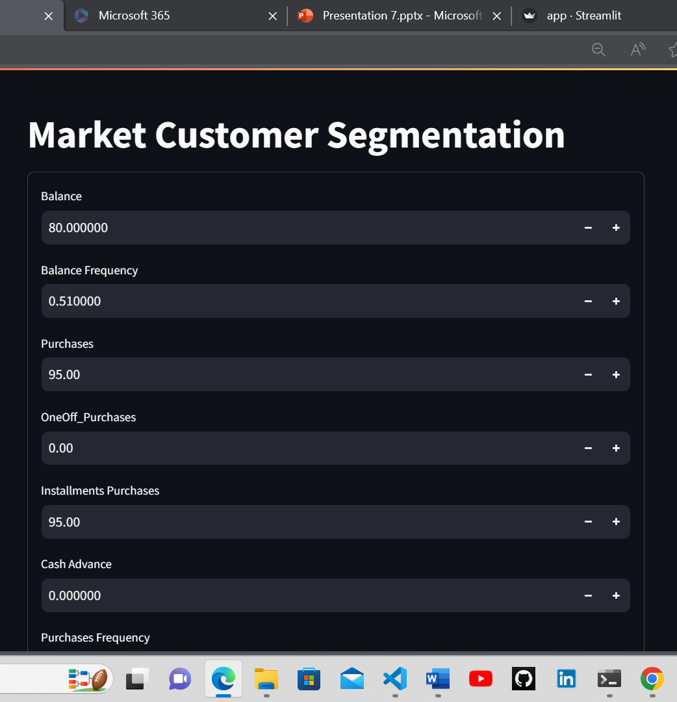
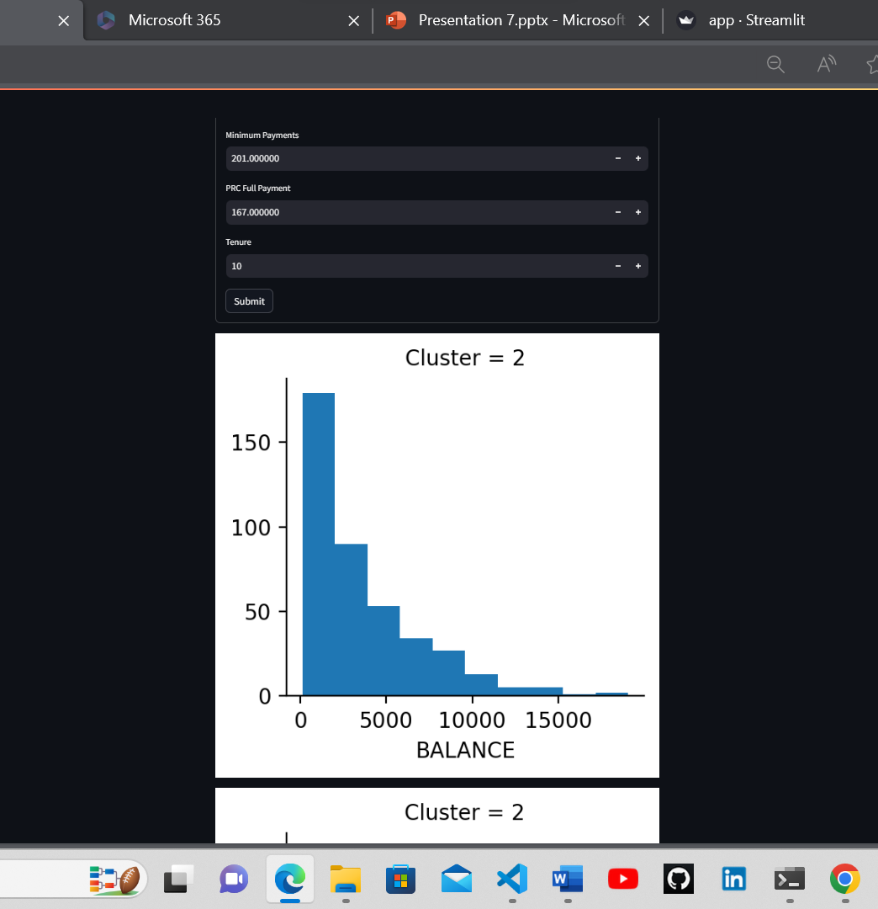
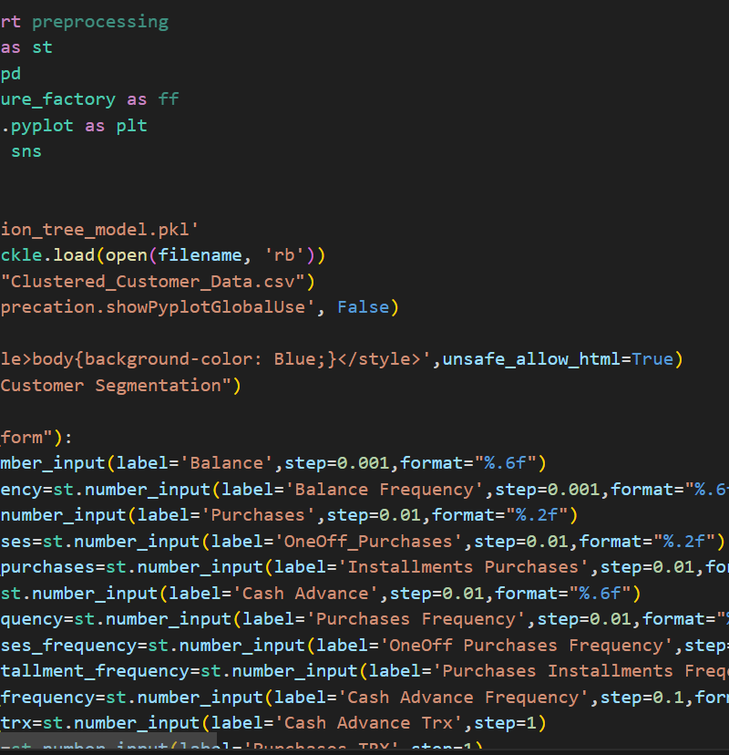
User Interface

Slide 8

Conclusion
Enhanced Customer Understanding
Targeted Recommendations
Strategic Decision-Making
Empowering Financial Services

Slide 9

Thank you
See you there!

