Slide 1
Sustainability Capstone: Decarbonising Travel
An Empirical Machine Learning Pipeline & Process Mining Framework to Intercept and Mitigate High-Carbon Corporate Logistics
LEAD PRESENTER
ACADEMIC INSTITUTION
PROGRAM & STREAM
TECHNICAL SUPPORT
Mohammad Owais Ansari
Indian Institute of Technology , Patna
Bachelor of Technology ,
Engineering Physics
ansariowais669@gmail.com
01

Slide 2


Core Capstone Objectives
Scope 3 Liability Challenge
Dual-Engine Optimization
Corporate logistics and business travel represent major carbon drivers for modern organizations. Celonis' own baseline travel database highlights a substantial operational footprint ripe for system-level mitigation.
This project deploys a dual-framework architecture:
Machine Learning Pipeline: Classifies high-risk carbon choices pre-booking.
By parsing corporate booking behavior, we build a strategic model that intercepts high-carbon journeys before confirmation, integrating intelligence directly into procurement pathways.
Process Mining Engine: Pinpoints conformance friction and structural latency in logistics systems.
Project context, raw inputs, and workflow files validated across baseline capstone data logs.
02

Slide 3


Target Class Distribution
Target Variable: HighCarbon
The primary predictive objective of the pipeline is to classify whether a journey is structurally inefficient and high-carbon (exceeding strict intensity limits). Class balance analysis of the 65,289 training records reveals:
Normal Journeys
48,963 trips (74.99%)
Normal Journeys (Class 0): 74.99% (48,963 total trips)
High-Carbon Journeys
High-Carbon Journeys (Class 1): 25.01% (16,326 total trips)
16,326 trips (25.01%)
Imbalance Factor: Exact 3:1 ratio, requiring weighted cross-entropy parameters during model tuning.
03

Slide 4
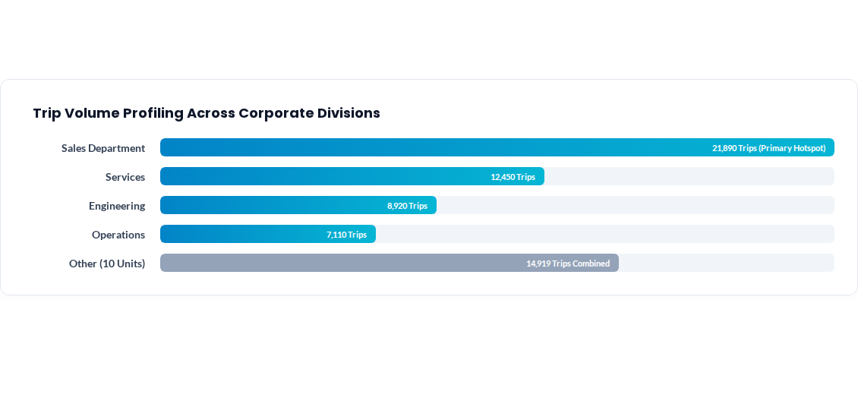
Hotspot Analysis: Business Units
04

Slide 5



Hotspot Analysis: Travel Purposes
Customer Visits
Partner Relations
Internal Meetings
28,229 Journeys
15,412 Journeys
9,114 Journeys
Representing the single largest operational hotspot. Travel routes are highly recurring and present the highest statistical potential for rail-first migration policies.
Secondary volume driver. Often correlated with short-notice booking delays, generating expensive, high-carbon express aviation routes.
High-carbon density without direct external revenue justification. Target category for strict virtual-first restriction policies.
05

Slide 6


Process Mining Bottleneck Logs
Approval Latency
Process Gaps
Policy Conformance
6.4 Days Delay
Aviation Preference
OutOfPolicy Outliers
Reconstructed logs from 671,547 event steps show request-to-approval latency depletes low-cost, low-carbon rail seats, forcing last-minute flight bookings.
High-carbon flight segments are consistently booked on regional corridors (such as Munich-Berlin) despite active, identical high-speed rail corridors.
Only 53,284 trips follow compliant channels. Severe process leakage (12,005 non-compliant trips) accounts for highly concentrated carbon intensity.
06

Slide 7

Pipeline Leakage Sanitization
Data Feature Name | Variable Type | Treatment in Pipeline | Action & Mitigating Rationale
Departure_CO2e / Return_CO2e | Numeric (Leakage) | EXCLUDED FROM MODEL | Direct mathematical proxies of target variable. Triggers absolute target leakage.
Hotel_CO2e / Spend_CO2e / TotalCO2e | Numeric (Leakage) | EXCLUDED FROM MODEL | Calculations are performed post-journey. Not available at pre-booking request phase.
NetCosts / HotelNights | Numeric (Valid) | RETAINED & IMPUTED | Pre-booking quote estimates. Imputed missing values (NetCosts mean: 2,151.65).
Purpose / BusinessUnit / OutOfPolicy | Categorical (Valid) | ENCODED & RETAINED | Captured at point-of-request. Crucial behavioral signals indicating carbon density.
07

Slide 8

ML Classifier Mathematical Tuning
Class Balancing Equation
MATHEMATICAL VARIABLES
To resolve the 3:1 class imbalance (25.01% High-Carbon vs 74.99% Normal), we apply inverse frequency scaling. This penalizes the objective function heavily for misclassifying minority carbon hotspots:
N = Total dataset training records (65,289)
C = Unique target class dimensions (2)
nc = Training records mapped within class c
w0 (Normal) = Inverse frequency weight of 0.67
w1 (High-Carbon) = High priority minority weight of 2.00
08

Slide 9
Low-Carbon Strategic Rules
Mandatory regional rail-first rules: Implement a strict geographic ban on flights where direct rail alternatives are active and travel time is under 4 hours. This addresses the core inefficiency identified in Munich-Berlin and Frankfurt-Paris corridors.
Virtual-by-default for internal trips: Apply strict travel restrictions to the internal meeting hotspot (9,114 trips), requiring executive level approval before any travel booking can be authorized.
Early booking approval triggers: Set automated SLA rules in procurement systems. Requests must be submitted at least 14 days before departure to eliminate late-booking pricing spikes and optimize seat allocation.
Proactive carbon risk interception: Deploy the predictive classifier directly inside the booking portal, intercepting bookings classified as "HighCarbon" and offering alternative, low-carbon routes.
09

Slide 10
Strategic Integration Roadmap
PHASE 1
PHASE 2
PHASE 3
PHASE 4
Data Preprocessing
Real-time Hooking
Process Mining Audit
Continuous Interception
Standardize 65,289 historical records and resolve target leakage features prior to model ingestion.
Deploy the balanced classifier into booking portals to score active requests before transaction confirmation.
Inject risk predictions back into Celonis, mapping out real-time process mining compliance dashboards.
Conduct monthly drift monitoring on the test set of 21,764 records to dynamically capture carbon profile shifts.
Integration architecture connects historical data prep pipelines directly with live Celonis Process Mining workflows.
10

Slide 11

Collaborative Q&A
Integrating machine learning predictions with process mining creates a proactive carbon mitigation tool. Real-time inference on flight requests allows organizations to identify and correct process leakage before high-carbon travel patterns occur.
LEAD DEVELOPER
ACADEMIC BRANCH
CAPSTONE SCOPE
OFFICIAL SUPPORT
Mohammad Owais Ansari
Engineering Physics
Celonis Sustainability
ansariowais669@gmail.com
11

