Slide 1
IBM UNIVERSITY ENGAGEMENT · AICTE 2026
Exploring Agentic AI with IBM Granite & LangFlow
SwachhAI
AI
AI-guided waste segregation
for India’s households
A proposed circularity assistant that helps people identify an item, act safely, and see a transparent impact estimate.
IDENTIFY
ACT SAFELY
SEE
MOHAMMAD RAMISH ANSARI
item → stream
short protocol
impact
B.Tech. Computer Science & Engineering · University of Lucknow
1M1B AI for Sustainability · 1M1B / AICTE / IBM SkillsBuild
04 NOVEMBER 2026
MOHAMMAD RAMISH ANSARI · SWACHHAI · AI FOR SUSTAINABILITY
01 / 22

Slide 2
PROJECT TILE
Project tile & presenter
A sustainability concept by a Computer Science student at the University of Lucknow
PROJECT TITLE
DOMAIN & PROGRAMME
SwachhAI
Sustainability · household waste · Agentic AI
AI-Guided Waste Segregation and Circularity Assistant
Built as a proposed solution for the 1M1B AI for Sustainability Virtual Internship, supported by AICTE and delivered in collaboration with IBM SkillsBuild.
ENVIRONMENT
CIRCULAR ECONOMY
EDUCATION
MA
Mohammad Ramish Ansari
B.Tech. CSE · University of Lucknow
Class X & XII: First Division · St. Francis School, Gomti Nagar
B.Tech. CSE · University of Lucknow
2024–2028 · Year 3, Semester V*
PROJECT INTENT
Make the correct action easier at the moment of disposal—without replacing local collection services or municipal rules.
EMAIL
ansariramish35@gmail.com
MOBILE
+91 7007043871
Project submitted 14 Sep 2026 · AI for Sustainability virtual internship
DESIGN CONCEPT
NOT A DEPLOYED PRODUCT
*Year / semester follows the current AICTE résumé.
MOHAMMAD RAMISH ANSARI · SWACHHAI · AI FOR SUSTAINABILITY
02 / 22

Slide 3
PRESENTER
A technical foundation for applied AI
Experience, skills and interests summarized from the supplied résumés
01
INTERNSHIP EXPERIENCE
02
TECHNICAL FOUNDATIONS
03
DIRECTION & STRENGTHS
Softpro India
Languages & tools
Career objective
Python with Machine Learning & Data Science
45 days · Jun–Jul 2026 · A++ grade
C · Java · Python · SQL
Build a professional career in Data Engineering.
ML · Data Science · NumPy · Pandas
DSA · OOP · OS · relational databases / data handling
Interests
1M1B · AI for Sustainability
Data infrastructure · databases & optimization · large-scale data processing
Exposure to AI/ML, LLMs, RAG, IBM Granite and Agentic AI through the virtual internship.
FOUNDATIONS
ACADEMIC LEVEL
Strengths
Earlier CV: beginner C/Java programs in logic, control flow and OOP.
Analytical · disciplined · patient · consistent
Problem-solving · independent learning
CERTIFICATIONS
IBM/Coursera: Python for Data Science, AI & Development · Google/Coursera: Crash Course on Python · Imperial College London/Coursera: Linear Algebra, Multivariate Calculus & PCA for ML · AI for Sustainability
MOHAMMAD RAMISH ANSARI · SWACHHAI · AI FOR SUSTAINABILITY
03 / 22

Slide 4
PROBLEM STATEMENT
At the bin, a few seconds decide what happens next
SwachhAI adapts AICTE-2026 Problem Statement No. 6: Eco Lifestyle Agent to household waste segregation
INDIA · CPCB 2020–21
AT THE BIN, THE ITEM IS SPECIFIC
WHY IT MATTERS
160,039
A poster says ‘recycle’. A resident still has to know what to do with…
Mixed waste contaminates recyclable streams.
tonnes of municipal solid waste generated per day
•
MILK POUCH
Residue can contaminate dry recyclables.
Unmarked hazards can put handlers at risk.
152,750 t/day
•
OLD BATTERY
A separate, safer take-back route is needed.
Landfilled organics can generate methane.
reported as collected
•
CHIPS PACKET
A laminate may belong in reject, not clean plastics.
National aggregate—not a current city estimate.
A real-world problem with household-level action points.
POLICY CONTEXT
Source segregation is a duty under India’s Solid Waste Management Rules, 2016. The Eco Lifestyle Agent problem statement calls for trusted, practical sustainability and local recycling guidance.
Sources: CPCB Annual Report 2020–21; Solid Waste Management Rules, 2016; supplied AICTE-2026 Problem Statements, No. 6.
MOHAMMAD RAMISH ANSARI · SWACHHAI · AI FOR SUSTAINABILITY
04 / 22

Slide 5
USERS & PAIN POINTS
Four stakeholders. One decision point.
Target users, pain points and downstream beneficiaries shape the design
HOUSEHOLD
STUDENT / HOSTELLER
Urban household head / homemaker
Shared rooms and shared bins
No time at the bin; item-specific rules are hard to remember.
Per-item answer in ordinary language, in seconds.
Limited storage; chargers, food cups and packaging are easy to mis-sort.
Compact steps and campus-relevant quick picks.
SANITATION WORKER
WARD / LOCAL BODY
Formal and informal handlers
Urban local-body operations
Mixed bags can hide sharps, batteries and mercury-bearing lamps.
Wrap / mark / separate instructions before handover.
Contaminated loads reduce recovery value; stream-level data may be limited.
Cleaner inputs; aggregate analytics only in a later phase.
WHY CURRENT OPTIONS MISS
Posters and municipal pages can be accurate but often remain general, formal and slow to search. SwachhAI proposes an item-level interface with source citations, Hinglish/typo tolerance, and an honest refusal path.
MOHAMMAD RAMISH ANSARI · SWACHHAI · AI FOR SUSTAINABILITY
05 / 22

Slide 6
SOLUTION OVERVIEW
Make the right bin the easy bin
Three cooperating modules share one taxonomy, one request pipeline and one privacy contract
01
WASTE CLASSIFIER
02
RULE ASSISTANT · RAG
03
IMPACT FORECASTER
Item → stream + confidence
Question → cited guidance
Habits → transparent estimate
Maps an item description to one of eight streams. Returns a short protocol; below 75% confidence, it says ‘unknown’.
Retrieves public rules, composes only from evidence, lists sources, and refuses when support is weak.
Uses household quantities and published factors to estimate 12-month diversion and CO₂e avoided.
IDENTIFY
GROUND
EXPLAIN
VALUE DELIVERED
Faster household decisions · safer handover · cleaner dry streams · visible, auditable progress
Decision support only: SwachhAI does not collect waste, enforce rules or replace the local municipal body.
MOHAMMAD RAMISH ANSARI · SWACHHAI · AI FOR SUSTAINABILITY
06 / 22

Slide 7
DESIGN FOUNDATION
Eight streams make household guidance actionable
A practical collection taxonomy—not a complete materials-science classification
W
WET
D
DRY
E
E-WASTE
H
HAZARD
Peels · food scraps
Clean paper · plastics
Phones · chargers
Batteries · CFLs
S
SANITARY
T
TEXTILE
D
DEBRIS
R
REJECT
Pads · masks
Clothes · footwear
Tiles · rubble
Laminates · soiled film
PREFERENCE ORDER: KEEP MATERIAL USEFUL BEFORE DISPOSAL
1 PREVENT
2 REUSE
3 RECYCLE
4 RECOVER
5 SAFE DISPOSAL
buy less · refill
repair · donate
clean & dry
compost
reject / hazard
Concept knowledge base: about 95 items. The roadmap proposes expansion toward ~250 items using real pilot queries; local rules vary.
MOHAMMAD RAMISH ANSARI · SWACHHAI · AI FOR SUSTAINABILITY
07 / 22

Slide 8
TECHNOLOGY PLAN
IBM technology mapped to the solution
Proposed component map for the Eco Lifestyle challenge; this presentation does not claim a deployed stack
PROPOSED TECHNOLOGY STACK
LANGFLOW NODE MAP · PROPOSED
IBM Granite
Small instruction-tuned model for classification and constrained answers.
01
Chat Input
typed query / item / review
02
Normalize
aliases · Hinglish · typos
IBM Cloud Lite
Proposed hosting / governance; watsonx.ai is not configured or deployed.
03
Router
classify / ask / estimate
LangFlow
Proposed visual orchestration for routing inputs and tools.
04
File / Retriever
public corpus · ranked passages
RAG knowledge layer
Curated public rules; retrieve and cite passages; refuse if weak.
05
Granite Agent
classify · answer · calculate
06
Guard & Format
confidence · citations · safety
Deterministic logic
Alias cleanup, schema checks, confidence gate and arithmetic.
07
Chat Output
action card + evidence
The project report describes a 20-document public corpus and TF–IDF-style demo retrieval; embeddings/vector store are a production option, not a deployed claim.
MOHAMMAD RAMISH ANSARI · SWACHHAI · AI FOR SUSTAINABILITY
08 / 22

Slide 9
WORKFLOW
One request pipeline, three possible paths
LangFlow-style orchestration shown as a conceptual flow—not an exported or running flow
USER INPUT
NORMALIZE
INTENT ROUTER
‘Where does this go?’
alias · language · clues
classify / rule / impact
ROUTED TASK
M1 · CLASSIFY
M2 · RETRIEVE + ANSWER
M3 · FORECAST
One stream + confidence
short protocol
Search public rules
answer with citations
Apply published factors
show assumptions
VALIDATE & GUARD
confidence · evidence · hazard safety → render action card
A failed confidence / retrieval check does not guess: it returns ‘unknown’ or an explicit refusal and points to local guidance.
MOHAMMAD RAMISH ANSARI · SWACHHAI · AI FOR SUSTAINABILITY
09 / 22

Slide 10
ARCHITECTURE BLUEPRINT
Layered architecture. Clear safety boundaries.
Conceptual responsibilities and data flow; deployment choices are not fixed
PRESENTATION
Household resident · student / hosteller · accessible text interface
ORCHESTRATION
Normalize → extract → route → compose → validate → render
THREE MODULES
M1 Waste classifier + confidence gate M2 RAG rule assistant + citations M3 Impact calculator
KNOWLEDGE & MODEL
~95-item taxonomy · public rule corpus · Granite-class model · published coefficients
DATA & GOVERNANCE
Client-side by default · no names/addresses · human-reviewed corpus · aggregate-only later
No autonomous action on the world: no collection order, household monitoring, enforcement or worker scoring.
MOHAMMAD RAMISH ANSARI · SWACHHAI · AI FOR SUSTAINABILITY
10 / 22

Slide 11
DEMO / SIMULATION
A quick item query becomes a safe action card
Worked interaction from the project narrative; shown as a simulation, not a live app screen
SIMULATED INTERACTION
TOKEN USAGE / RUNTIME EVIDENCE
U
USER ASKS
No token count
was supplied
“doodh ka packet”
NORMALIZE
milk pouch · LDPE film · residue / liquid contact
No live LangFlow or Granite session is documented.
DRY
Confidence field shown
Illustrative: 92%*
No deployed app or working URL is supplied.
Cut fully open and rinse; sun-dry to prevent residue and odour.
Bundle and hand over with dry waste or to a local kabadiwala.
Simulation demonstrates intended user experience only—not runtime, accuracy or field results.
If confidence is below 75, return ‘unknown’ and offer the rule assistant instead of guessing.
*The project report includes this illustrative example; it is not an independently verified accuracy measurement.
MOHAMMAD RAMISH ANSARI · SWACHHAI · AI FOR SUSTAINABILITY
11 / 22

Slide 12
AGENTIC AI & RESPONSIBILITY
Agentic does not mean unchecked autonomy
The system automates a narrow information task and keeps consequential decisions under human control
NARROW AGENT LOOP
RESPONSIBLE-AI BEHAVIOURS
✓
TRANSPARENCY
Show confidence, assumptions and source citations.
PERCEIVE
DECIDE
resident input
route to a module
✓
FAIRNESS
Accept Hinglish, transliteration and misspellings; avoid income-coded assumptions.
ACT
VALIDATE
retrieve / classify / calculate
check evidence & safety
✓
PRIVACY
No account, names, addresses or uploaded item photos in the proposed design.
It can return advice and log an anonymised pattern. It cannot contact a recycler, order collection, enforce a rule or change its own knowledge base.
✓
SAFETY
Hazard protocols start with safe wrapping / marking / separate handover.
✓
OVERSIGHT
Local bylaws take precedence; people review corpus and taxonomy updates.
HUMAN REVIEW FOR CORPUS / TAXONOMY CHANGES
Human safety outranks recycling purity—always.
MOHAMMAD RAMISH ANSARI · SWACHHAI · AI FOR SUSTAINABILITY
12 / 22

Slide 13
IMPACT MODEL
Make the estimate visible—and checkable
A worked household example using the project’s disclosed assumptions
HOUSEHOLD INPUTS
TRANSPARENT CALCULATION
MODELLED ONLY
Family of four
55% organic
25% dry · 20% reject
POTENTIAL NEW DIVERSION
≈435 kg / year
13 kg household waste per week
Organic composted × 0.47
About 30% currently segregated
kg CO₂e avoided / kg
DIRECTIONAL CO₂e AVOIDED
Dry recycled × 1.1
≈245 kg / year
No home composting at baseline
kg CO₂e avoided / kg
≈12 tree-years · ≈1,275 km petrol driving
Adopts home composting, daily dry separation and a take-back point.
Annual waste = 13 × 52 = 676 kg. Coefficients are directional, published factors—not measured project results.
Illustrative equivalents only. Actual local waste composition and collection routes vary.
Report notes that a project document also quotes ≈268 kg CO₂e under slightly different assumptions; neither value is a measured offset.
MOHAMMAD RAMISH ANSARI · SWACHHAI · AI FOR SUSTAINABILITY
13 / 22

Slide 14
IMPACT & EVALUATION
Contribution is a hypothesis; measurement comes next
SDG mapping and pilot metrics are proposed—not reported results
12
RESPONSIBLE CONSUMPTION
11
SUSTAINABLE CITIES
13
CLIMATE ACTION
Target 12.5 · Primary
Target 11.6 · Secondary
Target 13.3 · Secondary
Prevention, reuse and recycling at the point waste is generated.
Cleaner separated streams support better municipal waste management.
Explain mitigation through understandable, transparent estimates.
HOW A PILOT WOULD BE EVALUATED
Correct-sort rate
Dry-stream purity
Weekly active use
Handler incidents
waste audits
MRF checks
adoption
per 1,000 shifts
No pilot, accuracy study, field deployment, user feedback or measured diversion is claimed; results need independent audit. SDG 8 (safer work) and SDG 3 (reduced exposure) are indirect potential benefits, not delivered outcomes.
MOHAMMAD RAMISH ANSARI · SWACHHAI · AI FOR SUSTAINABILITY
14 / 22

Slide 15
NOVELTY & FIT
More than a generic sustainability chatbot
Design decisions are mapped to the four project-judging dimensions
WHAT IS DISTINCTIVE
PROJECT GUIDELINE RUBRIC · 5 POINTS EACH
1
Item-level answer at the point of disposal—not a general eco tip.
COMPLETENESS & FEASIBILITY
Three defined modules; explicit assumptions and measurement gates.
2
One of eight streams, with a visible confidence and an ‘unknown’ route.
CREATIVITY & INNOVATION
Combines item classification, grounded rules and impact arithmetic.
3
Public-rule answers include citations or a clear refusal.
DESIGN & USABILITY
Short action cards; Hinglish/typo tolerance; one-hand, at-the-bin use.
4
Safety instructions are written for the handler as well as the resident.
5
Impact uses inspectable arithmetic instead of a black-box score.
EFFECTIVENESS & EFFICIENCY
Targets household segregation; impact and adoption metrics are specified.
Alignment only—not a self-awarded score or a claim of tested effectiveness.
MOHAMMAD RAMISH ANSARI · SWACHHAI · AI FOR SUSTAINABILITY
15 / 22

Slide 16
FUTURE SCOPE
A phased roadmap earns scale with field evidence
Proposals in the report—not commitments or completed work
PHASE 1
PHASE 2
PHASE 3
CAMPUS PILOT
WARD PARTNERSHIP
AGGREGATE DATA LAYER
0–3 months
3–9 months
9–18 months
• ~500 students / 2 hostels
• one-week baseline waste audit
• expand taxonomy ~95 → ~250 items
• align with local collection routes
• multilingual voice, calendar & nudges
• verify dry-stream purity at MRF
• anonymised dashboard / housing API
• recycler / take-back integration
• quarterly audited diversion
Gate: target ≥60% weekly active; measure mixed-waste reduction
Gate: ward and MRF evidence
Gate: verifiable tonnes diverted
Later: image input only after accuracy testing; local voice and city rules need review. No household ranking.
MOHAMMAD RAMISH ANSARI · SWACHHAI · AI FOR SUSTAINABILITY
16 / 22

Slide 17
EVIDENCE & SUBMISSION
What is included—and what is not claimed
The presentation is complete as a design submission; missing runtime evidence is stated openly
PROJECT STATUS
SOURCE BASIS
INCLUDED
Problem framing, users, solution, architecture and a labelled simulation.
AICTE-2026 Problem Statements — closest match: No. 6, Eco Lifestyle Agent.
Project Guidelines and Template — required sections and judging rubric.
NOT DEPLOYED
No working app, model training, field test or accuracy result is claimed.
SwachhAI internship report — project design, examples, estimates, limits and references.
NO TOKEN LOG
No Granite / LangFlow runtime token count or run screenshot was supplied.
CPCB 2020–21; SWM Rules 2016; Battery / E-Waste Rules 2022; UN SDGs; IBM Granite / RAG references.
GITHUB LINK
No public repository, app.json or deployed URL was supplied.
Date note: the current AICTE résumé lists Jul–Aug 2026; the internship completion certificate records July–September 2026 and was issued 22 Sep 2026. Project submission: 14 Sep 2026. The deck follows the certificate for the certified period.
Repository URL is intentionally omitted rather than invented; a public repo can be added if code is supplied.
MOHAMMAD RAMISH ANSARI · SWACHHAI · AI FOR SUSTAINABILITY
17 / 22

Slide 18
REFERENCES
Selected sources behind the project claims
Clickable public references are included; the complete project bibliography appears in the internship report
CPCB · Annual Report 2020–21
United Nations · 2030 Agenda / SDGs
National municipal solid-waste figures cited on slide 4.
Targets 11.6, 12.5 and 13.3.
cpcb.nic.in/.../MSW_AnnualReport_2020-21.pdf
sdgs.un.org/2030agenda
MoEFCC · Solid Waste Management Rules, 2016
IBM · Granite 3.0 overview
Source-segregation obligations and local-body context.
IBM Granite model-family background.
cpcb.nic.in/.../SWM_2016.pdf
ibm.com · Granite 3.0
MoEFCC / PIB · Battery Waste Rules, 2022
Lewis et al. · Retrieval-Augmented Generation (2020)
Battery collection and take-back context.
Grounding pattern referenced in the technical report.
pib.gov.in · PRID 1854433
arxiv.org/abs/2005.11401
MoEFCC / CPCB · E-Waste Rules, 2022
Supplied project source set
Authorised route for electronic waste.
AICTE PS #6 · Guidelines · Template · CVs · project report.
cpcb.nic.in/.../e-waste_rules_2022.pdf
Source documents supplied for this presentation
Project-specific technical details and limitations are cited to the supplied SwachhAI internship report; links open in a browser.
MOHAMMAD RAMISH ANSARI · SWACHHAI · AI FOR SUSTAINABILITY
18 / 22

Slide 19
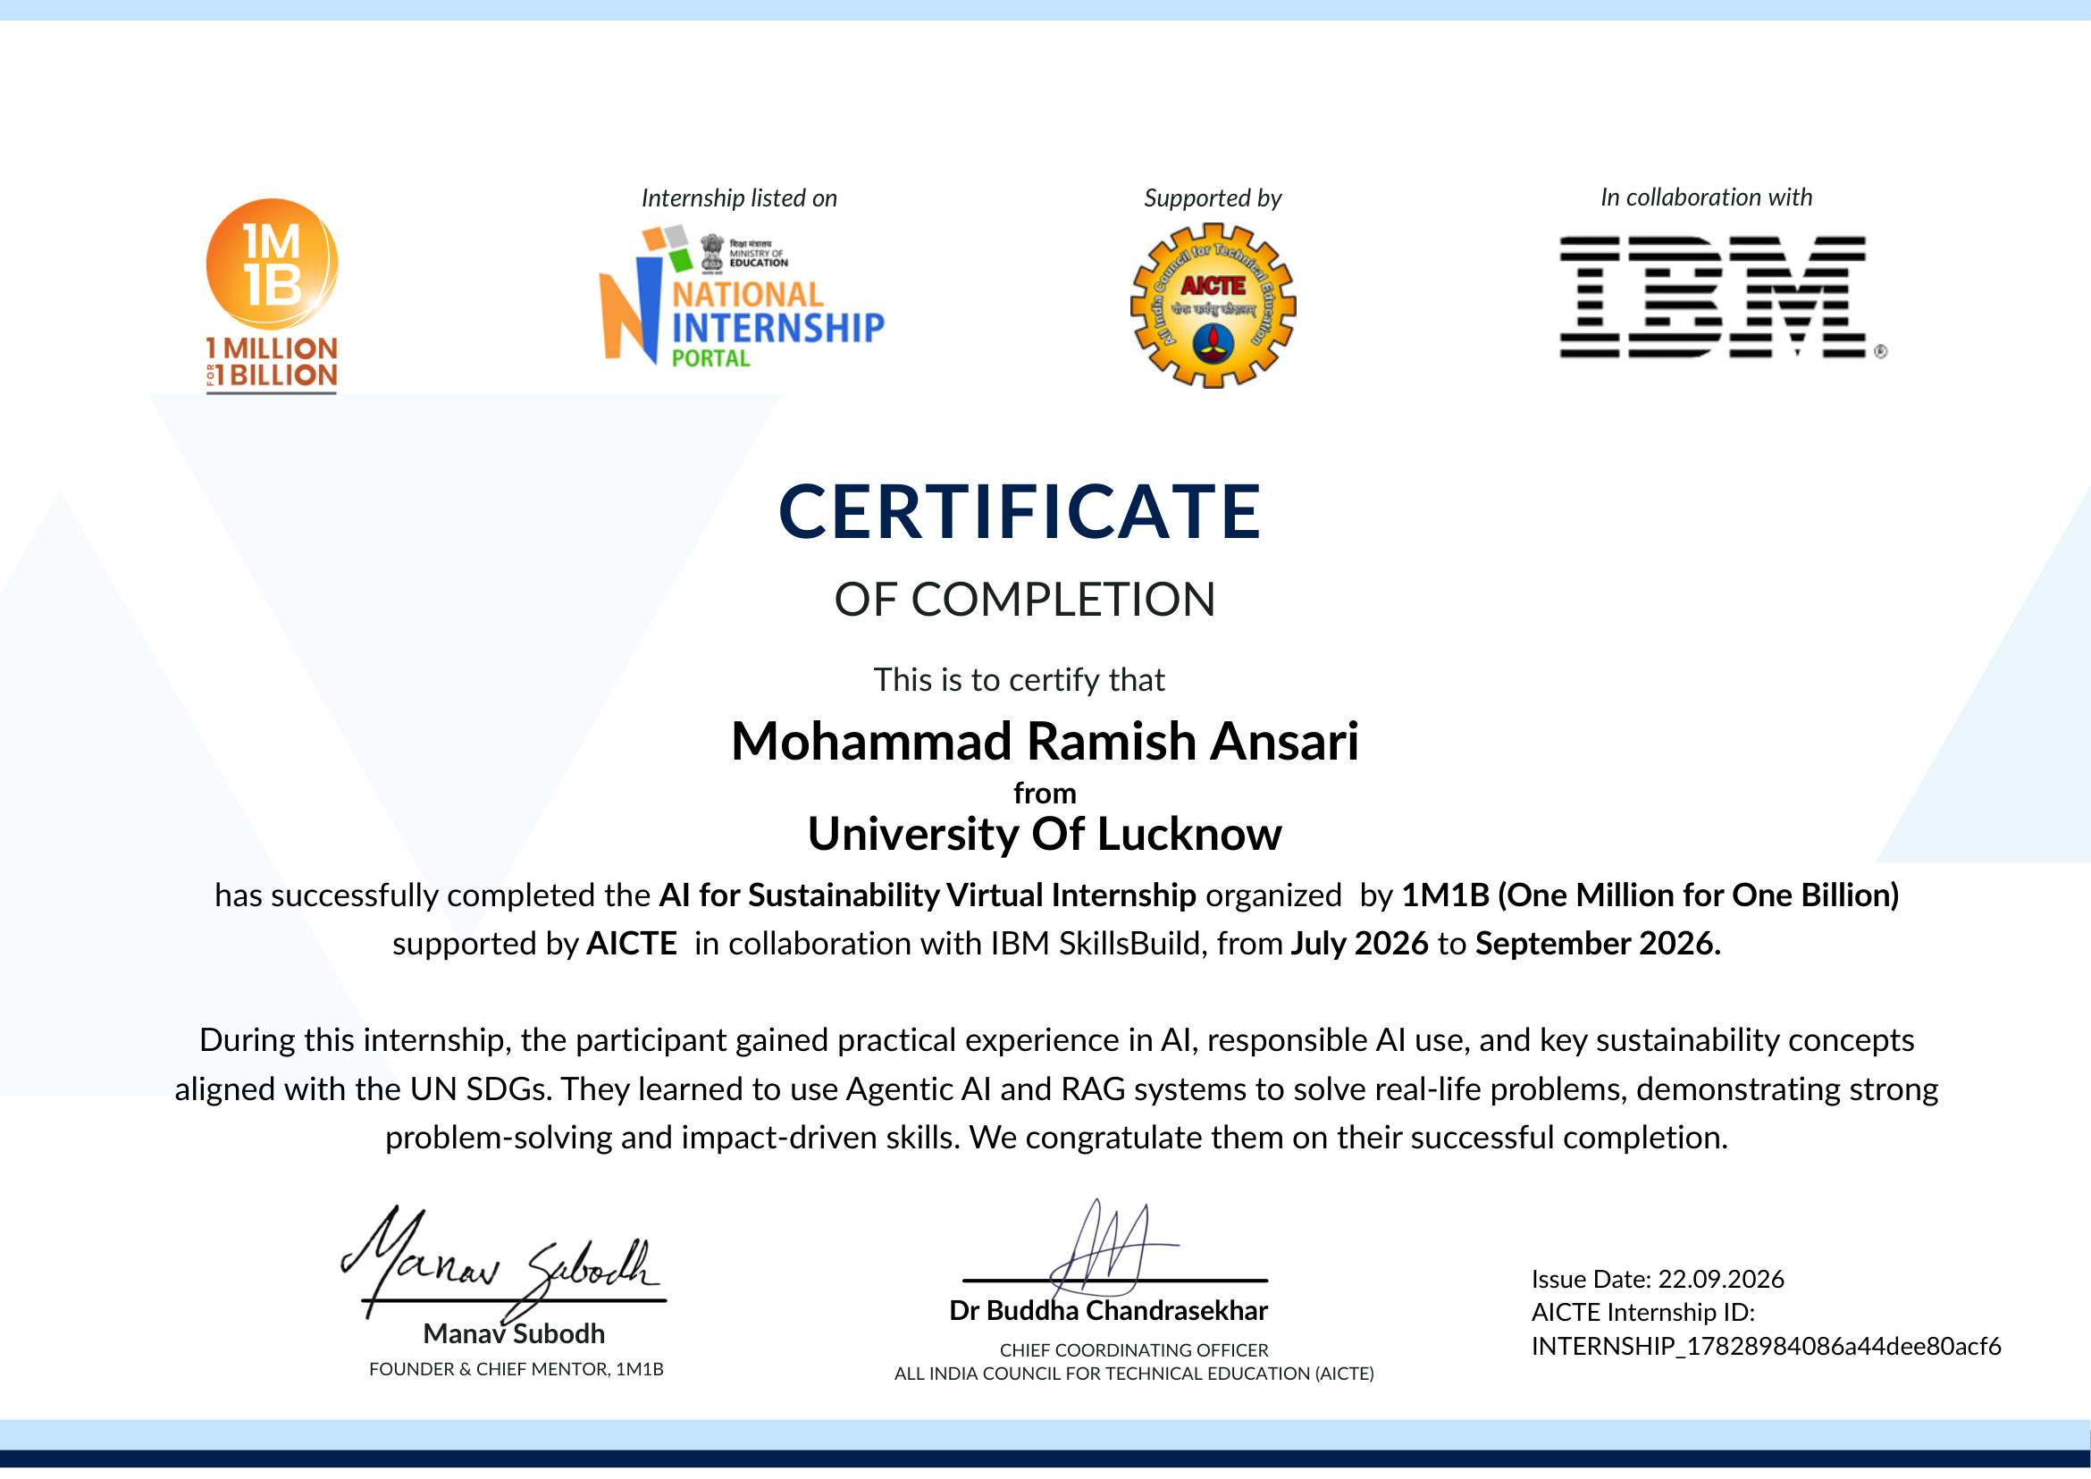
CERTIFICATE
AI for Sustainability Virtual Internship
Completion certificate · 1M1B, supported by AICTE, in collaboration with IBM SkillsBuild
INTERNSHIP COMPLETION
1M1B
AI for Sustainability
Mohammad Ramish Ansari
Certified period: July–September 2026
Issued: 22 September 2026
AICTE Internship ID
INTERNSHIP_17828984086a44dee80acf6
MOHAMMAD RAMISH ANSARI · SWACHHAI · AI FOR SUSTAINABILITY
19 / 22

Slide 20
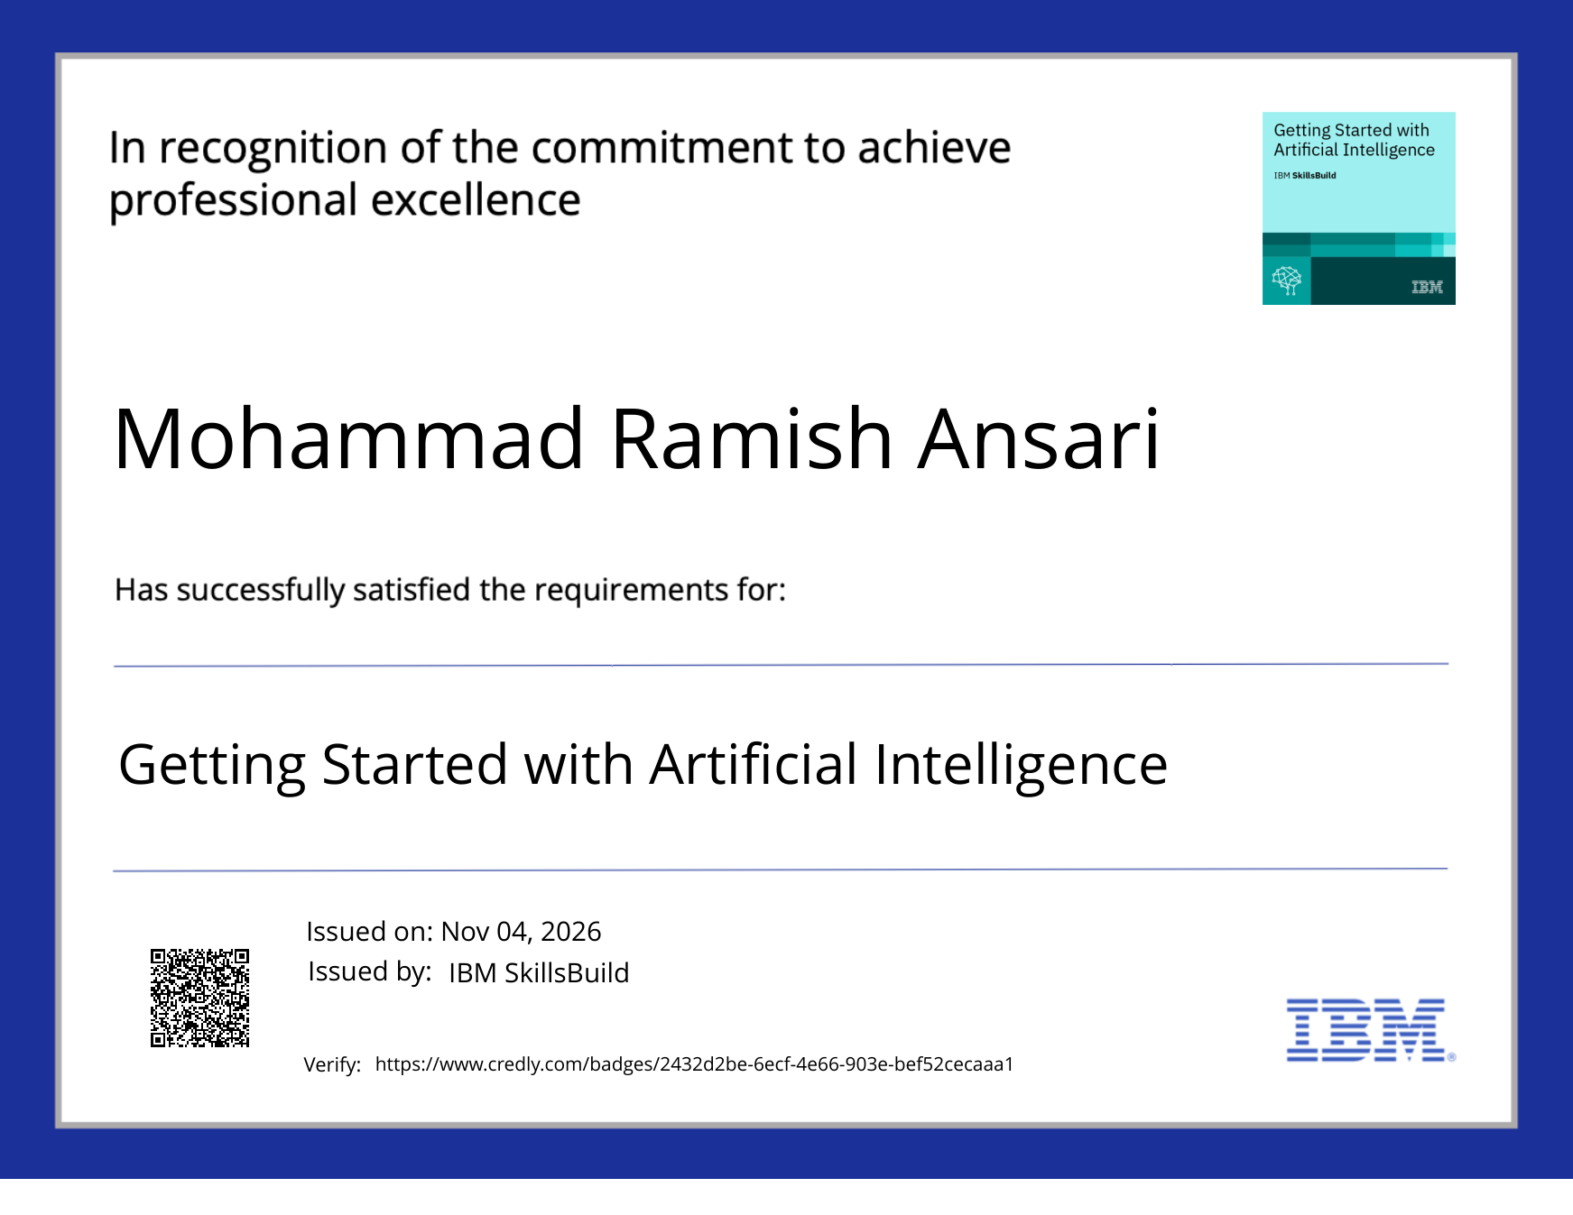
CERTIFICATE
Getting Started with Artificial Intelligence
IBM SkillsBuild · issued 04 November 2026 · Credly verification included on certificate
IBM SKILLSBUILD
Getting Started
with Artificial Intelligence
Mohammad Ramish Ansari
Issued 04 Nov 2026
Verify on Credly
The certificate QR code and credential record are visible in the scan.
MOHAMMAD RAMISH ANSARI · SWACHHAI · AI FOR SUSTAINABILITY
20 / 22

Slide 21
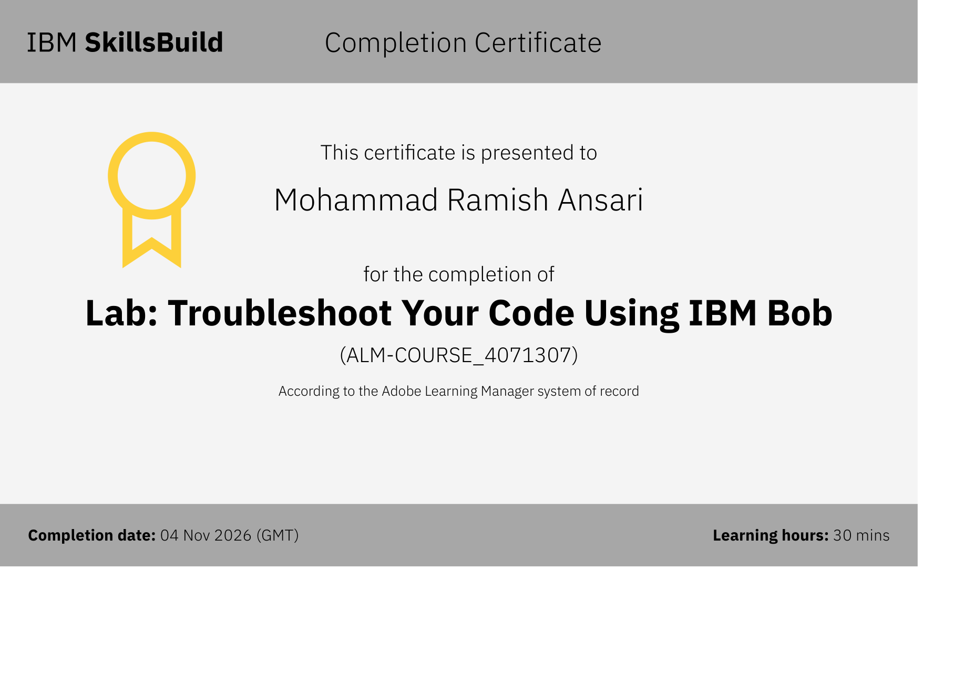
CERTIFICATE
Troubleshoot Your Code Using IBM Bob
IBM SkillsBuild completion certificate · 30 minutes
IBM SKILLSBUILD
Troubleshoot Your Code
Using IBM Bob
Mohammad Ramish Ansari
Completion: 04 Nov 2026 (GMT)
Learning time: 30 minutes
Course ID
ALM-COURSE_4071307
Certificate reproduced from the supplied PDF.
MOHAMMAD RAMISH ANSARI · SWACHHAI · AI FOR SUSTAINABILITY
21 / 22

Slide 22
THANK YOU
Make the right bin
the easy bin.
✓
SwachhAI · AI-Guided Waste Segregation and Circularity Assistant
MOHAMMAD RAMISH ANSARI
B.Tech. CSE · University of Lucknow
ansariramish35@gmail.com
+91 7007043871
QUESTIONS?
MOHAMMAD RAMISH ANSARI · SWACHHAI · AI FOR SUSTAINABILITY
22 / 22

