Slide 1
IBM University Engagement
Project Submission
Exploring the Power of Agentic AI with IBM Granite and LangFlow
NutriGuide
AI-Powered Personalized Nutrition Assistant
Problem Statement No. 8 · Nutrition Agent · AICTE 2026
Student: Mohammad Ramish Ansari · University of Lucknow
NutriGuide · AICTE 2026 · General education only, not medical advice
1

Slide 2
Student Details & Project Domain
Template page 2 structure adapted; provided template was a PDF, not an editable PPTX.
Student Name
Mohammad Ramish Ansari
Course
B.Tech Computer Science Engineering (pursuing)
Institution
University of Lucknow, Lucknow
Email
ansariramish35@gmail.com
Mobile / WhatsApp
+91-7007043871
Recent passport photo
Not supplied — intentionally left blank
Domain: Artificial Intelligence / Healthcare Technology / Agentic AI
Project Title: NutriGuide – AI-Powered Personalized Nutrition Assistant
NutriGuide · AICTE 2026 · General education only, not medical advice
2

Slide 3
Problem Statement – Nutrition Agent
Official AICTE 2026 Problem Statement No. 8
People seek personalized nutrition guidance, but common tools can give generic plans and miss lifestyle, culture, preferences, allergies and feedback.
Nutrition information is scattered, and portion and daily-intake tracking can be difficult for a busy person.
The official challenge proposes an interactive assistant that can explain meal choices and adapt to user feedback.
NutriGuide demonstrates a careful subset: traceable food facts, simple filtered meal suggestions, manual logging and clear totals.
Scope boundary: general education prototype — not a dietitian, diagnosis tool or medical treatment system.
NutriGuide · AICTE 2026 · General education only, not medical advice
3

Slide 4
The Challenge, Objective & Target Users
Why the problem matters and whom the prototype is designed to help
THE CHALLENGE
Generic plans overlook individual food choices and allergies.
Food values need a source and a stated portion.
People need a simple way to see what they logged.
OBJECTIVE
Build a modest app that explains food values, filters meal templates, tracks entries and returns sourced general guidance.
TARGET USERS & PAIN POINTS
Students, working professionals and families seeking basic food guidance.
Pain points: time, portion uncertainty, missing allergy context and fragmented food information.
Not intended for users requiring clinical diets or disease-specific advice.
NutriGuide · AICTE 2026 · General education only, not medical advice
4

Slide 5
Proposed Solution: NutriGuide
A practical workflow with deterministic safeguards and optional IBM generation
Create a minimal profile with dietary preference, fitness goal, allergies, cuisine and activity.
Retrieve food and WHO guidance from a small source-linked knowledge base.
Filter meal ingredients first; calculate portions from USDA-derived values and explain the match.
Log foods manually, edit or remove them, and update nutrient summaries automatically.
Route chat requests to a task-specific function; optionally let IBM Granite phrase a validated draft.
If IBM credentials are absent or a call fails, the interface labels the local answer DEMO — never a live Granite success.
NutriGuide · AICTE 2026 · General education only, not medical advice
5

Slide 6
Proposed Solution Diagram
Compact workflow representation
USER
STREAMLIT UI
Profile · Chat · Planner · Food Logger · Dashboard
TRANSPARENT AGENT ROUTER
Knowledge
Diet Plan
Health Advisory
Food Log
RAG: USDA / WHO records → FAISS retrieval → source-linked context
Optional Granite response → answer + sources + mode label → updated dashboard
NutriGuide · AICTE 2026 · General education only, not medical advice
6

Slide 7
Technology Used
Each technology has a specific, modest role in the working prototype
Python
Readable calculations, filtering, routing
Streamlit
Forms, pages, chat and dashboard
Pandas
CSV food data and log summaries
Plotly
Nutrient progress visualization
TF-IDF + FAISS
Local text retrieval for offline demo
IBM watsonx.ai + Granite
Optional real model generation through SDK
IBM Slate embeddings
Optional live IBM embeddings, if account permits
LangFlow
Visual workflow specification; runtime not verified
NutriGuide · AICTE 2026 · General education only, not medical advice
7

Slide 8
LangFlow Components Used
Visual workflow components and their prototype-equivalent implementation
Chat Input / Chat Output — text query and answer display.
File + Text Splitter — load structured CSV/JSON and make small retrieval documents.
Embeddings + FAISS Vector Store + Retriever — create/search vectors and return source context.
Custom Python Agent Router — choose one of the four domain functions.
Prompt Template + IBM watsonx.ai Model — optional grounded draft wording via Granite.
The Streamlit app runs equivalent Python directly; LangFlow itself is not connected or runtime-tested.
NutriGuide · AICTE 2026 · General education only, not medical advice
8

Slide 9
Explanation of Each Component
Simple data flow from user question to traceable answer
1 · Input
2 · Route
3 · Retrieve
Collect a query and current session choices.
Choose the specialist function using clear keyword rules.
Find relevant food/guidance records in FAISS.
4 · Validate
5 · Generate
6 · Display
Use Python-calculated draft and allergy-safe items.
Optionally call Granite with retrieved context.
Show response mode, references and dashboard update.
Unknown data should produce an explicit ‘not verified in this dataset’ response.
NutriGuide · AICTE 2026 · General education only, not medical advice
9

Slide 10
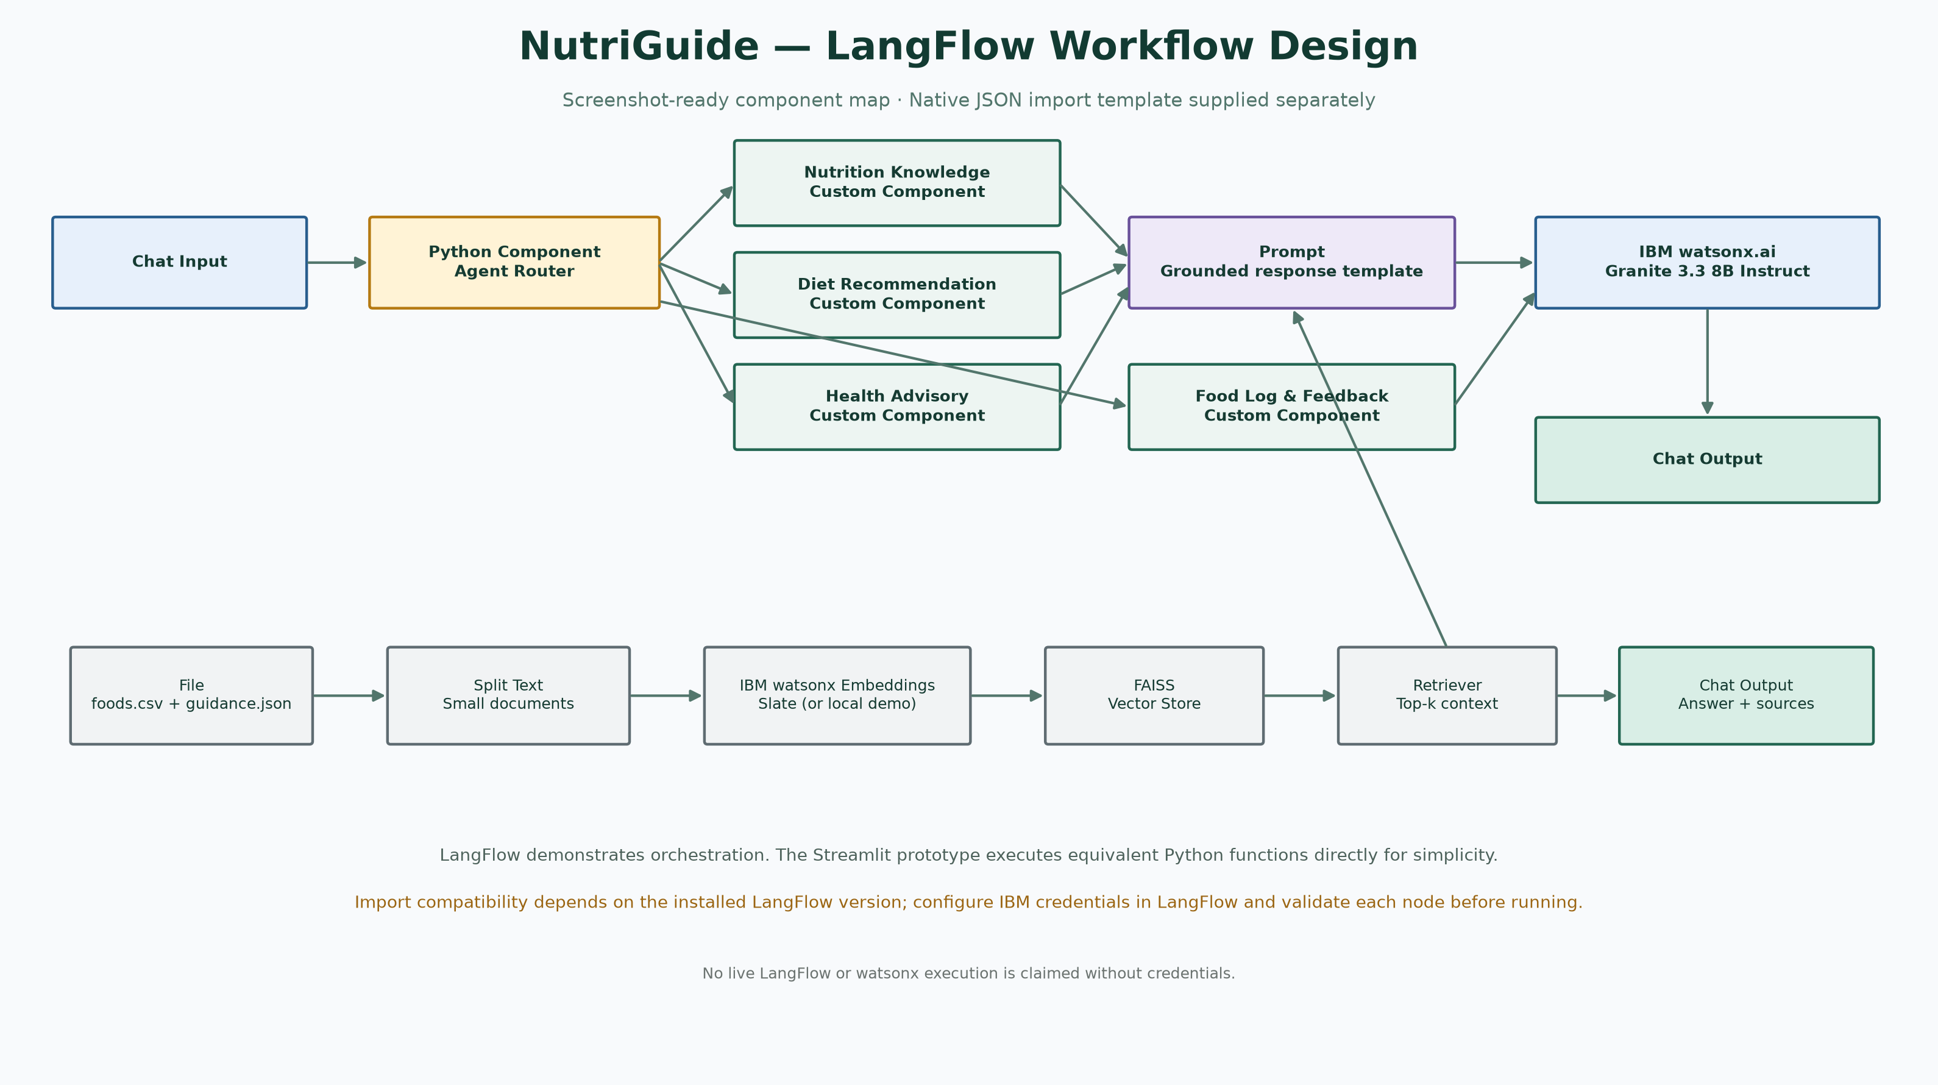
LangFlow Workflow
Version-neutral workflow design; import schema depends on LangFlow release
Manifest: langflow/workflow.json · Build and validate native flow in your LangFlow installation.
NutriGuide · AICTE 2026 · General education only, not medical advice
10

Slide 11
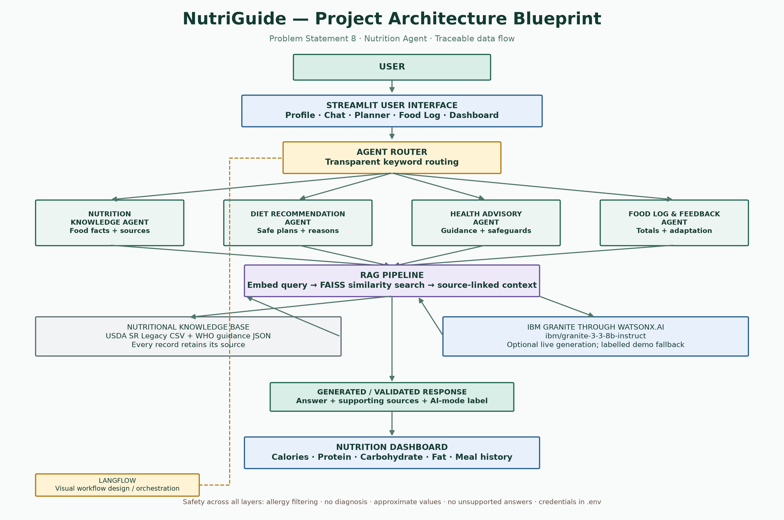
Project Architecture Blueprint
Data flow and safety points
NutriGuide · AICTE 2026 · General education only, not medical advice
11

Slide 12
Role of Agentic AI in the Solution
Implemented coordination versus future autonomous capabilities
IMPLEMENTED
A simple router directs queries to four function-based specialist components.
Python performs exact filtering, nutrient math and log updates.
RAG provides source context before optional model generation.
NOT CLAIMED
The components do not autonomously learn, plan across tools or operate continuously.
They are not a medical professional and do not diagnose or prescribe.
More autonomous coordination is future work and requires evaluation.
Precise description: routed, multi-function AI workflow — not four fully autonomous agents.
NutriGuide · AICTE 2026 · General education only, not medical advice
12

Slide 13
Token Usage
Actual usage was unavailable for this build
0 verified live Granite calls during build
No API credentials were provided; token usage was not measurable.
Local TF-IDF and FAISS demo retrieval does not consume watsonx model tokens.
When a real Granite call is made, the app displays input/output token counts only if IBM returns them.
No illustrative token figure is shown; actual usage depends on prompt size, model and account.
NutriGuide · AICTE 2026 · General education only, not medical advice
13

Slide 14
Before Prompt and After Prompt
Genuine example: a broad request gains relevant constraints and traceable context
BEFORE · USER
“Give me a healthy breakfast.”
Too broad: no stated diet, allergy, serving or data source.
AFTER · GROUNDED WORKFLOW
“Suggest a vegetarian high-protein breakfast. Avoid declared allergies. Use a matching NutriGuide meal template, state portion and calculated nutrients, cite retrieved food records, and say if evidence is missing. Keep it educational, not medical.”
The system adds profile context, allergy filters, deterministic calculations and retrieved source material; it does not invent user constraints.
NutriGuide · AICTE 2026 · General education only, not medical advice
14

Slide 15
Novelty and Uniqueness
A small integrated workflow with traceable, editable calculations
Multi-function routing makes the task and selected module visible.
RAG links answers to food and guidance records instead of relying on open-ended claims.
Personalized meal templates are filtered for diet, allergy, cuisine and availability before generation.
Food log and dashboard update together; serving edits immediately recalculate nutrient totals.
Explanations, source links and clear demo/live labels support user understanding.
Novelty is a feasible combination for an undergraduate prototype, not a claim of clinical innovation.
NutriGuide · AICTE 2026 · General education only, not medical advice
15

Slide 16
GitHub Repository
Local repository prepared · public repository not created
Repository folder: NutriGuide-AI-Nutrition-Assistant
No GitHub URL is supplied because no repository was created.
cd NutriGuide-AI-Nutrition-Assistant
git init -b main
git add .
git commit -m "Initial NutriGuide project"
git remote add origin https://github.com/YOUR-USERNAME/NutriGuide-AI-Nutrition-Assistant.git
git push -u origin main
Replace YOUR-USERNAME with your own account URL. Do not add .env, resumes or standalone certificate files.
NutriGuide · AICTE 2026 · General education only, not medical advice
16

Slide 17
Future Scope
Possible extensions — not implemented in this version
Expand and refresh the verified food dataset; add recipe ingredients and portion control.
Build and test a native LangFlow workflow compatible with the chosen version.
Add multilingual text/voice and image-assisted food entry after usability and accuracy testing.
Explore wearable integrations only with consent, privacy review and validated use cases.
Evaluate safety, accessibility and recommendations with qualified nutrition professionals.
Future scope is proposed only; no voice, image, wearable or multilingual feature is currently claimed.
NutriGuide · AICTE 2026 · General education only, not medical advice
17

Slide 18
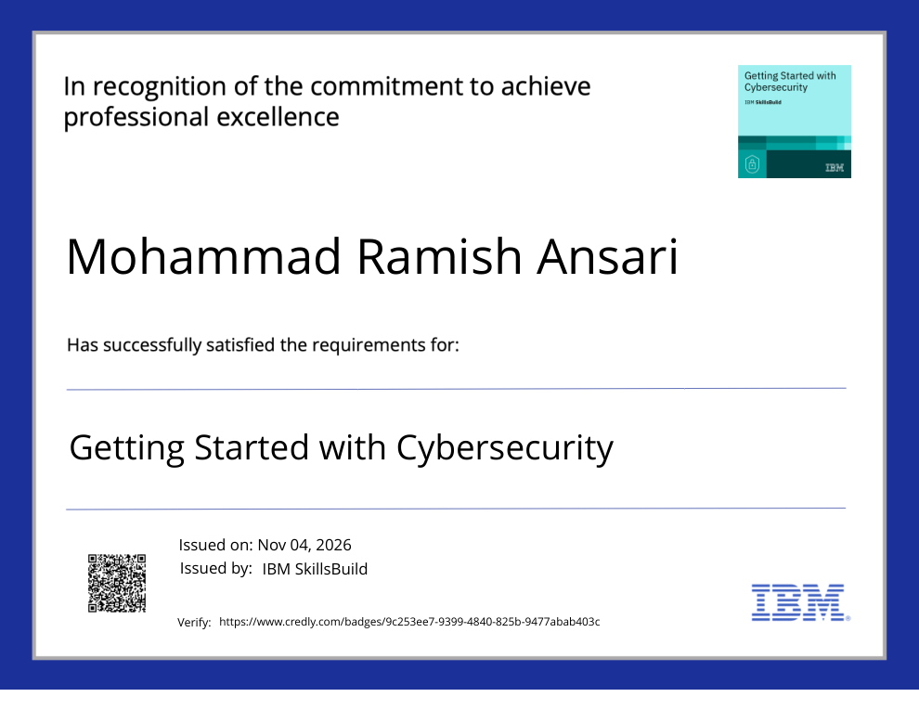
Certificates Earned — IBM SkillsBuild
Course title, issuer, date and verification link transcribed from uploaded certificate
Getting Started with Cybersecurity · IBM SkillsBuild · Issued Nov 04, 2026
Verification: credly.com/badges/9c253ee7-9399-4840-825b-9477abab403c
NutriGuide · AICTE 2026 · General education only, not medical advice
18

Slide 19
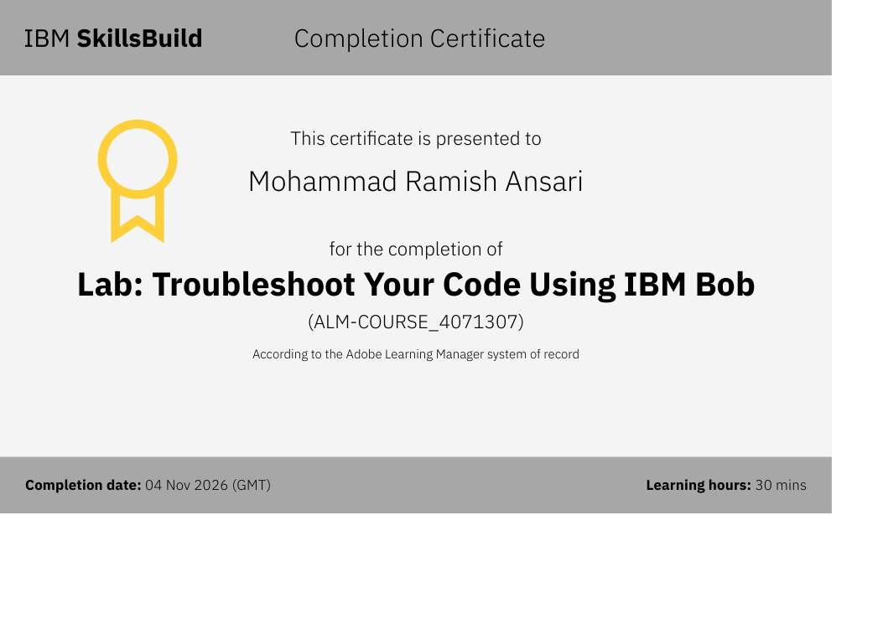
IBM Bob Certificate
Completion details shown exactly as provided in the uploaded certificate
Lab: Troubleshoot Your Code Using IBM Bob · Course code ALM-COURSE_4071307
Completed 04 Nov 2026 (GMT) · Learning time 30 mins · No verification URL was shown
NutriGuide · AICTE 2026 · General education only, not medical advice
19

Slide 20
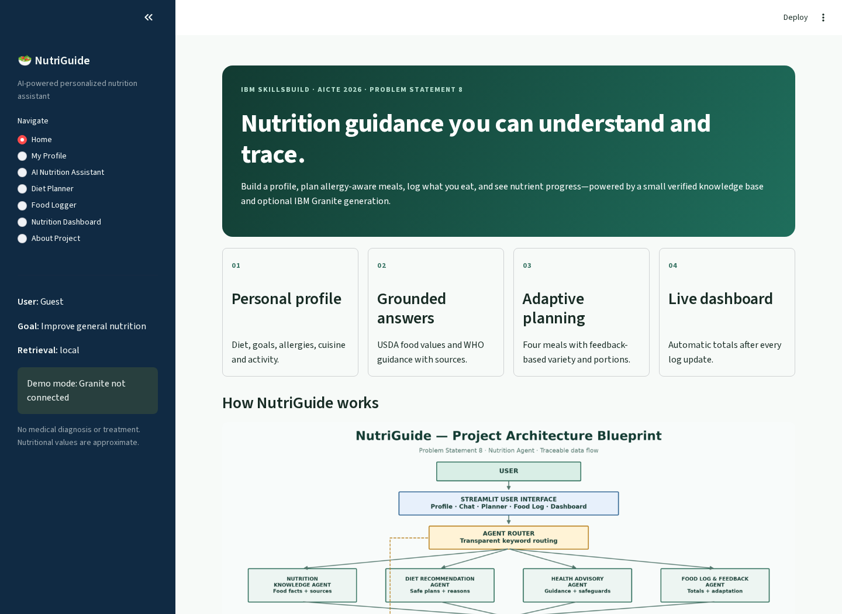
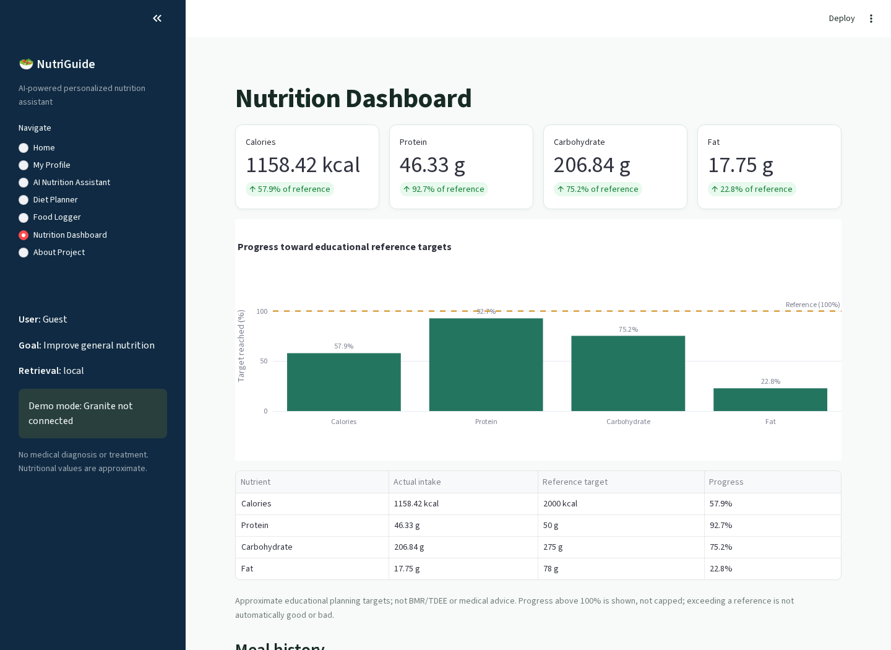
Working Application — Demonstration Screenshots
Genuine captures from the local Streamlit app; sample food log used on dashboard
HOME · Local TF-IDF/FAISS · Granite not connected
DASHBOARD · Sample day · totals and reference progress
Captured from the running app on 4 Nov 2026. Dashboard references are educational, not medical targets.
NutriGuide · AICTE 2026 · General education only, not medical advice
20

Slide 21
Thank You!
Questions and feedback
NutriGuide
Traceable · Explainable · Allergy-aware · Educational
Mohammad Ramish Ansari · University of Lucknow
NutriGuide · AICTE 2026 · General education only, not medical advice
21

