Slide 1

AgroAI
An AI-assisted agriculture web application built with Flask, SQLite and Data Structures & Algorithms
Team members: [ Md. Saad Ansari ,Md. Farhan Ansari, Fraaz, Aditya raj, Ritinsh kumar ]
Guide: [Aarshi Gupta]
Department: [CSE CORE]

Slide 2
Project Overview and Objective
AgroAI is a Flask web application that combines AI assistance with a custom DSA module.
Uses the Groq API for AI responses, SQLite for local storage, and a browser-based interface.
Objective: apply core data structures and algorithms in a practical agriculture-oriented project.
Secondary goal: practise full-stack development and Git/GitHub workflow.
AgroAI | 2

Slide 3
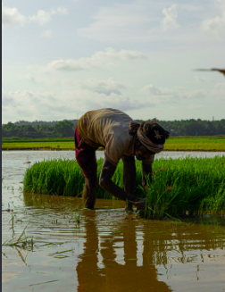
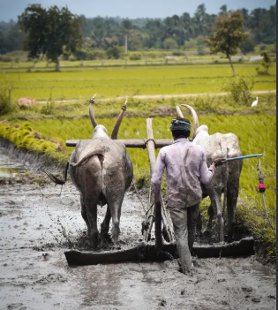
Problem Statement
The Problem
Our Solution
Farmers and students often lack quick, accessible guidance for agricultural questions and data-driven decisions.
A simple web app that offers AI-based assistance, stores application data locally, and uses efficient algorithms to organise and process information.
AgroAI | 3

Slide 4




Features
AI Integration
Database
Groq API connected through environment configuration.
SQLite for lightweight local data storage.
DSA Module
Web Interface
Dedicated dsa_core package with separate algorithm files.
HTML, CSS, JavaScript and Jinja2 templates.
AgroAI | 4

Slide 5
Technology Stack
Technology | Purpose
Python 3.10+ | Main programming language
Flask | Backend framework and routing
HTML5 / CSS3 | Page structure, styling, responsive UI
Vanilla JavaScript | Frontend interactions
Jinja2 | Dynamic HTML templates
SQLite | Database storage
Groq API | AI integration
Git and GitHub | Version control and hosting
Virtual Environment | Isolated Python dependencies
AgroAI | 5

Slide 6
Project Structure
AgroAI/
└── src/ # Primary application source files
├── app/
│ ├── database/ # SQLite database configuration & scripts
│ ├── dsa_core/ # Core Data Structures & Algorithms modules
│ │ ├── arrays_stacks.py
│ │ ├── graph_rotation.py
│ │ ├── hash_map.py
│ │ ├── linked_list.py
│ │ ├── npk_calculator.py
│ │ ├── priority_heap.py
│ │ └── sorting_searching.py
│ ├── static/ # High-contrast CSS & Vanilla JS
│ │ ├── css/
│ │ └── js/
│ ├── templates/ # Jinja2 HTML templates
│ │ └── routes.py # Flask backend routes
└── run.py # Application entry point script
AgroAI | 6

Slide 7
System Architecture
User / Web Browser
HTML · CSS · JavaScript
Flask Backend
Routes · Logic · Requests
SQLite
Local database
DSA Module
Algorithms and data processing
Groq API
External AI service
AgroAI | 7

Slide 8
Installation and Execution
1. Clone
git clone https://github.com/ansarisaad810-lgtm/AgroAI.git
2. Virtual env
python -m venv venv (then activate it)
3. Install
pip install -r requirements.txt
4. Configure
Create .env with GROQ_API_KEY and FLASK_ENV=development
5. Run
python src/run.py → http://127.0.0.1:5000/

Slide 9
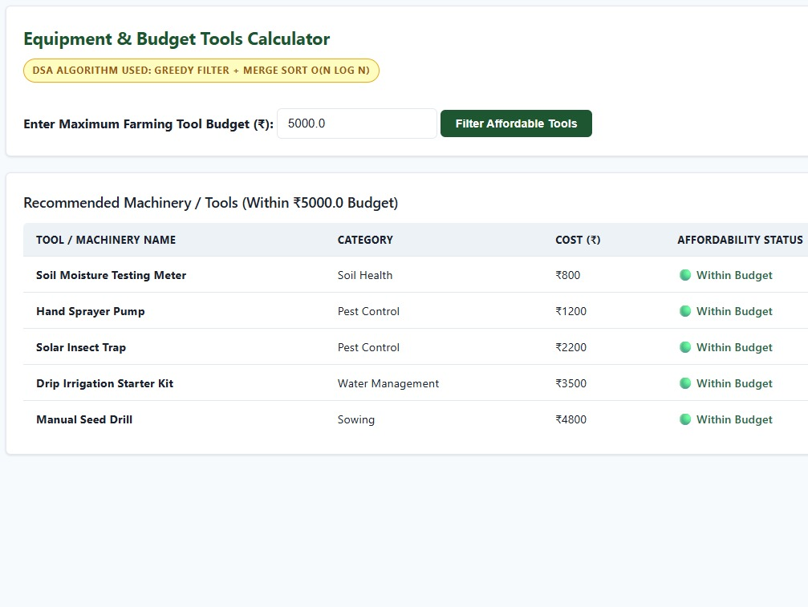
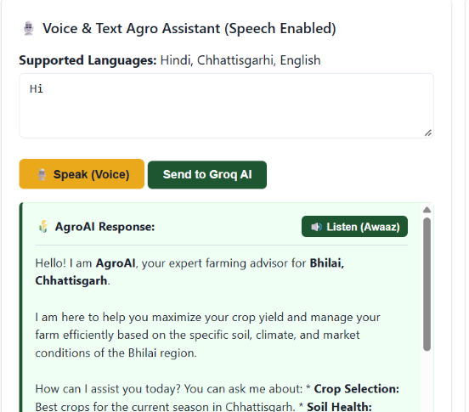
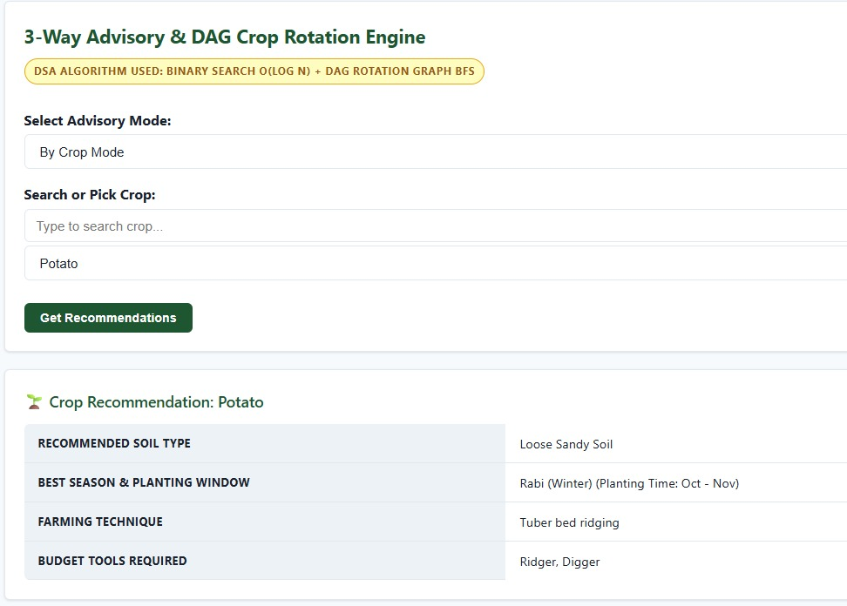
Screenshots and Output
Insert screenshot
Insert screenshot
Insert screenshot
Home Page
AI Assistant
DSA / Database Output
AgroAI | 9

Slide 10
DSA Concepts Used
Concept | File | Application
Arrays and stacks | arrays_stacks.py | Array operations, stack processing
Linked lists | linked_list.py | Linked-list operations
Hash maps | hash_map.py | Key-value lookup and retrieval
Priority heaps | priority_heap.py | Priority-based processing
Sorting and searching | sorting_searching.py | Ordering data, finding elements
Graph processing | graph_rotation.py | Graph-related operations
Calculator module | ppk_calculator.py | Calculation logic
AgroAI | 10

Slide 11

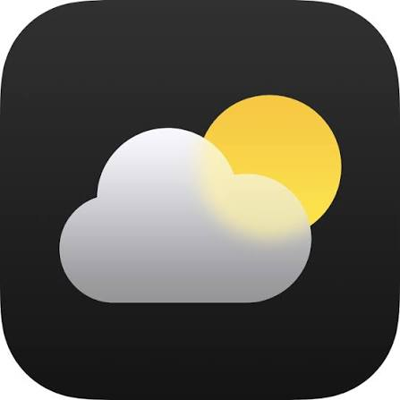



Future Scope
Advanced AI
Weather
Disease Detection
Better agricultural Q&A and regional-language support.
Location-based forecasts and alerts.
Image-based crop disease identification.
Market Analysis
Mobile Friendly
Verified prices, costs and profit estimates.
Improved interface for mobile and low connectivity.
AgroAI | 12

Slide 12
References and License
Repository: github.com/ansarisaad810-lgtm/AgroAI
Python: docs.python.org/3
Flask: flask.palletsprojects.com
SQLite: sqlite.org/docs.html
Groq API: console.groq.com/docs
MDN Web Docs: developer.mozilla.org
License: MIT (preserve copyright and license notice)
AgroAI | 13

