Slide 1
Multimedia Data Repository for Event
Information System

Slide 2
Broad Area Of Research
Multimedia Repository

Slide 3
Introduction
Origin of the Research Problem :
It is an inhouse project to manage events.
Faculties and Event Organizers face many difficulties to manage all the details related to events.

Slide 4
Review Of Research and Development in the Topic
Relevant Paper :
Science Db : A public multidisciplinary research data repository for eScience
Multimedia Repository for online education Content
Design & Implementation of Multimedia Repository System Based on Middle Tier Structure

Slide 5
Proposed System
How the system will work:
User Registration
Event Upload
Attendance
Feedback
Report

Slide 6
Technology for Proposed System
Technical Review:
Microsoft Visual Studio
Xamarin Form
Azure Sql Database Service

Slide 7
Objective
This system is going to use by colleges to organize and manage an event. Following are the main objective of this system:
To store all the detail information and data related to events.
To take attendance while events are going on.
For taking feedbacks about events.

Slide 8
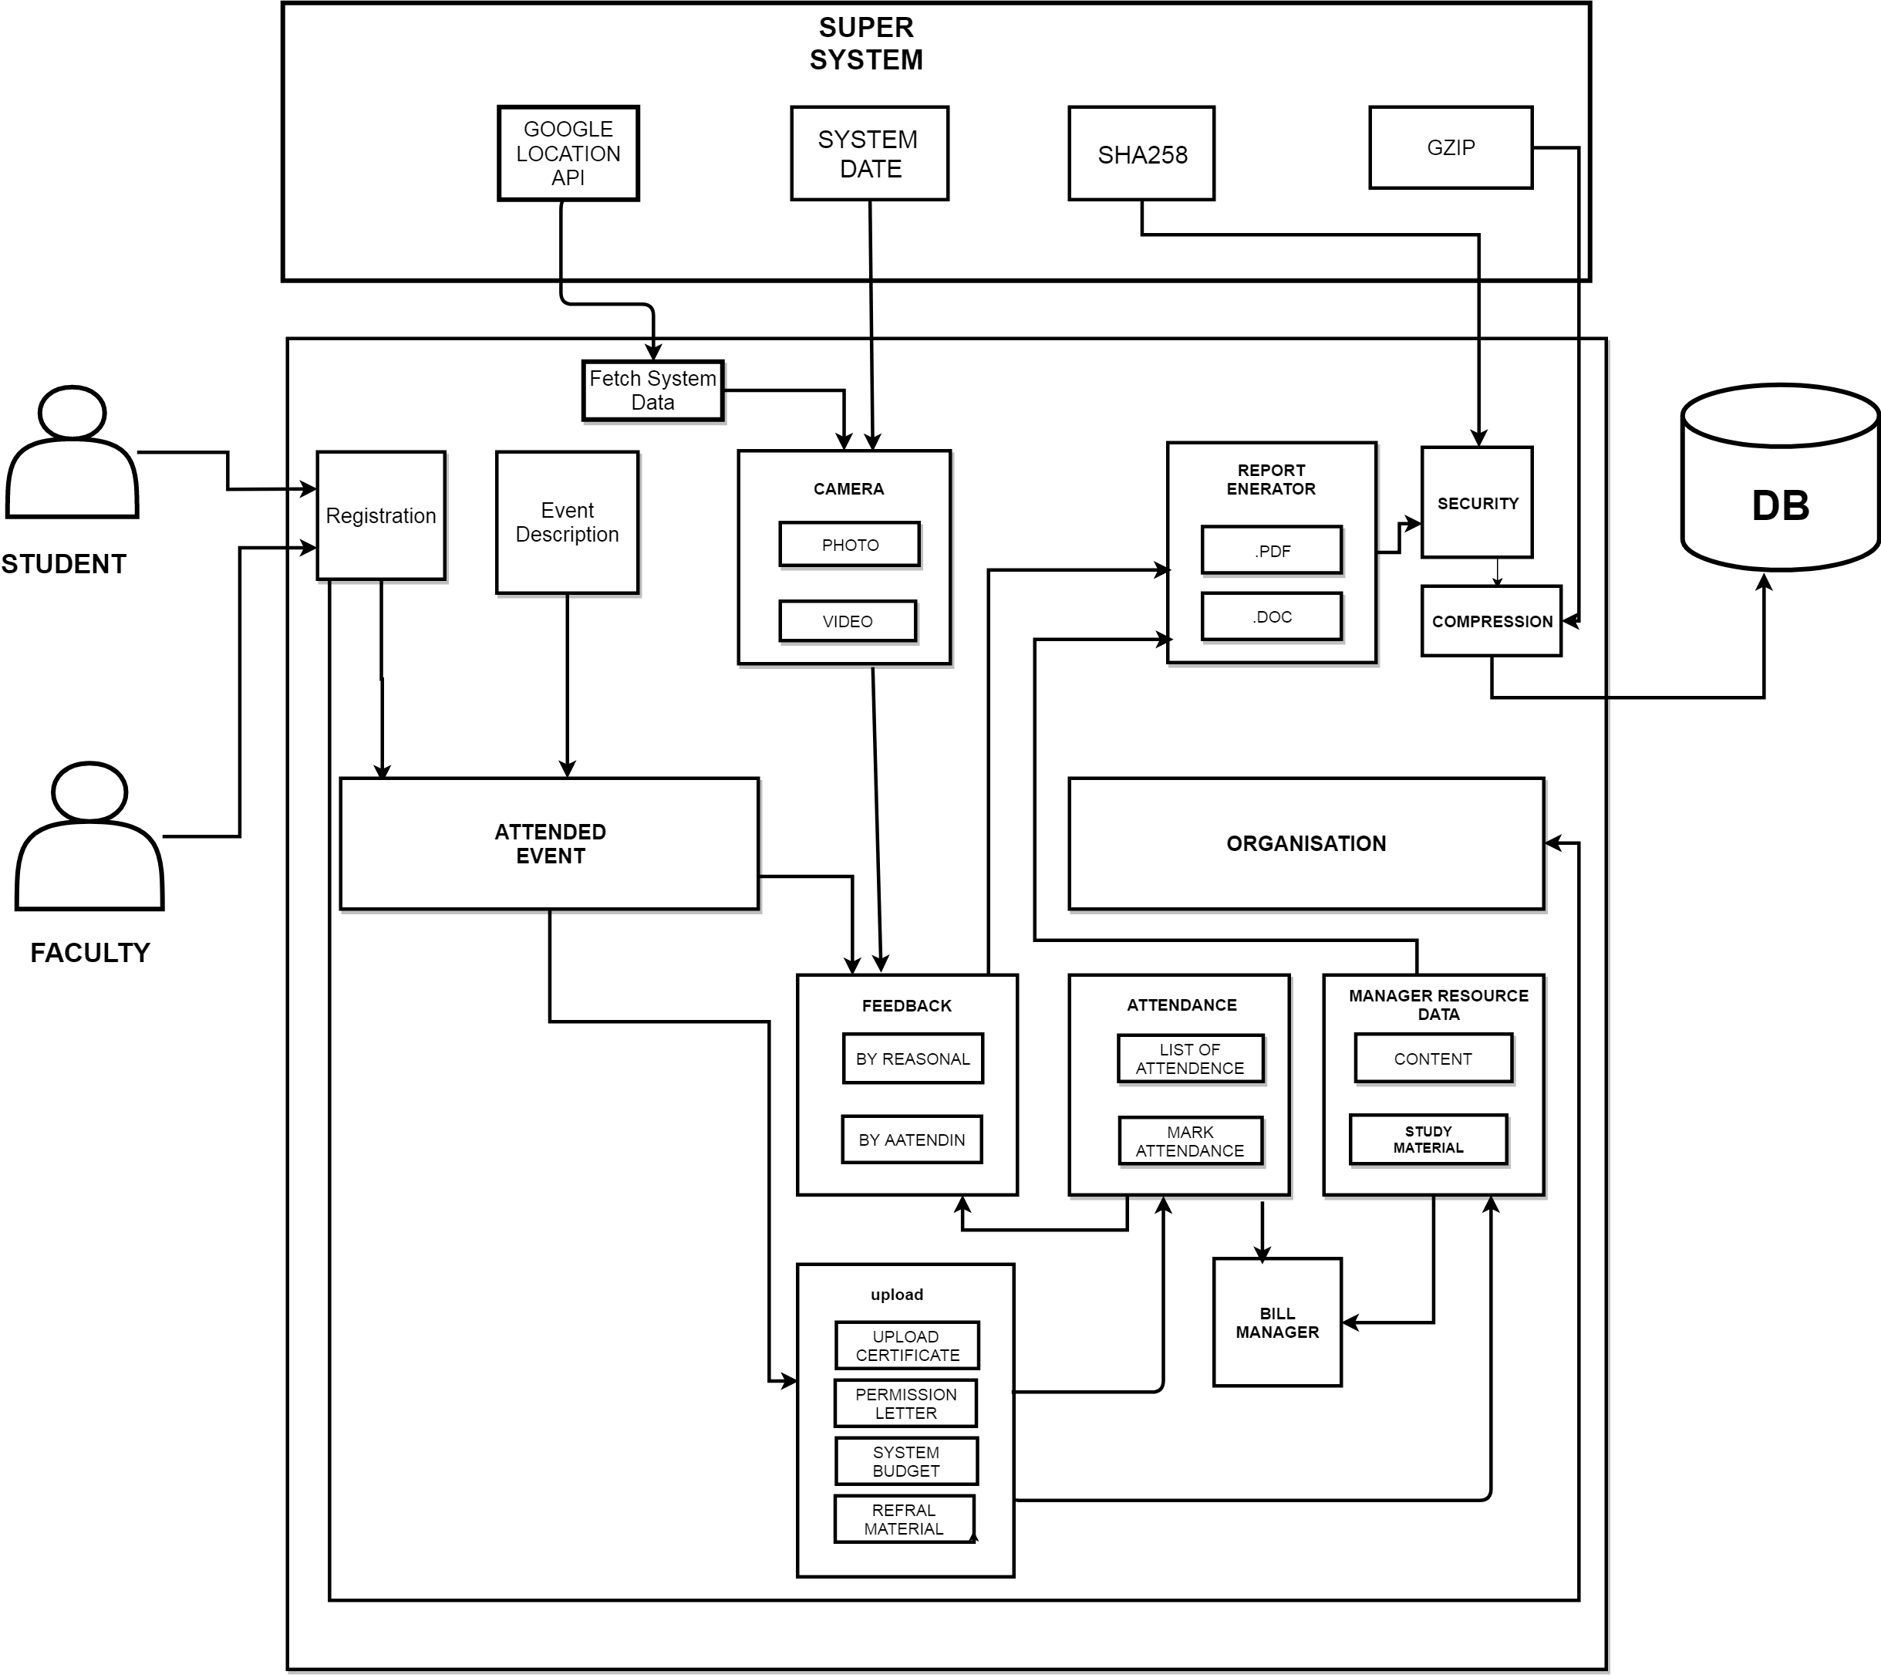
System Architecture :

Slide 9
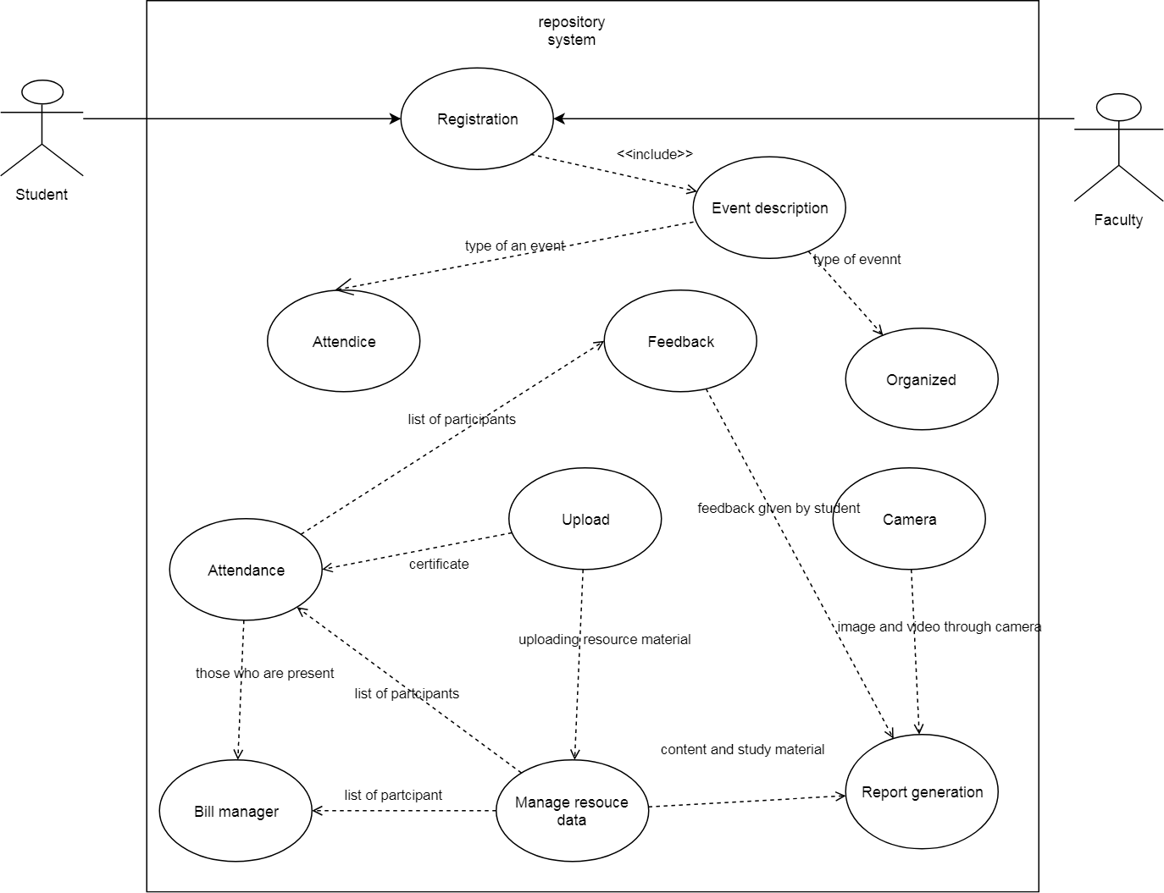
UML :

Slide 10
Conclusion
Decrease the manual work load
Generate the Report
Feedback

