Slide 1
Multimedia Data Repository for Event Information System
Name Of Guide : Prof. Kalpana R. Bodke
Name Of Group Members :
1. Siddiqui Neha
2. Khan Aaisha
3. Ansari M.Saeem
4. Ansari Kurban

Slide 2
Broad Area of Research
Our System will gonna work on Multimedia Data Repository.
Multimedia data repository is a collection of interrelated multimedia data i.e text ,graphics,images,animations,videos,audios.
Data Repository:
It is going to store vast amount databases where in enterprise and organization.
Partitioned data store together.

Slide 3
Origin of the Research Problem
It is an in-house project to generate the report of the event.
Currently AIKTC is using buzz online tool for upload,organize and attendent event.
This is maintain on private cloud.
Faculty found some difficulties to upload the data after the event is completed.

Slide 4
Introduction
This system is based on data repository.
This system also use for taking attendance.
Attendee can upload multimedia data related to the event.
Event organizer can upload study material (if any).
Events organizers generate the report of the events and store them into repository.

Slide 5
Need
Following are the need of the system:
To take attendance of attendees of event
To generate report of the events
Event Organizers need to submit reports of the events to the college.

Slide 6
Objective
This system is going to use by colleges to organize and manage an event, Following are the main features of this system:
To store all the detail information and data related to events.
To take attendance while events are going on.
And taking feedbacks about the events.
Generating report of event
Upgrade resume by updating the detail of event

Slide 7
Review Of Literature

Slide 8
ScienceDB
Science DB is a data repository aiming to promote the preservation, publication and reuse of research data.
Researchers use it for storing,managing and sharing their research data
Moreover it allows research projects or teams to preserve and share their data according to their flexible demands.
A public multidisciplinary research data repository for eScience^{[1]}

Slide 9
Cont..
Advantages
Data Collaboration
Disadvantages
Platform dependent
Manually Checker for Quality Assurance
No Compression
How to Overcome in our proposed system
Available for all Native Platform
Compression Algorithm (Gzip)^{[7]}

Slide 10
Multimedia Repository for online Education Content^{[2]}
This paper proposes an architecture of a multimedia repository for online educational
This system helps to manage the continuously growing amount of electronic learning material.
It is designed to manage a large amount of interactive multimedia learning material
Provides a centralized access to all stored content

Slide 11
Cont..
Advantages
Remote access Facilities
Disadvantages
Security is not very good
No Compression
NO Encryption
How to Overcome in our proposed system
Security (SHA256)^{[6]}
Compression Algorithm (Gzip)^{[7]}
Encryption (AES , RSA)^{[5]}

Slide 12
Design & Implementation of Multimedia Repository System Based on Middle Tier Structure^{[3]}
This paper summarizes the current mainstream web file Upload methods and presents difficulties realizing the Cloud repository media resource management System on large file upload.
For that they uses the FileList interface and Blob of File API to segment a single large file before upload to server.

Slide 13
Cont..
Advantages
Provide Security
Disadvantages
Large file restriction
Uses Different Platform that increases the cost
Platform Dependent
How to Overcome in our proposed system
Compression
Single Platform to reduce cost
Available for all Native Platform

Slide 14
Summary of Literature Review
Features | Science Db | Online Education | Middle Tier | Proposed System
Data Collaboration | YES | No | YES | YES
Encryption | NO | NO | NO | YES
Security | NO | NO | NO | YES
Storage | YES | NO | NO | YES
Report Generation | NO | NO | NO | YES
Platform Dependency | YES | YES | YES | NO
Remote Access | YES | YES | YES | YES

Slide 15
Proposed System Architecture
It’s Data Repository
We are keeping the data of multiple events :
Event Participation
Event Organize
We gonna maintain following types of Data:
Attendance - text
Event Pic - Images
Lectures Notes - Text , Images , Videos
We are using Gzip^{[7]} for compressing large file
For Security we are using SHA256^{[6]}

Slide 16
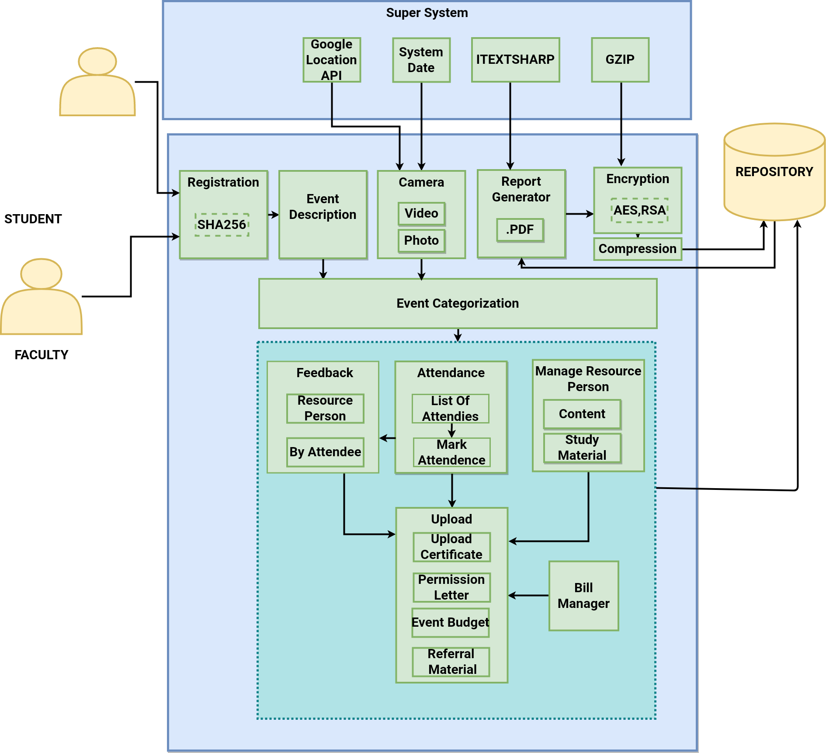

Slide 17
Module wise Explanation of System
User Registration
Upload
Attendance
Report
Compression
Security

Slide 18
User Registration
In our system we are having multi role of users like participants (In-house or Outer ), faculty , event coordinators and event organizer etc.
User register in our system.
User’s Credential will get hash using SHA256 algorithm.

Slide 19

Upload Module
In this module users can upload data related to events.
Larger data such as image or videos get compressed before storing to database.
Modular Diagram:

Slide 20
Attendance Module
This module will take attendance of both attendee and organized in ATT format.
Attendee will upload a pic of the event then our system takes system date time and location.
If this date time and location is match with event’s date time and location then a ATT format sheet will generate which have list of all attendee

Slide 21

Cont...
Modular Diagram
Modular diagram for Attended Event:
Modular diagram for Organized Event:

Slide 22
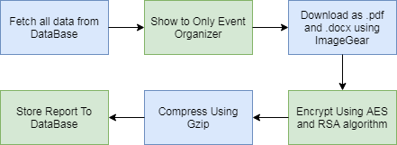
Report Generator Module
One of the most important module of the system.
Input of the all the module will store into database.
With that data we will generate report of event and store the report into our repository.
This module is only for Event-organizer
This report can be download as .pdf and .docx format by using ImageGear Library.
Modular Diagram:

Slide 23

Compression Module
Since it is a multimedia data repository hence we have to store large data like image , videos .
To overcome storage problem we use compression to reduce the size to large data.
Compressed data will be stored to our database.
This will also increase the response time and efficiency of system.
Modular Diagram:

Slide 24

Security Module
For securing Users Credential we are going to use SHA256
Modular Diagram:

Slide 25
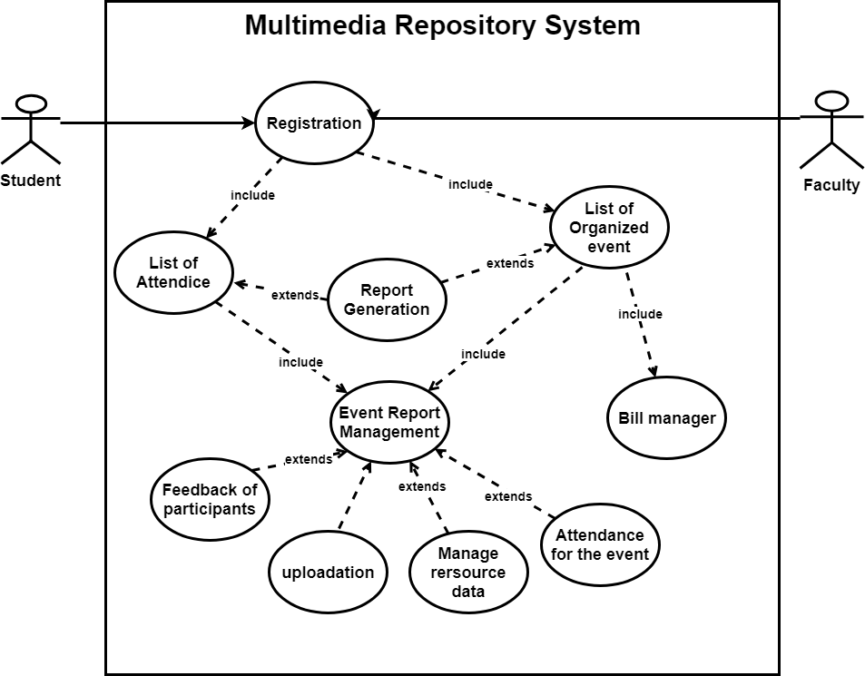
Use Case Diagram of System

Slide 26
Details of Requirements with Justification

Slide 27
Implementation Requirements
Following are the minimum requirements for the implementation of our project:
Software Requirements:
Visual studio 2017
Xamarin 2.5.0.280555
Azure Sql Service
DirectX-9
Microsoft Visual C++ Redistributor 2017
Hardware Requirements:
40 GB Hard Disk Space
2.3 GHZ or Faster Processor
4 GB RAM

Slide 28
Deployment Requirements:
Following are the minimum requirements for deploymenting the system:
Software Requirements:
Android 5.0+(For Android Devices)
iOS 8.0+(For Iphone Devices)
Hardware Requirements:
1 GB RAM
8 GB Storage

Slide 29
Conclusion
This system will be going to generate the reports of the events in the form of .pdf or .docx. For reducing the workload of paper work we are making this system.We are using multimedia repository system for storing the reports.

Slide 30
Future plans
Following are the plans that we are going to add in our project in future.
Prediction is one of the most important part in data science and machine learning, So we will going to predict the achievement or success rate of the events.
We will going to give unique QR code to each report so that it can be easily shared and access.

Slide 31
References
Li Chengzan, Hou Yanfei, Li Jianhui, Zhang Lili Big data technology and application development department Computer Network Information Center, Chinese Academy of Science Beijing 100190, China.
Paul Müller Department of Computer Science University of Kaiserslautern, Germany.
Lingzi Xiao Information Engineering School Communication University of China Beijing, China.
www.xamarin.forum.com
www.msdn.microsoft.com/en-us/library/2w117ede.aspx
https://msdn.microsoft.com/en-us/library/system.security.cryptography.sha256(v=vs.105).aspx
https://docs.microsoft.com/en-us/dotnet/api/microsoft.visualstudio.utilities.gzip?view=visualstudiosdk-2017
https://www.accusoft.com/blog/look-imagegear-c-samples/

Slide 32
THANK YOU

