Slide 1
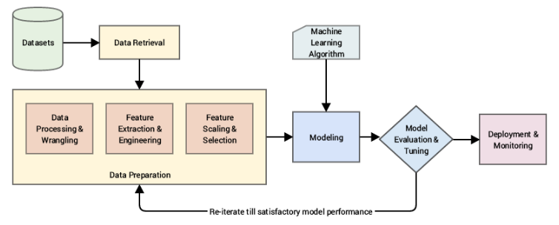
Methodology:
Step1: Data Wrangling and manipulation:
This step consists of getting useful information from raw data . If there is any missing values in data then those values should be properly filled according to the structure of features.
This question has three features which has missing values . These missing values should be filled with appropriate values.
Missing values for this question has been replaced by mean value.

Slide 2
Step 2:
Model selection:
model is selected so that it does not overfit and underfit the data.The model should predict the response with high accuracy and low mean absolute error.
For this question I have selected random forest as the prediction model because random forest has highest accuracy among all other models.
Random Forest is a supervised learning algorithm. Like we can already see from it’s name, it creates a forest and makes it somehow random. The “forest“ it builds, is an ensemble of Decision Trees, most of the time trained with the “bagging” method. The general idea of the bagging method is that a combination of learning models increases the overall result.
One big advantage of random forest is, that it can be used for both classification and regression problems, which form the majority of current machine learning systems.
Random Forest adds additional randomness to the model, while growing the trees. Instead of searching for the most important feature while splitting a node, it searches for the best feature among a random subset of features. This results in a wide diversity that generally results in a better model.
Another great quality of the random forest algorithm is that it is very easy to measure the relative importance of each feature on the prediction.

Slide 3
Result and conclusion:
The random forest method gives the minimum mean absolute error with respect to any other regression methods.
The predicted rank of soldiers is approximately near to the actual rank.
Python is used for data analysis because of large datasets .
following are the errors associated on submission file
Mean Absolute Error: 0.07331440145859625
Mean Squared Error: 0.010976497357898095
Root Mean Squared Error: 0.10476878045438008

