Slide 1

Reducing credit default rate at ABC bank
ABC bank is facing the challenge of high credit default rates. One of the strategies which the bank has come up with is to identify the risky customers (those who are likely to default) and take proactive measures to perform actions for these risky customers before they actually default.
As a data scientist, you are assigned this task of finding out the risky customers using data, identify the characteristics and recommend suitable actions which will help the bank reduce overall default rate.
The provided data set has information about 1000 customers with an indicator of if the customer defaulted the loan
Variable Name | Variable Description | Variable Sample Values | Remarks
checkin_acc | Status of existing checking account. | A11,A12
duration | Duration in month | 6,48
credit_history | Credit history | A34,A32
purpose | Purpose | A43,A43
amount | Credit amount | 1169,5951
svaing_acc | Savings account/bonds | A65,A61
present_emp_since | Present employment since | A75,A73
inst_rate | Installment rate in percentage of disposable income | 4,2
personal_status | Personal status and sex | A93,A92
other_debtors | Other debtors / guarantors | A101,A101
residing_since | Present residence since | 4,2
property | Property | A121,A121
age | Age in years | 67,22
inst_plans | Other installment plans | A143,A143
housing | Housing | A152,A152
num_credits | Number of existing credits at this bank | 2,1
job | Job | A173,A173
dependents | Number of people being liable to provide maintenance for | 1,1
telephone | Telephone | A192,A191
foreign_worker | foreign worker | A201,A201
status | classification for whether an applicant is considered a Good or a Bad credit risk | 1,2 | 1 = good ( no default), 2 = bad (default)

Slide 2
Submission Guidelines
Submission date : 8th June’ 19, 12:00PM
Submission files (python notebook file in ipynb format, final processed exported csv file used for model building, 5 slide presentation)
Slide 1 & 2 Complete methodology, variable selection, importance and Modeling technique details
Slide 4 - Final model performance metrics
Slide 5 – Recommendations
Submissions to be sent in zip file to
vibhu.srivastava@maxlifeinsurance.com, divyan.kavdia@maxlifeinsurance.com

Slide 3
Methodology
Detailed statistics
Check mean, median and variance of numerical variable
Univariate data analysis
PDF and CDF of numerical data
Bi-variate data analysis
Aim
import dataset
Exploratory data analysis
One hot encoding
Processing categorical data set
Normalization
Normalization of numerical dataset
Featurization of data
Models used on dataset
KNN, NB,LOGISTIC
SVM, Decision tree, Random forest
XGBoost, Stacking
Split dataset into train and test
Modeling
Assessment
Log-loss value
Confusion matric
Precision
Recall
Assessment
Recommendation

Slide 4
Variable selection and importance
Modeling technique
Models used on dataset for classification problem
K-Nearest neighbor
Naïve base and
Logistice model
SVM, Decision tree, Random forest, XGBoost
Stacking is combining all above model using logistic model for final output
Variable importance using Random Forest and XGBoost
Selected variable sing EDA
Purpose, amount, personal_status, saving_amount and duration
Above listed importance variable using EDA
Variable importance using Random forest
Purpose, Checkin_acc, personal_status, saving_acc, amount
Above list importance variable using Random forest
Variable importance using XGBoost
Purpose, Persional_status, checkin_acc, Telephone, Inst_plans, saving_acc.
Above list top 5 importance variable using XGBoost
Each model shown above is also parameter tuned for getting optimal parameter which later used for final modeling on test dataset.

Slide 5
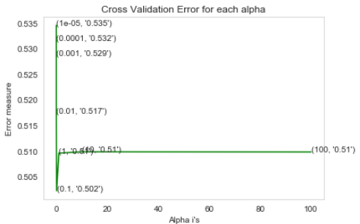
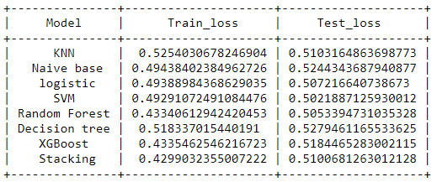
Model performance metrics
SVM accuracy assessment
Below table shows the loss value of each model using tuned parameter
The optimal value of tuned parameter (max_iteration) is 1000 with hing loss
Observation:
SVM model have minimum test error and very near train error which shows that SVM is neither having variance nor bias.
Other models is also having less test error but gap between train test error is more compare to SVM. Means other models have some variance inside them.

Slide 6
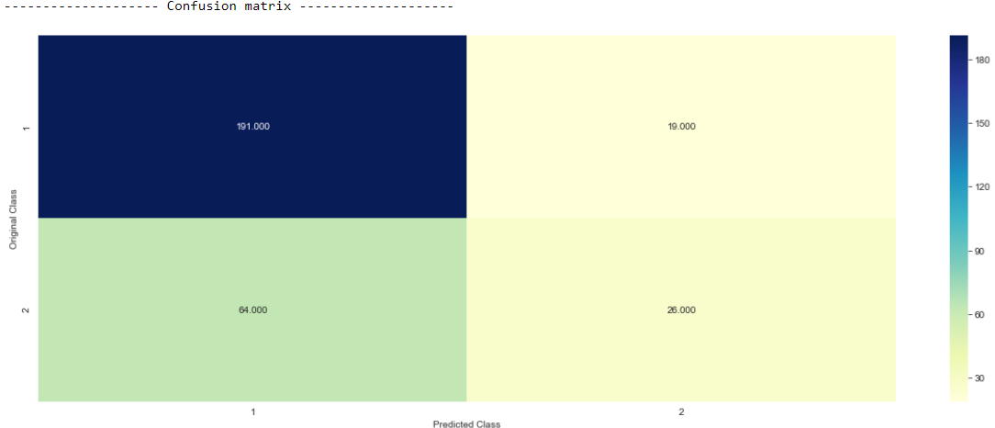
Continue:
Confusion matrix
Observation:
the true positive and false negative value at diagonal cell are correct observation in above confusing matrix.
Most of error occur in FP(false positive) cell means that cell should contain minimum element because it have people originally loan default people but predicted as non-default.
Number of misclassified people using SVM is 27% of total available people.

Slide 7
Recommendations
Purpose, Checkin_acc, personal_status, saving_acc, amount, Age are most important variable which should be judged carefully before giving loan.
It has been seen that People having less age is highly prone to be default.
Loan duration should not be too much high
It has been seen that people who are in default list have very large range of loan amount and duration. Among them people have high loan amount and duration have high chance to be default.
Some people are given very high amount of loan where mean value is very less(mean=4907, max=27636)

