Slide 1
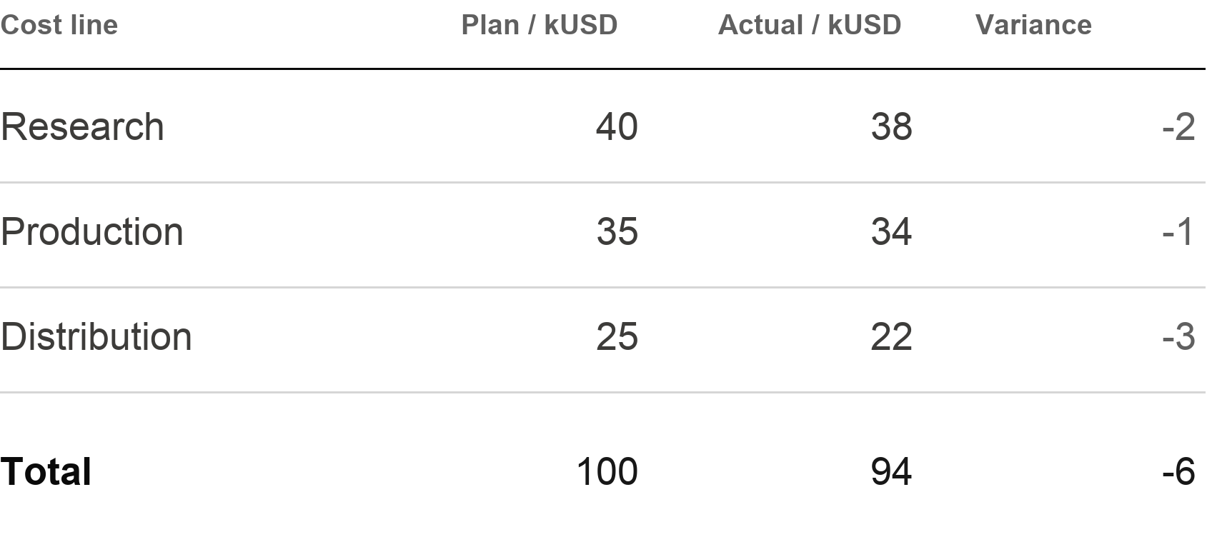
Delivery stays 6% below the planned budget
Illustrative closed-period budget / kUSD / actual minus plan
94 kUSD
Actual spend
100 kUSD planned
Do not treat savings
as proof of equal
output quality.
Release the balance only after delivery-quality review.
Source: data.json — illustrative budget, not financial guidance.
1 / 1

