Slide 1
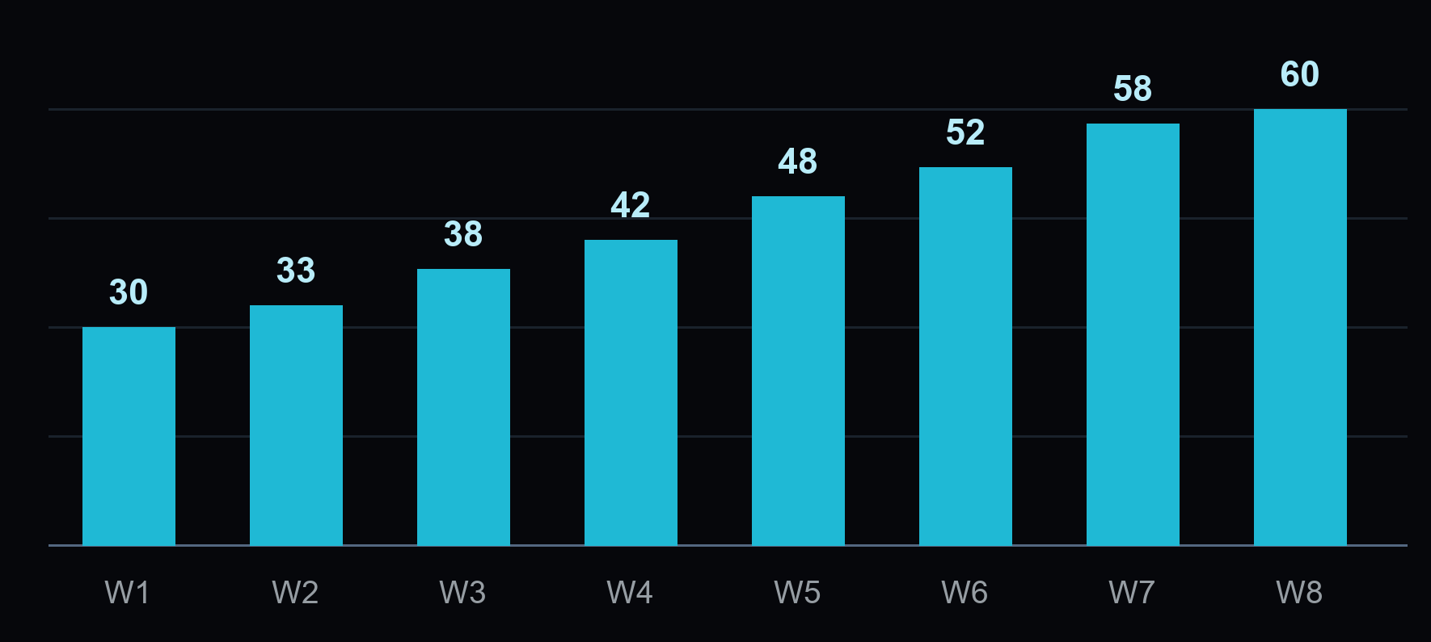
OPERATIONS / WEEKLY DELIVERY
DEMO • 8 WEEKS
Weekly throughput reaches the 60-item target
Illustrative completed items / W1–W8 / constant counting rule
100%
W8 actual: 60 items
W8 target: 60 items
Throughput alone does
not establish quality
or a causal improvement.
Keep the target; add an independent quality check before scaling.
Source: data.json — synthetic weekly counts; no forecast shown.
01 / 01

