Slide 1
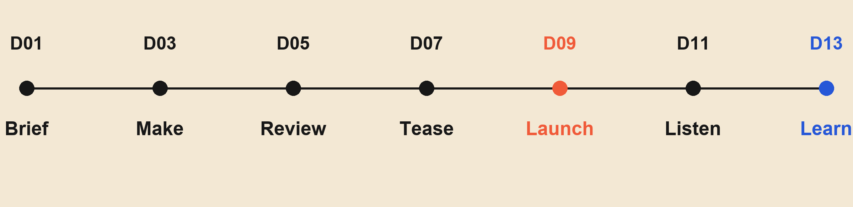
Build a launch that leaves room to learn.
A proposed 13-day sequence — milestones, not measured campaign results.
The launch is a midpoint. Listening is part of the plan.
Source: data.json — original illustrative launch sequence.
01

