Slide 1
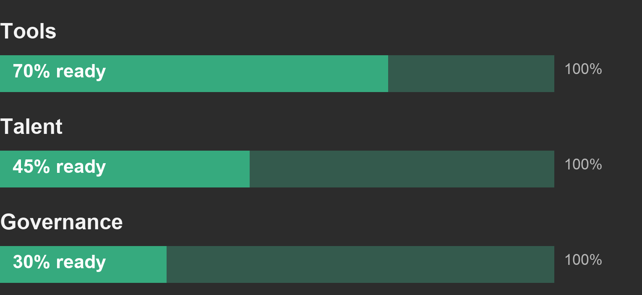
01 / CAPABILITY
Governance is the first readiness gap
Illustrative assessment / readiness score, 0–100 / not measured company data
01 Tools lead at 70%
02 Talent needs a
practical training pilot
03 Agree ownership before
extending automation
Start with accountable decisions, then scale the tooling.
Source: data.json — synthetic scores for this layout demonstration.
01 / 01

