Slide 1
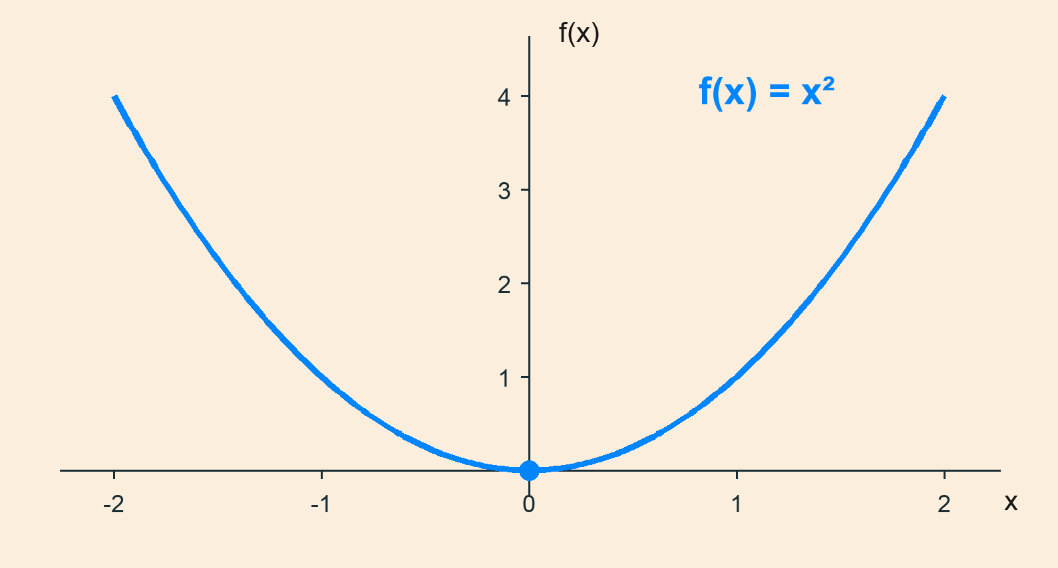
A positive quadratic has one global minimum
Let f(x) = x², x ∈ R.
f′(x) = 2x
f′(0) = 0
Here f(x) ≥ 0 everywhere;
stationarity alone is not enough.
Since x² ≥ 0, equality occurs only at x = 0.
Analytic example: y = x²; 201 plotting samples over [-2, 2]. Both axes dimensionless.

