Slide 1

Predicting Crime Rates from Weather
TEAM 18
SEEMA INAMDAR
ANDREW SAVVA

Slide 2
Agenda
Research Question
Data Description
Descriptive Statistics
Data Pre-Processing
Model Evaluation

Slide 3
Research Question
Does average crime rate within a given city have a linear relationship with city weather conditions?
As weather conditions worsen, the average crime rate within a given city increases
As weather conditions improve, the average crime rate within a given city decreases

Slide 4

Data Description
Chicago City Crime Dataset
Reports crimes in the city of Chicago over the past year from the Citizen Law Enforcement Analysis and Reporting (CLEAR) system
Austin City Crime Dataset
Reports crimes that occurred in the city of Austin as collected by the Austin City Police Department
Los Angeles City Crime Dataset
Reports crimes that occurred in the city of Los Angeles as collected by the municipal government of Los Angeles

Slide 5

Data Description
Weather Dataset
Reported weather conditions in all three cities as provided by Weather Underground: a leading public weather data provider
Report was generated from January 1st 2015 to January 1st 2016

Slide 6
Descriptive Statistics
 | Chicago Crime | Austin Crime | Los Angeles Crime
Number of Records | 264,335 | 38,573 | 935,259
Number of Attributes | 17 | 13 | 13
 | Chicago Weather | Austin Weather | Los Angeles Weather
Number of Records | 366 | 366 | 366
Number of Attributes | 23 | 23 | 23

Slide 7
Data Pre-Processing
DATA GATHERING, DATA CLEANING, AND DATA MERGING

Slide 8
Chicago Crime Data Sample
CASE# | HZ209325
DATE OF OCCURRENCE | 3/26/2016 2:00
BLOCK | 002XX S HALSTED ST
IUCR | 810
PRIMARY DESCRIPTION | THEFT
SECONDARY DESCRIPTION | OVER $500
LOCATION DESCRIPTION | STREET
ARREST | N
DOMESTIC | N
BEAT | 1232
WARD | 27
FBI CD | 6
X COORDINATE | 1171090
Y COORDINATE | 1899016
LATITUDE | 41.87837335
LONGITUDE | -87.6472551
LOCATION | (41.878373345, -87.647255095)

Slide 9
Austin Crime Data Sample
GO Primary Key | 201510782
Council District | 4
GO Highest Offense Desc | AGG ROBBERY/DEADLY WEAPON
UCR Offense Description | Robbery
GO Report Date | 1-Jan-15
GO Location | 9001 N IH 35 SVRD NB
Clearance Status | N
Clearance Date | 28-Jan-15
GO District | E
GO Location Zip | 78753
GO Census Tract | 18.13
GO X Coordinate | 3130483
GO Y Coordinate | 10102366

Slide 10
Los Angeles Crimes Sample
Date.Rptd | 3/20/2013
DR.NO | 132007717
DATE.OCC | 3/20/2013
TIME.OCC | 2015
AREA | 20
AREA.NAME | Olympic
RD | 2004
Crm.Cd | 997
CrmCd.Desc | TRAFFIC DR #
Status | UNK
Status.Desc | Unknown
LOCATION | OXFORD
Cross.Street | OAKWOOD
Location.1 | (34.0776, -118.308)

Slide 11
Weather Data Sample
CST | 1/1/2015
Max TemperatureF | 40
Mean TemperatureF | 37
Min TemperatureF | 34
Max Dew PointF | 39
MeanDew PointF | 35
Min DewpointF | 29
Max Humidity | 100
Mean Humidity | 82
Min Humidity | 64
Max Sea Level PressureIn | 30.38
Mean Sea Level PressureIn | 30.25
Min Sea Level PressureIn | 30.15
Max VisibilityMiles | 10
Mean VisibilityMiles | 3
Min VisibilityMiles | 1
Max Wind SpeedMPH | 9
Mean Wind SpeedMPH | 5
Max Gust SpeedMPH | 13
PrecipitationIn | 0.63
CloudCover | 8
Events | Rain-Thunderstorm
WindDirDegrees | 359

Slide 12

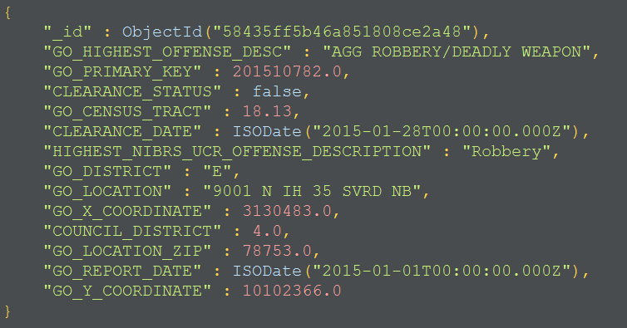
Read in 3 Crime Data Sets into MongoDB
Austin Data Set JSON Exert

Slide 13
Data Cleaning Process
Converted string data types from csv files into MongoDB data types such as: float, double, string, and datetime
Removed any special characters from string fields
Stripped empty characters from strings
Replace characters in float fields with 0

Slide 14
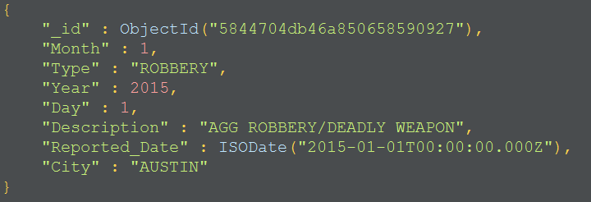
Combined to Make Final Data Set
Crime Master Data Set JSON Exert

Slide 15
Model – Setup of Poisson Regression
Crime Rate
Assumed to have Poisson distribution with mean z such that z is linear function of weather predictors
Weather Data
20 predictors + Constant term

Slide 16
Model – Why Poisson or Binomial Regression
Training
Crime count data per day,city from 2015-2016
Rate floored by 0 with high rate unlikely
We want to predict average crime rate
In-Sample Training-
Testing
Python statsmodels API to train GLM Poisson regression training on 2/3rd of data ( Jan – August )
Out of Sample Testing
Test predicted poisson mean against observed crime counts ( Sep-Dec ) with plots

Slide 17
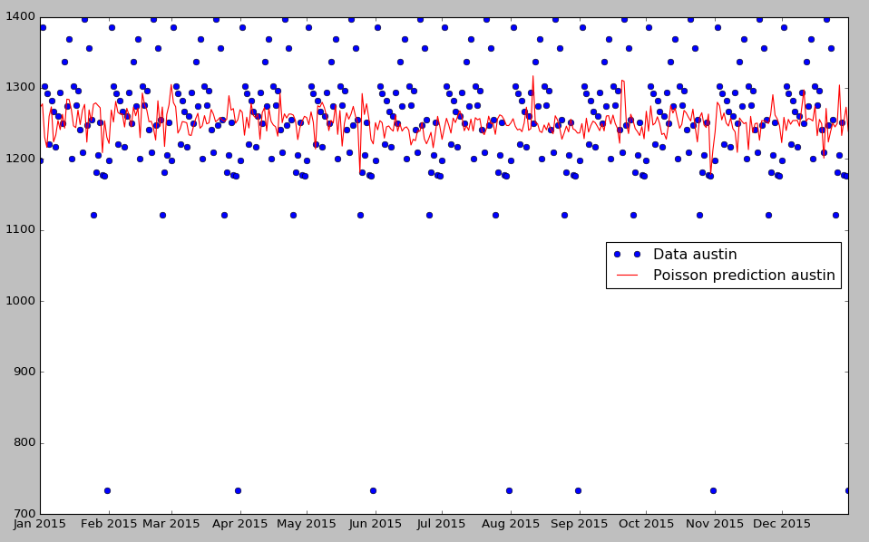
Result Analysis – Full sample Austin
Full sample

Slide 18
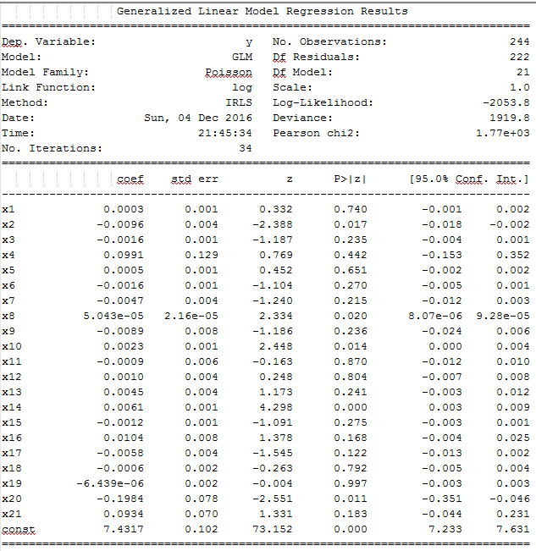
Result Analysis: Austin
Deviance 1919
Pearson Goodness fit test
p-value :
p(chisq(222) > 1770) = 0
Hence, highly significant result to ascertain model is a good fit
Full sample

Slide 19
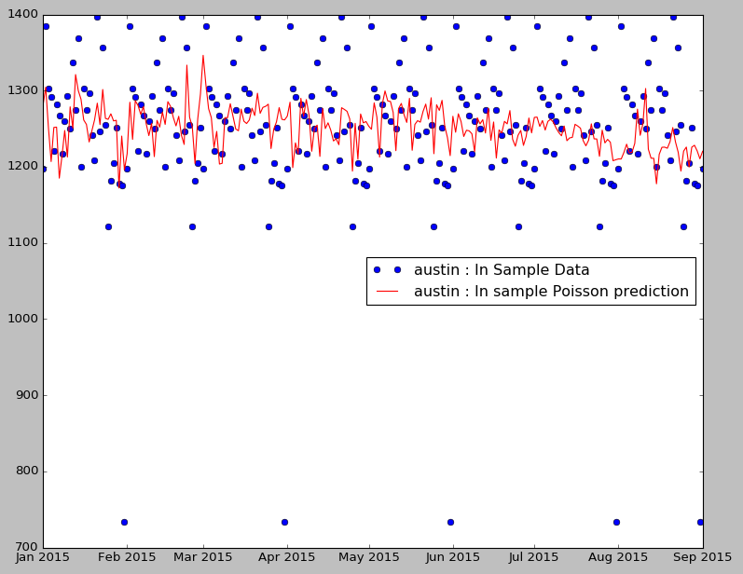
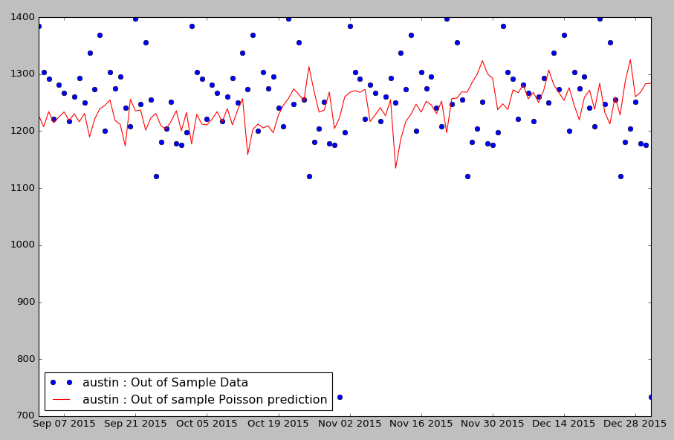
Result Analysis: In Sample vs Out of Sample Austin
In Sample
Out of Sample

Slide 20
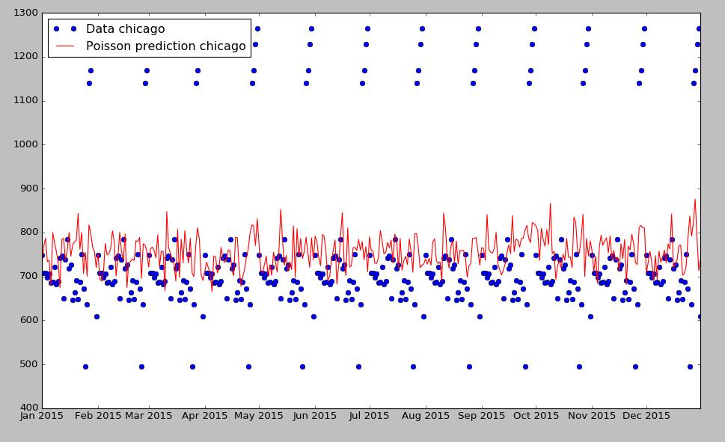
Result Analysis: Full sample Chicago

Slide 21
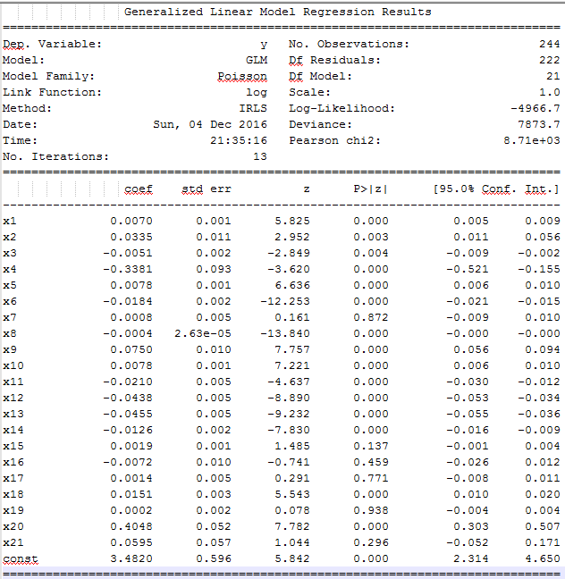
Result Analysis – Chicago
Deviance 7873
Pearson Goodness fit test
p-value :
p(chisq(222) > 8710 ) = 0
Hence, highly significant result to ascertain model is a good fit
Full sample

Slide 22
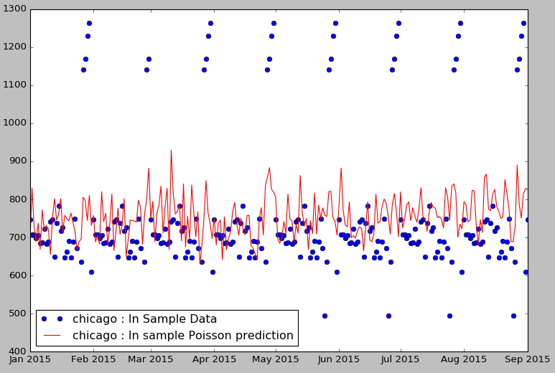
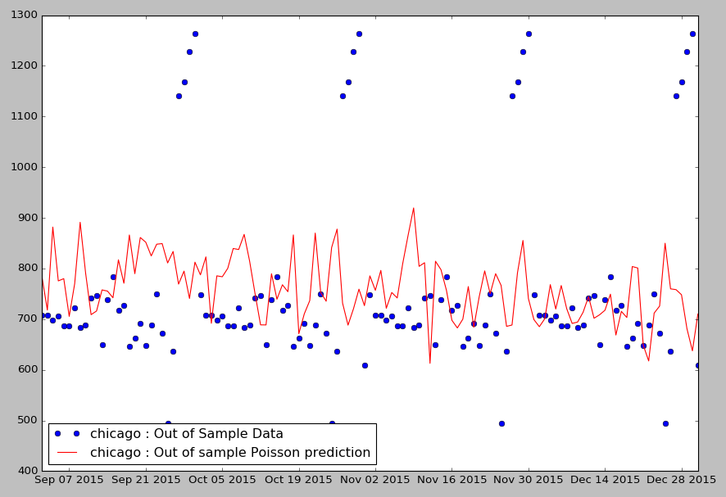
Result Analysis – In Sample vs Out of Sample Chicago
In Sample
Out of Sample

Slide 23
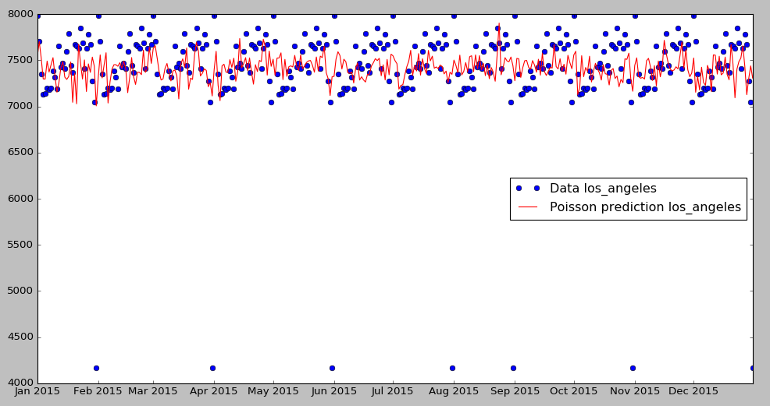
Result Analysis – Full sample Los Angeles

Slide 24
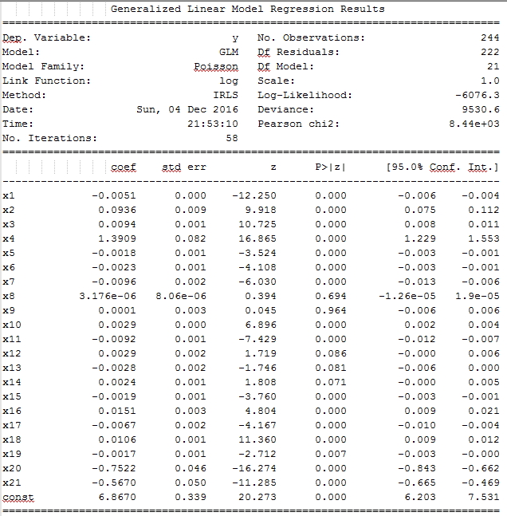
Result Analysis – Los Angeles
Deviance 9530
Pearson Goodness fit test
p-value :
p(chisq(222) > 8440 ) = 0
Hence, highly significant result to ascertain model is a good fit
Full sample

Slide 25
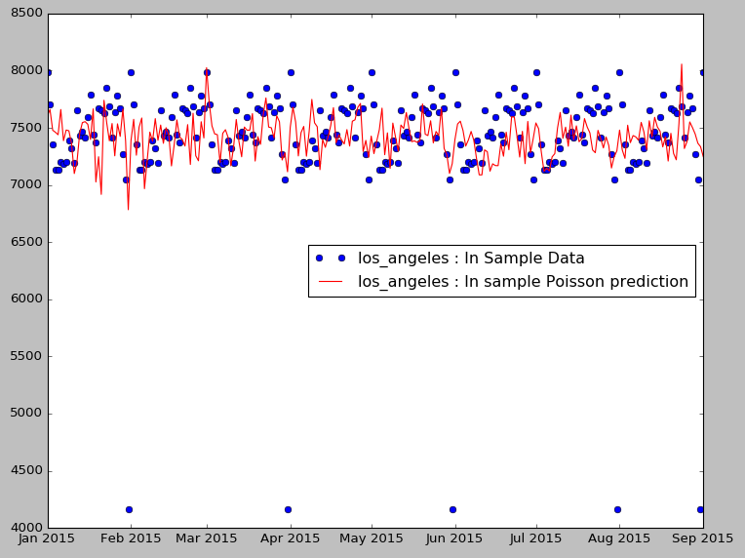
Result Analysis – In Sample vs Out of Sample Los Angeles
In Sample
Out of Sample

Slide 26
Conclusions
Pearson Goodness of Fit test indicates our model is a good Poisson fit in all 3 cities
We had fairly granular data but we performed analysis on crime rates per day vs weather
Plots indicate good performance of model while testing it out of sample

Slide 27
Future Work
Implement Binomial model to classify crime rates as average, high and low
Fit the model with richer data-set like Age, salary, Education per city
Determine which parameters are important ( reduce dimensionality of weather parameters by PCA )
Perform more granular analysis by crime type or location within city

Slide 28
Thank You

