Slide 1
AI-AgroBot: Universal AI-based Agricultural Assistant
Presented By:
Ansee Geo K

Slide 2
Project Statement
Farmers face major challenges such as lack of proper information about fertilizers, crops, and pest control, limited access to agricultural experts in rural areas, and delays in decision-making which can reduce productivity and cause financial loss.
To overcome these issues, we developed AI-AgroBot, an intelligent chatbot system that allows farmers to ask questions easily and receive instant, accurate answers anytime.
This helps farmers make better decisions and improves overall agricultural productivity.

Slide 3
Outcomes
• Accessible advice in multiple languages
• Accurate responses on crops, pests, fertilizers
• Improved productivity
• Scalable system
• Secure user interaction
• Reduce financial losses in farming
•Enable easy access in anywhere,anytime

Slide 4
Technologies Used
Frontend: HTML, CSS, JS / Streamlit
Backend: Python
AI: NLP
Database: MySQL
Weather API

Slide 5
Modules: Authentication
User Registration & Login: This feature allows users to create an account and securely log in to the system using their credentials.
Role-Based Access: The system provides different access levels based on user roles, such as admin or normal user.
User Profile: Each user has a personal profile where their basic information and activity details are stored..

Slide 6
Modules: AI Core
NLU (Natural Language Understanding): This component helps the system understand the user’s question.
Dialogue Management: This manages the flow of conversation between the user and the chatbot.
NLG (Natural Language Generation): After processing the query, this component generates a clear and human-like response that is easy for the user to understand.
Multi-Language Support: The system supports multiple languages, allowing farmers to interact in their preferred language, making it more accessible and user-friendly.

Slide 7
Modules: Knowledge Base
Crop Information: The system stores detailed information about different crops, including suitable seasons, and growing conditions.
Pest Details: It contains information about common pests that affect crops, along with their symptoms and control methods.
Fertilizers: The system provides guidance on the correct type and quantity of fertilizers required for different crops, helping improve soil health and crop yield.
Weather & Market Integration: The system is connected with weather and market data sources.

Slide 8
Modules: Admin Dashboard
Manage Data: The admin can add, update, or delete agricultural information such as crops, fertilizers, pest details, and other data.
.
Monitor Users: The system allows the admin to track user activities, such as queries asked and system usage.
Improve Chatbot: Based on user interactions and feedback, the admin can enhance the chatbot by updating responses, improving accuracy, and fixing errors to provide better results

Slide 9
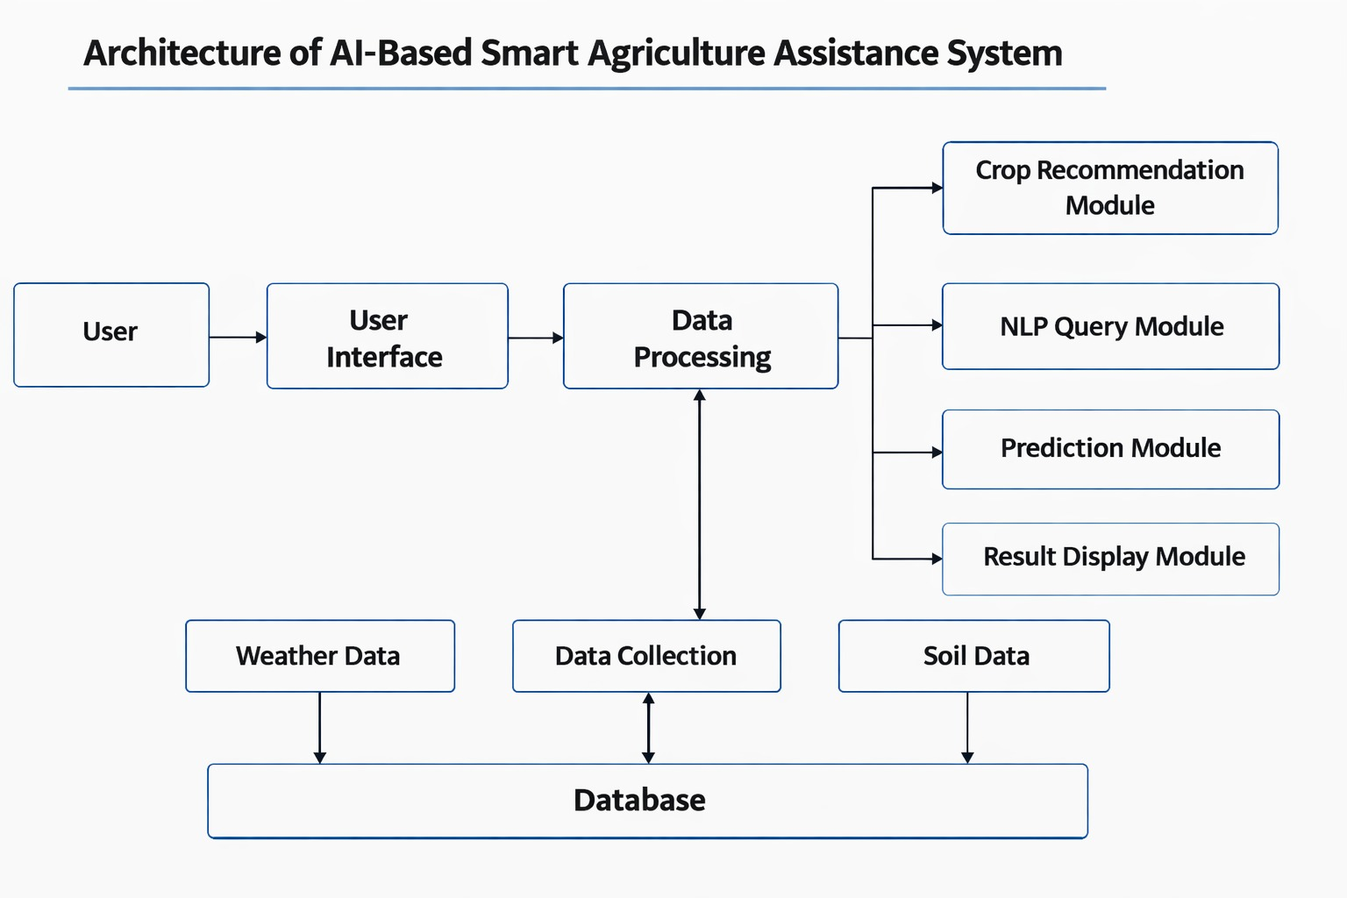

Slide 10
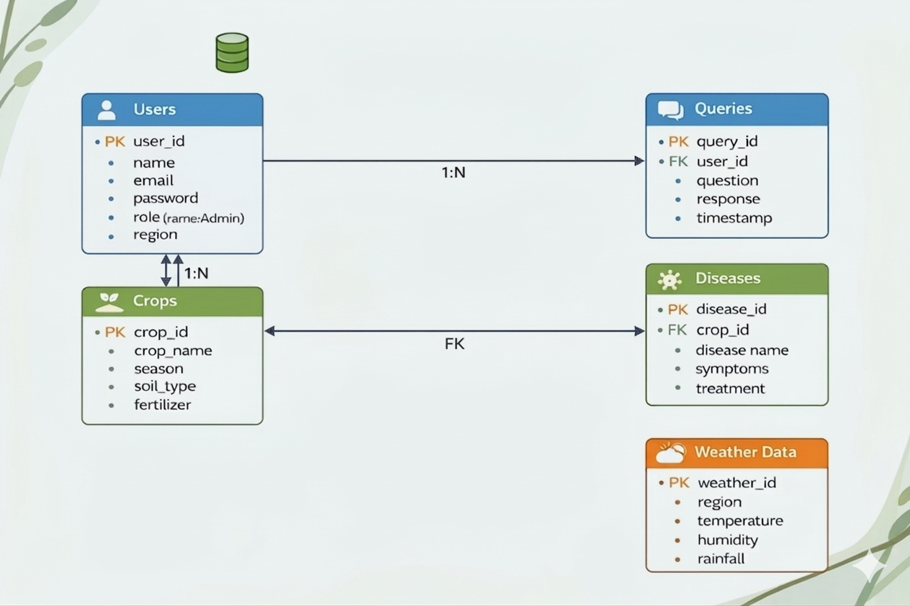
Database Schema

Slide 11
Feature Enhancements
Mobile Application: Developing a mobile app will make the system easily available on smartphones.
.
Enable Offline Mode: This feature allows the system to work even in areas with poor or no internet.

Slide 12
Conclusion
AI-AgroBot provides quick and reliable agricultural guidance to farmers.
It improves decision-making and crop productivity.
Supports multi-language interaction for better accessibility.
Enables future growth with advanced AI features and scalability.
and productivity.

Slide 13
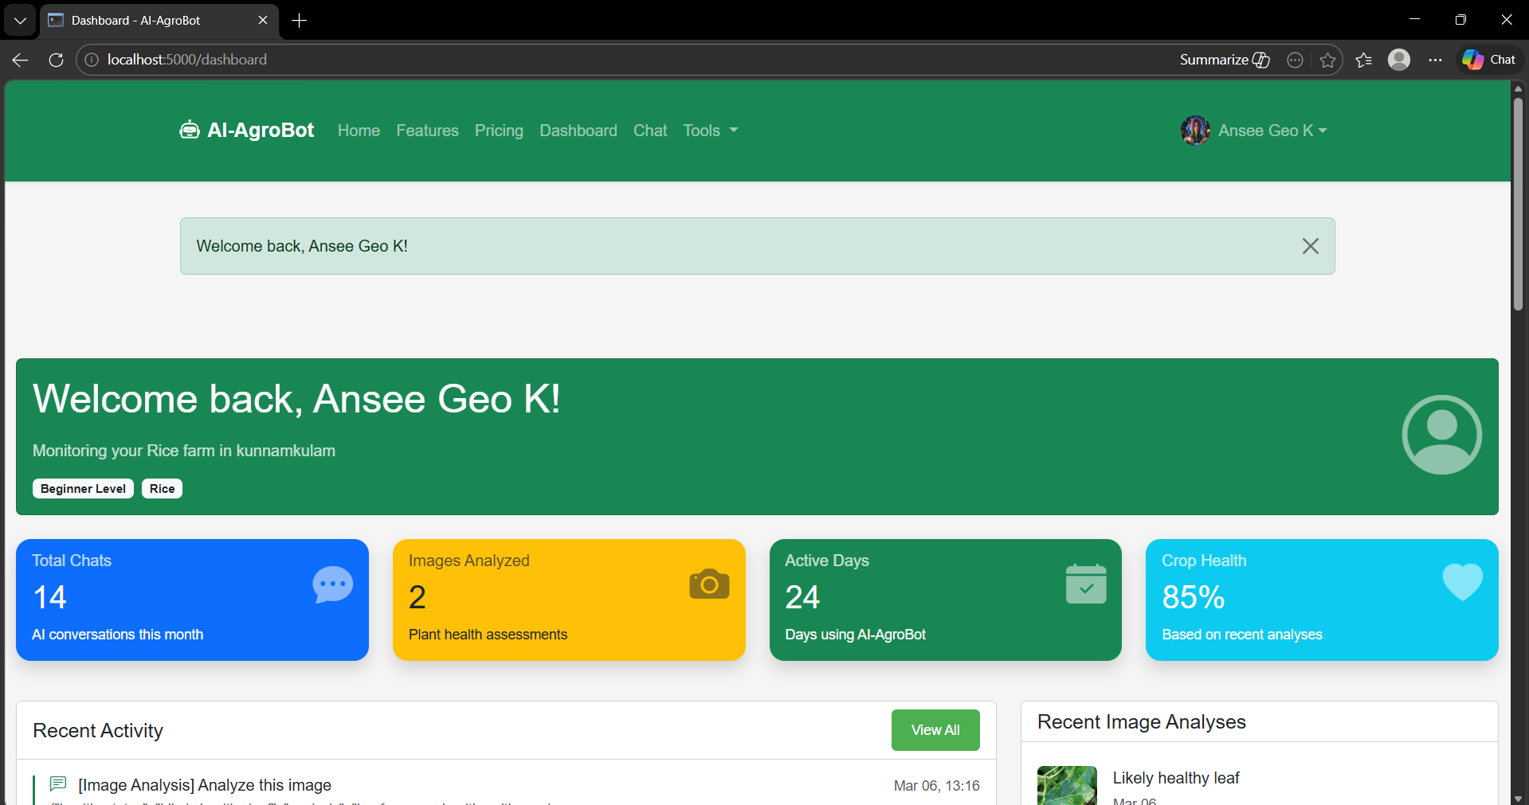
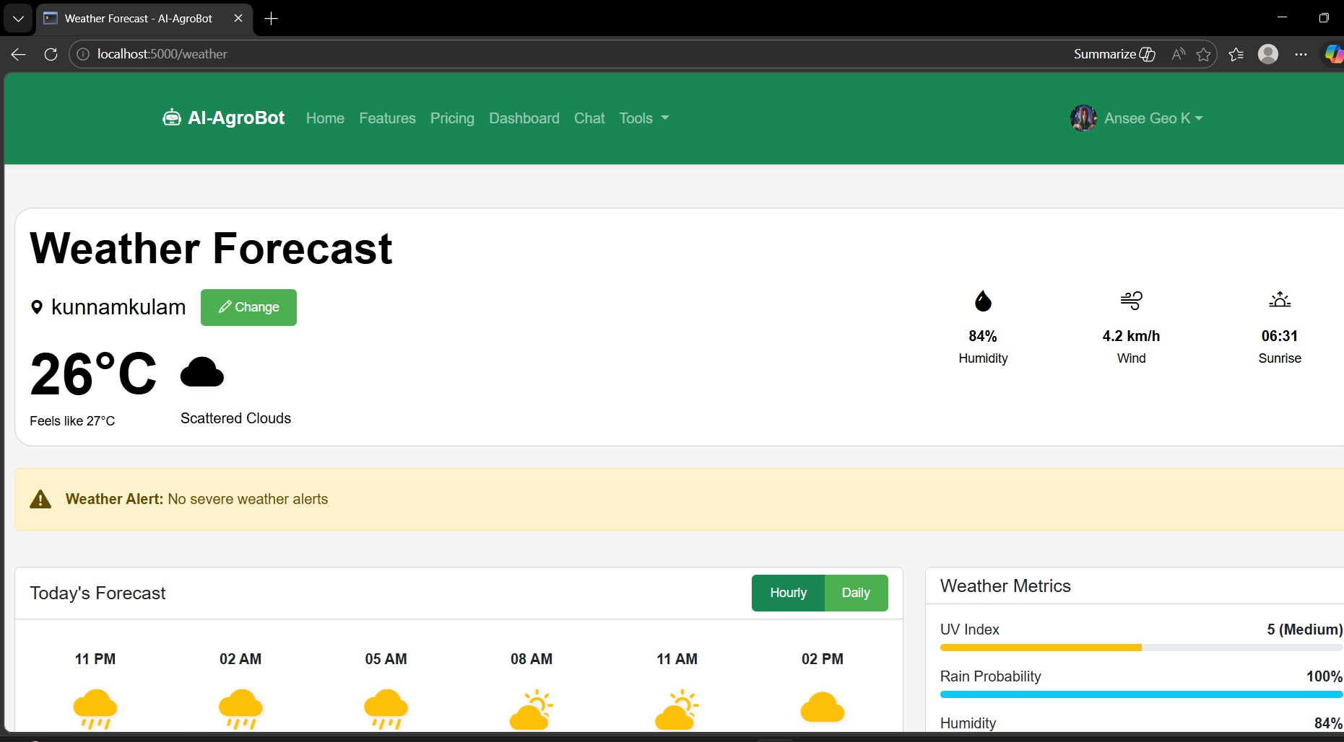
Sample Outputs
User page
Weather forecast page

Slide 14
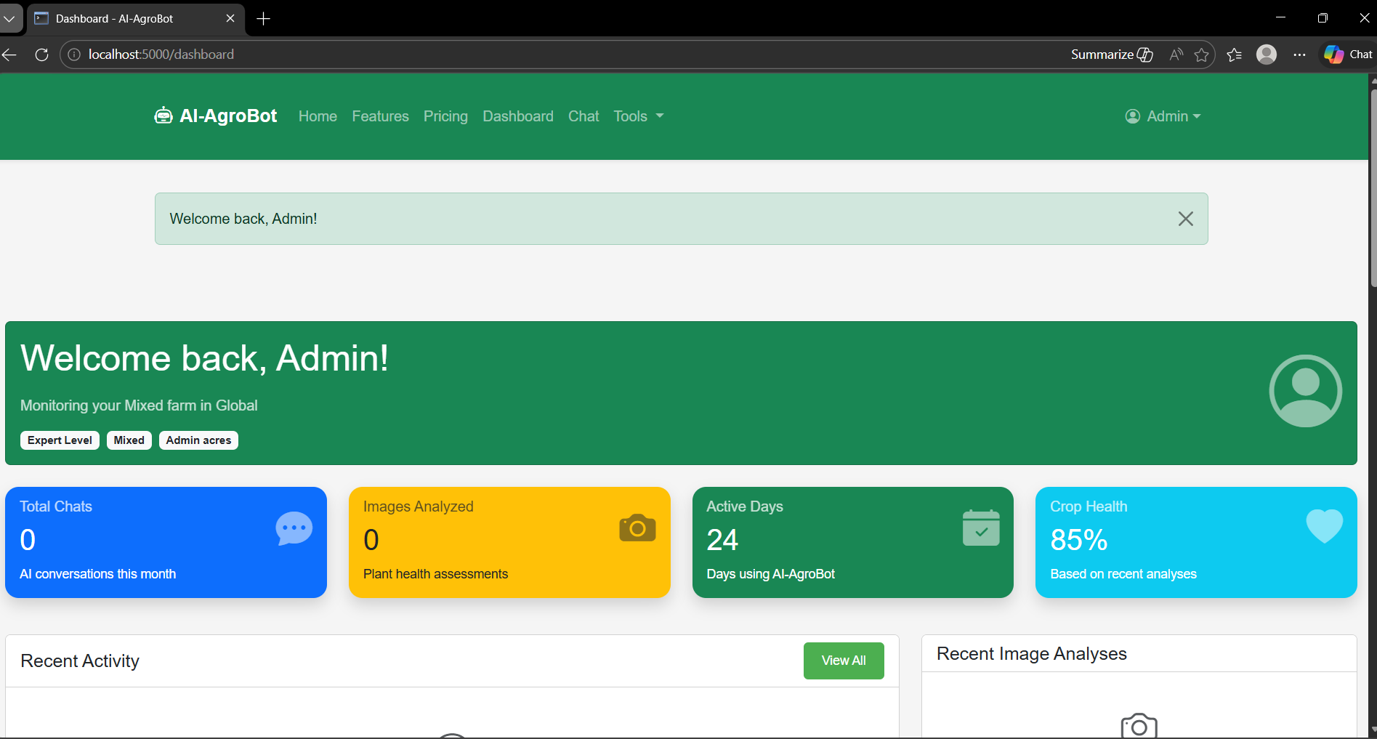
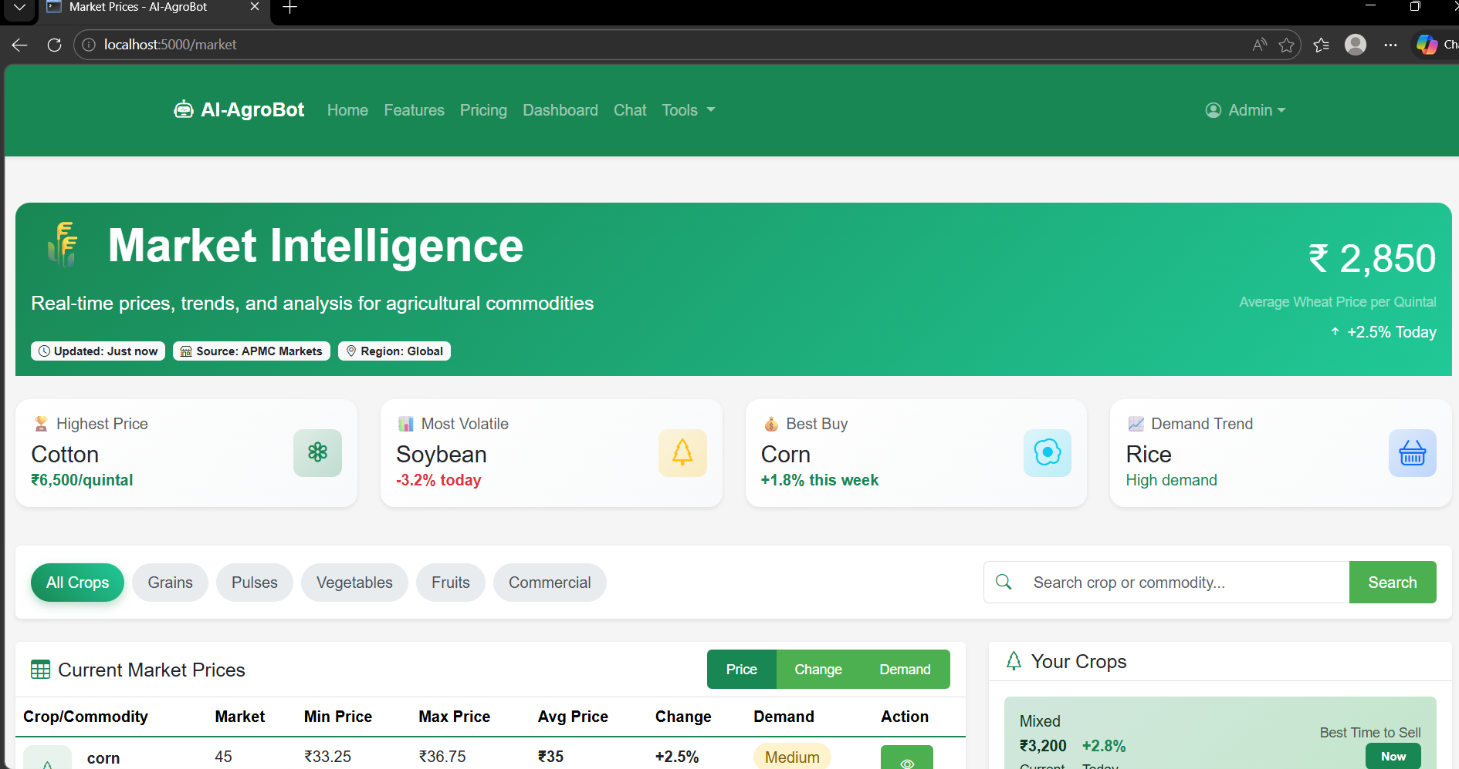
Sample Outputs
Admin Page
Market Inteligence page

