Slide 1
USB
ISOLATED
Red blocks are not included on PSoC 5LP Prototyping Kit
POWER
LDO
LDO
5V
5V
5V
Vcnt
1kΩ
VDDD
VDDIO
VDDA
P0[1]
OUTPUT
PSoC 5LP
HV
P3[4]
P3[5]
MONITOR
ISOLATED
D+
D-
1μF
P0[5]
INPUT
1kΩ

Slide 2
1μF
PGA
ADC
INPUT
DSP
P0[5]
1kΩ
BLR

Slide 3
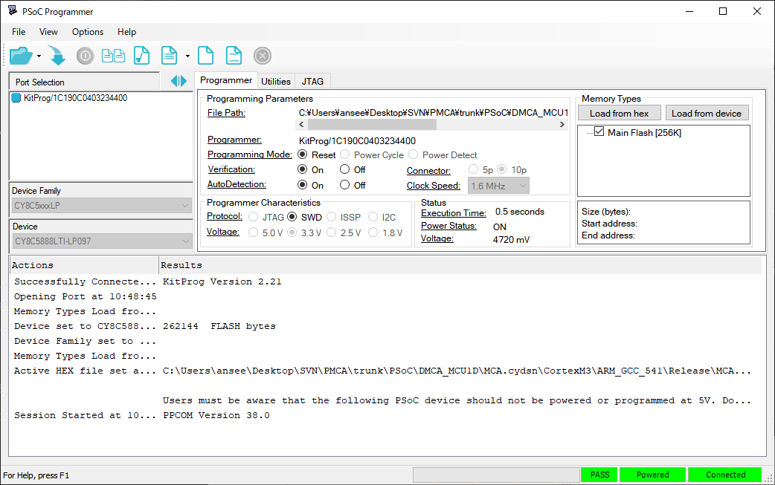
②
③
①

Slide 4
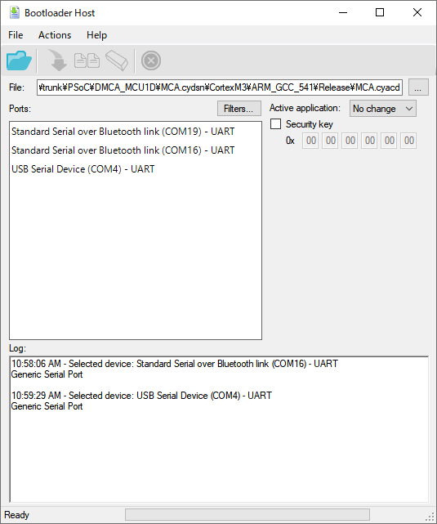
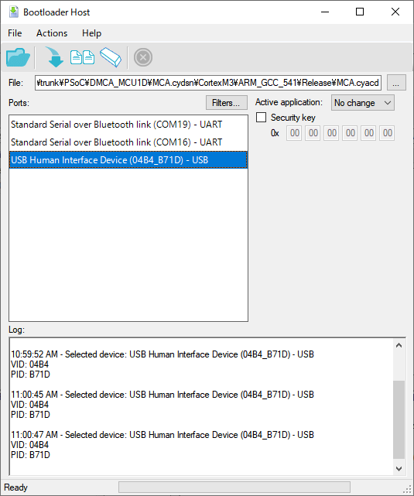
④
③
①
②

