Slide 1
Coding Concepts 101
2021 Fall Session

Slide 2
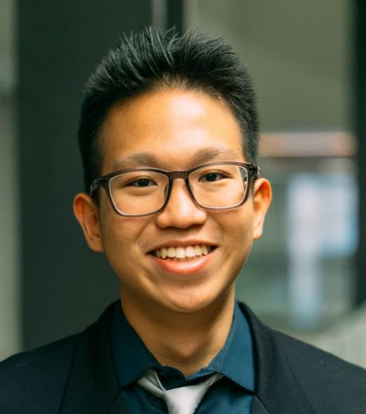
A bit about myself: Ansel
5th year graduating student from UBC, Business and Computer Science
David Lloyd George Elementary Graduate of 2011
Churchill Ideal Mini School Graduate of 2016
Lived in Marpole for most of my life
3rd time running Coding Concepts 101, low-cost programming and coding sessions

Slide 3

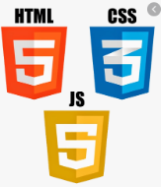
Coding Concepts 101: What we are doing
Week1: Intro, Expectations, Tools and Software, Data Types, Start Website Building
Week2: Data Types Pt.2, Booleans and Conditionals, IF statements, Github,
Week3: Images and CSS, Arrays, HTML Buttons and Forms, Hyperlinks
Week4: Arrays, For Loops , While Loops, Objects
Week5: Binary, Video/GIF embedding, Website Clock
Week6: Multi-page Navigation, Loops pt2
Week7: Project Time with Q&A;
Week8: Presentation & Showcase

Slide 4

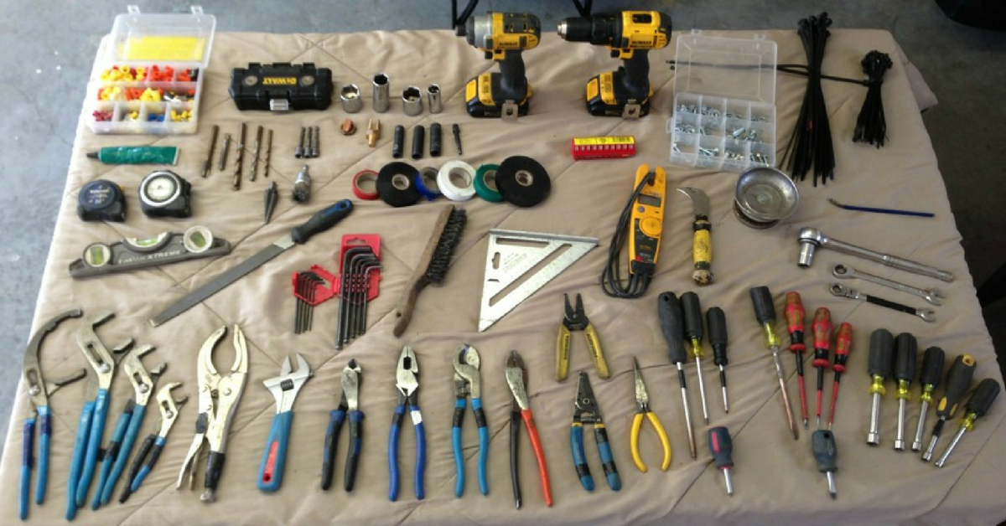






Slide 5
Course Expectations
No assigned homework and tests/grades*
Will send summary of class each week before and after class and recommended activities/readings
Expectation to work on website (~1-3 hours off-class work per week), responsibility is on you to keep pace or not to make the most of your time
Attendance is strongly encouraged, only 8 sessions
Classes will not be recorded due to privacy reasons
Cameras for lag please stay off, use #help on Discord for any questions

Slide 6
How to get help
#ask-for-help channel on Discord for all questions please
Google and StackOverflow is your best friend
Email me (anselhartanto@gmail.com)

Slide 7
Tools and Software We Use
Github – code management tool
Visual Studio Code – copy code at end of class to local computer to “save” it

Slide 8
Example of Finished Website
Andy (Grade 7): https://andyhu0929.github.io/index.html
This is just an example, yours can be more complex and different than this.
There is no “correct” way to design your own website
Everyone will go on different pace and levels

Slide 9
Takeaways From the Coding Concepts 101
Complete personal website that can be improved further
Programming fundamentals with HTML/CSS and JS
Inspire to take high school courses such as Programming 8/9/10 and Computer Science/Programming 11/12
Think about how coding is everywhere in our lives

Slide 10
Make Github Accounts (optional)
Download VS Code

