Slide 1
Ansel Hartanto anselhartanto@gmail.com
5th year UBC Business and Computer Science Student

Slide 2
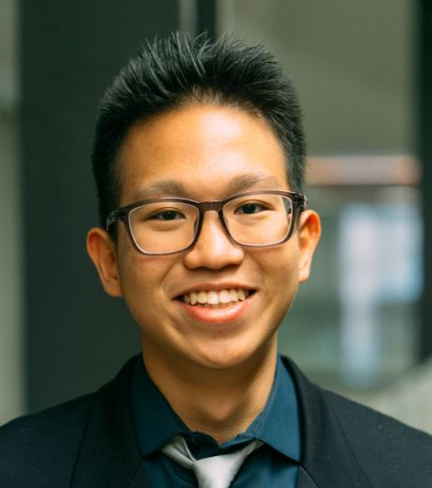
A bit about myself
Immigrated to Canada in 2007
Sir Winston Churchill Secondary 2011-2016
UBC Business and Computer Science 2016-2021
Aspiring entrepreneur and software engineer

Slide 3
Why Code?

Slide 4
HTML Editing Demo

Slide 5



Coding languages
Javascript
Scratch
Java
C++
Python

Slide 6





Universities

Slide 7
UBC Computer Science
Bachelor’s of Science
CPSC 210, Java, software engineering
Bachelor’s in Computer Science
CPSC 121, logic gates, computational proofs, basic algorithms
CPSC 213, Computer Systems (C, Java)
CPSC 110, intro software engineering, DrRacket
CPSC 221, algorithm and data structure (C++)

Slide 8
What can you do now
Programming Classes
Outside workshops and classes
Workshop I run! Coding Concepts 101(Over right now, tutoring only) (https://ca.apm.activecommunities.com/vancouver/Activity_Search/coding-101-website-building-and-theory-virtual/313675)
Private tutoring (send me an email if you are interested)
Coding competitions (or hackathons)
Be good at math!

Slide 9
Tips On Getting into UBC
90+ average
Volunteer, volunteer, volunteer!
Join competitions available to high school students
Mental health, take care of yourself
Apply to many other universities
Consider your financial situation

Slide 10
Thank you for listening!
FAQ Questions
anselhartanto@gmail.com

