Slide 1
Twitter News Sentiment Analysis For Stock Index Price Prediction
Project Contributors (TEAM SOAKK): Anselmo Garza, Solomon Miller, Kathleen Loretto, Kenneth Bledsoe, Oscar Vasquez

Slide 2
Intro
Stock market plays a role in all our lives
Retirement accounts
Daily spending actions
We are constantly trying to understand price movements with different tools
Technical analysis
High frequency trading
News drives price movement more than ever

Slide 3
OVERVIEW
Background
Objectives
Methods
Visualization
Conclusions

Slide 4
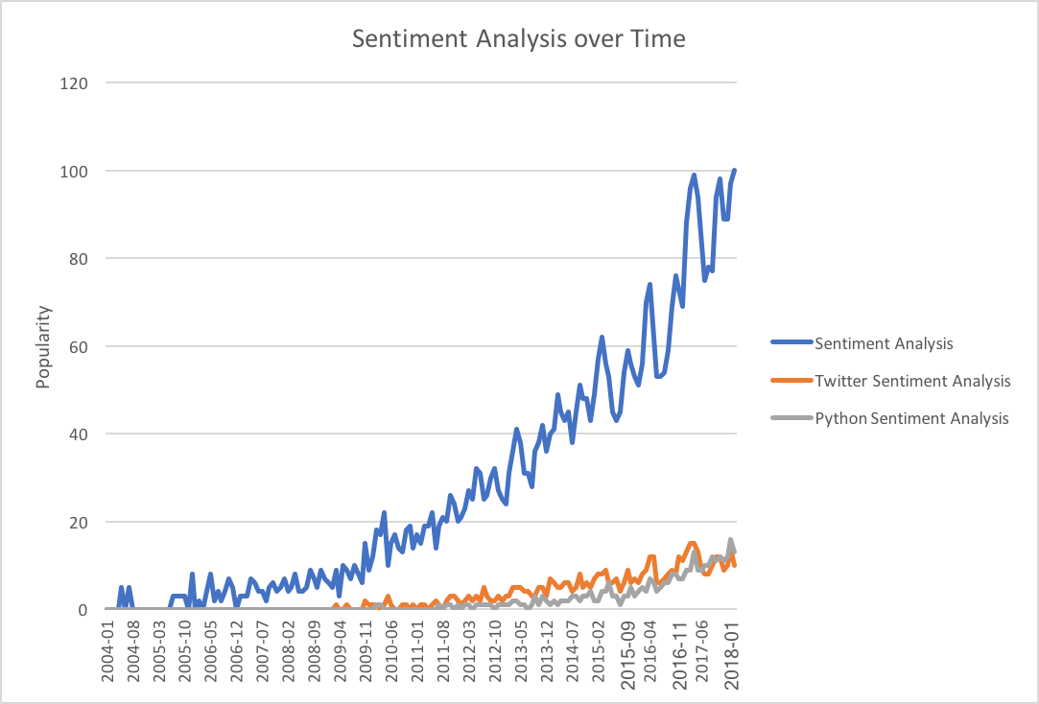
BACKGROUND
Sentiment analysis is a growing science!
99% of research papers regarding sentiment analysis have been published after 2004
Recent research has focused on using sentiment analysis for stock market predictions
Notes:
The use of twitter as a sentiment analysis tool hit a spike in 2016, but it’s been of interest since ~2004 as part of behavioral finance studies.
Public opinion has had an influence on stocks (BP disaster, IBM security flaws, Wells Fargo troubles, etc)

Slide 5
OBJECTIVES
Will analyzing 30 days of Twitter sentiments provide insight into stock market index performance?
Which stock index appears to be the most influenced by sentiments?
Which news source provides the most accurate sentiment per index?
Does Vader or TextBlob provide a better stock prediction when related to Twitter sentiment?

Slide 6
METHODS STOCK MARKET DATA
API – Alpha Vantage (www.alphavantage.com)
Indices
S&P 500 Index (SPX)
Based on market capitalizations of 500 large companies
Dow Jones Industrial Average (DJI)
Shows how 30 companies have traded during a standard stock market session
NASDAQ-100 (NDX)
Made of 104 equity securities issued by 100 of non-financial companies listed on the NASDAQ
Properties
Price
Volume
Notes:
Market capitalizations: value of a company that is traded on the stock market, calculated by multiplying the total number of shares by the present share price
Equity securities = stock shares(?). NASDAQ is a stock exchange
These stocks were chosen because…
Price is the cost of a share and volume is the amount of shares traded in a given time
Volume gives the amount of buying and sellers where price can give you the direction of the stock

Slide 7



METHODS TWITTER NEWS SENTIMENT
Tweepy API
Sentiment Analysis: Vader & TextBlob
Twitter News Sources
Barron’s(@barronsonline)
New York Times (@nyTimes)
Financial Times (@FT)
Investor’s Business Daily(@IBDinvestors)
USA Today (@USAToday)
And more! (@More)

Slide 8
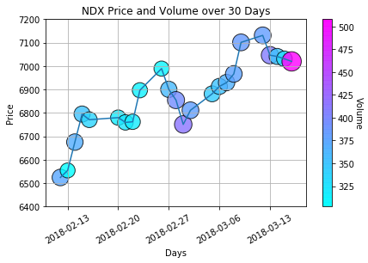
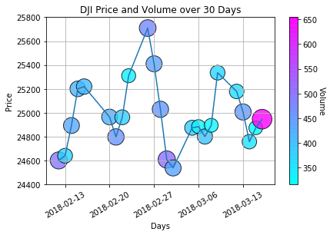
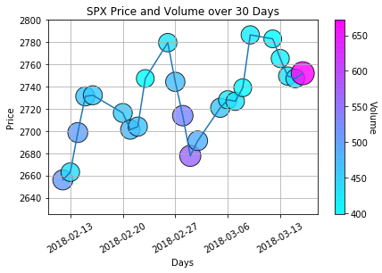
VISUALIZATION Price and Volume

Slide 9
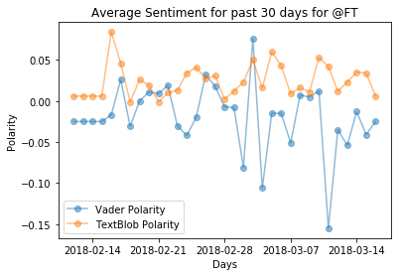
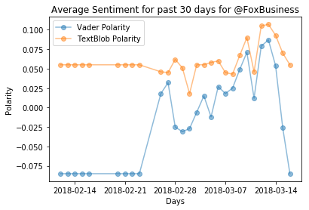
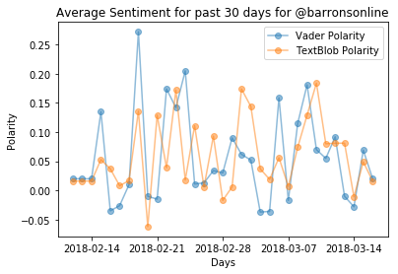
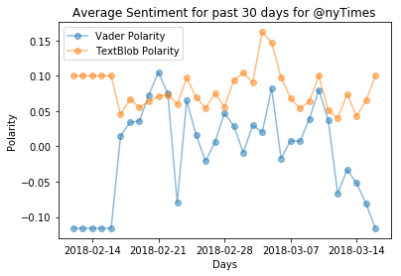
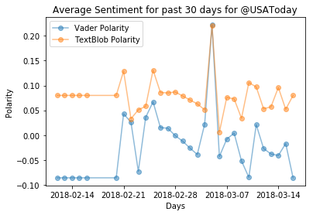
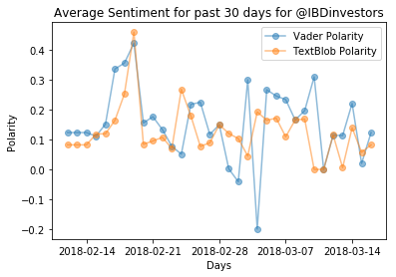
VISUALIZATION Sentiment Analysis

Slide 10
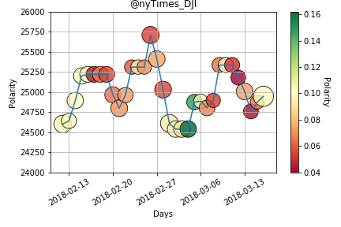
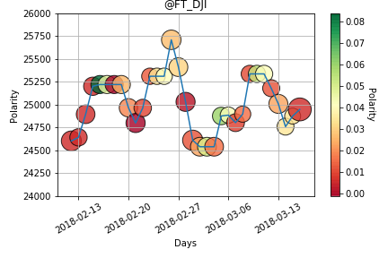
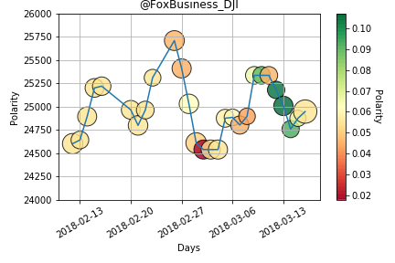
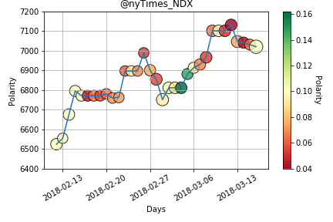
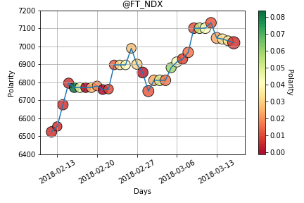
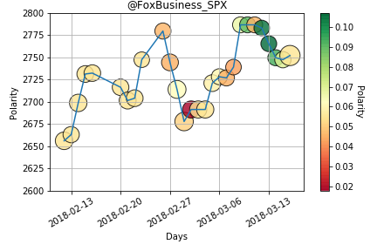
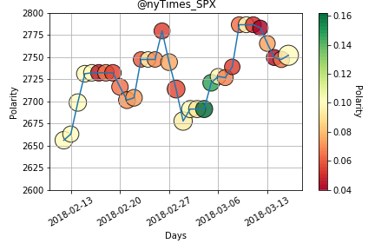
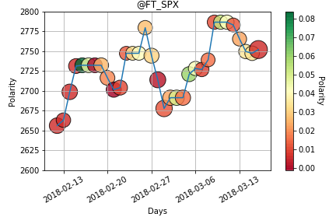
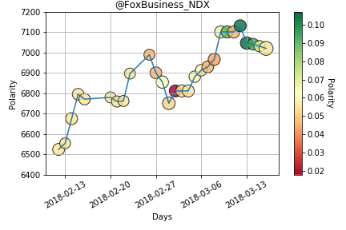
VISUALIZATION Price and Volume with Sentiments (TextBlob)
Price
Price
Price
Price
Price
Price
Price
Price
Price
Notes:
February 26 – stock correction leading to fall
March 5 – negative sentiments begin, may be caused by tariff announcements. Significant drop on opening after weekend

Slide 11
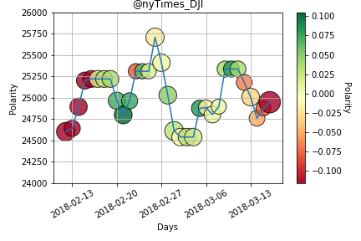
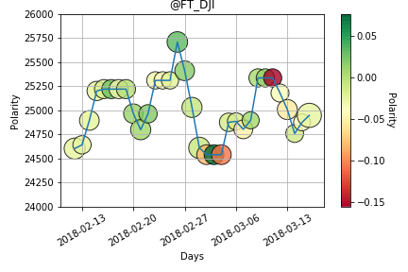
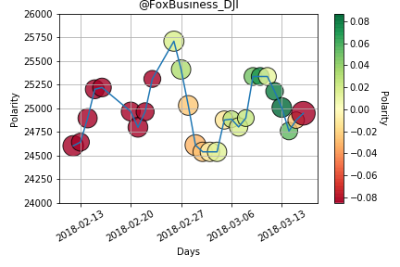
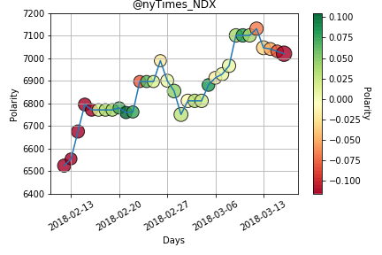
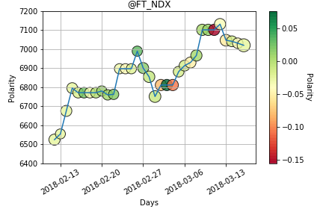
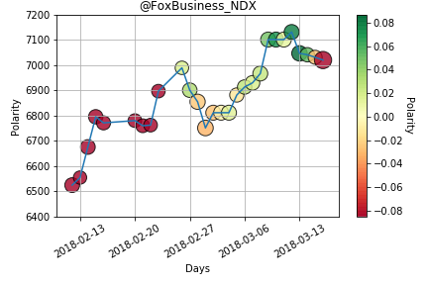
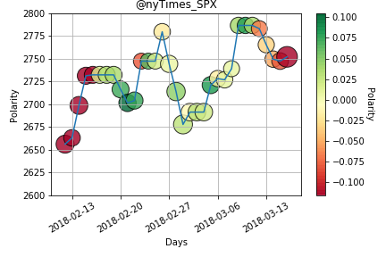
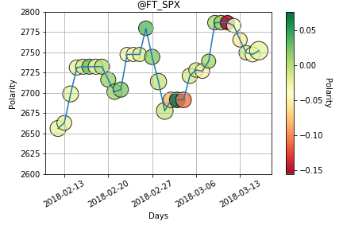
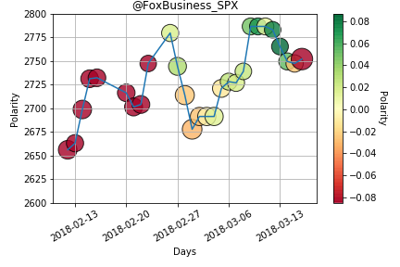
VISUALIZATION Price and Volume with Sentiments (Vader)
Price
Price
Price
Price
Price
Price
Price
Price
Price

Slide 12
CONCLUSIONS/ OBSERVATIONS
Fox Business had opposite sentiments to market trends (Market Manipulation)
The Dow Jones (index most affected by price) had significant drops (and rises) with corresponding sentiments (except for Fox Business)
Sentiments observed over the weekend provide a good indicator on how the index will open
Financial focused sources provide biased insights than general news sources
Different algorithm/ weights make VADER and TextBlob difficult to compare, but TextBlob seems to give more accurate analysis

Slide 13
Further Work
Back testing with Premium Twitter API (Data Archived since beginning)
Extend analysis to other social media platforms such as Facebook
Add an “Influencer” score to each observation
Visualize over different markets, individual stocks, sectors
Analyze sentiments over hashtags and individual people (ie. Trump)
Add interactivity to each scatter point to display actual tweets for the day

Slide 14
REFERENCES
Bhandari, N. (2018). Stock Market Trend Prediction Using Sentiment Analysis. Earlham College Senior Project, 1-7
Hutto, C., & Gilbert, E. (2014). VADER: A Parsimonious Rule-based Model for Sentiment Analysis of Social Media Text. Association for the Advancement of Artificial Intelligence, 1-10. https://github.com/cjhutto/vaderSentiment.
Loria, S. et al. TextBlob Documentation. Retrieved March 1, 2018, from http://textblob.readthedocs.io/en/dev/index.html# Release 0.15.1
Mantyla, M.V. et al (2018). The evolution of sentiment analysis-A review of research topics, venues, and top cited papers. Computer Science Review, Volume 27, 16-32.
Nofsinger, J.R. (2003). Social Mood and Financial Economics. Journal of Behavioral Finance, 1-46.

