Slide 1
SPEED
SFC Placement in Edge-Cloud Environments:
a Distributed Approach
Estudante:
Anselmo Luiz Éden Battisti
Orientadoras:
Flávia Coimbra Delicato
Débora Christina Muchaluat Saade
PhD Qualifying Exam
Date:
April 12th 2023
Notes:
Minhas orientadoras são a professora Débora e professora Flávia

Slide 2
Agenda
Introduction
Our Goals
Proposed Solution - SPEED
Evaluation
Conclusion

Slide 3
Introduction
NFV Paradigm & NFV Platform
Service Function Chain
VNF & SFC Placement Problem
Distributed Environment

Slide 4
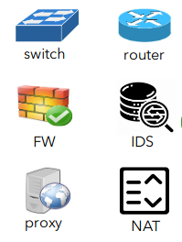
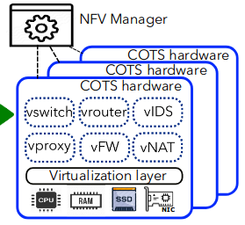
NFV Paradigm
Is the virtualization of the core network function as VNFs.
High-level functions
Video encoders
Text to speech
VNF Platforms
Management
Orchestration
T. Zhang, H. Qiu, L. Linguaglossa, W. Cerroni and P. Giaccone, "NFV Platforms: Taxonomy, Design Choices and Future Challenges," in IEEE Transactions on Network and Service Management, vol. 18, no. 1, pp. 30-48, March 2021, doi: 10.1109/TNSM.2020.3045381.

Slide 5
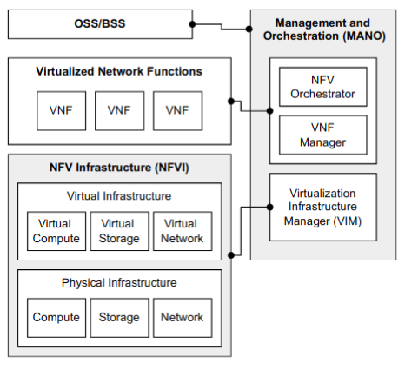


NFV Platform
To execute a VNF, an NVF Platform is required.
The VIM provides interfaces that enable the NFV Orchestrator and VNF Manager to execute VNFs in the NFVI.

Slide 6
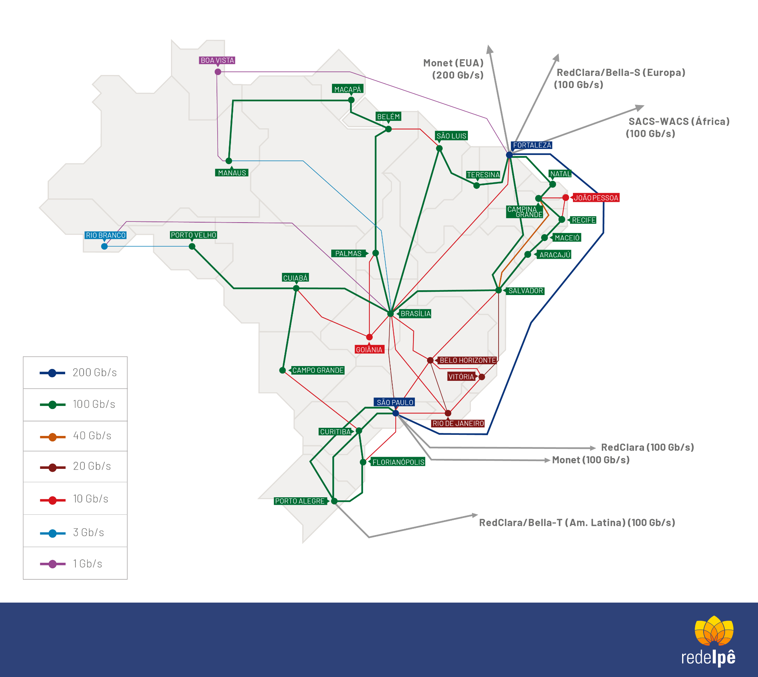
VNF Placement Problem
NFV paradigm, the VNF Placement Problem arise.
Decides which computational node will be used to execute the VNF.
This problem is NP-Hard => requiring good heuristics.

Slide 7
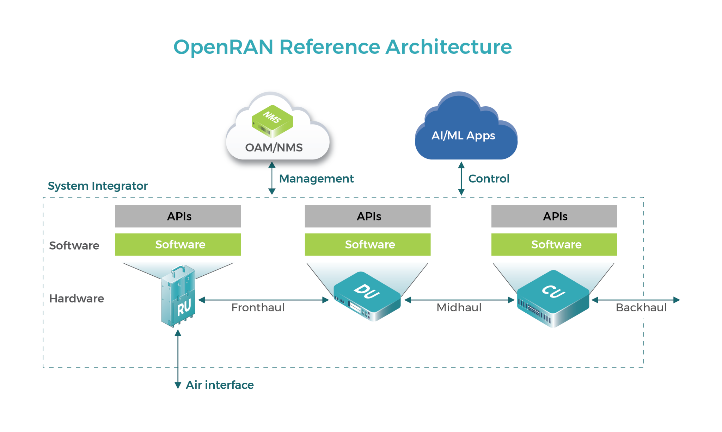
SFC Definition
Virtualizing VNFs individually is insufficient in some scenarios thus the SFC concept was created.
The SFC is a chain of VNFs associated an SLA.

Slide 8
SFC Placement Problem
Now the SFC Placement Problem has emerged.
New challenges must be addressed
Where to execute each VNF of the requested SFC
The networking connectivity creation to enable the flow across all the VNFs.
Solved using multiple technologies
Integer Linear Programming
Tabu search
Game Theory

Slide 9
SFC Use Case Example

Slide 10
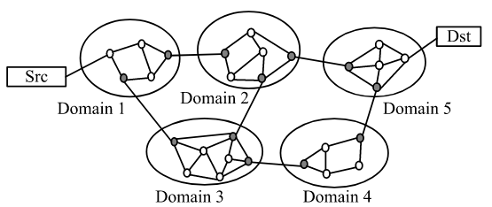
Distributed Environment
Edge-Cloud paradigm enable
Coordination between multiple domains
Potentially managed by different service providers.
G. Sun, Y. Li, D. Liao and V. Chang, "Service Function Chain Orchestration Across Multiple Domains: A Full Mesh Aggregation Approach," in IEEE Transactions on Network and Service Management, vol. 15, no. 3, pp. 1175-1191, Sept. 2018, doi: 10.1109/TNSM.2018.2861717.

Slide 11
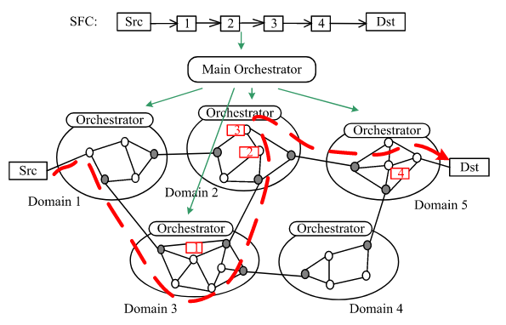
Distributed Environment
Centralized placement is unsuitable, given the huge number of nodes.
Distributed mechanism should be created to allocate the SFC without full knowledge of the infrastructure.

Slide 12
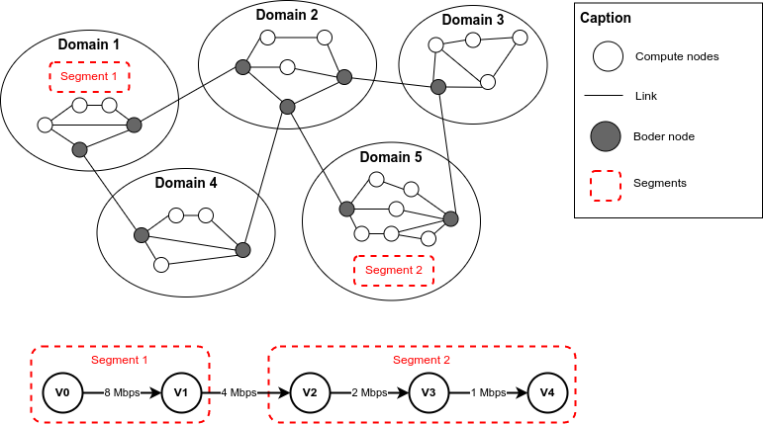
Distributed SFC Placement Problem
Distributed SFC Placement composed of two phases:
Segmentation: the SFC are divided into segments,
Resource Selection: each segment is delivered to a domain.

Slide 13
Open Problems
Even in distributed environment, the placement plan is created by only one domain.
The segments are created only during the initialization of the placement.

Slide 14
Objectives
Goals
Research Questions

Slide 15
Goals
Create a new method to solve the SFC Placement Problem in a distributed fashion.
With segments being created
Recursively
Multiple times

Slide 16
Research Questions
This thesis is guided by the following research questions:
Q1: Is it possible to adopt a distributed SFC Placement mechanism, using a dynamic segmentation process to solve the SFCPP in a multi-domain environment?
Q2: Can the adoption of SPEED reduce the monetary allocation cost compared with a centralized approach?
Q3: Can the adoption of SPEED increase the rate of SFC placed successfully compared with a centralized approach?

Slide 17
Related Work
Study | Distributed Approach | Segmentation
Chen et al. | The allocation of each VNF segment in each domain is executed in parallel. | Static
Liu et al. | The auction consensus phase defines which segment will be executed in each domain. | Static
Gang et al. | The allocation of each sub-SFC in each domain is executed in parallel. | Static
Avasalcai et al. | Auction-based with a centralized orchestrator that defines the winner domain for each VNF in the SFC. | Static
Gao et al. | The allocation of each service in each satellite is executed in parallel. | No Segments

Slide 18
Proposed Solution - SPEED
SFC Placement in Edge-Cloud Environments: a Distributed Approach
Hierarchical Organization
Data Aggregation
Architectural Components
The SPEED Approach
Manager Zone Selection
Segmentation
Zone Selection as a Singleton Congestion Game

Slide 19
Proposed Solution
New approach SPEED - SPC Placement in Edge-Cloud environment a Distributed approach.
Solve the SFC Placement problem in a multi-domain environment in a distributed fashion.
Architectural components.
Mapping model between the Distributed SFC Placement Problem and the Game-Theory approach.
New data aggregation pattern over the network topology.

Slide 20
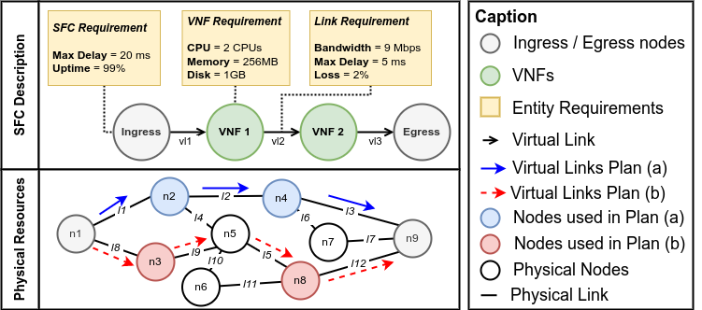
SFC Placement Problem

Slide 21
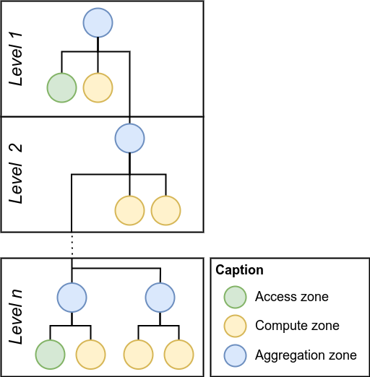
Hierarchical Organization
Access zones are elements that provide connectivity for the users.
Compute zones are the elements that provide computational resources.
Aggregation zones are abstracted elements that aggregated the data about the descending zones.

Slide 22
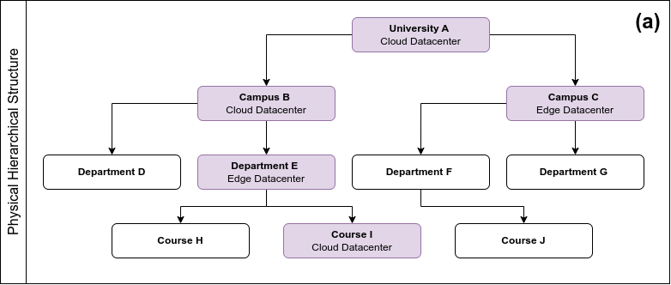
Hierarchical Organization

Slide 23
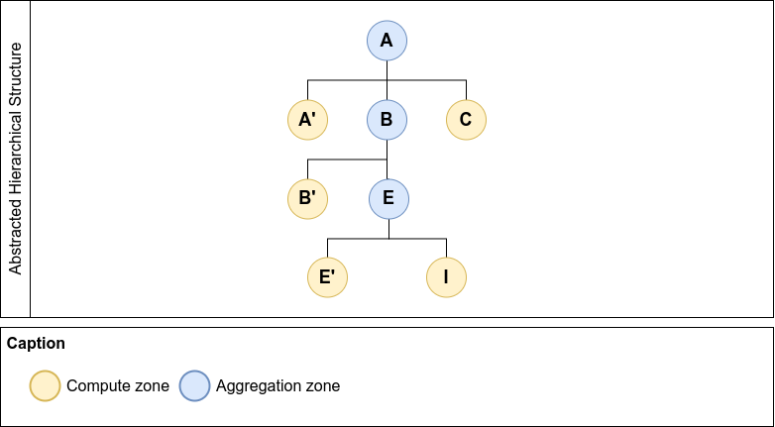
Hierarchical Organization

Slide 24
Data Aggregation
In our approach, the Aggregation zones process and store all the data sent by their underlying child zones.
Compute, Access and Aggregation zones send their internal data solely to the Aggregation zone of which they are part.
The Aggregated data flow from the bottom to the top-level Aggregation zones.
The top-level Aggregation zones have aggregated information about their own Compute zone and all the bottom-level Aggregation zones.

Slide 25
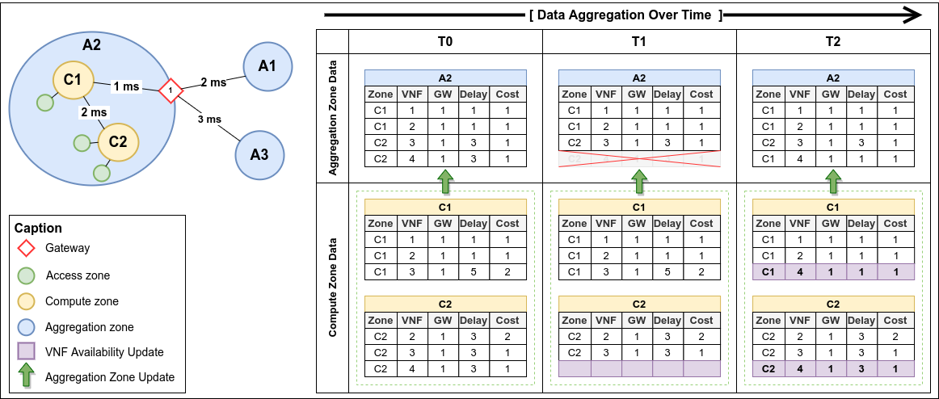
Data Aggregation Example

Slide 26
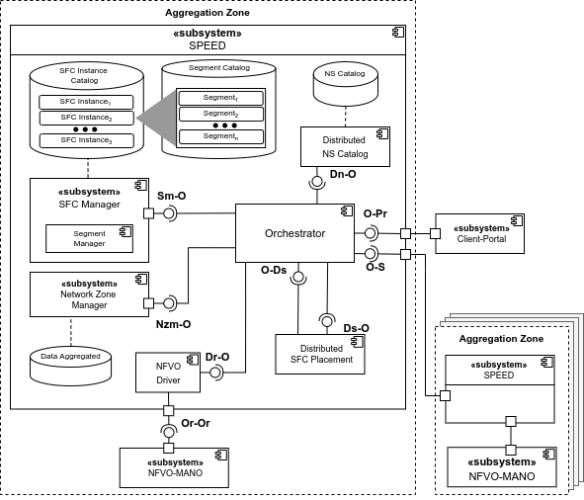
Architectural Components
Integrated NFV Platform
Aggregation zone has SPEED components.
Each SFC is manage by one SPEED component.
The segments can be manage by a different zones.

Slide 27
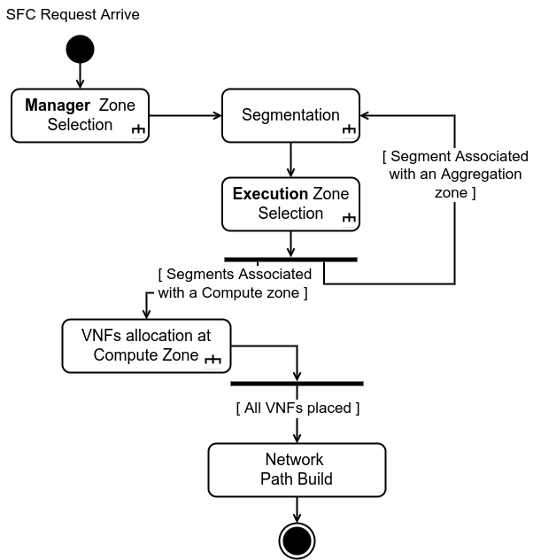
The SPEED Approach

Slide 28
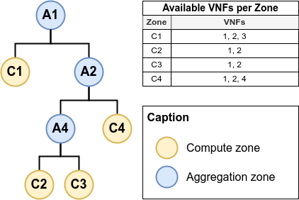
Manager Zone Selection
Selecting the Aggregation zone that coordinates SFC Placement.
The most inferior Aggregation zone between the source and destination.
All the VNFs must be executed in a computed zone underneath the selected manager zone.
Req | SRC | DST | VNFs | Zone
r1 | C2 | C3 | 1, 2 | A4
r2 | C2 | C3 | 1, 3 | A1

Slide 29
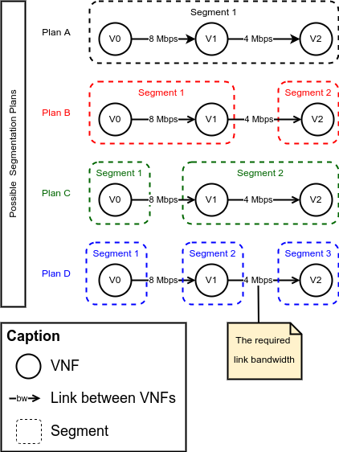
Segmentation
Segmentation problem.
Separation of the VNFs that compose the SFC into segments.
Different segmentation plans can be created from the same SFC.

Slide 30
Game Theory
Game Theory can be adopted in scenarios where multiple entities make strategic decisions, for example, leasing or not a resource, based on the behavior of the other entities.
Congestion game is a class of games used to model situations in which players compete against each other for the same resources.
In a Singleton Congestion Game all players must allocate a single resource from a subset of allowed resources .

Slide 31
Mapping the SFC Placement Problem as a SCG
The set of players is composed of segments.
The set of resources is composed of the bind between the Aggregation zone and its child zones.
The set of strategies that each player is the graph's edges that connect the Aggregation zone with the child zones.
The cost function is the cost of executing the segment into a particular child zone.

Slide 32
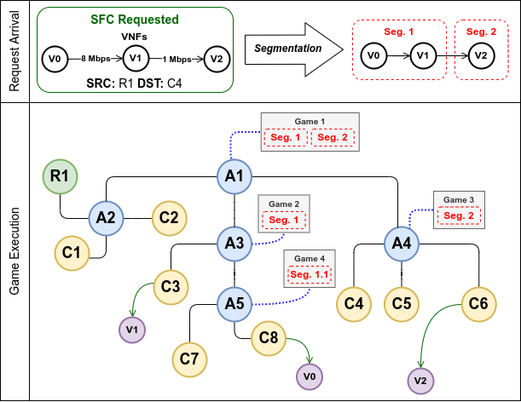
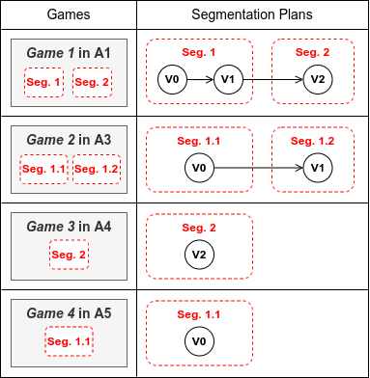
Zone Selection as a Singleton Congestion Game

Slide 33
Evaluation
GQM
Simulation Environment
Results

Slide 34
GQM - Goals and Questions
Goal | Description
G1 | Analyze our proposed approach SPEED in a multi-domain environment, for the purpose of evaluating its performance in terms of allocation cost, and service allocation rate in comparison with approaches proposed in the literature.
Question | Description
Q1 | Does the adoption of SPEED reduce the allocation cost compared with a traditional approach?
Q2 | Does the adoption of SPEED increase the allocation rate compared with a traditional approach?

Slide 35
GQM - Metrics
Metric | Description
SPC | Service Placement Cost (SPC) is the cost to allocate the requested service.
SPR | Success Placement Rate (SPR) is the number of requested services divided by the number of services placed.
PT | Placement Time (PT) is the total time for finding the placement solution.
DAS | Data Aggregated Size (DAS) is the total aggregated data consumed for finding the placement solution.

Slide 36
Simulation Environment
We build our simulation
SimPy is a process-based discrete-event simulation.
NetworkX allow the creation, manipulation of complex networks.
The behavior of active components like:
domain, nodes and service requests are modeled with processes and all processes live in an SimPy environment.
Source Code
https://github.com/anselmobattisti/speed

Slide 37
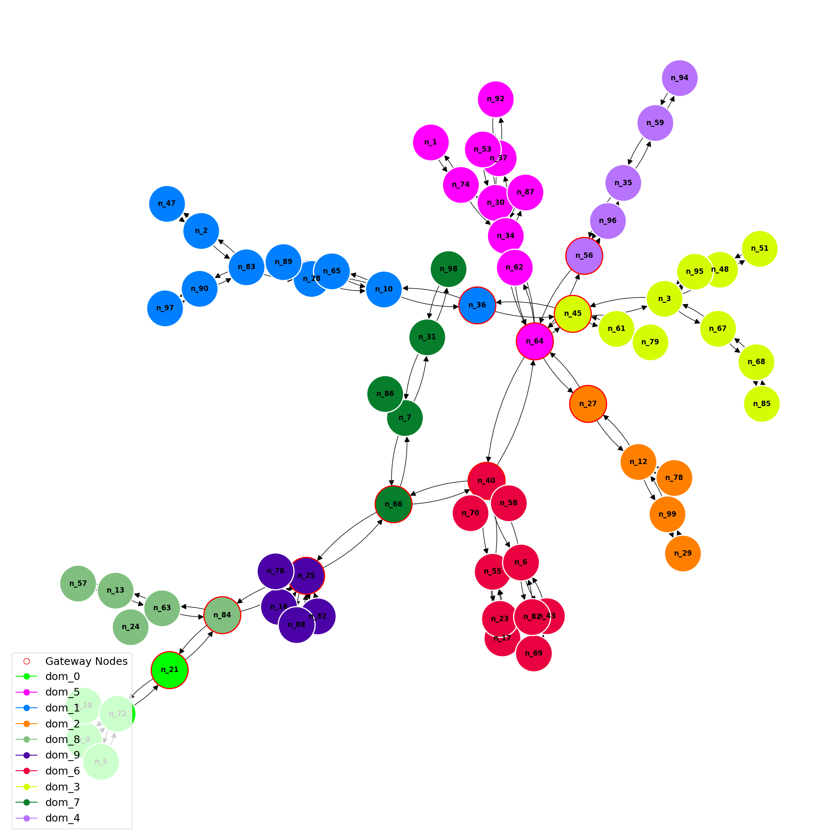
Simulation Environment
Resource | Value
Domains (10)
Nodes | 5, 10
Gateway | 1
Nodes
CPU | 1, 2, 3
Mem | 1, 2, 3 GB
Num VNFs | 1, 3, 5
SFC
VNFs | 2, 3, 5
Max Delay | 20, 30, 50 ms

Slide 38
Compared Approaches
Method | Description
Random | Randomly selects a domain to execute the VNFs of the requested service.
Greedy | Selects the zone with the minimum delay to place the next VNF of the requested service.
SPEED | Create segments while executing Games to find a suitable domain for each VNF.

Slide 39
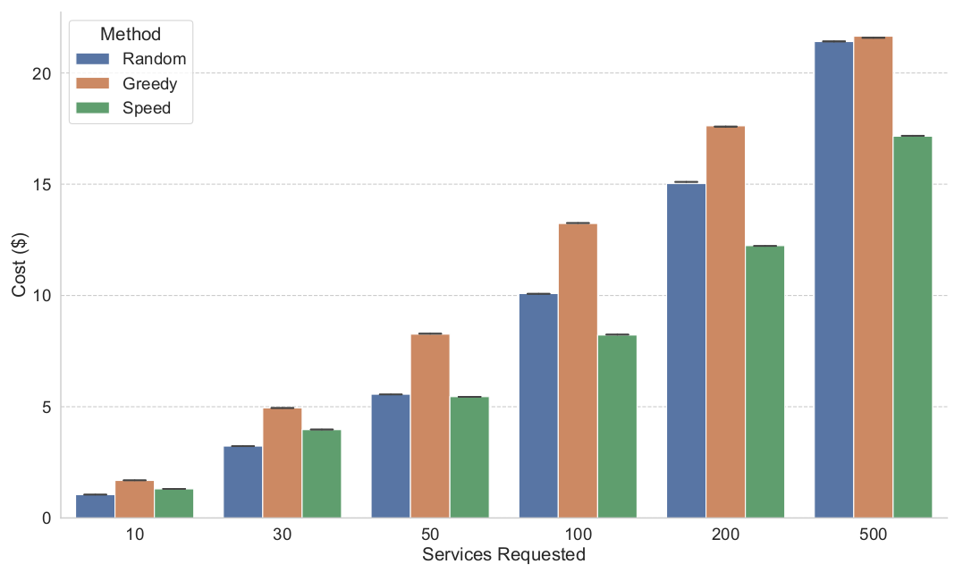
Results
Question 1: Does the adoption of SPEED reduce the allocation cost compared with a traditional approach? Metric: Service Placement Cost (SPC)

Slide 40
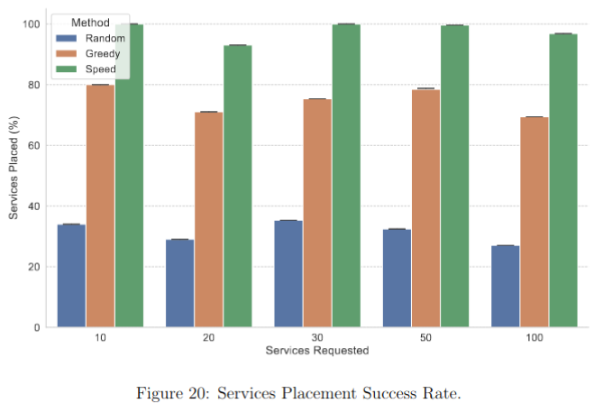
Results
Question 2: Does the adoption of SPEED increase the allocation rate compared with a traditional approach? Metric: Success Placement Rate (SPR)

Slide 41
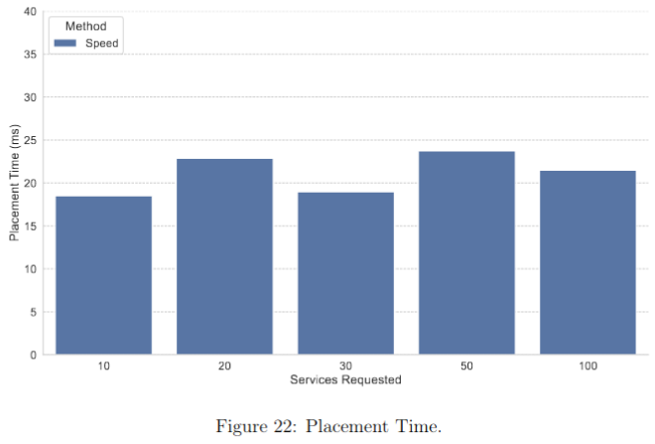
Results

Slide 42
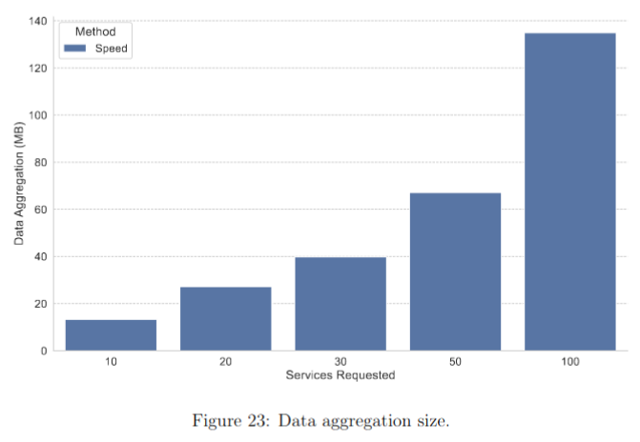
Results

Slide 43
Conclusion
Main Contributions
Conclusion
Work Plan
Current Scientific Production

Slide 44
Novel Approach
Study | Distributed Approach | Segmentation
Chen et al. | The allocation of each VNF segment in each domain is executed in parallel. | Static
Liu et al. | The auction consensus phase defines which segment will be executed in each domain. | Static
Gang et al. | The allocation of each sub-SFC in each domain is executed in parallel. | Static
Avasalcai et al. | Auction-based with a centralized orchestrator that defines the winner domain for each VNF in the SFC. | Static
Gao et al. | The allocation of each service in each satellite is executed in parallel. | No Segments
SPEED | Create segments while executing Games to find a suitable domain for each VNF. | Dynamic

Slide 45
Main Contributions
A novel approach, named SPEED, for solving the SFC placement problem in a multi-domain environment adopting a distributed fashion.
A new mapping model between the SFC Placement Problem and the Game-Theory approach.
A new data aggregation approach to share VNF information.

Slide 46
Conclusion
The proposed approach SPEED has unique features:
The new data aggregation process.
The recursive segmentation approach
thus qualifying it as an original thesis.
Simulated experiments show:
that the SPEED is feasible and, compared with other approaches, has a gain of 20% in placed requests.

Slide 47
Work Plan
Task | Period
Select and prepare the testbed for evaluation | 05/23 - 08/23
Execute the experiments in the testbed. | 08/23 - 12/23
Thesis writing. | 01/24 - 06/24
Article writing and submission. | 04/23 - 06/24
Thesis defense. | 07/24

Slide 48
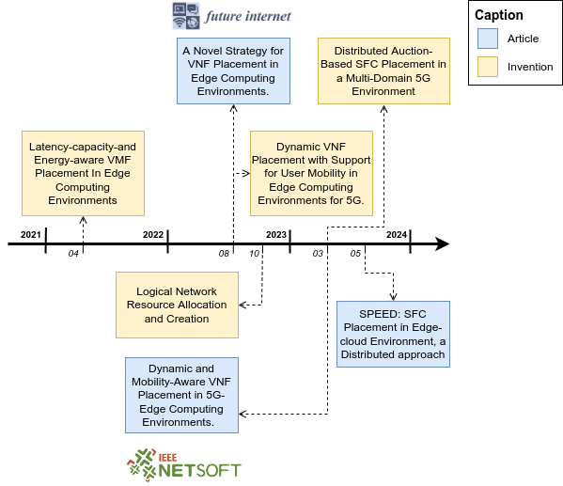
Current Scientific Production

Slide 49






. Thank You .
Contact
Anselmo Luiz Éden Battisti
anselmo@midiacom.uff.br
Funding

