Slide 1

PITCH DECK · EXPO 7 · USC MARSHALL MSBA
Roundtable
Every view counts.
One plan.
An AI facilitator that helps teams think together, inside the group chat they already use.
Notes:
Sumedha

Slide 2




02 · THE OPPORTUNITY
Group chats let the first answer win because not all opinions are heard
SYMPTOMS
ROOT CAUSE
Quieter members drop out
Speaking up in chat costs something, and staying quiet costs nothing.
Idioms and tone get misread
Asking in public feels risky
Decisions get buried
02
Notes:
Sumedha

Slide 3
03 · USER EVIDENCE
Students told us where team chats break and what would make them trust a bot
20
75%
90%
students surveyed on their team chats
report progress is delayed because no one takes responsibility for making a decision
report the key pain point:
quiet voices dropping out
HYPOTHESIS
A neutral, private-first facilitator helps every view reach the decision.
03
Notes:
Cecilia

Slide 4





04 · THE CONCEPT
Roundtable is a neutral facilitator that lives in the chat teams already use
PROBLEM
CUSTOMERS
VALUE
SOLUTION
CHANNELS
First answers win and messages get misread.
MSBA teams of 3-5, especially mixed-language ones.
Every view counts.
One plan.
Private rounds, private clarify, owned tasks.
A bot in the team chat, assigned by faculty.
04
Notes:
Suri

Slide 5
05 · THE SOLUTION
Roundtable stays quiet until a decision is underway, then asks before it acts
1
2
3
4
5
Listens
Asks
Collects
Reveals
Logs
Scans recent messages for a decision in progress.
Roundtable kicks off the round and gets the team to an actual decision.
Each member shares a one-line view in private.
Posts the spread and the strongest minority case.
The team confirms; Roundtable records outcome and owner.
MVP built with Codex and Vertex API.
05
Notes:
Ansel

Slide 6

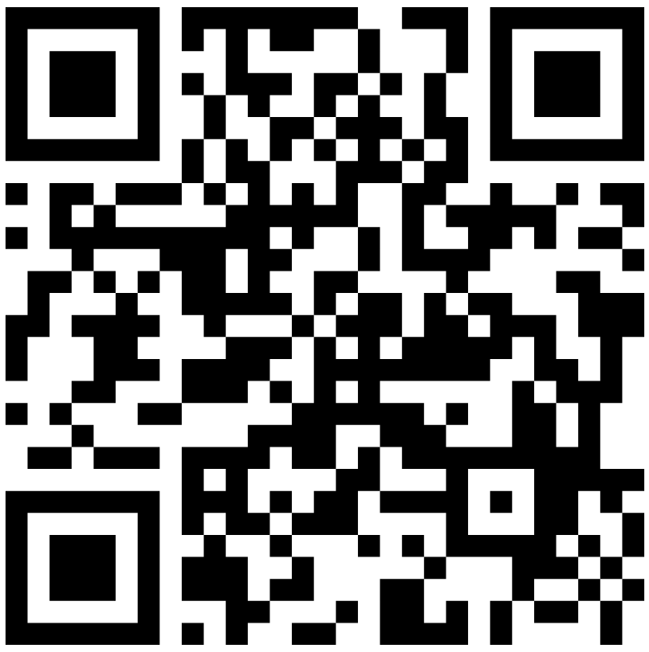
06 · PRODUCT DEMO
In one minute, a team decides, assigns owners and clarifies a message in private
1
Private round
2
Spread and trade-off
3
Owned tasks
4
Private clarify
Join our discord server to try it out!
Video Link
06
Notes:
Ansel

Slide 7

07 · RESPONSIBLE AI
The design follows the research: AI improves team process and people stay in charge
WHAT RESEARCH SAYS
WHAT WE BUILT IN
Facilitation surfaced more information
Opt-in, asks first, pausable by anyone
Alsobay et al., 2025
Stores decisions, tasks and dates, not chat
Private 1:1 prompts draw out quiet members
Do, Kong, Lee & Bailey, 2022
Private clarify shows only to the asker
Teams perform better when members take turns more equally
Everyone is asked for opinions privately
Woolley et al., 2010
So we claim better process and ownership, not automatically better answers.
07
Notes:
Aubrey

Slide 8

08 · CUSTOMER FEEDBACK
We tested Roundtable with 20 real students against four goals and acted on their feedback
Goal | Before Roundtable (1-5) | Expected with Roundtable
How well decisions were made | 2.8 | 4.3
All members participated in all rounds | 2.3 | 4.5
Minority view surfaced | 1.9 | 4.1
How often you faced misunderstandings | 3.8 | 1.7
We changed: A new re-open feature that allows re-voting on previous decisions.
Metrics were calculated using an average of all individual ratings per each goal.
08
Notes:
Vicky

Slide 9





09 · GO TO MARKET
A free pilot earns a department license, and its results carry Roundtable further
1 · PILOT
2 · PROTECT
3 · LICENSE
4 · EXPAND
A free semester pilot
Privacy terms on day one
A flat department license
More programs, more schools
Professors assign it in 1–3 MSBA courses, judged on our four pilot goals.
Decisions, tasks and dates only, never chat; deleted on request.
Annual, priced by enrollment tier, once the pilot goals are met.
Other Marshall programs, then USC schools, with the pilot as our case study.
09
Notes:
Hosung
Before any department pays, we run a free one-semester pilot under a short MOU, with success measured on the four goals from slide 7. Privacy terms come first: Roundtable stores decisions, tasks and dates, never chat, and the department can delete everything, which shortens IT and FERPA review. If the pilot meets its goals, it converts to a flat annual department license priced by enrollment tier rather than per team, so faculty never have to ration it. The pilot results then become the case study for other Marshall programs and other USC schools.
What I'd recommend before launch: a pilot-to-license agreement
1. Free pilot for one semester: a short memorandum of understanding (MOU) with the department covering 1–3 MSBA courses. The success goals in it are the four targets already on slide 7: prompts accepted, members stating a view first, members who can name the decision and owner, and clarify rated helpful.
2. Privacy terms on day one: spell out what Roundtable stores (decisions, tasks and dates, never chat), how long it keeps them, and that the department can delete everything. This is your biggest advantage, because "we never store chat" shortens any IT or FERPA review. Keep Brightspace to dates only so the pilot doesn't wait on an integration approval.
3. Convert after the pilot: if the targets are met, a flat annual department license priced by enrollment tier, not per team or per student. Per-team pricing makes faculty ration it, and a flat fee is easier for a department to budget. I wouldn't put a price on the slide yet; say it's "set from pilot results."
4. Expand to other programs: other Marshall programs, then other USC schools, using the first department's results as the case study.

Slide 10

ROUNDTABLE
Every view counts.
One plan.
A neutral facilitator that keeps every MSBA team member heard and in charge.
Roundtable · Expo 7 · USC Marshall MSBA
Notes:
Hosung

